Slide 1
7 Quality Control Tools

Slide 2
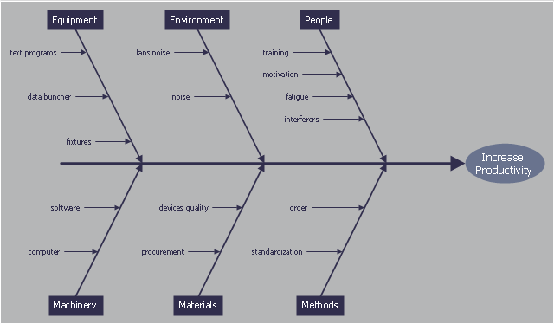
1. Cause and Effect Diagram (Example 1)

Slide 3
1. Cause and Effect Diagram (Example 2)

Slide 4
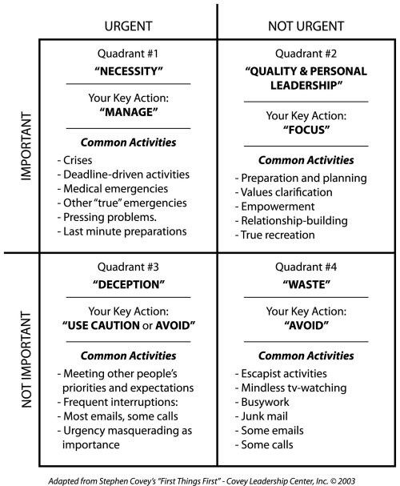
How to manage time?

Slide 5
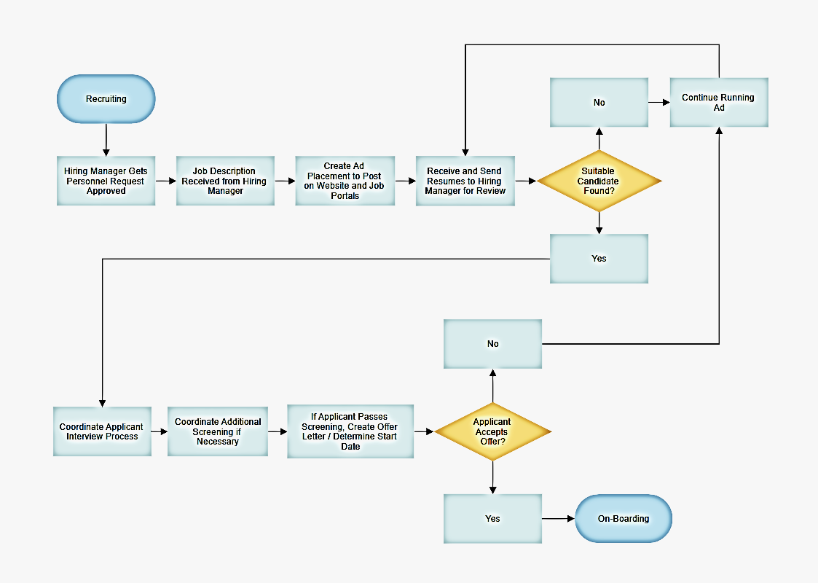
2. Flowcharts

Slide 6
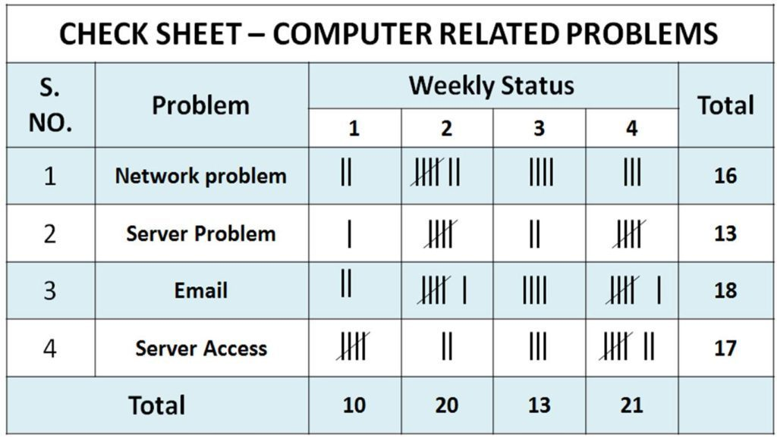
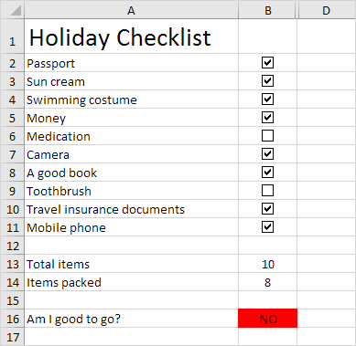
3. Check sheets and Check lists

Slide 7
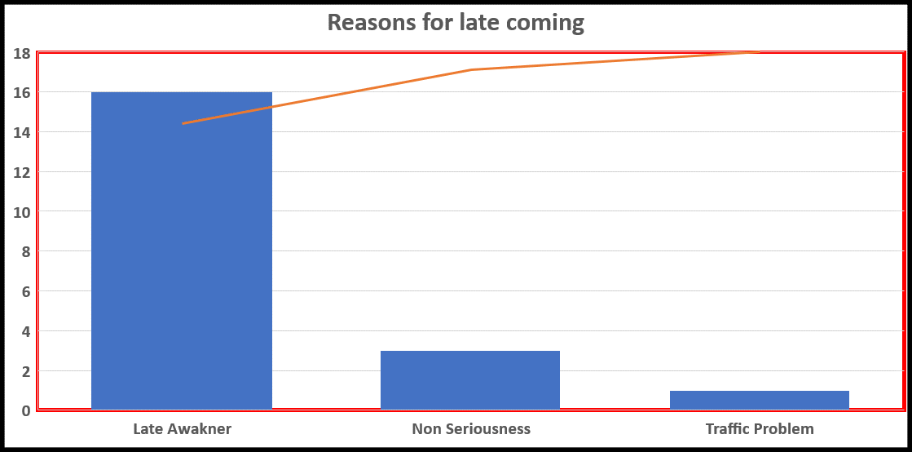
4. Pareto Diagram

Slide 8
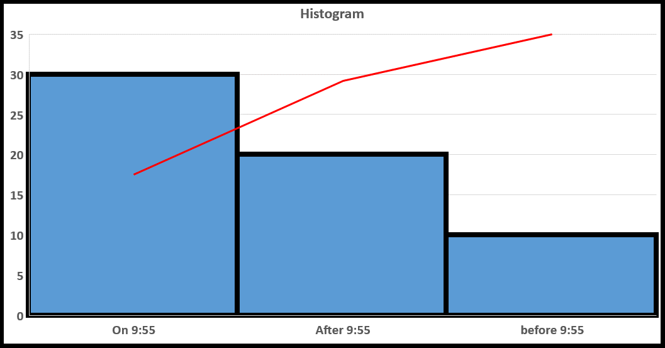
5. Histogram

Slide 9
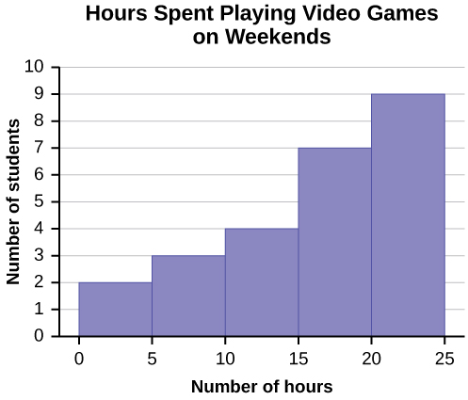
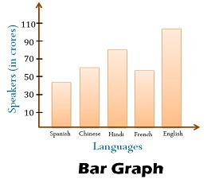
Histogram vs Bar Chart

Slide 10
6. Control Chart:
Sr. No. | Teacher’s Name | Arrival time
1 | Ali | 9:55
2 | Aslam | 9:56
3 | Akram | 9:45
4 | Asghar | 9:50
5 | Abkbar | 10:00
6 | Zain | 10:15
7 | Usman | 10:00
8 | Murtaza | 9:50
9 | Shafique | 10:15
10 | Ashfaq | 10:15
11 | Sarwar | 10:15
12 | Zafar | 10:15
13 | Sajjad | 10:15
14 | Qasam | 10:15

Slide 11
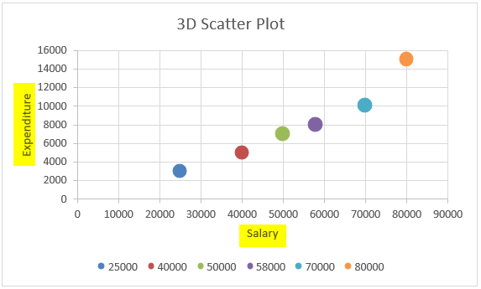
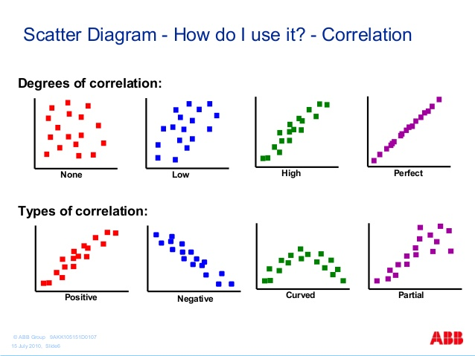
7. Scatter Diagram:

Slide 12
Thank You!

