Slide 1
Git
A distributed version control system

Slide 2
Agenda
Introduction to Version Control Systems
Git VS Github
Code Management
Collaboration
Conclusion

Slide 3
Version control systems
Version control (or revision control, or source control)
Is tracking and managing of changes to software code.
It keeps track of every modification in the code and store it in a database
If a mistake is made, developers can turn back the clock and compare earlier versions of the code.
version control systems help software teams work faster and smarter.
It helps to minimize the disruption to all team members
It saves the source code from catastrophe and damaging

Slide 4
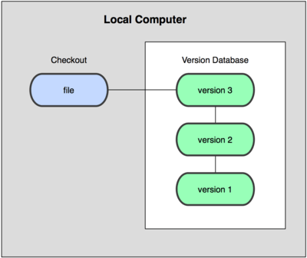

Types Of VCS
Local version control system
Centralized version control system

Slide 5
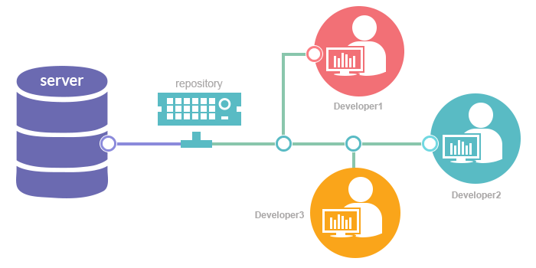
Distributed version control system

Slide 6
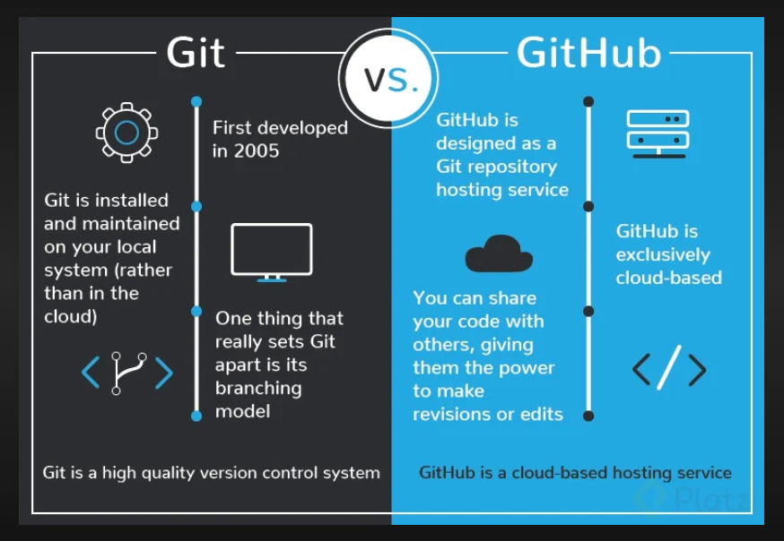
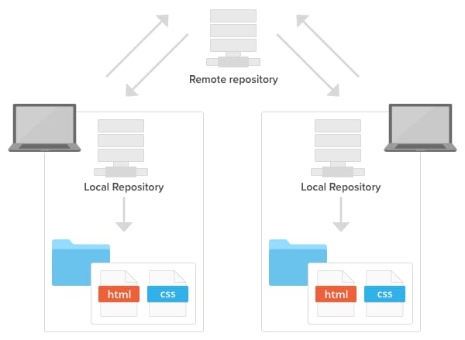
Git VS Github

Slide 7
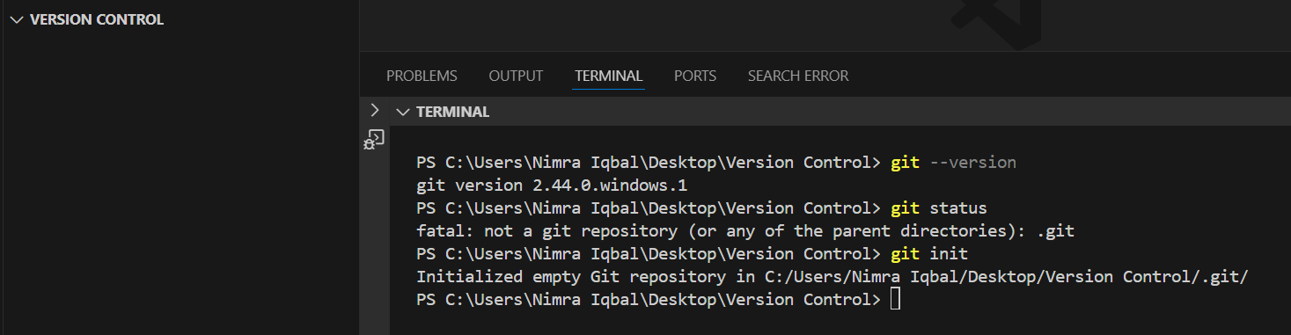
Code Management
git --version: check whether git is installed on not.
https://git-scm.com/downloads: Link to install git on your machine
git status: check the state of your Git working directory.
git init: create an empty Git repository or reinitialize an existing one.

Slide 8
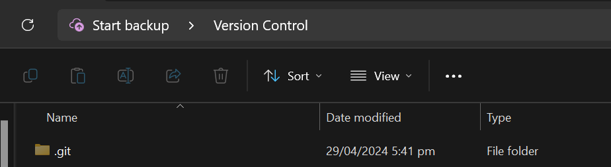
Code Management
.git repository created inside the Version Control repository.

Slide 9
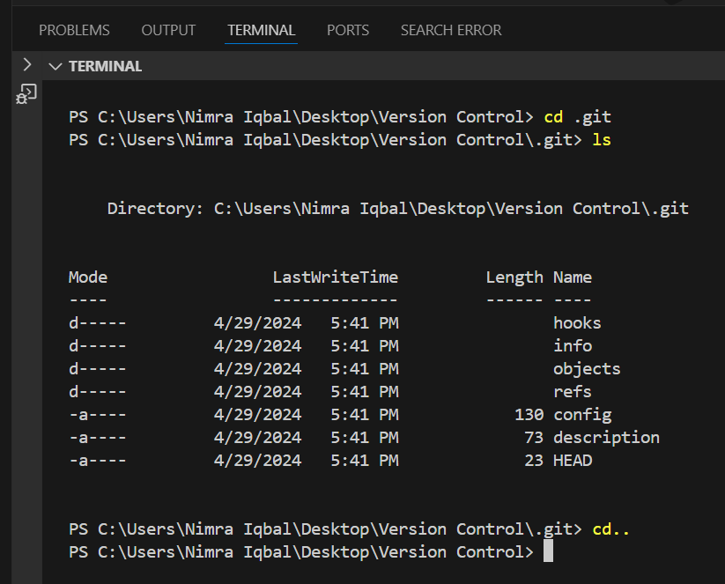
Code Management
cd .git: move inside .git folder
ls: list of all files and directories inside .git folder.
cd..: back to Version Control directory.

Slide 10
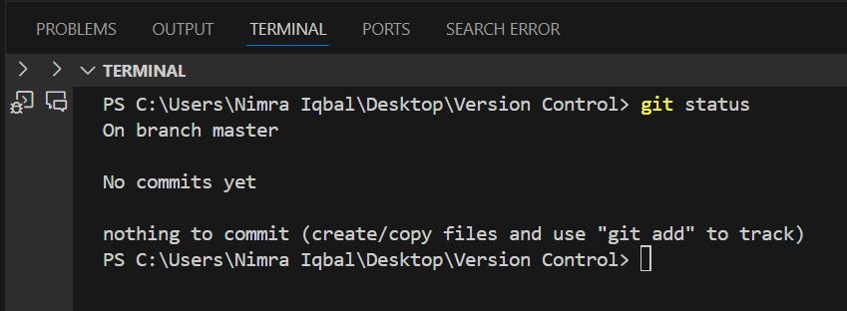
Code Management
git status: check the state of your Git working directory.
On branch master
No commits yet

Slide 11
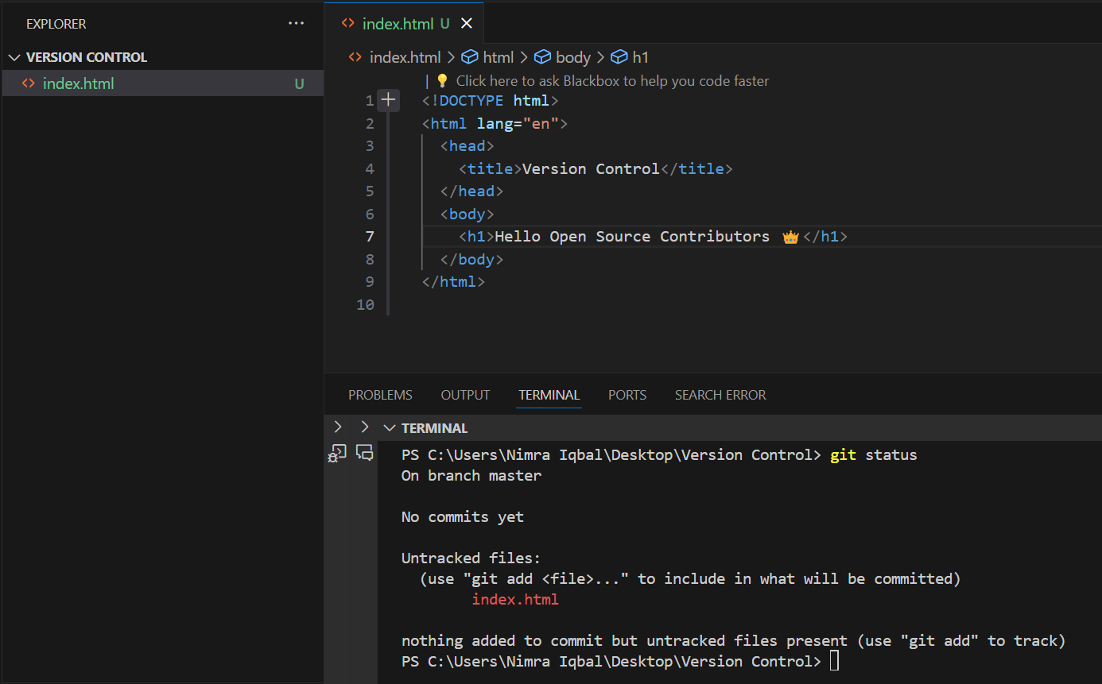
Code Management
An index.html file is created, but it is untracked.

Slide 12
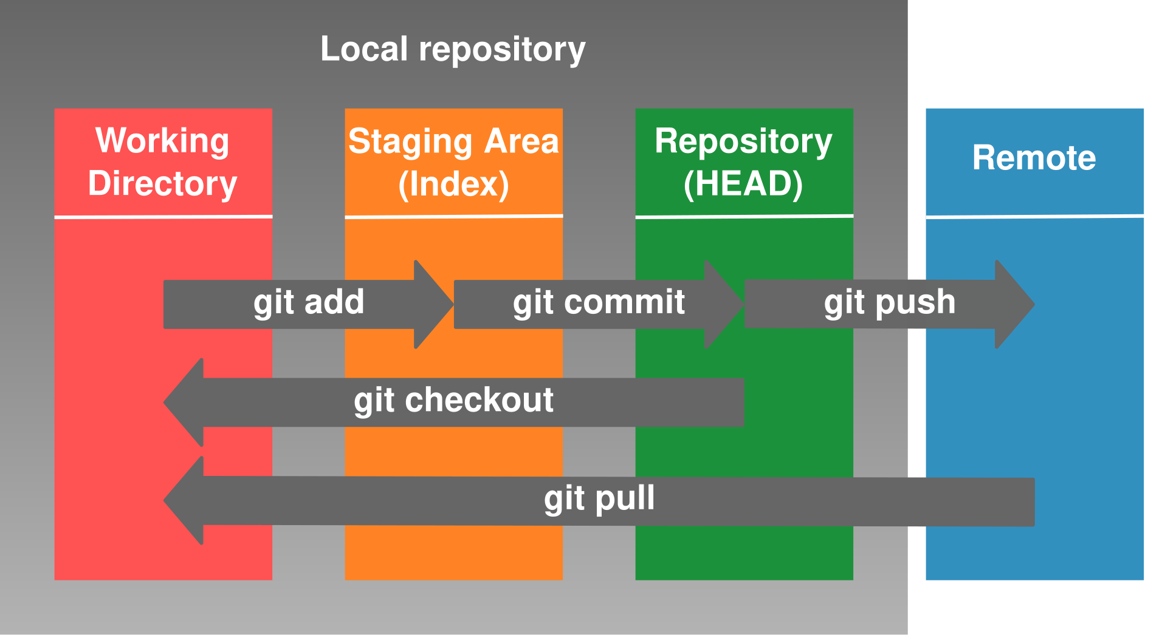
Git Different Zones

Slide 13
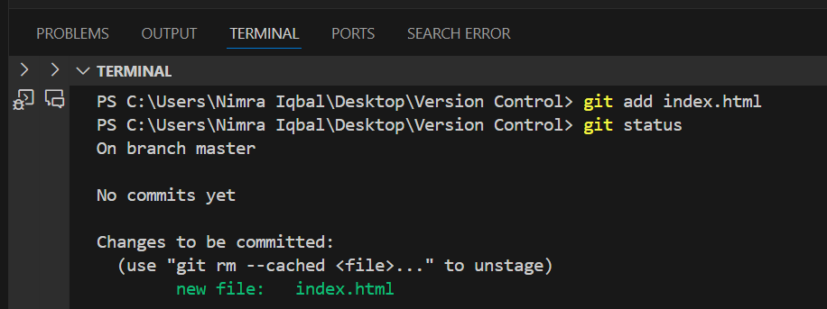
Code Management
git add index.html: a copy of the file index.html is added to the staging area.
git rm --cached index.html: to remove index.html from staging area.

Slide 14
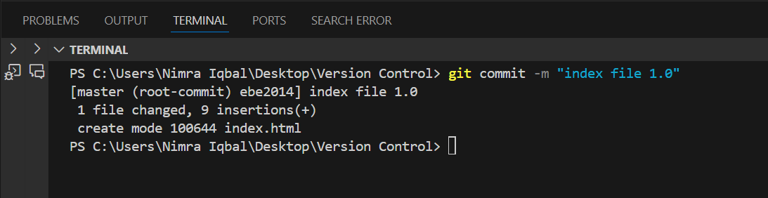
Code Management
git commit -m “index file 1.0”: snapshot of the repository along with the meassage “index file 1.0”.

Slide 15
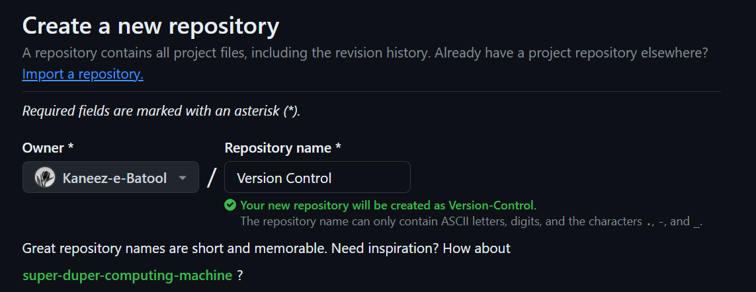
Code Management
You must have an account on github
Create a new repository.
Here I have created a repository with the name “Version Control”.

Slide 16
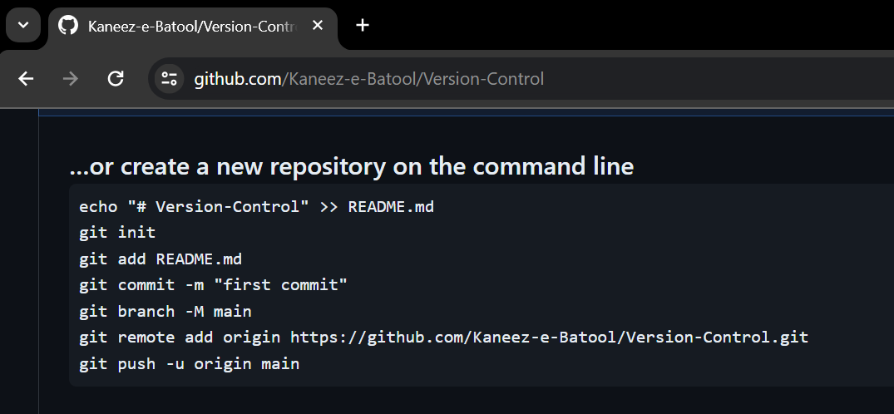
Code Management
These are the commands provided by github in order to link our git repository with the github repository.
For now, we will run the last two commands on our terminal.

Slide 17
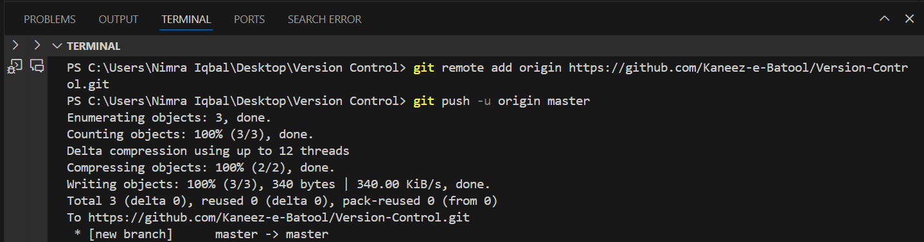
Code Management
The connecction between our git repository and github repository has been established.

Slide 18
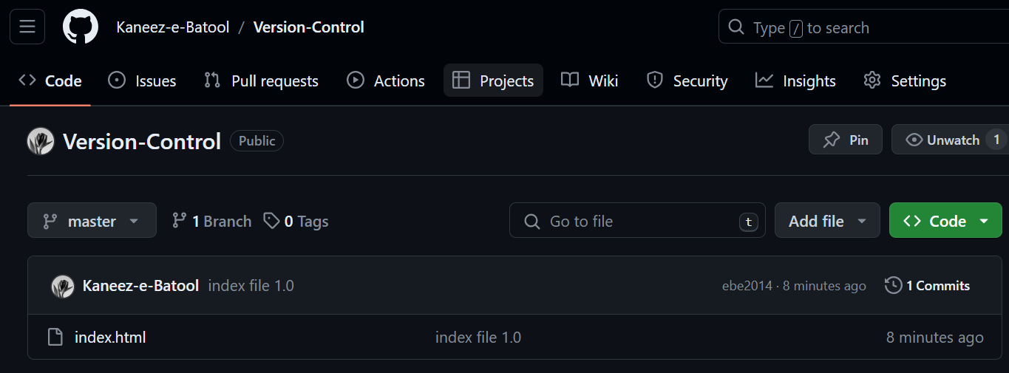
Code Management
Files have been transferrred on our github “Version Repository”.

Slide 19
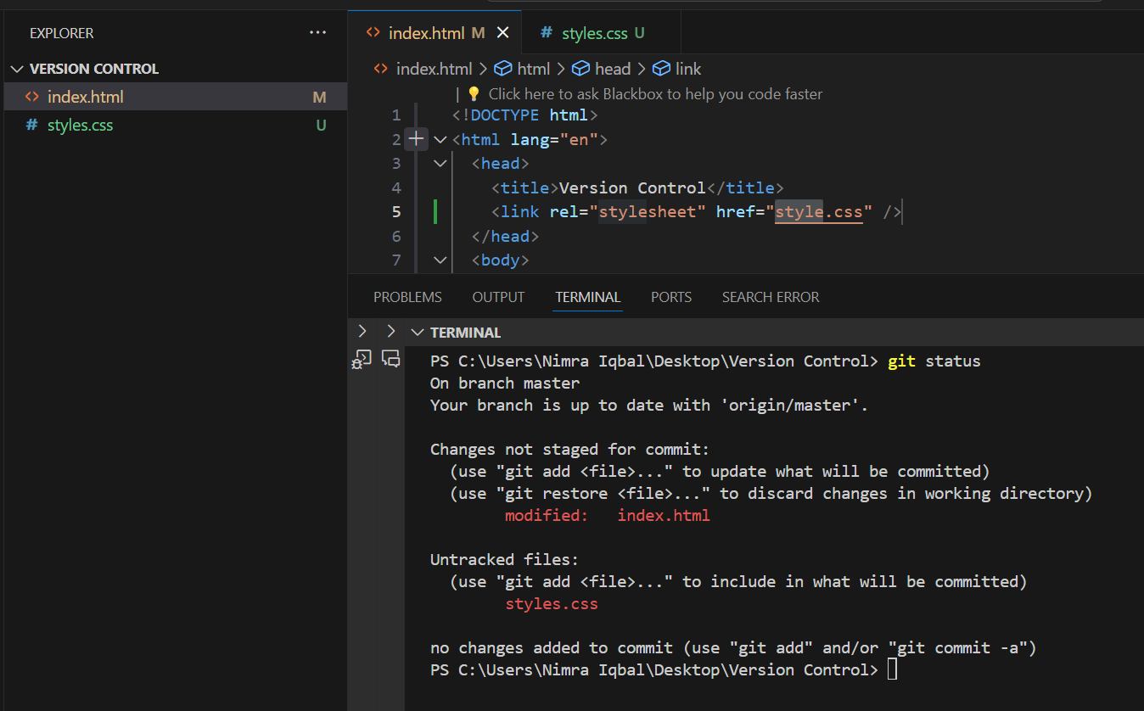
Code Management
After transferring files from git to github, changes have been made on our local repoditory.
A new file styles.css is created and index.html is modified/
M says that the file is modified, while U says the file is untracked.

Slide 20
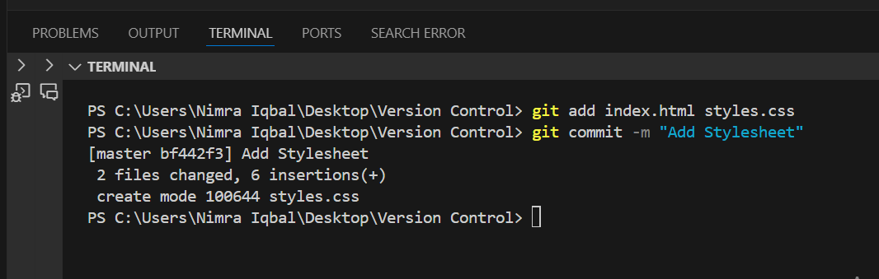
Code Management
git add index.html styles.css : Add index.html and styles.css to the staging area
git commit -m “Add stylesheet”: snapshot of the repository along with the meassage “Add stylesheet”.

Slide 21
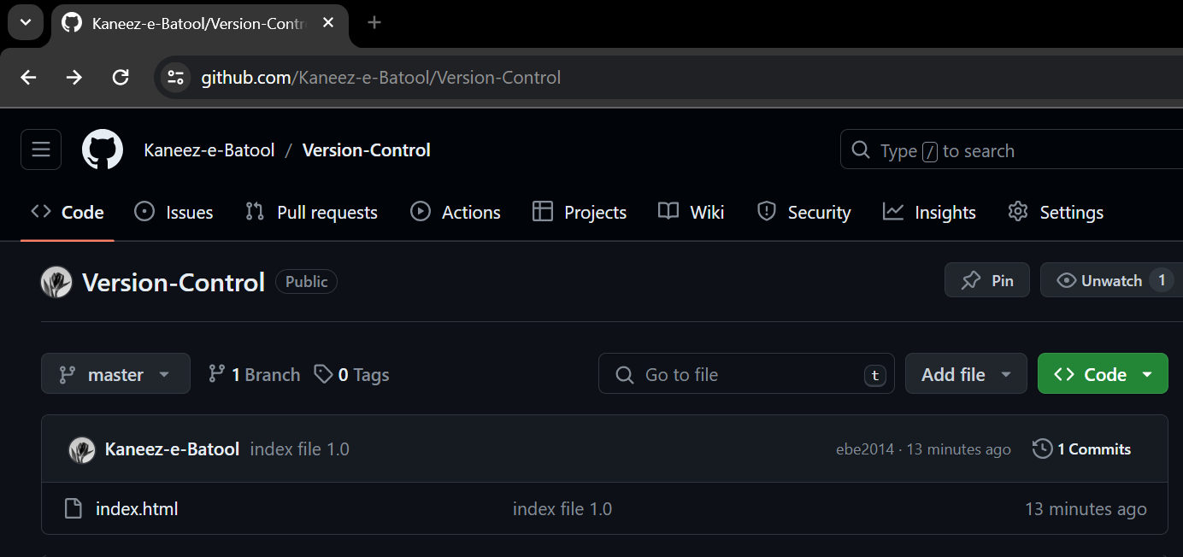
Code Management
Until now, the file styles.css is not added to our Github repository Version Control, because we have not push it from Git repository.

Slide 22
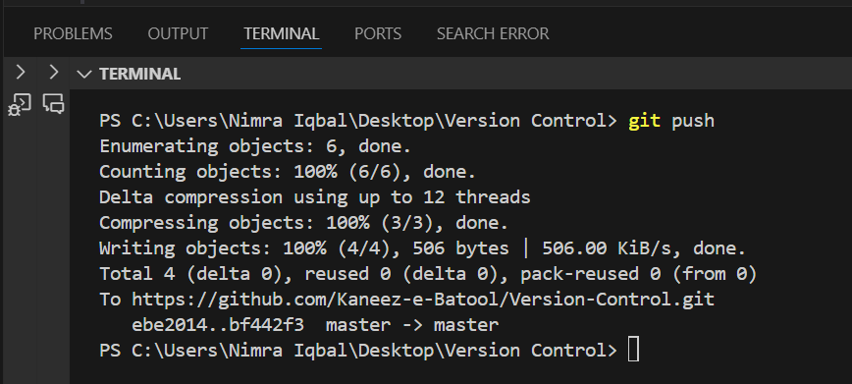
Code Management
All updations are saved from commit to the github repository Version Control.

Slide 23
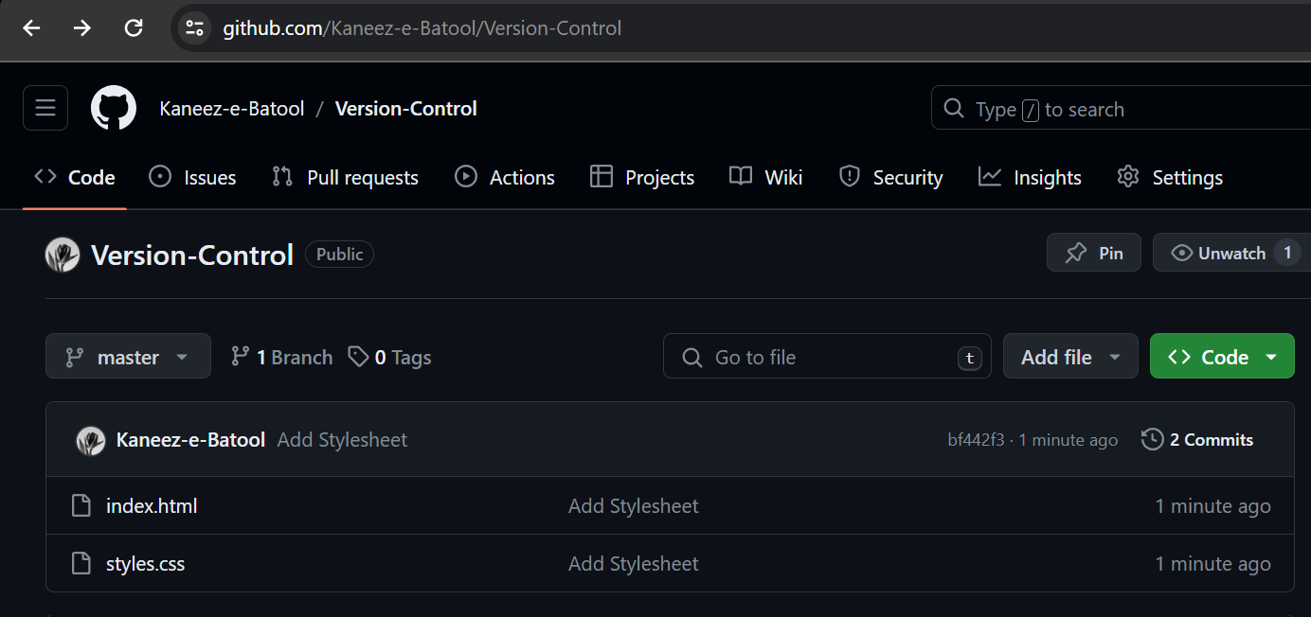
Code Management
Now we can see our sysles.css and modified index.html on github.

Slide 24
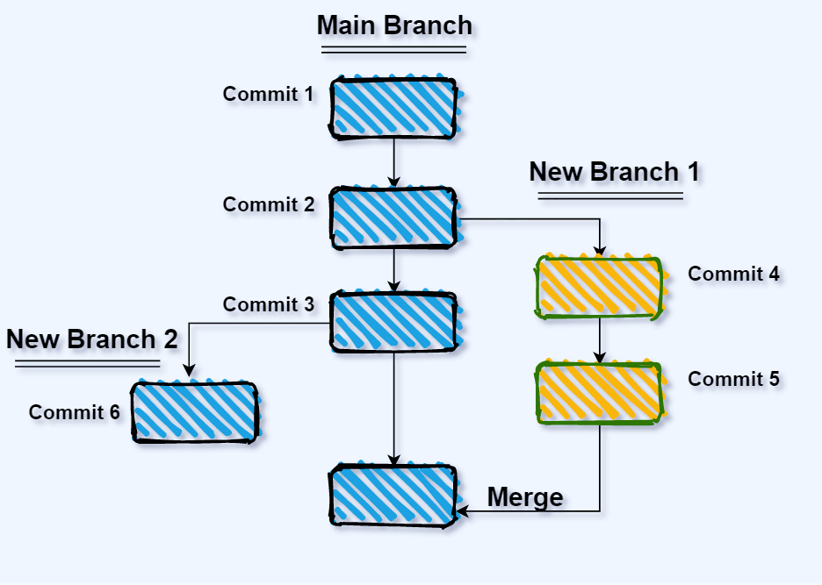
Branching and merging
Git uses branching heavily to switch between multiple tasks.
To create a new local
branch:
– git branch name
To list all local branches:
(* = current branch) – git branch

Slide 25
Branching and merging
Git uses branching heavily to switch between multiple tasks.
To switch to a given local
branch:
– git checkout branchname
To merge changes from a
branch into the local master:
– git checkout master –
git merge branchname

Slide 26
Enhancing Collaboration in Distributed Development
Distributed development teams face challenges in coordinating efforts and sharing code effectively.
Version control systems like Git provide a centralized placefor developers to collaborate on code from different locations.
Features such as branching and merging enable parallel development without conflicts.
Real-time updates and notifications keep team members informed about changes made by others.

Slide 27
Enhancing Collaboration in Distributed Development
Allows for flexible and remote work arrangements
Enables cross-functional collaboration
Reduces conflicts and errors with version control and branching
Increases productivity and efficiency
Enhances code quality and maintainability.

Slide 28
Benefits of Version Control
Traceability: Detailed history of code changes aids project oversight.
Commit Logging: Essential commit details aid comprehension of code progression.
Code Reviews: Structured reviews ensure quality and teamwork.
Automated Testing and CI/CD: Integration streamlines validation and deployment, boosting code reliability.

Slide 29
Benefits of Version Control
Versioning: Easy management of different code versions
Security: Access control and authentication ensure only authorized access
Backup and Recovery: Regular backups and easy recovery in case of data loss
Code Reuse: Existing code can be easily reused in other projects

