Slide 1

Emerging Technologies and Trends in Software Development

Slide 2
Emerging Technologies and Trends in Software Development
The software development landscape is constantly evolving, with emerging technologies like AI, ML, blockchain, and serverless computing reshaping the industry. These advancements are enabling innovative solutions and driving changes in development practices.

Slide 3
Artificial Intelligence (AI) and Machine Learning (ML)
AI Capabilities
ML Applications
Intelligent Interactions
AI and ML are empowering software to perceive, learn, and make intelligent decisions, revolutionizing user experiences and automating complex tasks.
From predictive analytics to natural language processing, ML algorithms are driving breakthroughs in software functionality and efficiency.
AI-powered chatbots, virtual assistants, and intelligent process automation are redefining how users interact with software.

Slide 4
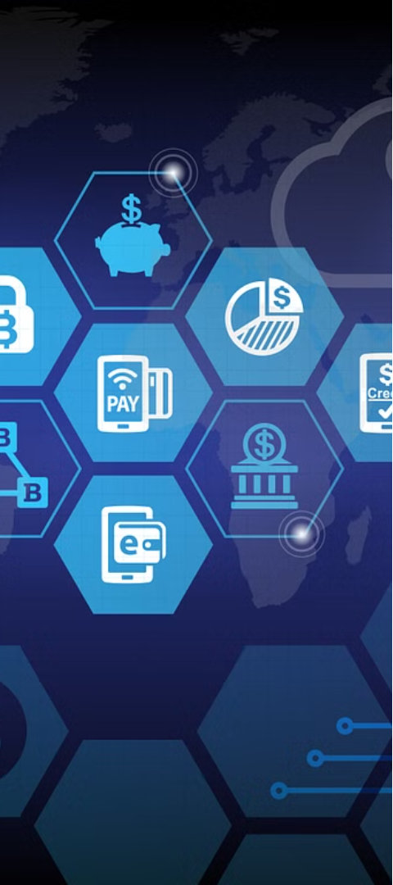
Blockchain Technology
1
Decentralized Trust
2
Smart Contracts
Blockchain enables secure, transparent, and decentralized data transactions, transforming how software manages and shares information.
Blockchain-powered smart contracts automate workflows and facilitate trustless agreements, streamlining software processes.
3
Traceability
The immutable blockchain ledger provides an auditable trail of transactions, enhancing software security and compliance.

Slide 5
Serverless Computing
Scalability
Cost Efficiency
Developer Productivity
Serverless architectures automatically scale resources, enabling software to handle fluctuating workloads without infrastructure management.
Serverless computing charges based on actual usage, reducing software development and operational costs.
Serverless platforms abstract away infrastructure concerns, allowing developers to focus on building innovative software features.

Slide 6
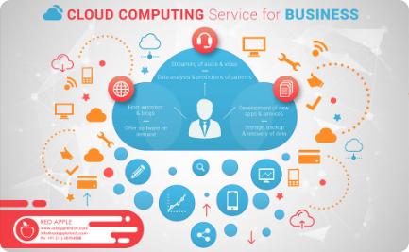
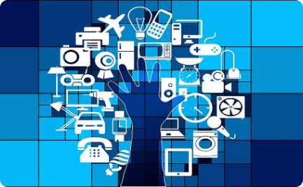

Innovative Software Solutions
Cloud-Native Applications
IoT and Edge Computing
Immersive Experiences
Advancements in AR, VR, and mixed reality are enabling software to create more engaging and immersive user experiences.
Emerging technologies enable the development of cloud-native software that is scalable, resilient, and optimized for the modern cloud ecosystem.
The convergence of IoT and edge computing allows software to process data closer to the source, improving responsiveness and reducing latency.

Slide 7



Reshaping Software Development Practices
Agile Methodologies
DevOps Collaboration
Low-Code/No-Code
Agile development practices, such as iterative sprints and continuous integration, are becoming the norm to adapt to changing requirements.
DevOps principles foster closer collaboration between development and operations teams, streamlining software delivery and maintenance.
Low-code and no-code platforms empower non-technical users to build and customize software, democratizing application development.

Slide 8




Opportunities in Adopting Emerging Technologies
Enhanced User Experiences
Leveraging AI, ML, and immersive technologies can lead to more intuitive, personalized, and engaging software experiences.
Improved Operational Efficiency
Serverless computing, IoT, and edge computing can optimize software performance, scalability, and cost-effectiveness.
Competitive Advantages
Implementing emerging technologies can help software companies differentiate their offerings and stay ahead of the curve.

Slide 9
Challenges in Adopting Emerging Technologies
Skill Gaps
Integrating new technologies requires upskilling development teams and adapting organizational cultures.
Data Governance
Emerging technologies like AI and blockchain demand robust data management and security protocols.
Legacy Infrastructure
Transitioning from traditional software architectures to cloud-native and serverless models can be complex.
Regulatory Compliance
Emerging technologies must adhere to evolving industry regulations and data privacy standards.

Slide 10
The Future of Software Development
Hyper-Automation
1
AI and ML will drive increasing automation across the software development lifecycle, from ideation to deployment.
2
Decentralized Applications
Blockchain-based decentralized applications will disrupt traditional software models, offering new levels of security and transparency.
Intelligent Experiences
3
Software will become more intuitive, adaptive, and responsive, seamlessly integrating with users' digital lives.

