Slide 1
Agile Software Development
Best Practices and Implementation

Slide 2
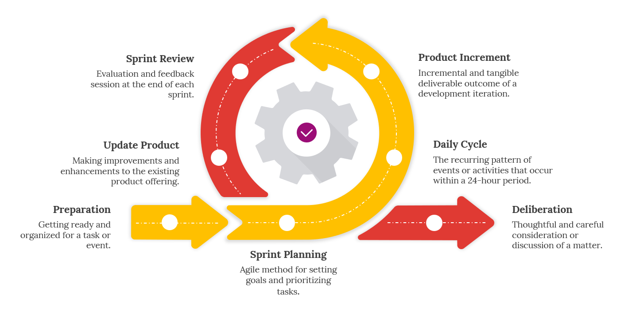
Introduction
Agile is a software development methodology that emphasizes flexibility, collaboration, and iterative progress.
Origin:
Response to rigid waterfall methodologies
Focuses on adaptability and customer satisfaction.

Slide 3
Agile Manifesto
Technical Excellence
Continuous delivery of value
Collaboration
Customer satisfaction
Respond To Changes

Slide 4
Advantages
01
03
Iterative Progress
02
Flexibility
04
Frequent Delivery of Product
Change according to customer need
Collaboration
Time
Face to face communication with stakeholder
Less documentation

Slide 5
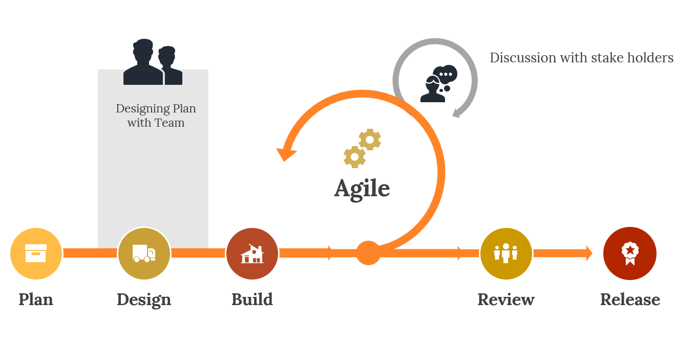
Disadvantages
01
02
Documentation
Maintainance
Due to Frequent releases
Due to lack of documention

Slide 6
Agile Principles
Principle 1
Satisfy Customers Through Early and Continuous Delivery
Principle 2
Welcome Changing Requirements Even Late in the Project
Core
Principles
Principle 3
Deliver Value Frequently
Break the Silos of Your Project
Principle 4

Slide 7
Agile Principles
Principle 5
Build Projects Around Motivated Individuals
Principle 6
The Most Effective Way of Communication is Face-to-face
Core
Principles
Principle 7
Working Software is the Primary Measure of Progress
Maintain a Sustainable Working Pace
Principle 8

Slide 8
Agile Principles
Principle 9
Continuous Excellence Enhances Agility
Principle 10
Simplicity is Essential
Core
Principles
Principle 11
Self-organizing Teams Generate Most Value
Regularly Reflect and Adjust Your Way of Work to Boost Effectiveness
Principle 12

Slide 9
Agile Frameworks
Kanban
Focuses on visualizing workflow and limiting work in progress (WIP)
Framework with defined roles, ceremonies and artifacts
Scrum

Slide 10
Agile Practices
Sprint Planning
Daily stand-ups
Backlog grooming
Retrospectives

Slide 11
Sprint Planning
Sprint backlog
Assign tasks
And responsibilities
Estimating and
Prioritizing user stories
Set clear
Sprint goals
Determine sprint
duration

Slide 12
Daily Stand-ups
Keep it short
15 min or less
What did you do yesterday? What will you do today? Are there any impediments?
Encourage collaboration and problem-solving

Slide 13
Backlog Grooming
Estimate efforts for backlog items
Ensure backlog items are clear
Break down user stories into smaller tasks
Regularly review and prioritize backlog items
Involve stakeholders in backlog refinement

Slide 14
Retrospectives
Schedule regular retrospective meetings
Create a safe and open environment for team members to share feedback
Focus on continuous improvement
Identify what went well, what didn't, and actionable items for improvement

Slide 15
Real World Examples

Slide 16
PlayStation Network
Collaboration
Dependency
Trouble collaborating between hundreds of members
Problems
Highly interdependent teams located in different cities
Initial framework(s)
Planning
Initially used Waterfall and Scrum
Teams could only plan one or two iterations in advance

Slide 17
Solution?
Solution
Switch to SAFe (Scaled Agile Framework)
Value
Managed to deliver double the value compared to before
Benefits
Planning
Initial planning time cut by 28%
700 memebers in 60 teams using SAFe; improving collaboration
Collaboration

Slide 18
LEGO Digital Solutions
Expansion
Initially only 5 teams, which expanded to over 20
Collaboration
Trouble collaborating with client
Alignment
Difficult to align teams when they are all disconnected
Release
Release planning more complicated than needed

Slide 19
Solution
Framework
Planning
Improvement
Opted for the SAFe framework
Improved planning and execution
Innovation is improved as a result of issues being solved
Dependency
Execution
Reduction in dependency issues
Gradually trained the team managers

Slide 20
Summary

Slide 21
Agile
Introduction
Frameworks
Flexibility Colaboration Iterative Progress
Kanban Scrum Safe(Scaled)
Advantage
Disadvantage
+Time
Documentation Maintaince

Slide 22
Agile Practices
Sprint Planning
Daily stand-ups
Backlog grooming
Retrospectives

Slide 23
Real Life Examples
Playstaion
Lego

