Slide 1

Software Testing
Supercharge your Agile development with top-notch testing methodologies and automation techniques for bulletproof software.

Slide 2
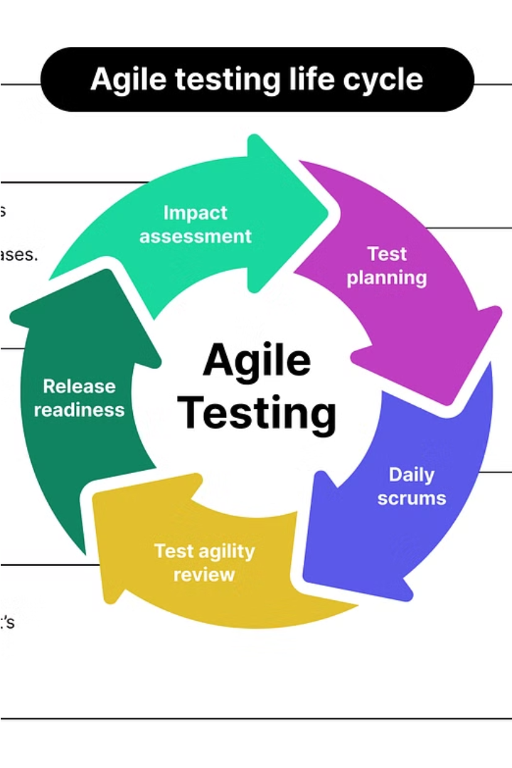
Software Testing Strategies
Ensuring Quality in Agile Environments. Explore effective testing methodologies and automation techniques to build robust, reliable software.

Slide 3
Software Testing Strategies
Comprehensive Approach
Automation-Driven
Implement a diverse range of testing methodologies to ensure thorough evaluation of the software system, from unit tests to end-to-end acceptance testing.
Leverage test automation tools and frameworks to streamline the testing process, improve efficiency, and catch issues early in the development cycle.
Shift-Left Testing
Continuous Integration
Integrate testing practices into the earlier stages of the Agile development process to identify and address defects sooner, reducing the cost of rework.
Implement a robust CI/CD pipeline to automatically build, test, and deploy the software, providing rapid feedback and ensuring consistent quality.

Slide 4

Ensuring Quality in Agile Environments
In Agile software development, ensuring quality is a crucial aspect. Agile teams must employ robust testing methodologies to validate the functionality, performance, and reliability of the software being built. This includes a mix of unit tests, integration tests, and acceptance tests to catch issues early in the development cycle.
Automation is key in Agile environments, as it allows for continuous integration and continuous deployment. Leveraging test automation tools and frameworks like Selenium, JUnit, and TestNG can significantly improve the efficiency and speed of the testing process.

Slide 5
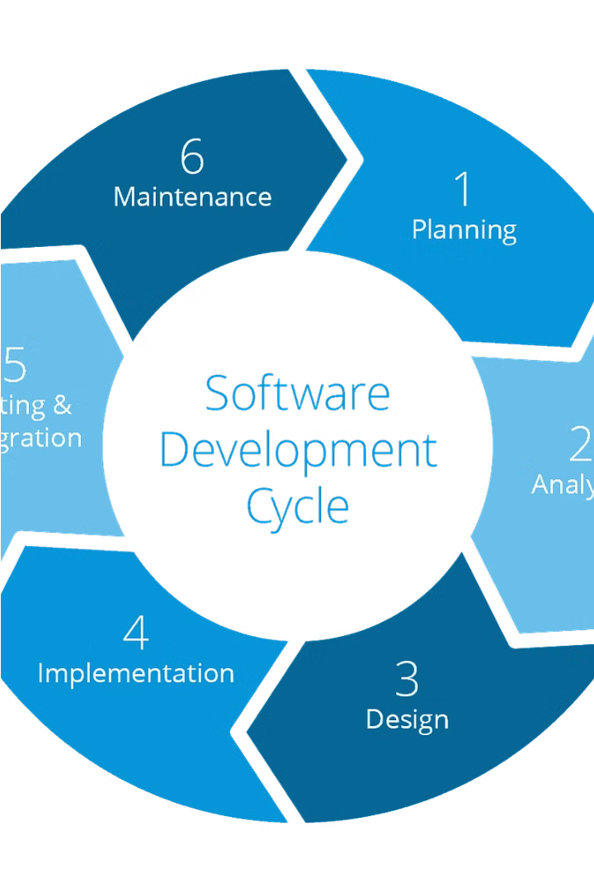
What is Agile?
Agile is an iterative and flexible software development methodology that emphasizes collaboration, customer feedback, and rapid iterations. It aims to deliver value quickly and respond to changing requirements effectively.
Agile teams work in short "sprints", continuously integrating and testing new features, rather than a single long development cycle. This allows for faster time-to-market and greater adaptability to evolving customer needs.

Slide 6

Testing Methodologies in Agile
1
Unit Testing
Verifying individual code components or units to ensure they work as expected before integration.
2
Integration Testing
Checking how different components work together as a whole system, identifying integration issues early.
3
Acceptance Testing
Validating that the software meets the specified requirements and user acceptance criteria.

Slide 7
Testing Methodologies in Agile
Unit Testing
Integration Testing
Acceptance Testing
Collaboration
Developers write small, isolated tests to verify the behavior of individual code units, ensuring they work as expected before integration.
These testing approaches complement each other, with teams leveraging them together to achieve comprehensive quality assurance.
Tests how different components of the software system work together, identifying issues at the interfaces between modules.
Validates that the complete, integrated system meets the specified requirements and user needs, often performed by stakeholders.

Slide 8




Test Automation Strategies
Continuous Integration
Comprehensive Test Suites
Analytics and Reporting
Cloud-based Testing
Implement automated tests that run with every code commit, ensuring bugs are caught early in the development cycle.
Build robust test suites covering unit, integration, and end-to-end tests to validate application functionality at multiple levels.
Leverage test automation tools to generate detailed reports and analytics, providing valuable insights into the testing process.
Utilize cloud-based testing platforms to scale test execution, improve test coverage, and ensure cross-browser/device compatibility.

Slide 9




Automation Tools and Frameworks
Selenium
JUnit
TestNG
Cypress
Selenium is a popular open-source web automation tool that allows you to write and run automated tests across multiple browsers and platforms.
JUnit is a unit testing framework for the Java programming language, providing a structured approach to writing and running unit tests.
TestNG is an advanced testing framework for Java, with features like data-driven testing, parallel execution, and detailed reporting.
Cypress is a modern JavaScript-based end-to-end testing framework that makes it easy to write, run, and debug tests for web applications.

Slide 10
Test-Driven Development (TDD) in Agile
Step 1
1
Write tests first
Step 2
2
Write minimum code to pass tests
Step 3
3
Refactor code for quality
Test-Driven Development (TDD) is a cornerstone of Agile software development. It involves writing automated tests before writing the actual code, ensuring that the application behaves as expected. TDD promotes a design-first approach, fostering a culture of quality and allowing for rapid iterations in an Agile environment.

Slide 11
Behavior-Driven Development (BDD) in Agile
Aligning with User Stories
1
BDD focuses on writing executable specifications that capture the desired behavior of the system from the user's perspective, ensuring the final product meets their needs.
2
Collaborative Approach
BDD encourages close collaboration between developers, testers, and business stakeholders to collectively define and validate the application's behavior.
Living Documentation
3
The BDD specifications act as living documentation, providing a clear understanding of the system's functionality and serving as a communication tool throughout the development process.
4
Automated Testing
BDD frameworks, such as Cucumber and Selenium, allow for the automation of acceptance tests, ensuring the system's behavior is continuously verified.

Slide 12

Thank You

