Slide 1
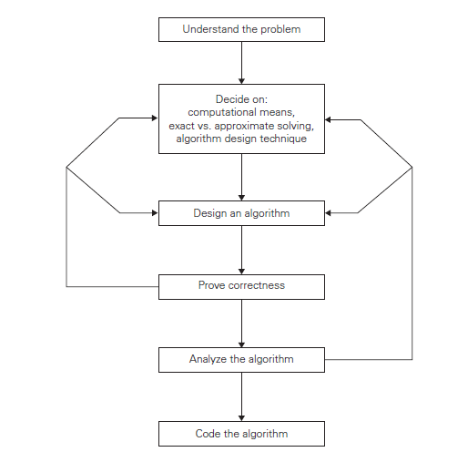

Slide 2
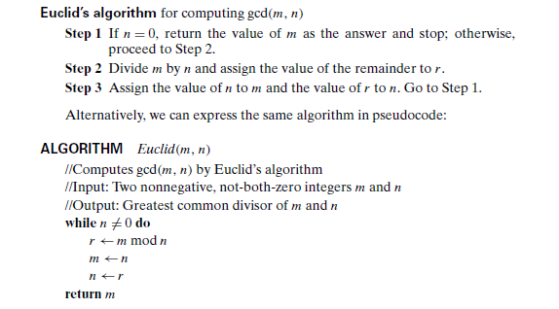

Slide 3
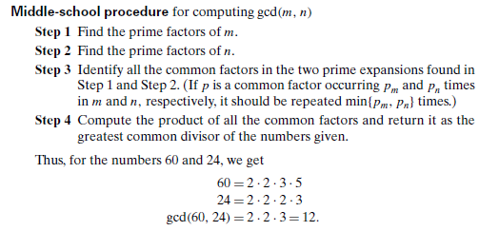
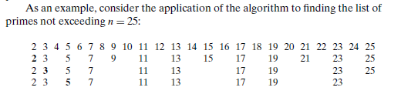

Slide 4
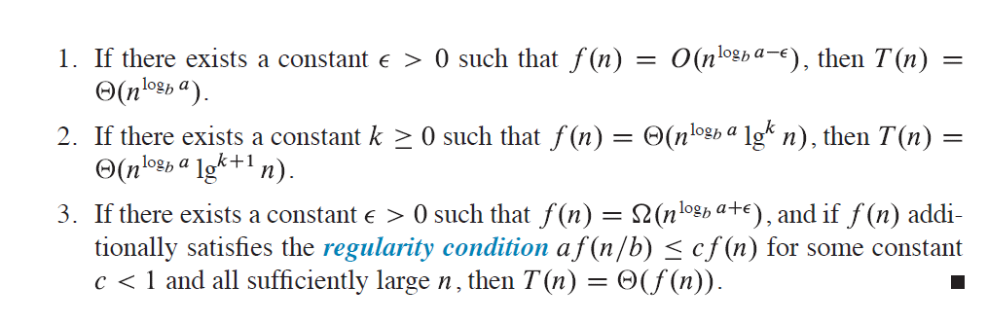

Slide 5
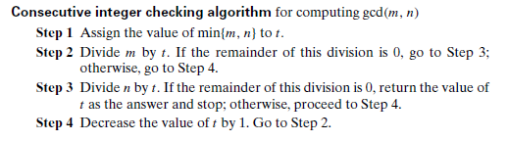

Slide 6
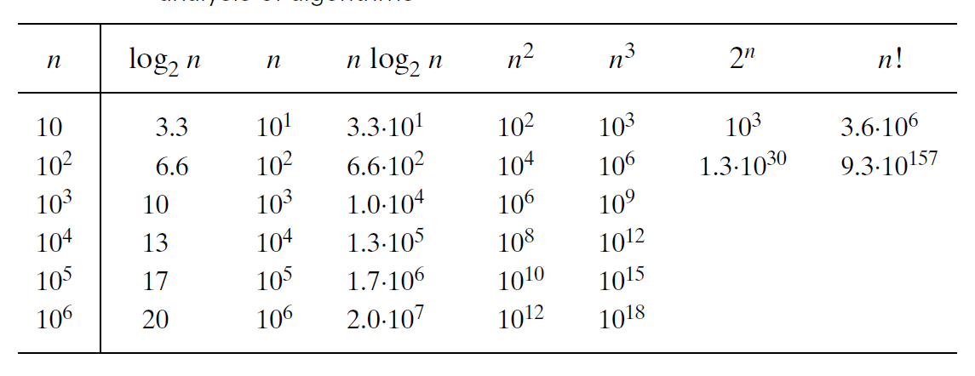

Base switching:

Slide 7
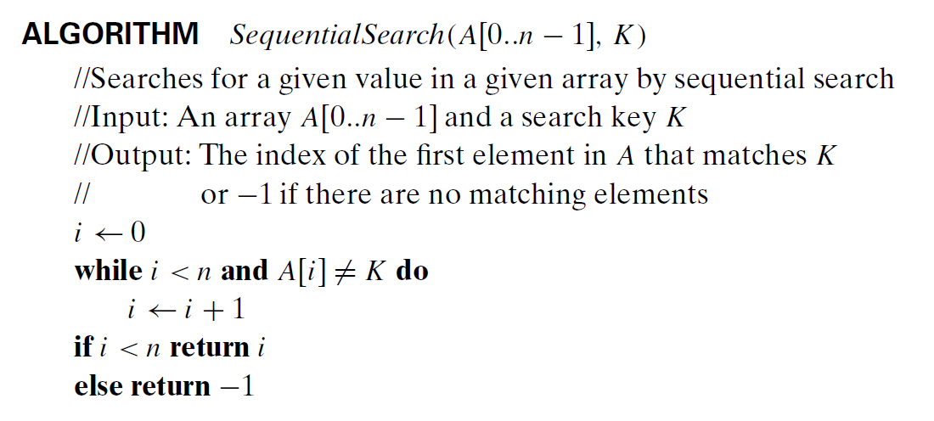

Slide 8
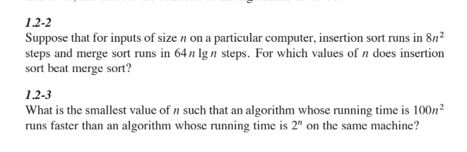

Slide 9
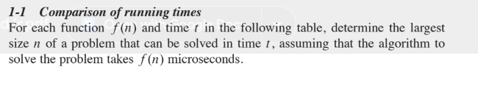
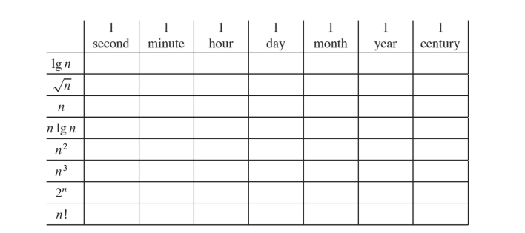

Slide 10
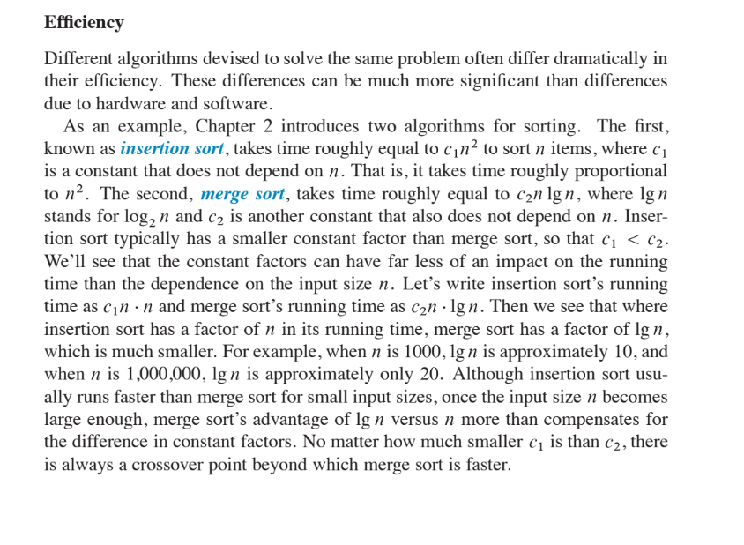

Slide 11
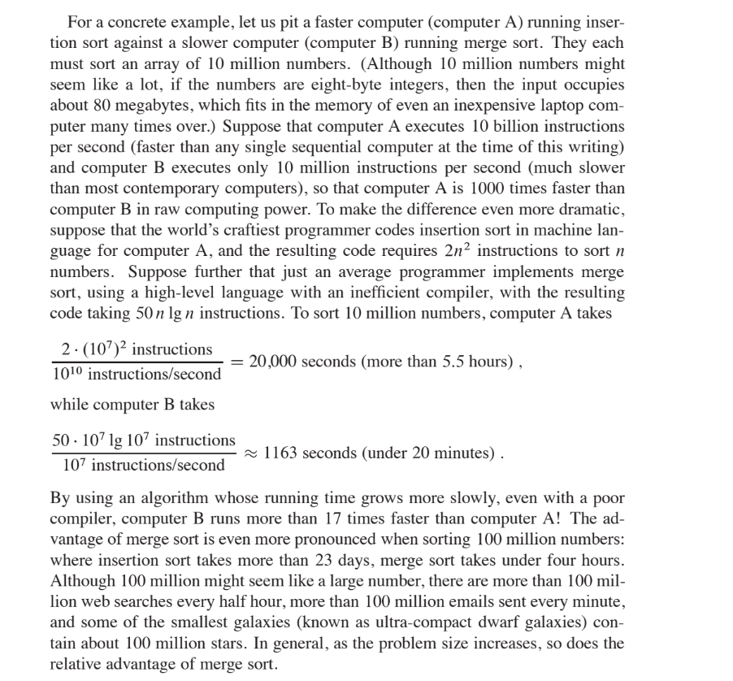

Slide 12
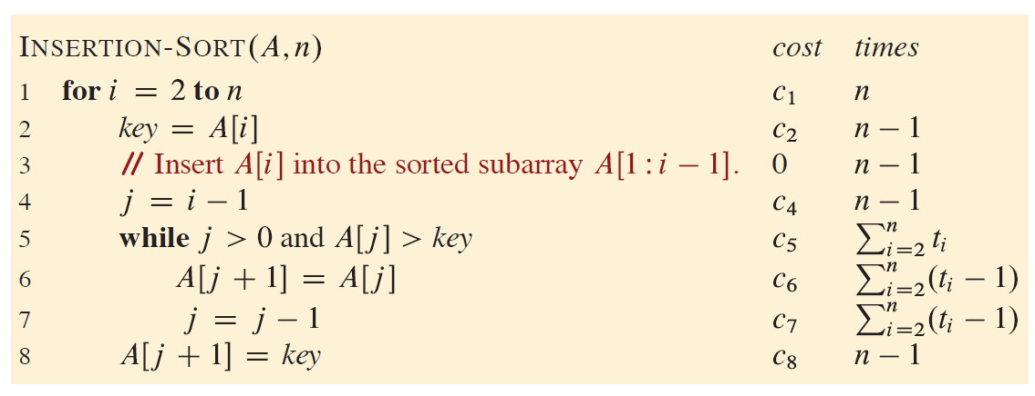

Slide 13
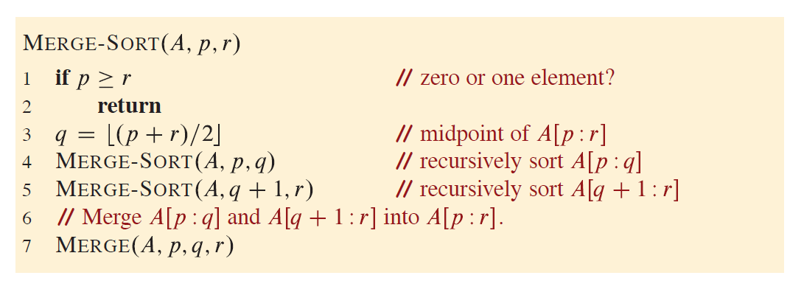

Slide 14
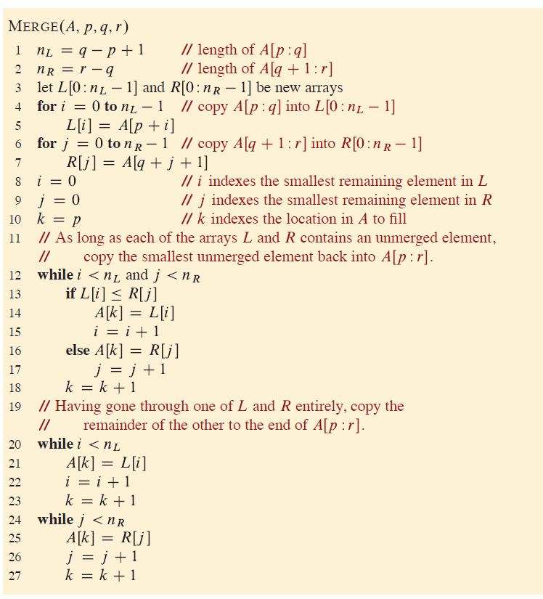

Slide 15
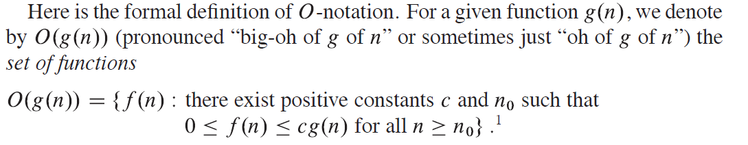

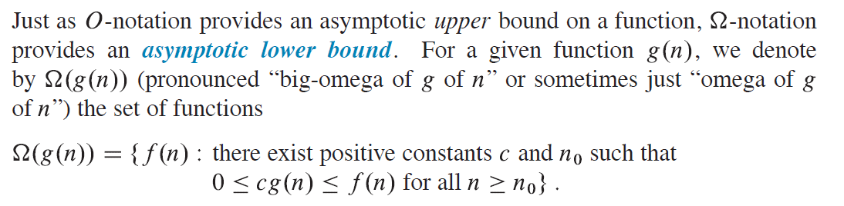

Slide 16
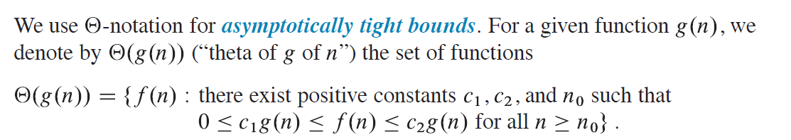
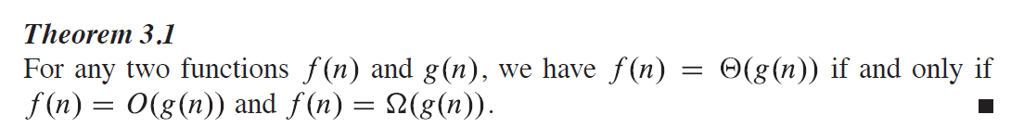

Slide 17
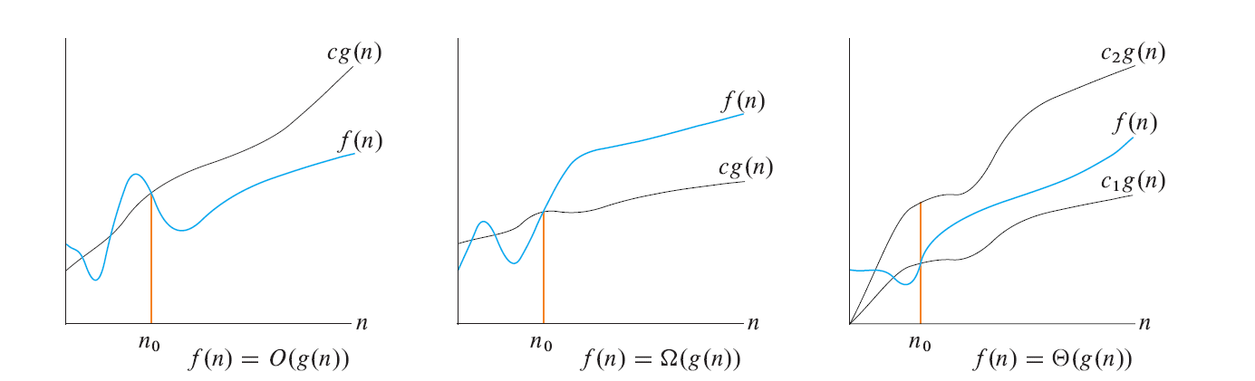

Slide 18
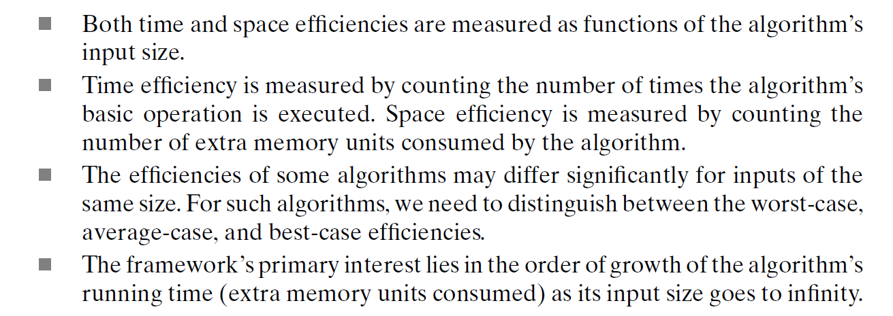

Slide 19
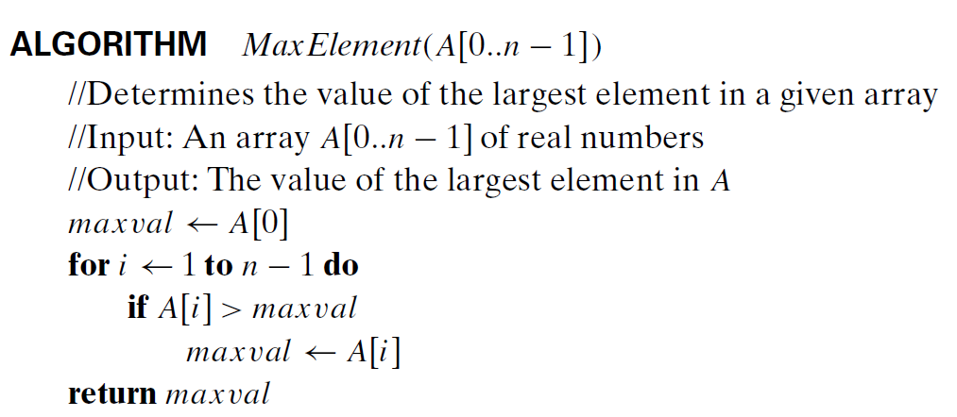

Slide 20
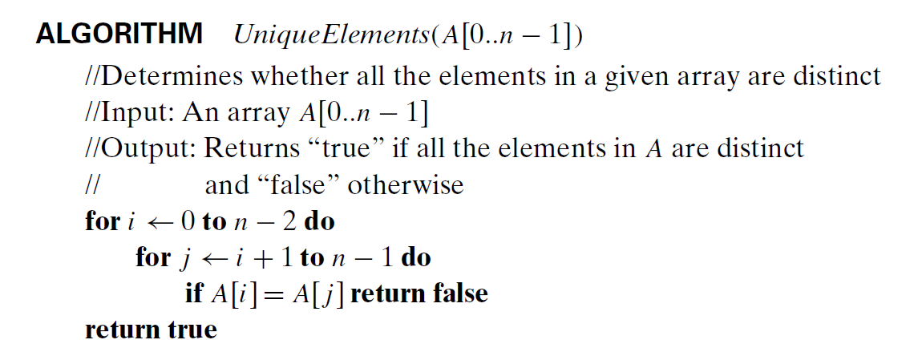

Slide 21
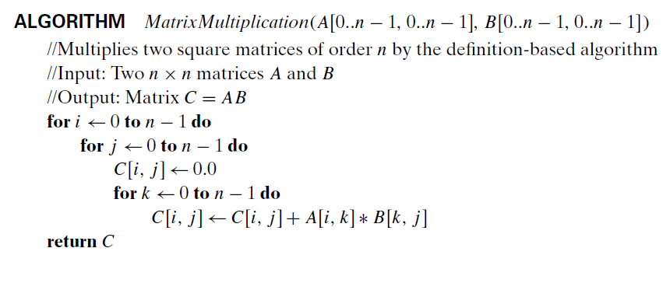

Slide 22
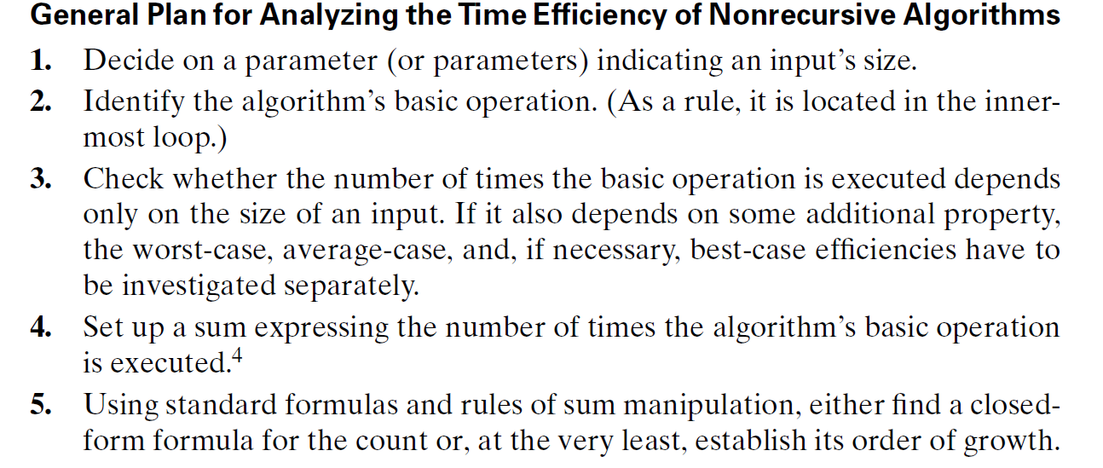

Slide 23
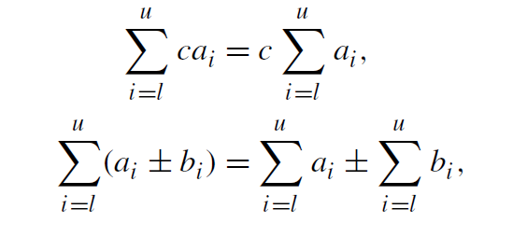
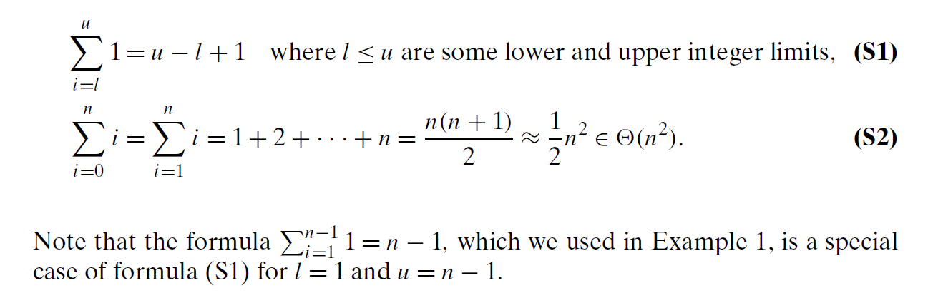

Slide 24
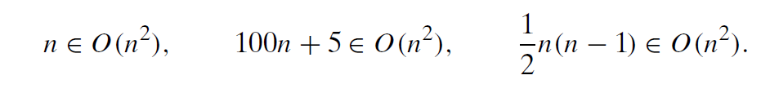
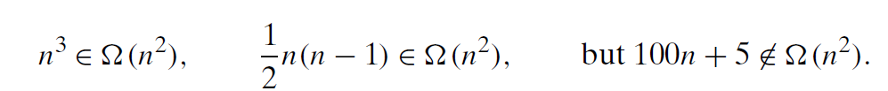

Slide 25
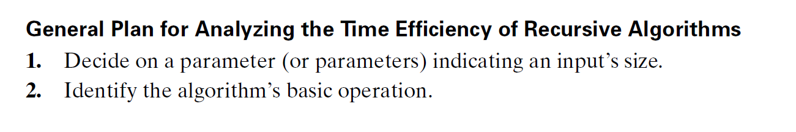
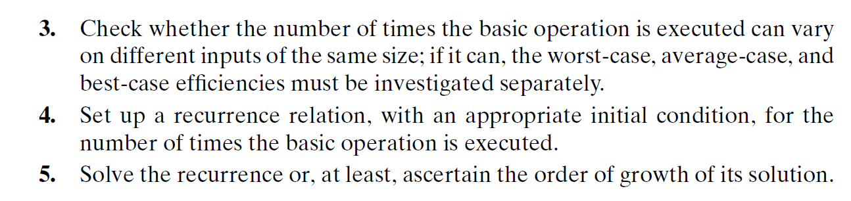

Slide 26
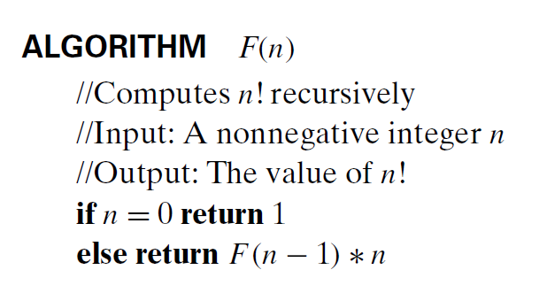

Slide 27

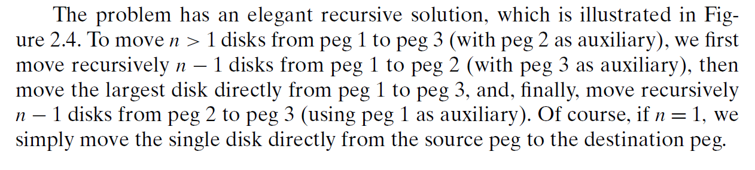

Slide 28
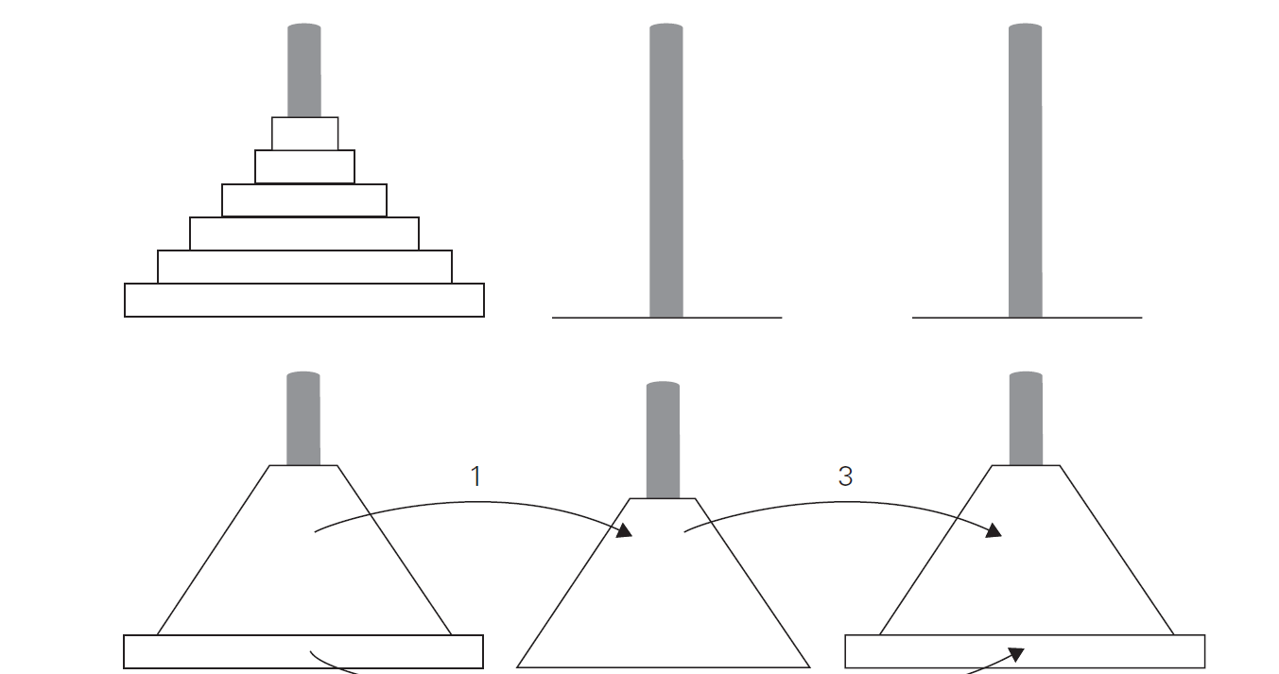

Slide 29
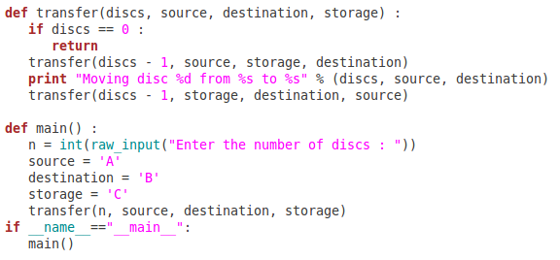

Slide 30
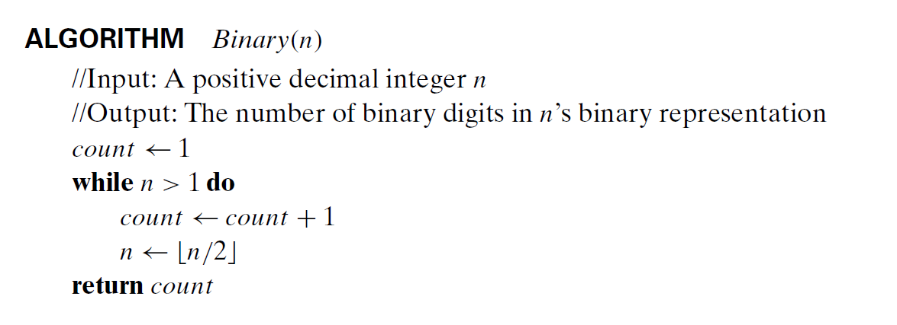
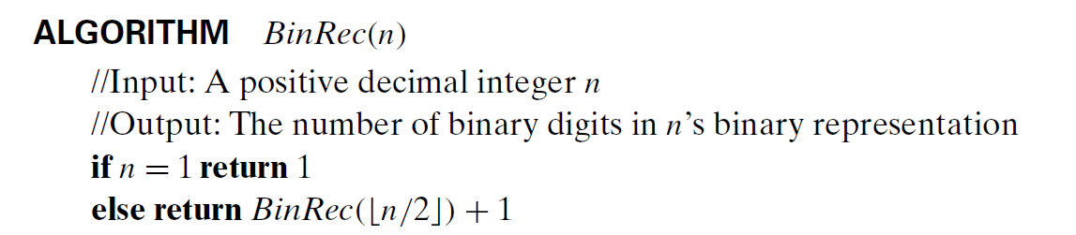

Slide 31
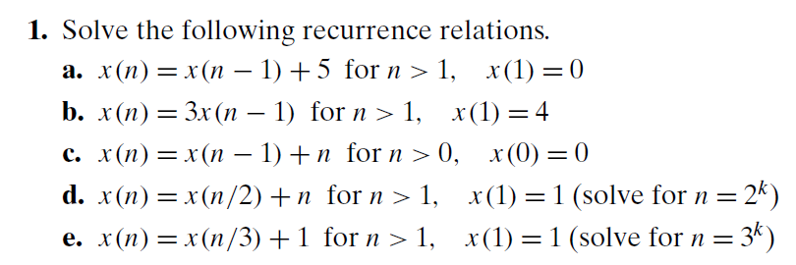

Slide 32
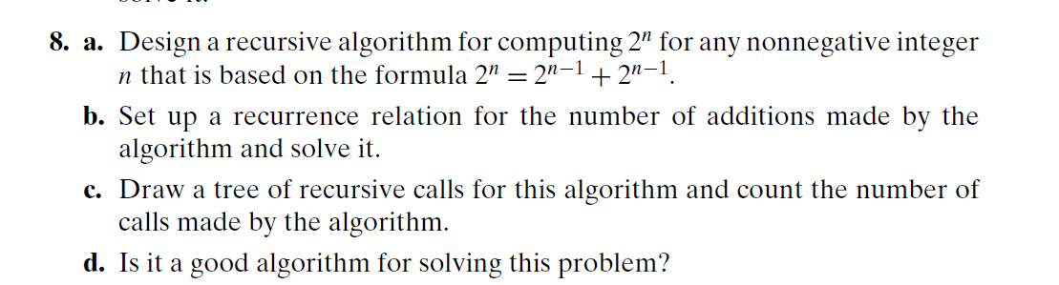

Slide 33
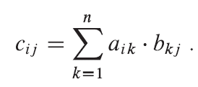
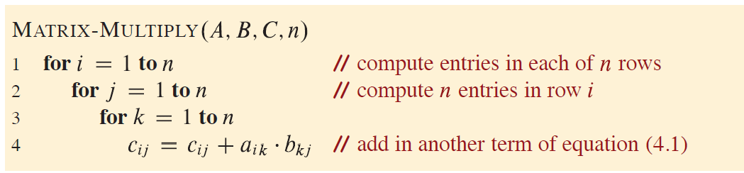

Slide 34
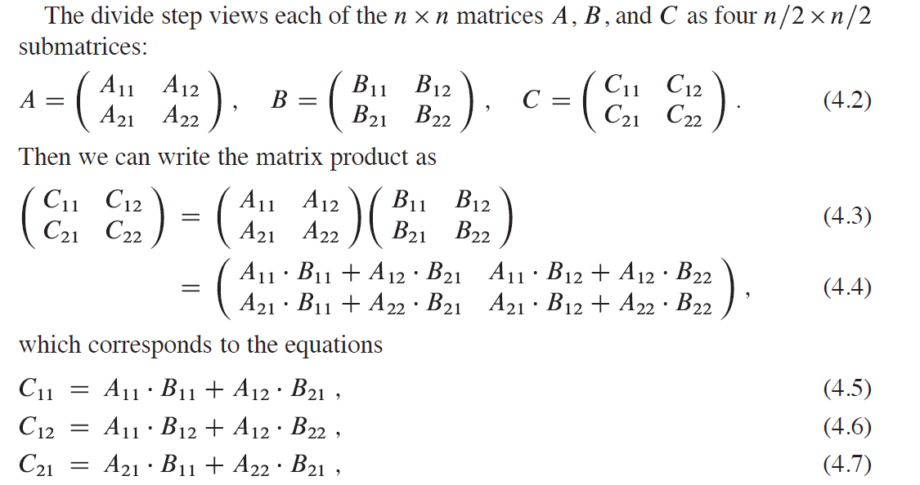

Slide 35
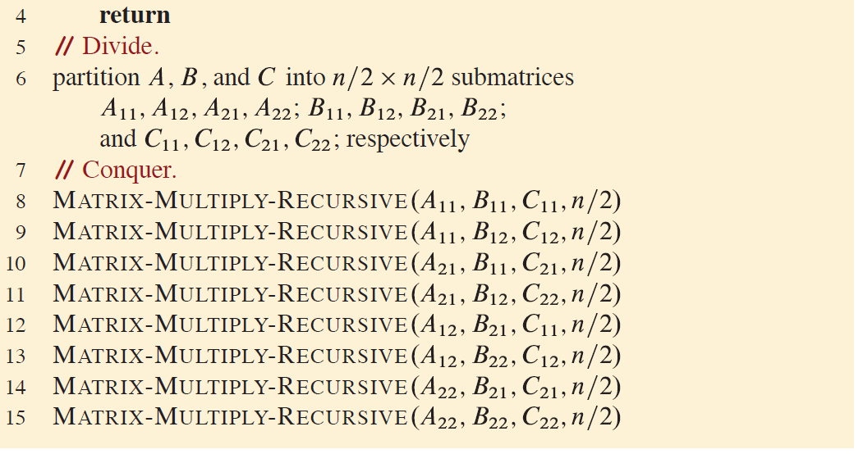

Slide 36
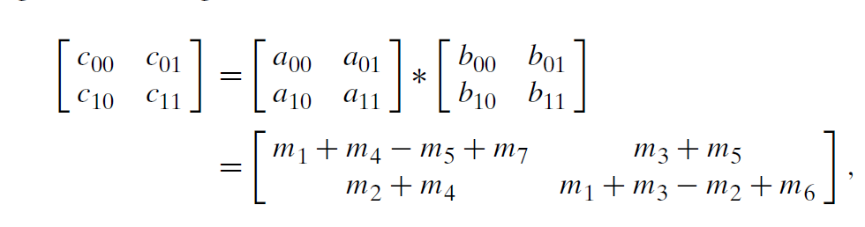
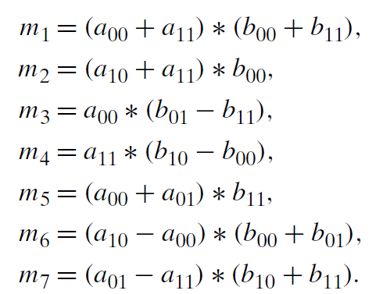

Slide 37
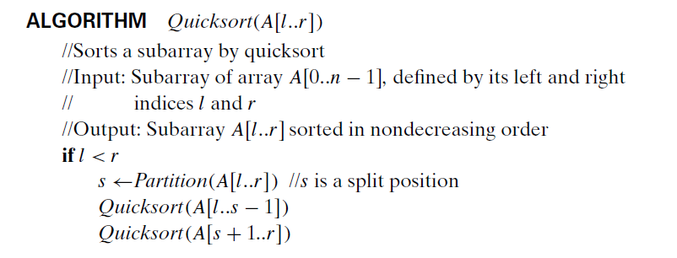


Slide 38
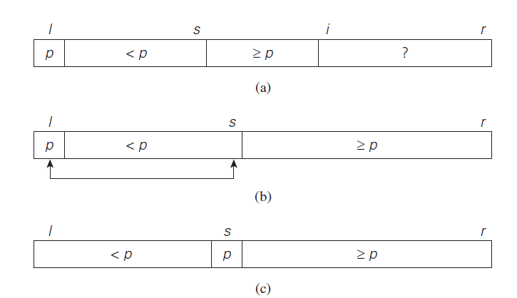

Slide 39
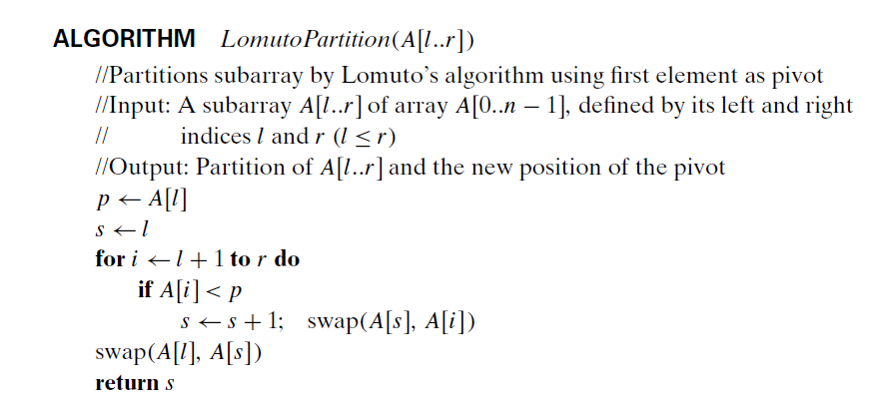


Slide 40
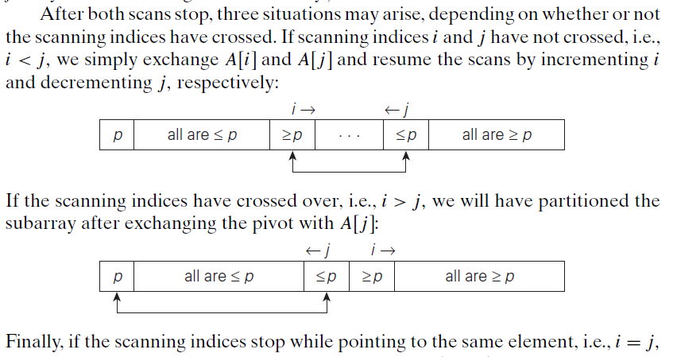

Slide 41


Slide 42


Slide 43





Slide 44








Slide 45


Slide 46





Slide 47




Slide 48




Slide 49




Slide 50


Slide 51


Slide 52


Assignment Problem

Slide 53

A node in a state-space tree is said to be promising if it corresponds to a partially constructed solution that may still lead to a complete solution; otherwise, it is called non-promising.
Leaves represent either non-promising dead end or complete solutions found by the algorithm.

Slide 54
Backtracking
Success in solving small instances of three difficult problems earlier in this section should not lead you to the false conclusion that backtracking is a very efficient technique. In the worst case, it may have to generate all possible candidates in an exponentially (or faster) growing state space of the problem at hand.
It is typically applied to difficult combinatorial problems for which no efficient algorithms for finding exact solutions possibly exist.
Second, unlike the exhaustive search approach, which is doomed to be extremely slow for all instances of a problem, backtracking at least holds a hope for solving some instances of nontrivial sizes in an acceptable amount of time. This is especially true for optimization problems, for which the idea of backtracking can be further enhanced by evaluating the quality of partially constructed solutions.
Third, even if backtracking does not eliminate any elements of a problem’s state space and ends up generating all its elements, it provides a specific technique for doing so, which can be of value in its own.

Slide 55

Backtracking

Slide 56
Branch and Bound
Central idea of backtracking: cut off a branch of the problem’s state-space tree that cannot lead to a solution.
An optimization problem usually subject to some constraint
seeks to minimize or maximize some objective function (a tour length, the value of items selected, the cost of an assignment etc.)
Standard terminology of optimization problems:
A feasible solution is a point in the problem’s search space that satisfies all the problem’s constraints
e.g., a Hamiltonian circuit in the traveling salesman problem
or a subset of items whose total weight does not exceed the knapsack’s capacity in the knapsack problem
An optimal solution is a feasible solution with the best value of the objective function
e.g., the shortest Hamiltonian circuit or the most valuable
subset of items that fit the knapsack

Slide 57

Principal idea of the branch-and-bound technique.
Compared to backtracking, branch-and-bound requires two additional items:
a way to provide, for every node of a state-space tree, a bound on the best value of the objective function on any solution that can be obtained by adding further components to the partially constructed solution represented by the node
the value of the best solution seen so far
If this information (Bound) is available, we can compare a node’s bound value with the value of the best solution seen so far. If the bound value is not better than the value of the best solution seen so far—i.e., not smaller for a minimization problem and not larger for a maximization problem—the node is nonpromising and can be terminated (some people say the branch is “pruned”). Indeed, no solution obtained from it can yield a better solution than the one already available.

Slide 58


Slide 59

Assignment Problem

Slide 60


Lower bound:

Slide 61


Slide 62


Slide 63


Slide 64


Knapsack Problem

Slide 65


Slide 66


Slide 67


Travelling Salesperson Problem
Moreover, for any subset of tours that must include particular edges of a given
graph, we can modify lower bound (12.2) accordingly. For example, for all the
Hamiltonian circuits of the graph in Figure 12.9a that must include edge (a, d),
we get the following lower bound by summing up the lengths of the two shortest edges incident with each of the vertices, with the required inclusion of edges (a, d) and (d, a)

Slide 68


Slide 69


Slide 70

Dynamic Programming
Dynamic programming, like the divide-and-conquer method, solves problems by combining the solutions to subproblems.
(Programming= in this context refers to a tabular method, not to writing computer code.)
A dynamic-programming algorithm solves each subproblem just once and then saves its answer in a table, thereby avoiding the work of recomputing the answer every time it solves each subproblem.
Dynamic programming typically applies to optimization problems.
Such problems can have many possible solutions.
Each solution has a value, and you want to find a solution with the optimal (minimum or maximum) value.
We call such a solution an optimal solution to the problem
As opposed to the optimal solution, since there may be several solutions that achieve the optimal value.
To develop a dynamic-programming algorithm, follow a sequence of four steps:
1. Characterize the structure of an optimal solution.
2. Recursively define the value of an optimal solution.
3. Compute the value of an optimal solution, typically in a bottom-up fashion.
4. Construct an optimal solution from computed information.

Slide 71





Fibonacci numbers

Slide 72


Slide 73




Slide 74


Slide 75




Slide 76



Slide 77




Slide 78




Slide 79






Slide 80

Saving subproblem solutions comes with a cost: the additional memory needed to store solutions. Dynamic programming thus serves as an example of a time-memory trade-off.
A dynamic-programming approach runs in polynomial time when the number of distinct subproblems involved is polynomial in the input size and you can solve each such subproblem in polynomial time.

Slide 81


These two approaches yield algorithms with the same asymptotic running time, except in unusual circumstances where the top-down approach does not actually recurse to examine all possible subproblems. The bottom-up approach often has much better constant factors, since it has lower overhead for procedure calls.

Slide 82


Slide 83


Slide 84




Slide 85



Slide 86


Slide 87


Slide 88






Slide 89



Slide 90


Slide 91

Greedy Technique
A greedy algorithm always makes the choice that looks best at the moment. That is, it makes a locally optimal choice in the hope that this choice leads to a globally optimal solution
Dynamic programming, which solves the subproblems before making the first
Greedy algorithm makes its first choice before solving any subproblems.

Slide 92


If you use a fixed-length code, you need ceil(lgn) bits to represent n >= 2 characters.
A variable-length code can do considerably better than a fixed-length code. The idea is simple: give frequent characters short codewords and infrequent characters long codewords.
We consider here only codes in which no codeword is also a prefix of some other codeword. Such codes are called prefix-free codes

Slide 93


Slide 94



Slide 95


Slide 96


Slide 97


Slide 98


Slide 99


Slide 100


Slide 101


Slide 102


Slide 103


Slide 104
Apply BFS and DFS to find the spanning tree of the graph.
Change the source vertex to generate MST using Kruskal and Prims.

