Slide 1

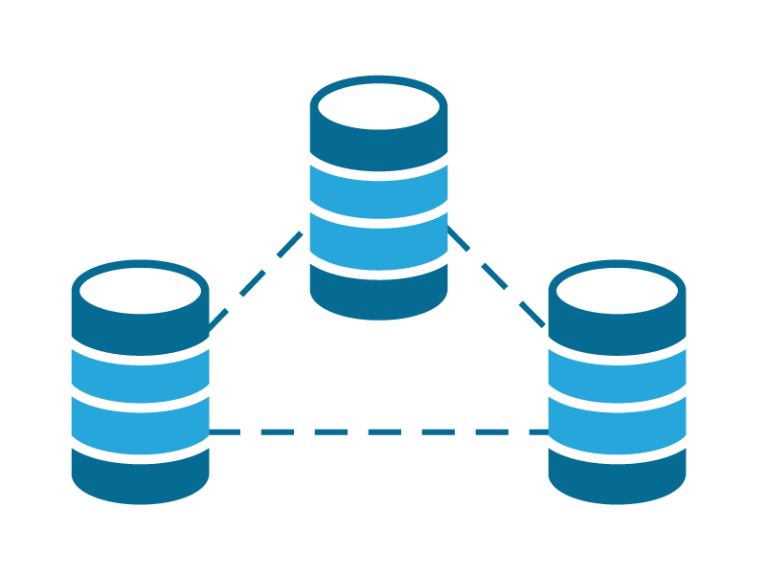

Cipher Implementation

Slide 2

1
Algorithmic Description
2
3
Objectives
Implementation of the project
5
7
6
4
Testing
Example of Various Cipher
Learning Achievement
Introduction
Topic Content

Slide 3



Introduction
Data Security

Slide 4



.
Objectives
Practical experience in implementing classical cipher techniques
​
Explore the encryption and decryption process​
​
improve coding and problem-solving skills. ​

Slide 5



Algorithmic Description
Substitution Cipher

Slide 6
Algorithmic Description
Transpositional Cipher

Slide 7

Implementation of the Project
Solution methodology
Implementation of the project
Substitution cipher method
Transposition cipher method

Slide 8

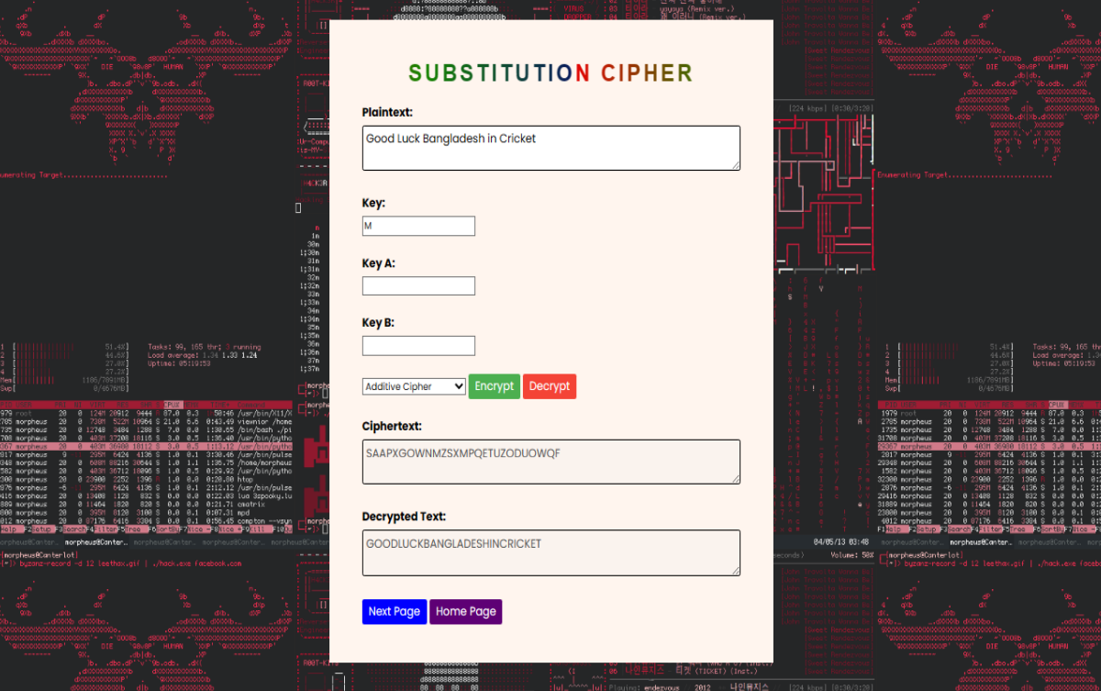
Testing of the project
Show Project Output

Slide 9

Example of Various Cipher
End-to-End Encryption in Messaging Apps
Secure Email Communication
File Encryption

Slide 10

Minimize storage space
Represent all possible values of the field
Improve data integrity of the field.
Support all data manipulations desired on the
Project Advantages

Slide 11


Learning Achievement
Implementing classical ciphers
Coding and programming
Understanding complex algorithms

Slide 12


