Slide 1





INDUSTRIAL TRAINNING
at
NextTech Limited
Presented by:
Md. Foysal Ahmed
202002058
Academic Supervisor
Industrial Supervisor
Prof. Dr . Md. Ahsan Habib Tareq
Professor, Dept. of CSE
Green University of Bangladesh
Md Anis Mojumder
Full Stack Web Developer,
NextTech Limited.

Slide 2

AGENDA
01
Goal of Industrial Training
02
Organization Overview
03
My Work on Industry
04
Tools and Technique used
05
Skill Grown
06
Conclusion
07
Question Session

Slide 3





Introduction
What is industrial training?
Why we need industrial
training?

Slide 4

Projects
During industrial training

Slide 5
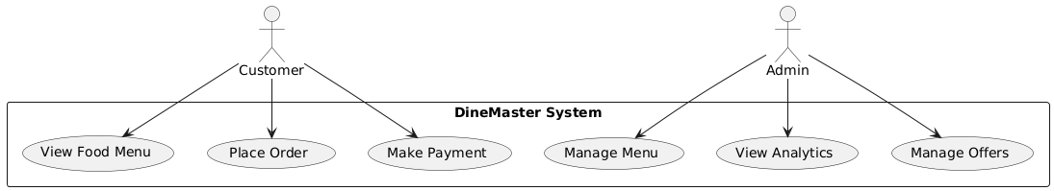
Project Overview
Fig-02: Use Case Diagram

Slide 6

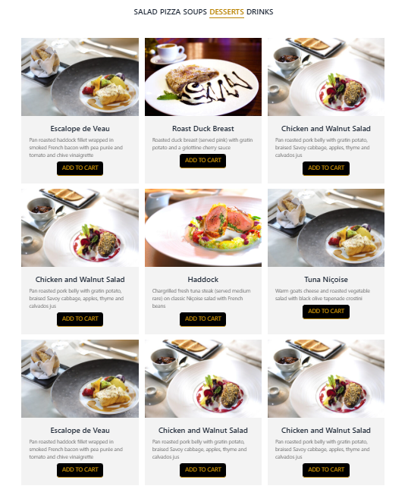

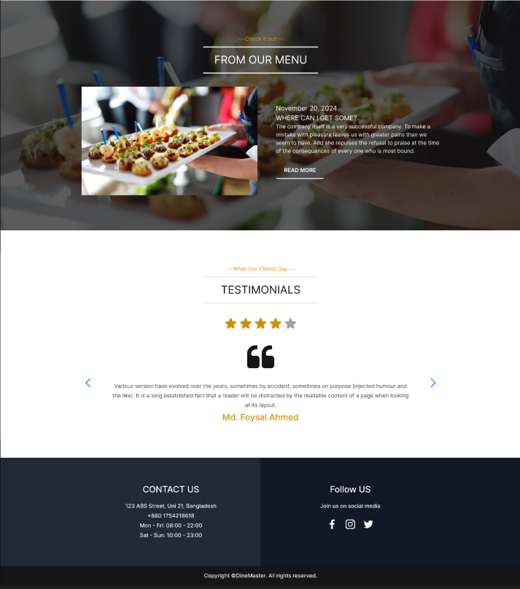
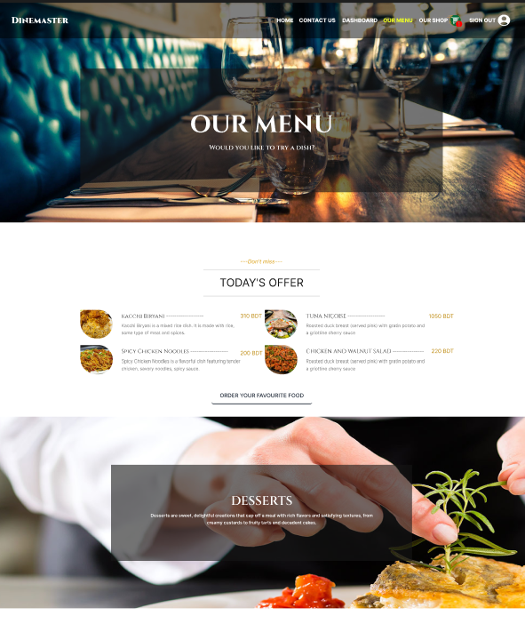
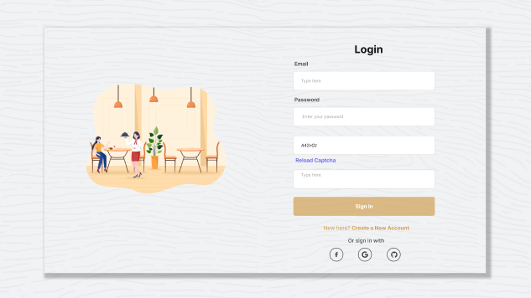
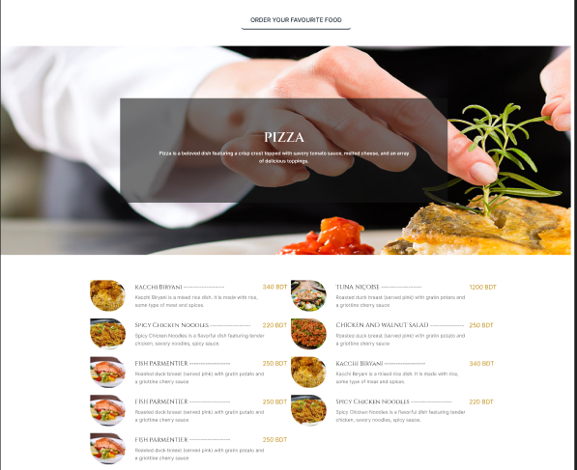
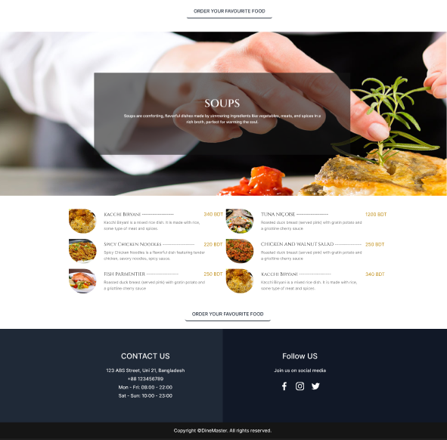
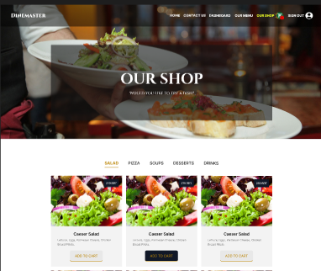
Fig-04: DineMaster (Food for life)

Slide 7
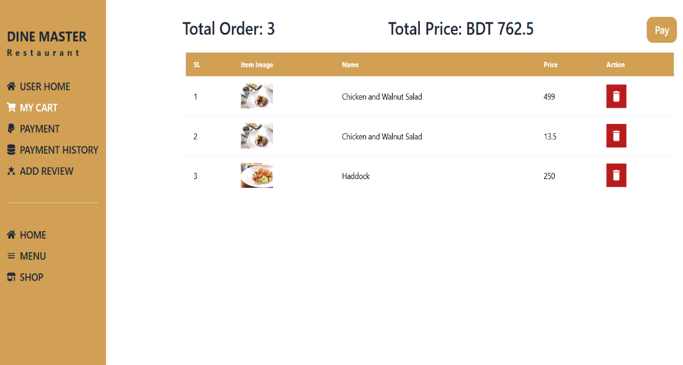
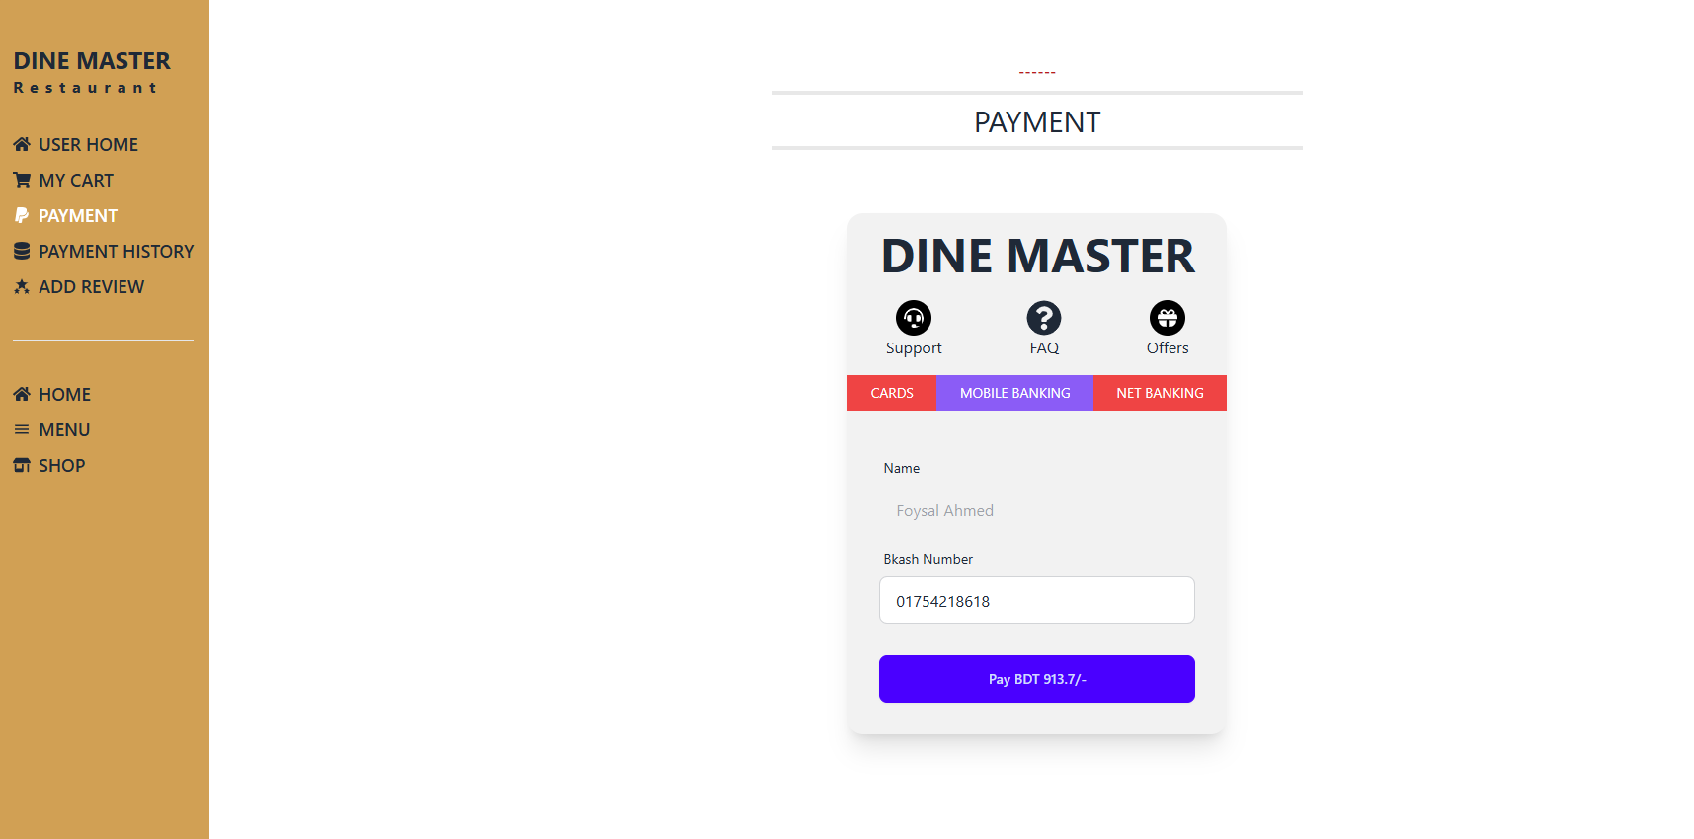
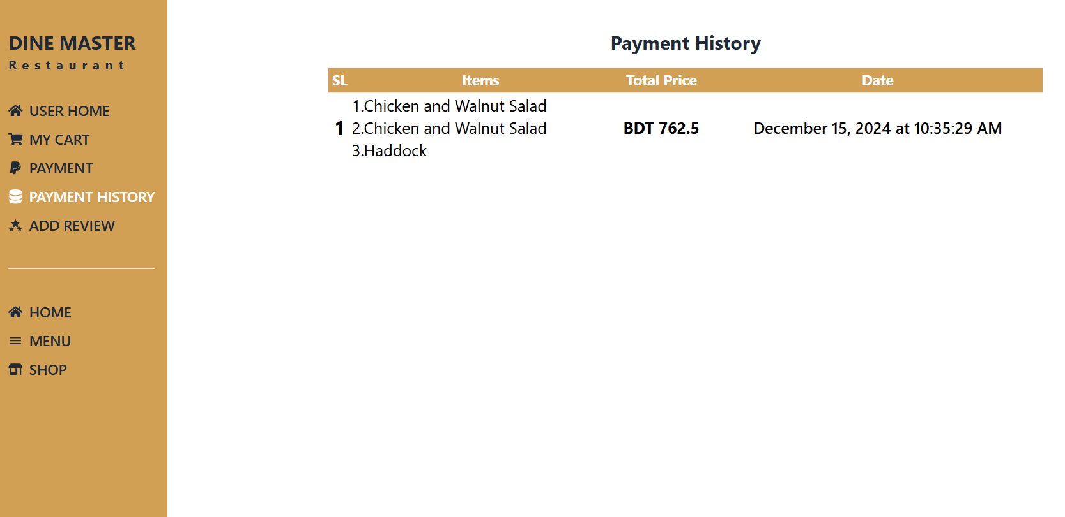
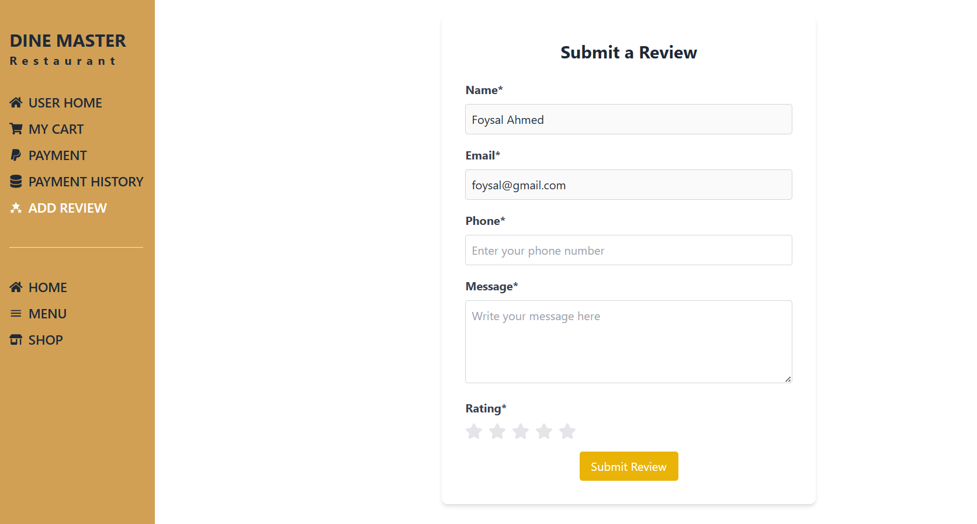
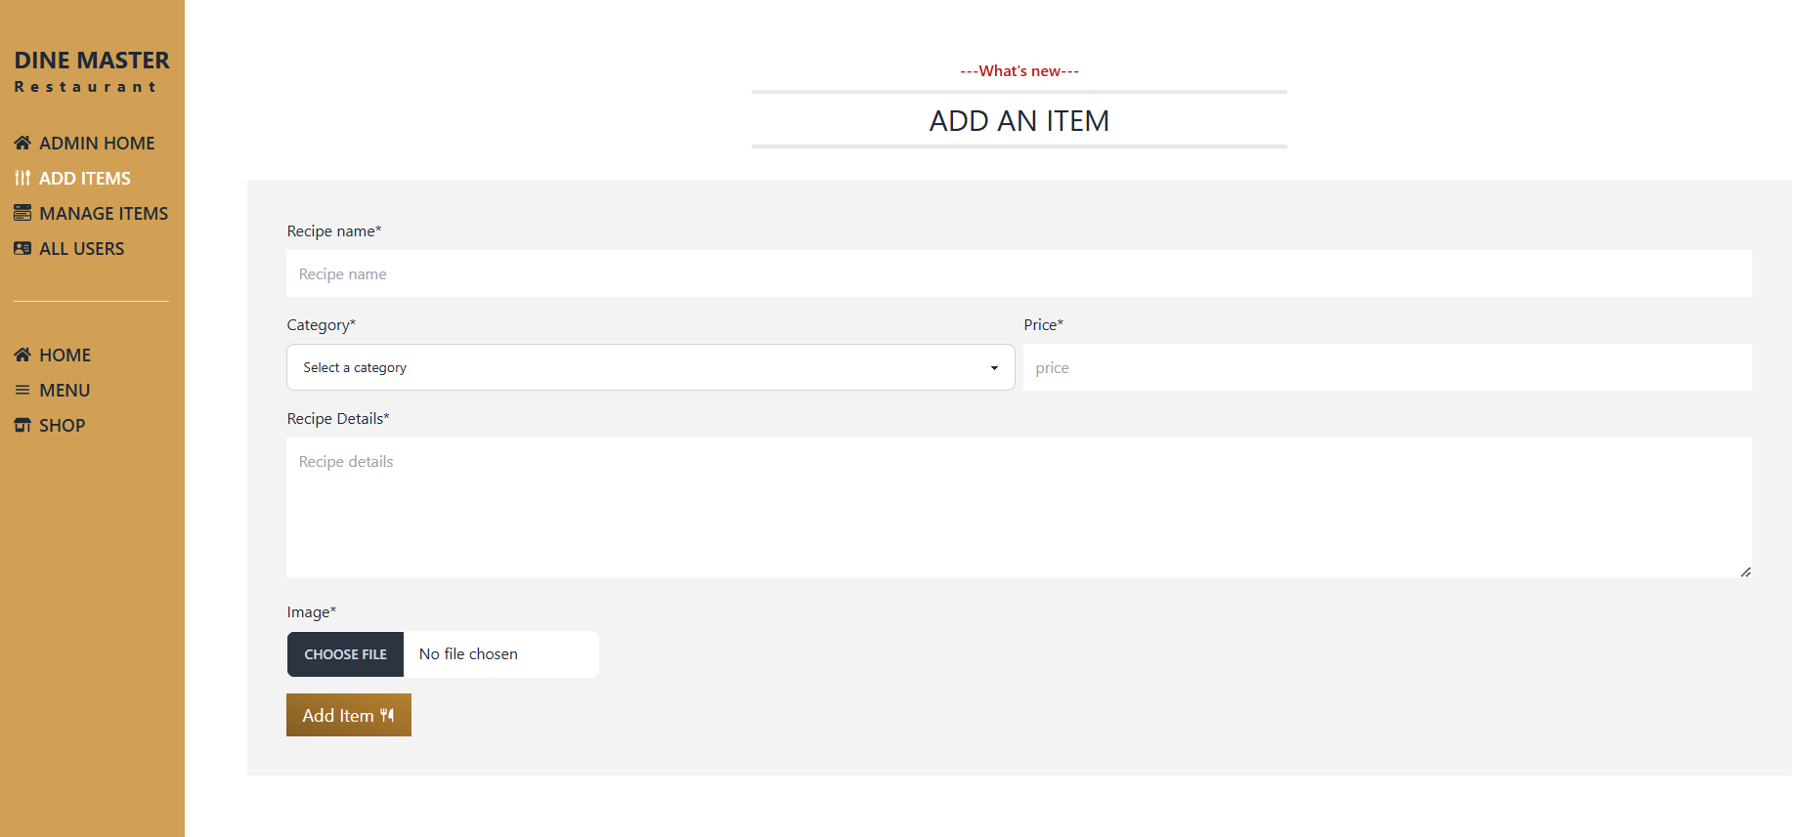
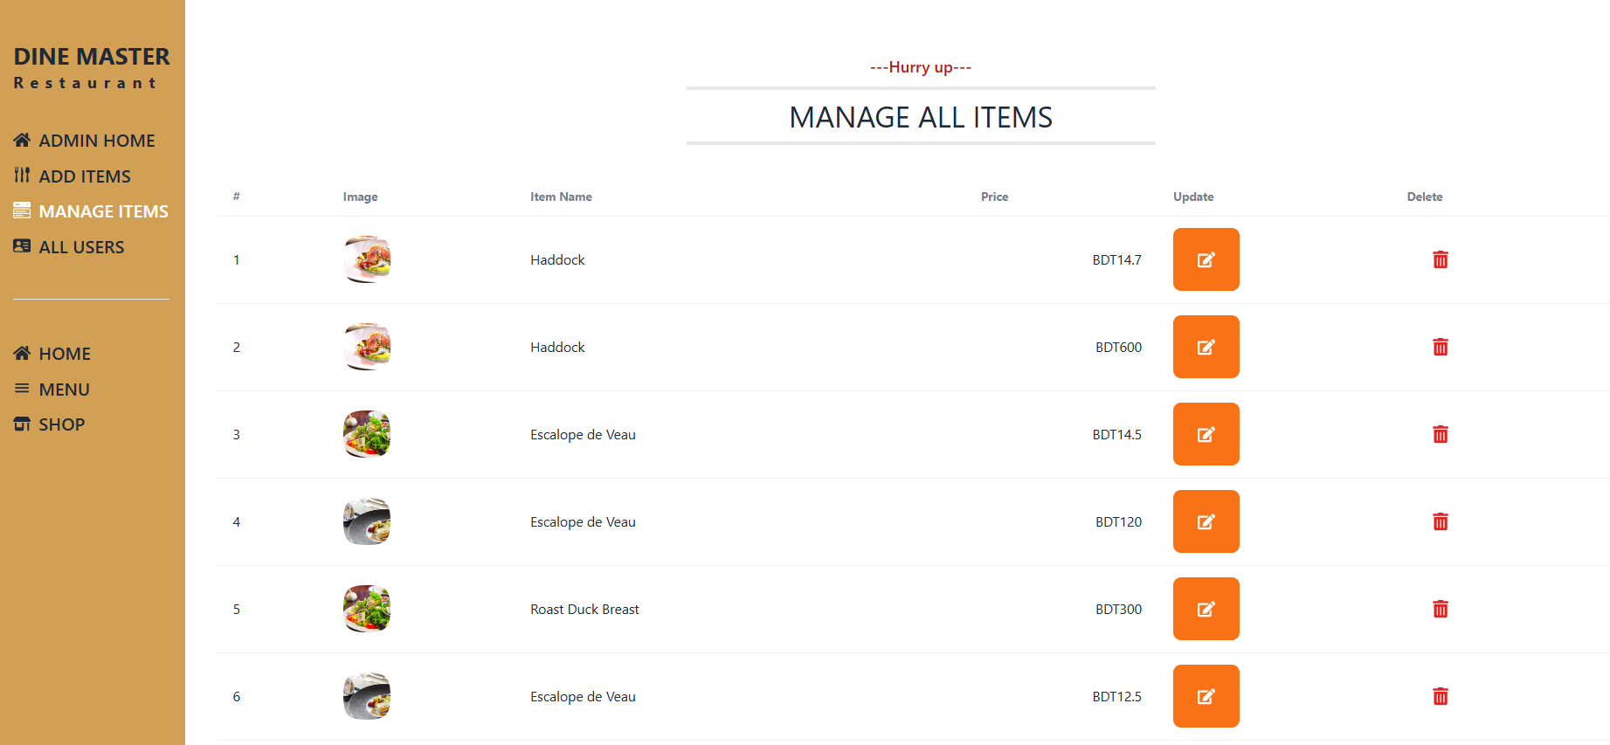
Fig-08: DineMaster(Food for Life)

Slide 8
Skill and Learning
UX Research Skills
Wire-framing and Prototyping
Visual Communication
Analytical Skills

Slide 9
Testing
Test ID | Test Case Type | Description | Actual Result | Excepted Result | Status
01 | Functional Test | Home: click “Add to Cart” | Added to cart | Added to cart | Passed
02 | Functional Test | Shop: click “Add to Cart” | Added to cart | Added to cart | Passed
03 | Payment flow test | Cart > Enter bKash number > Pay | Payment successful | Payment successful | Passed
04 | Performance test | Page load time | sometimes take long time | Each page load in 3 seconds | Failed

Slide 10
Skill and Learning
Different Types of Test
Test Planning and Design
Bug Tracking and Reporting
User Acceptance Testing

Slide 11
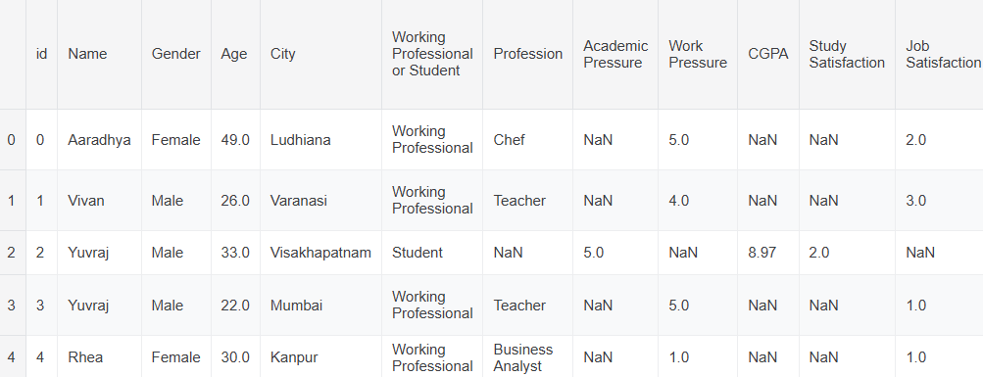
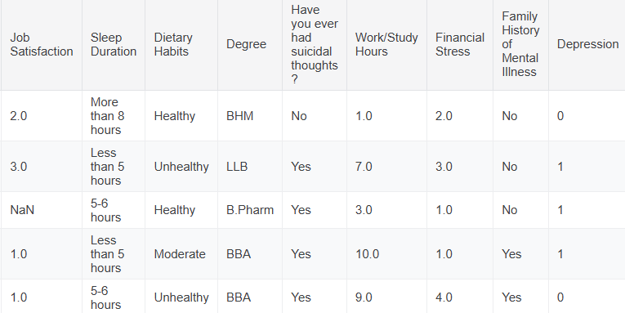
Exploring Mental Health Data
140,700 rows and 20 columns

Slide 12
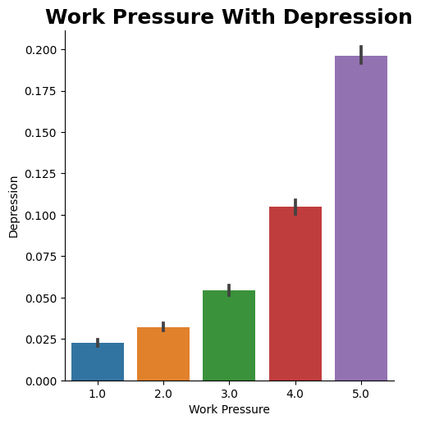
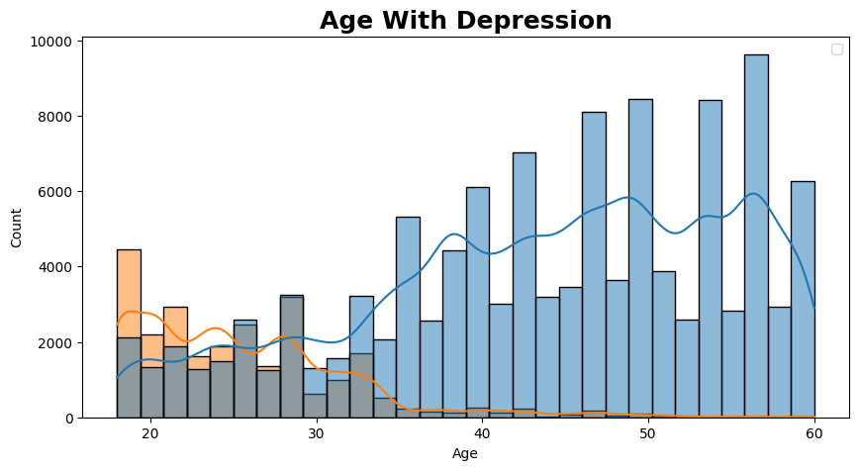
Exploring Mental Health Data
Fig-08: Mental Health Data Analysis

Slide 13
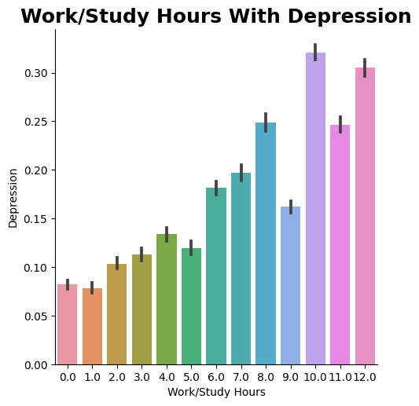
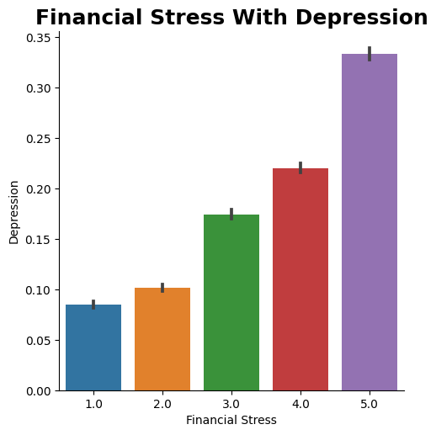
Exploring Mental Health Data
Fig-08: Mental Health Data Analysis

Slide 14
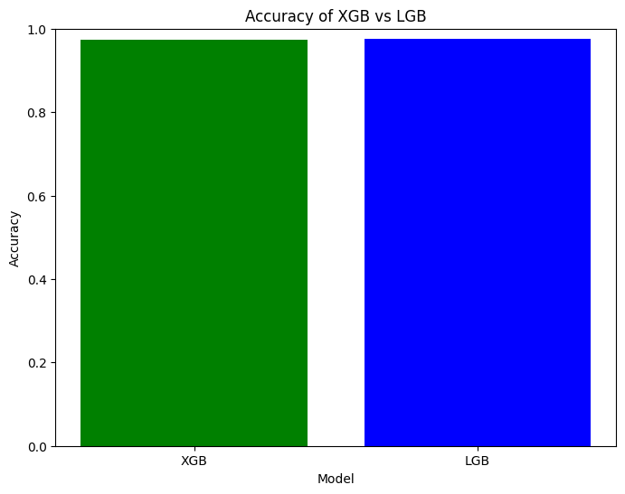
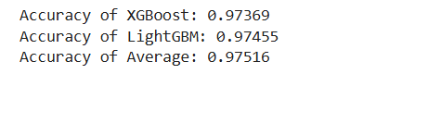
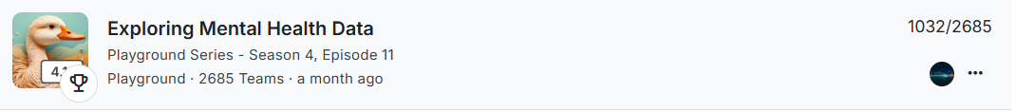
Exploring Mental Health Data
Fig-08: XGBoost vs LightGBM

Slide 15
Skill and Learning
Handling Missing Value
Analysis Data
One-Hot Encoding
Different Model

Slide 16
Conclusion
In conclusion, my transition to web design and data analysis has allowed me to apply theoretical knowledge to practical projects, enhancing my technical and collaborative skills. This experience has built a strong foundation for a dynamic and innovative career in technology.

Slide 17


