Slide 1
Student Performance Prediction Support System
Final Project Presentation

Slide 2
The Problem
Why Did We Build This?
Many students struggle silently.
Reactive support is too late.
Shift from Reactive to Proactive support.

Slide 3
Our Goal
What We Set Out To Achieve:
Preprocess and analyze student data.
Build and compare multiple ML models.
Integrate NLP for sentiment analysis.
Deploy the best model as a web app.

Slide 4
Dataset
Understanding the Data:
Source: UCI Machine Learning Repository
649 Students | 33 Features
Demographic: age, gender, address
Academic: grades, study time, absences
Social: alcohol consumption, free time
Target: Final Grade (G3)

Slide 5
Our Methodology
How We Did It: The AI Pipeline
Preprocessing
Feature Engineering
Model Training
Evaluation
Deployment
Data

Slide 6
Model Comparison
Which Model Performed Best?
Winner: Random Forest!
Reason: Highest F1-Score. Robust against overfitting.

Slide 7
Results (Deep Learning & NLP)
Neural Network: Also performed well.
NLP: Found a significant link: Negative sentiment correlates with higher risk.

Slide 8
The Web App
From Model to Application:
A counsellor inputs student data and gets an instant risk prediction.

Slide 9
Ethical Considerations
We Also Considered the Ethics:
Anonymization: No student names or personal IDs.
Bias: We must audit for socio-economic bias.
Purpose: A tool to HELP students, not to label them.

Slide 10
Some Screenshots
Data head:

Slide 11
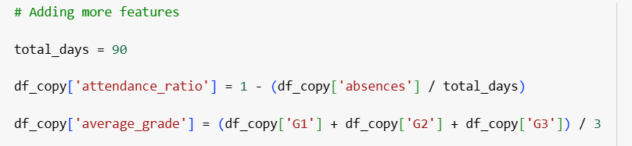
Some Screenshots
Feature engineering code:

Slide 12
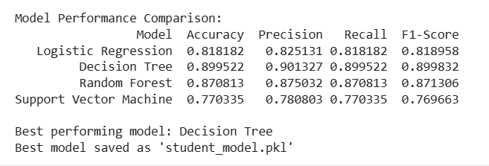
Some Screenshots
Model Comparison Table:

Slide 13
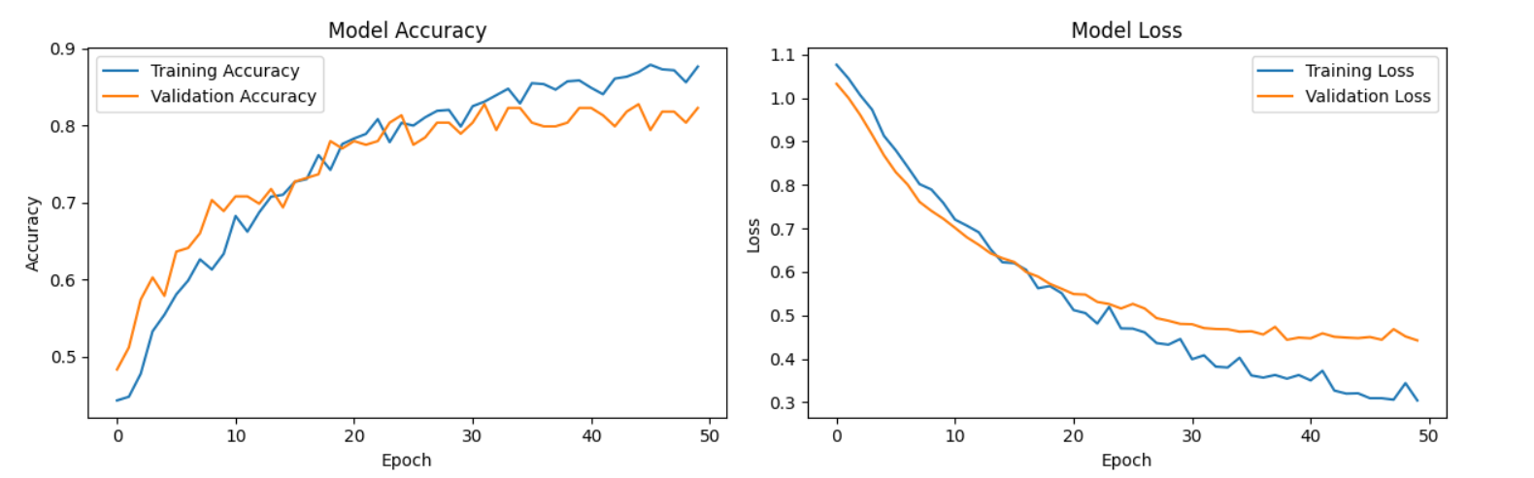
Some Screenshots
Neural Network Training Plot:

Slide 14
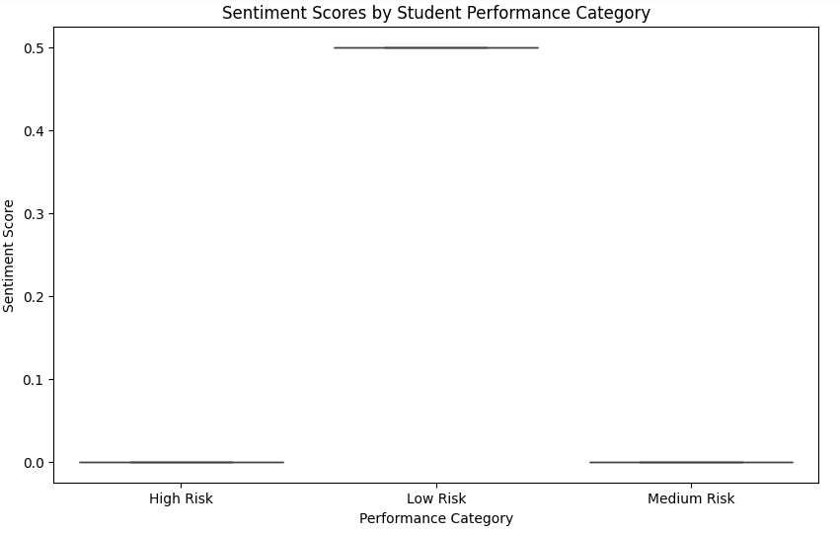
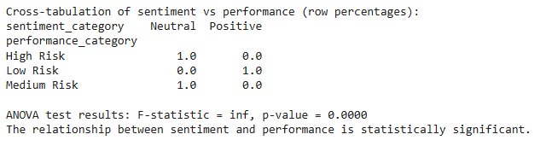
Some Screenshots
Sentiment Analysis Boxplot:

Slide 15
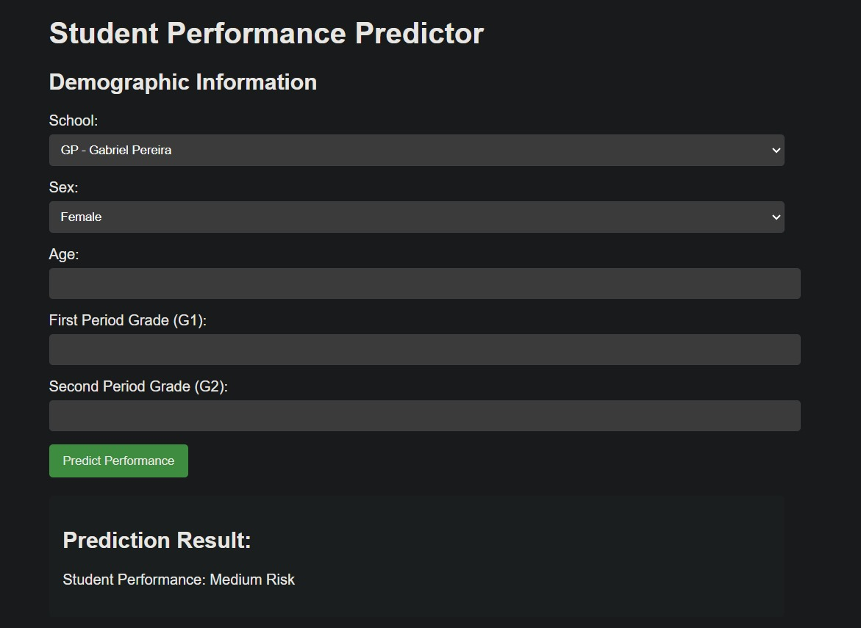
Some Screenshots
The Web App:

