Slide 1
E-AUCTION

Slide 2

E-AUCTION:
An E-AUCTION is a transaction between sellers (the auctioneers) and bidders (suppliers in the business to business scenarios) that takes place on an electronic marketplace.

Slide 3


ADVANTAGES OF ONLINE AUCTIONS:
Convenience
Rich Information
Time Saving and Money Saving
No Physical Location or Multiple Physical Locations
Compare Prices

Slide 4

DISADVANTAGES OF ONLINE AUCTIONS:
Prolonged Time
Anonymous
Bidder

Slide 5
Types of E-Auction:
Classic reverse auction
English Auction
Dutch Auction
Japanese Auction

Slide 6

Aim:
To verify the E-auction web application.

Slide 7
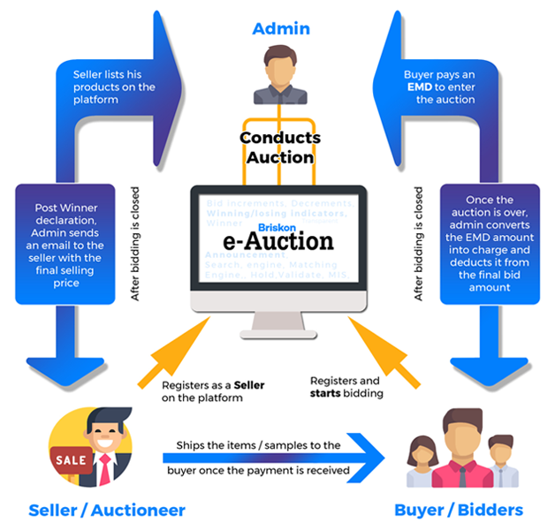
REQUIREMENTS:
Log In Module.
Search Module.
Purchasing Module.
Payment Module.
Adding New Product.
Delivery.

Slide 8
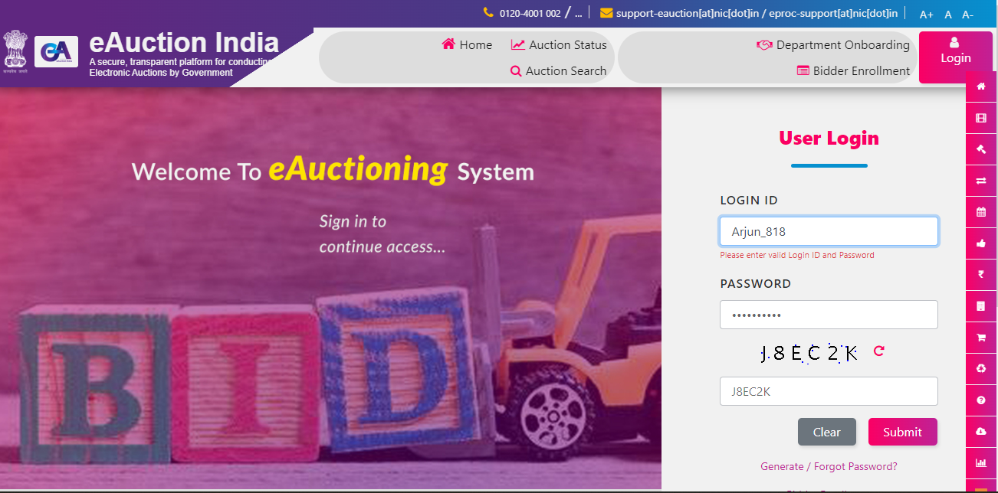
LOG IN MODULE:

Slide 9
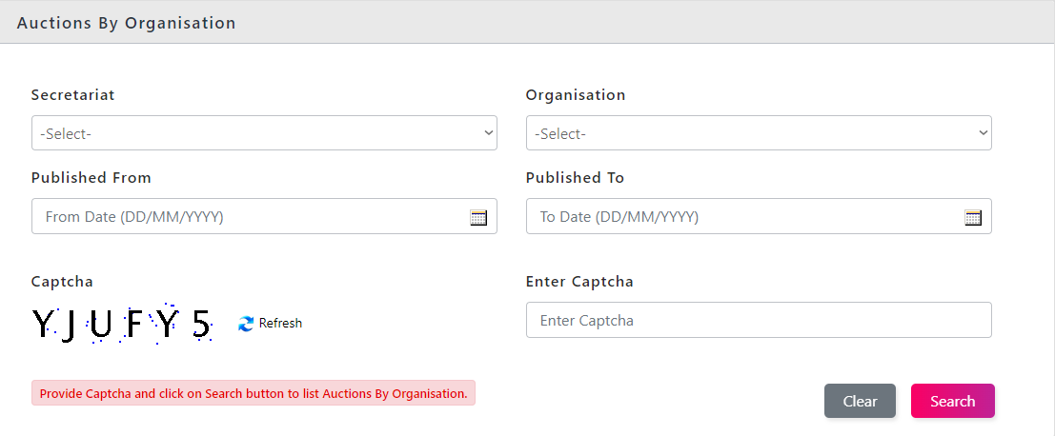
Search Module:

Slide 10
POSITIVE TEST SCENARIO:
Admin managed to add new auction details.
Admin clicks the tab of "add new" and does not fill up the auction details correctly or add auction by not adding lots.
Users type at search text field.
Admin removes the sold auction.
Buyers logged in and place bids on auction successfully.
Seller able to create lots under auction by providing necessary details successfully.
Admin allocates lots that are unassigned due to buyer's hammer price.
Admin can check the lots which meet seller requirements as "sold".
User can post FAQ section and search question.

Slide 11
NEGATIVE TEST SCENARIO:
No reserve price is provided in price section by seller for buyer.
User post the questions that are already answered by admin recentlt.
User can change the price in price section.
Hotline number is not available or temperory not available.
User wants to logput from the system without log in.
Admin verifies one's registration with a set of incomplete of information.
Buyer does not log into the paypal account and makes full payment by cash or cheque.
Amin verifies one's registration with a set of incomplete of information.
Seller does not give the buyer the correct item to the buyer.

Slide 12
TEST CASES:
S NO | TEST CASES | PASS/FAIL
1 | Verify admin can add new auction details | pass
2 | Verify admin can add new product or lot | pass
3 | Verify admin can remove the sold auctions | pass
4 | Verify buyer can check the delivery updates | pass
5 | Verify the seller or bidder can check the delivery updates | pass

Slide 13
S NO | TEST CASES | PASS/FAIL
6 | Verify the address given by buyer is blank. | FAIL
7 | Verify the buyer can decrease the product price | FAIL
8 | Verify the user can post the FAQ's in the section after the admin given answer for the same question recently. | FAIL
9 | Verify the admin can check one's registration with a set of incomplete of information. | FAIL
10 | Verify the seller does not give the buyer the correct item to the buyer. | FAIL

Slide 14

CONCLUSION:
E-AUCTION industry is a complex environment. I have navigate the E AUCTION INDIA web application and find out the positive/pass and negative/fail test cases. This is to improve the application performance in better manner.

Slide 15

M GANGI REDDY
192111404

