Slide 1
Industrial Human Resource Geo-Visualization
Presented By
M.Giridharadhayalan
DS-S-WD-T-B56

Slide 2
Problem Statement
In India, the industrial classification of the workforce is essential to understand the distribution of the labor force across various sectors. The classification of main workers and marginal workers, other than cultivators and agricultural laborers, by sex and by section, division, and class, has been traditionally used to understand the economic status and employment trends in the country. However, the current data on this classification is outdated and may not accuratelyreflect the current state of the workforce. The aim of this study is to update the information on the industrial classification of the main and marginal workers, other than cultivators and agricultural laborers, by sex and by section, division, and class, to provide relevant and accurate data for policy making and employment planning.

Slide 3
Tools Used
Python: Data processing and modeling scripting
Pandas: Efficient data cleaning, manipulation, and aggregation
Natural Language Processing (NLP): Keyword-based classification of industry categories
Streamlit: Rapid dashboard app development and deployment
Plotly: Interactive and customizable visualizations (bar charts, pie charts)
Matplotlib/Seaborn:(optional for extended analysis)
Scikit-learn: Classical machine learning for potential model building (classification)

Slide 4
Approaches
Data : It is already given in many sepearte csv files and first thing is to merge to one csv file.
Data cleaning: Standardize column names, handle missing values, remove duplicates.
NLP for business categories: Defined keyword sets for Retail, Poultry, Agriculture, Manufacturing, Mining and Text matching to map raw industry names to business categories.
Feature engineering: Aggregate main and marginal worker counts and Create summary columns for modeling and visualization.
EDA: Summary Statistics and Distribution Analysis
Machine Learning: Model is to classify industries into business categories based on workforce composition and employment patterns.
Deployment : Streamlit App with plotly integration.

Slide 5
EDA Insights
Business Category Distribution
Total Main Workers by Category
Rural vs Urban Workers
Distribution of Total Main Workers
Correlation Heatmap

Slide 6
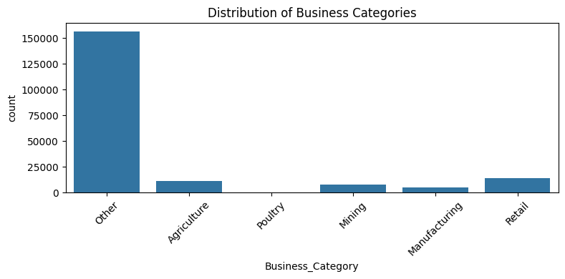
Business Category Distribution
Agriculture dominates Delhi’s industry landscape, followed by Manufacturing and Retail. This reflects a strong rural-urban employment mix and highlights key sectors for policy and investment focus.

Slide 7
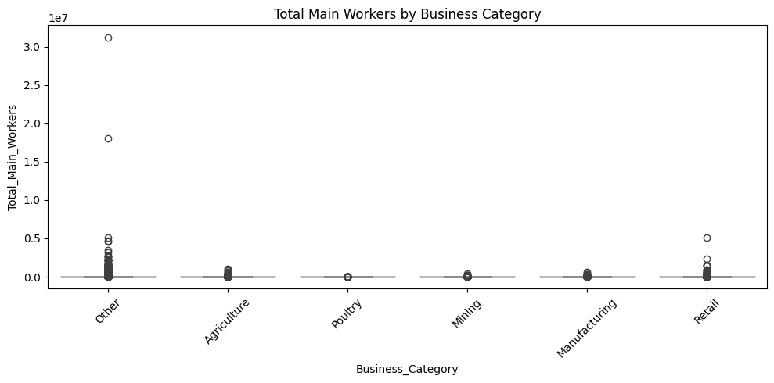
Total Main Workers by Category
Worker counts vary widely across categories. Agriculture and Manufacturing show high variability, indicating both large-scale and niche operations. Retail and Poultry are more consistent, suggesting standardized employment patterns.

Slide 8
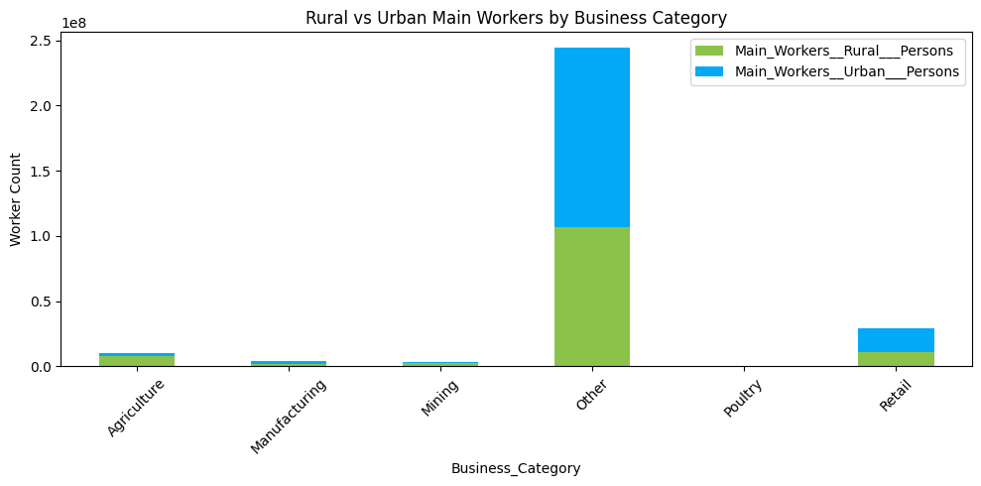
Rural vs Urban Workers
Urban employment leads in most sectors, especially Manufacturing and Retail. Agriculture and Poultry maintain strong rural presence, reinforcing their role in peri-urban livelihoods.

Slide 9
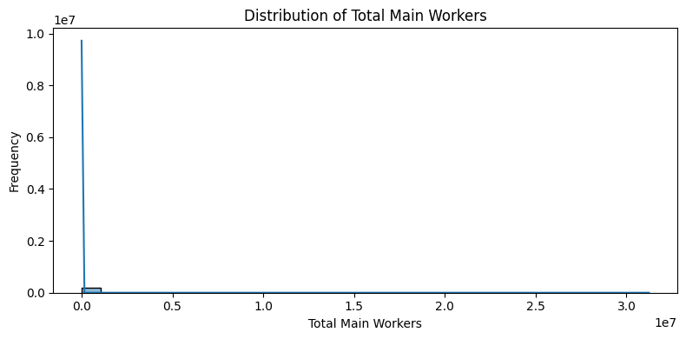
Distribution of Total Main Workers
The distribution is right-skewed — most industries employ fewer than 500 main workers, but a few sectors spike above 1,000. This long-tail pattern suggests fragmented employment and potential for consolidation.

Slide 10
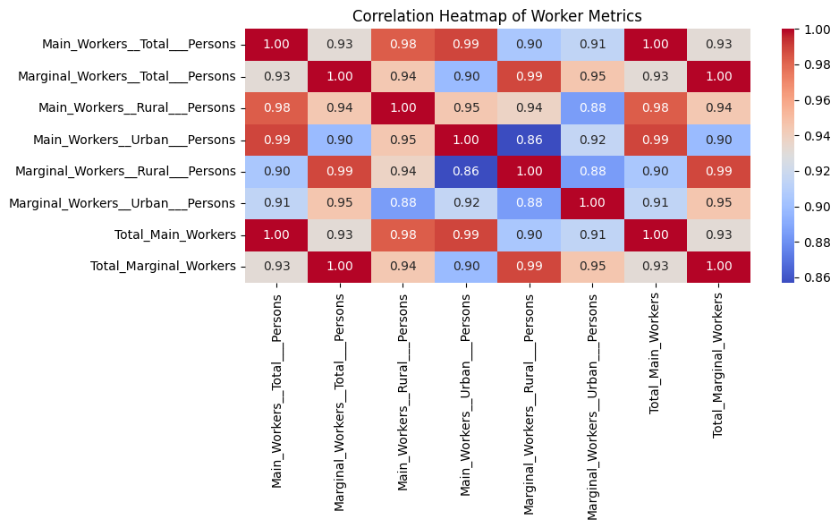
Correlation Heatmap
Strong positive correlations exist between rural, urban, and total worker counts. Marginal and main workers also correlate, suggesting overlapping labor dynamics. These insights guide feature selection for ML models.

Slide 11
Conclusion
Successful fusion of classic ML, NLP, and interactive visualization technology.
Streamlit and Plotly enable rapid prototyping and user-engaging dashboards.
Valuable tool for policymakers, business strategists, and labor economists.

