Slide 1
Erdos: A Novel Blockchain
Consensus Algorithm with Equitable Node Selection and Deterministic Block Finalization
Erdos
Student Name: Seyed Mohammad Hossein Tabatabai
Instructor Name: Dr. Maryam Lotfi
Course: Distributed Systems

Slide 2

Why Do We Need a New Consensus Algorithm?

Slide 3

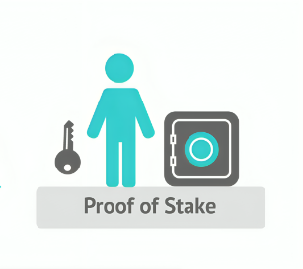


Serious Problems of the Two Main Blockchain Consensus Algorithms

Slide 4


Slide 5



 | Feature | PoW ⚡ | PoS 💰 | Erdos 🔒
 | Energy Consumption | Very High ❌ | Low ✅ | Low ✅
 | Power Centralization | High ❌ | High ❌ | Very Low ✅
 | 51% Attack Vulnerability | Possible ❌ | Possible ❌ | Very Difficult ✅
 | Block Finality | Probabilistic ❌ | Probabilistic ❌ | Deterministic ✅
 | Equal Opportunity for Nodes | Very Low ❌ | Low ❌ | High ✅
 | Forks (Chain Splits) | Common ❌ | Likely ❌ | Near Zero ✅

Slide 6

What Is Consensus in Distributed Systems?

Slide 7



The key role of consensus in blockchain
Validating the legitimacy of transactions
Determining the order of transactions
Ensuring consistency across versions

Slide 8



How Does the Erdos Algorithm Work ?

Slide 9

1
Fair and Random Selection of Nodes

Slide 10
Fair and Random Selection of Nodes
Forger
Vetter1
Vetter2

Slide 11

1
Fair and Random Selection of Nodes
Deterministic Finalization
of Blocks
2

Slide 12



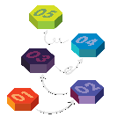

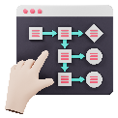


Block Creation and Finalization Steps in Erdos
Node Selection Mechanism for Block Creation and Validation
Step 1
Step 2
Step 3
Step 4
Step 5
Step 6

Slide 13





Block Creation and Finalization Steps in Erdos

Slide 14

Block Creation and Finalization Steps in Erdos
1
2
3
4
5
Initial Block Creation
by the Forger
Initial Validation
by Vetter1
Adding Rewards
by the Forger
Final Verification
by Vetter2
Adding to the Chain +
Network Synchronization

Slide 15

Deterministic Finalization Without Forks
Key Difference: Deterministic Finalization

Slide 16
Key Innovations in Erdos
Node Selection Without Power or Wealth
Transparent and Fair Reward Distribution
Two-Stage and Deterministic Finalization
Automatic and Unified Chain Synchronization

Slide 17





Key Innovations in Erdos
Node Selection Without Power or Wealth
Two-Stage and Deterministic Finalization
Transparent and Fair Reward Distribution
Automatic and Unified Chain Synchronization

Slide 18

Erdos in the Context of Distributed Systems

Slide 19


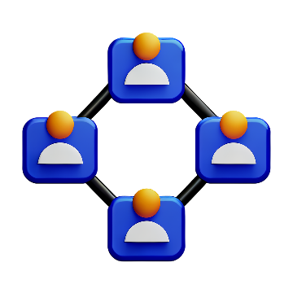
Fault Tolerance
Liveness + Safety
Consensus Without a Central Authority

Slide 20





Challenges and
Future Work
The need for large-scale (scalability) testing
Formal security analysis against common attacks
Development of governance and
on-chain decision-making mechanisms

Slide 21
Summary and Conclusion

Slide 22
THANK YOU

