Slide 1

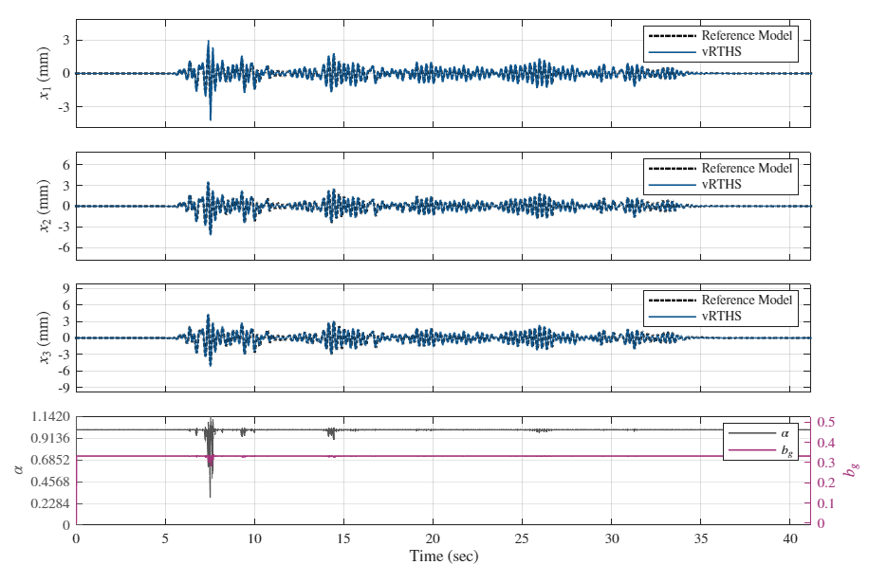
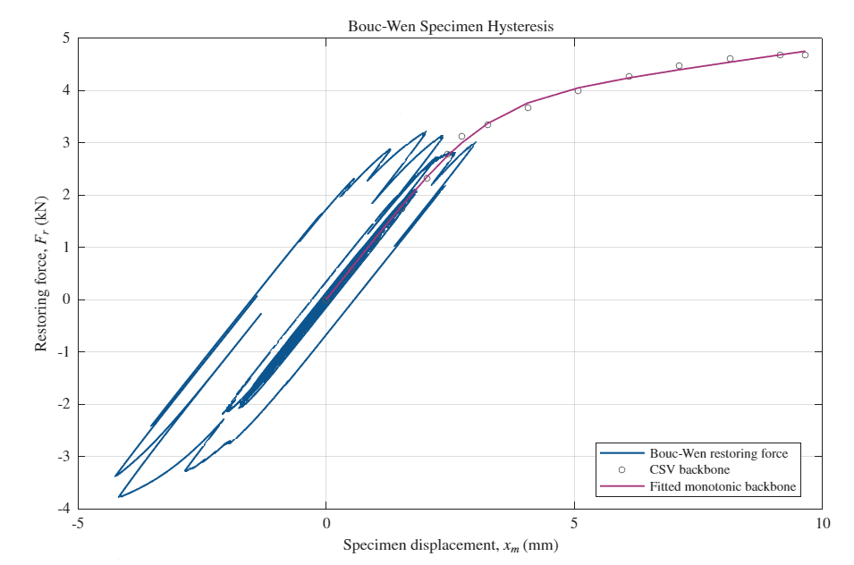
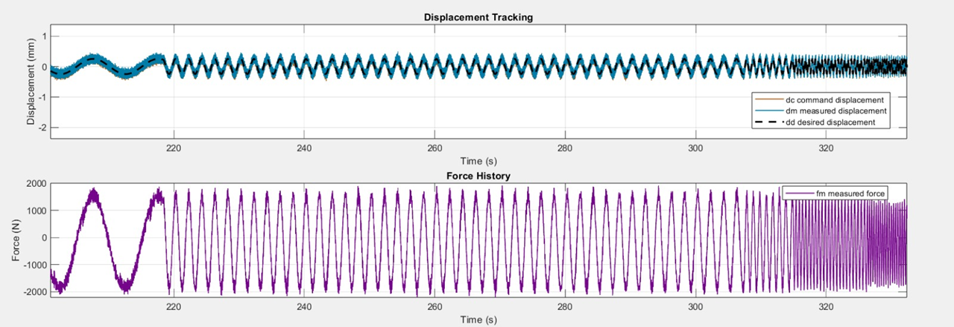
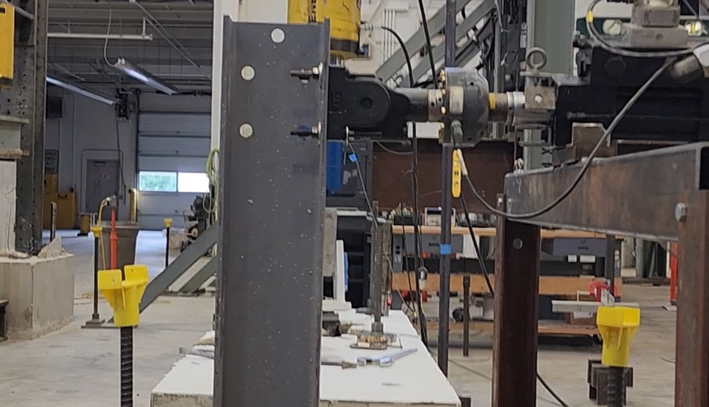
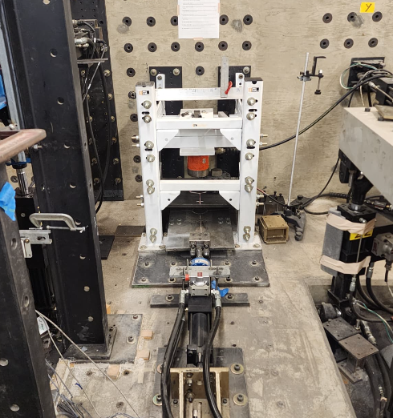
A Stability-Driven Real-Time Hybrid Simulation
Framework for Hysteretic Structural Components
Mohamed Gomaa · Gaurav Chobe · Julian D. Calonge · Edwin D. Patino · Motahareh Mirfarah
Johnny W. Condori Uribe · Juan Nicolas Villamizar · Shirley Dyke · Akanshu Sharma
Student: Mohamed Gomaa | Advisor: Akanshu Sharma
MOTIVATION & RTHS
STABILITY-DRIVEN FRAMEWORK
RESULTS & IMPLICATIONS
Why this matters
Controller regulation follows the specimen
Closed-loop interaction remained stable
Prescribed cyclic protocols cannot reproduce the system-dependent demands that emerge when a degrading component interacts with the surrounding structure.
The framework monitors the evolving closed-loop system and regulates controller authority as stiffness loss and nonlinear hysteresis alter the plant.
The simulation sustained real-time coupling as the specimen exhibited nonlinear hysteretic behavior.
The experimental gap
1
2
3
4
• Component tests provide valuable nonlinear data, but their loading histories are fixed in advance.
• Full-scale dynamic testing captures interaction, yet cost, scale, and laboratory demand limit routine use.
• RTHS closes this gap by coupling a physical component to a numerical structure at every time step.
Estimate
evolving dynamics
Track stability
margin
Regulate controller
authority
Maintain stable
real-time coupling
Real-time closed-loop interaction
response → command displacement
NUMERICAL
STRUCTURE
REAL-TIME
CONTROLLER
PHYSICAL
SPECIMEN
Floor responses follow the reference finite-element model across the three-story system.
← measured restoring force
Hysteretic response changes stiffness and phase, so a controller tuned only to the initial specimen can lose stability margin.
Stability-driven control logic
• Continuously observe the coupled numerical–experimental system.
• Reduce aggressive control action when stability margin erodes.
• Preserve tracking performance without breaking the real-time feedback loop.
Experimental program
Command and measured interface displacement remain closely aligned while measured force is fed back to the numerical model.
• Nonlinear tests on a column-base connection.
• Physical restoring force fₘ advances the numerical substructure.
• The calculated interface response defines the next actuator command.
• Reference FEM responses provide the system-level benchmark.
What the results show
• Stable real-time interaction was maintained through the hysteretic response.
• Floor and interface responses agreed well with the reference FEM.
• Stability-aware regulation addresses the changing specimen dynamics that undermine fixed-gain controllers.
Experimental substructure: column-base connection anchored to a concrete foundation and driven at the interface point.
Challenge: hysteretic degradation changes the actuator–controller–specimen dynamics during the test.
TAKEAWAY | Specimen-aware stability regulation extends RTHS to degrading structural components.

