Slide 1
AN ONLINE STABILITY INDICATOR FOR REAL-TIME HYBRID SIMULATION
Mohamed Gomaa
03/02/2026

Slide 2
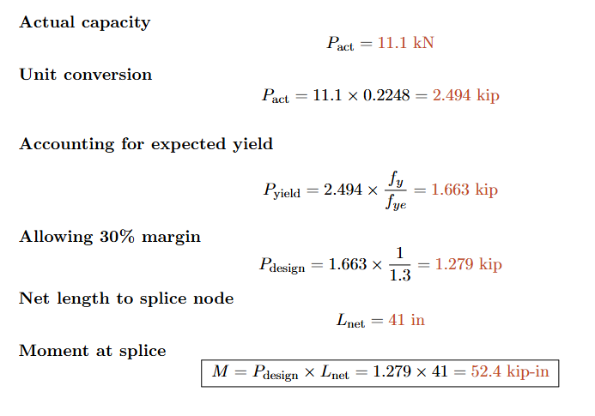
Proposed Setup

Slide 3
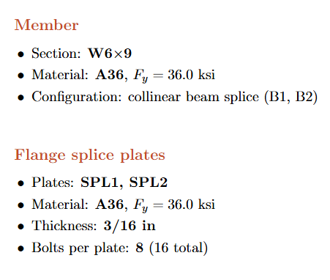
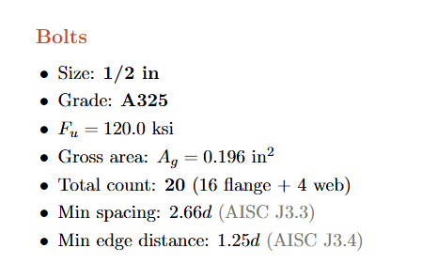
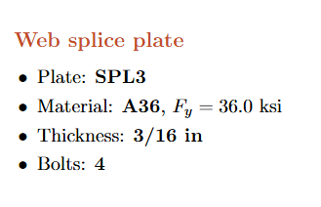
Proposed Setup

Slide 4
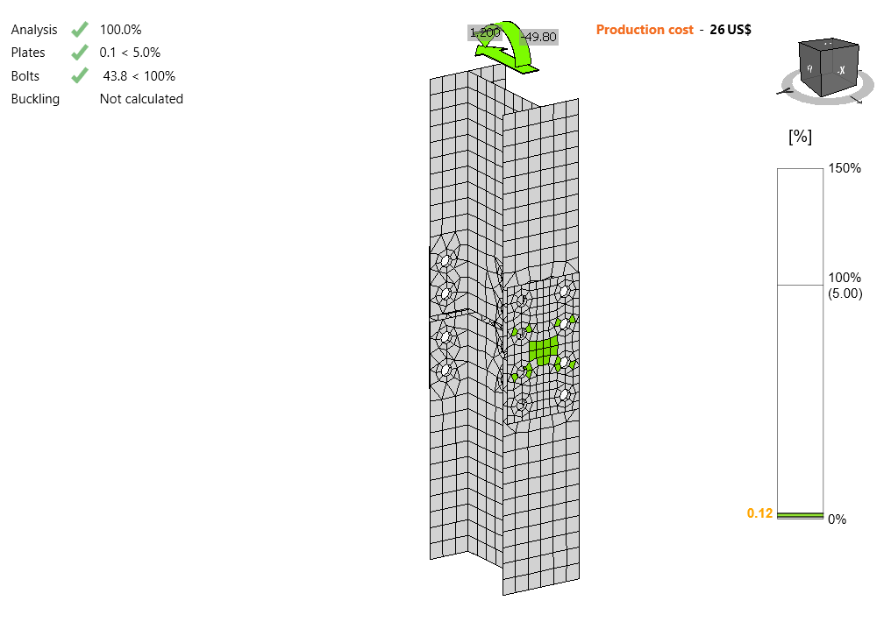
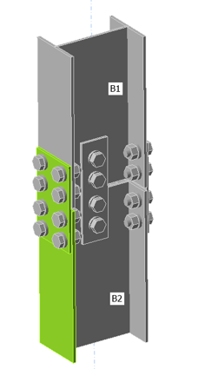
Proposed Setup
Using A36 3/16” flange plate (minimum available)

Slide 5
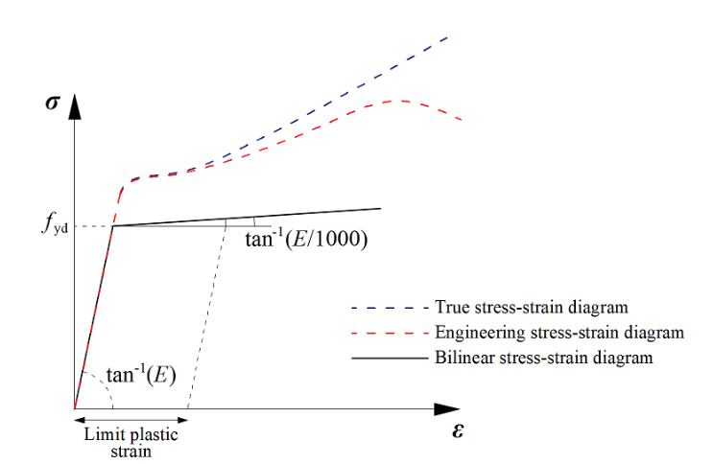
Proposed Setup

Slide 6
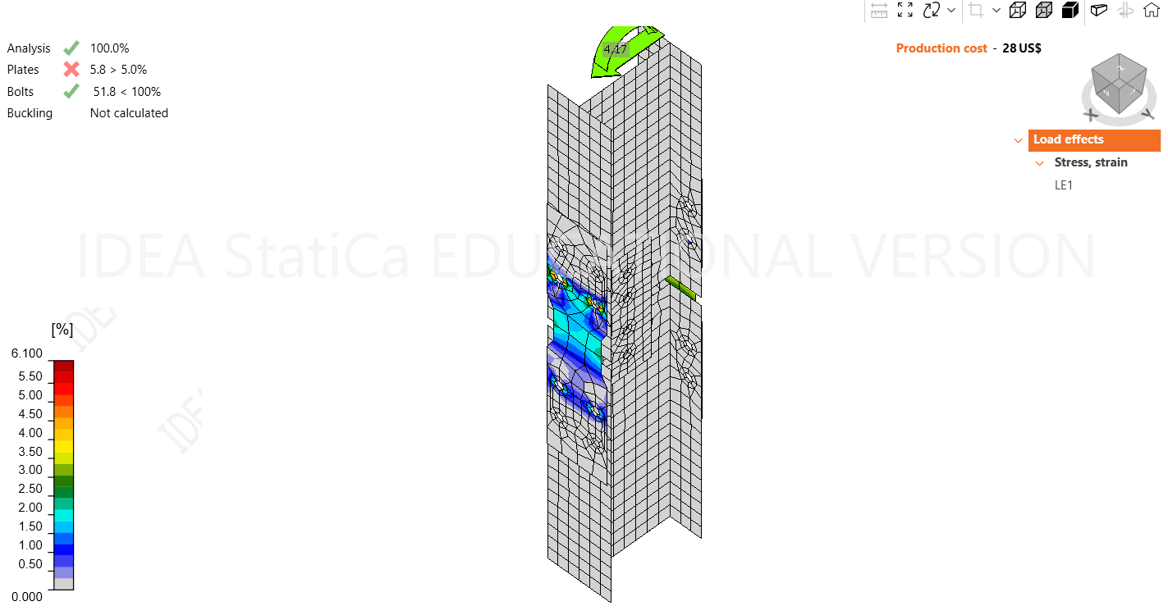
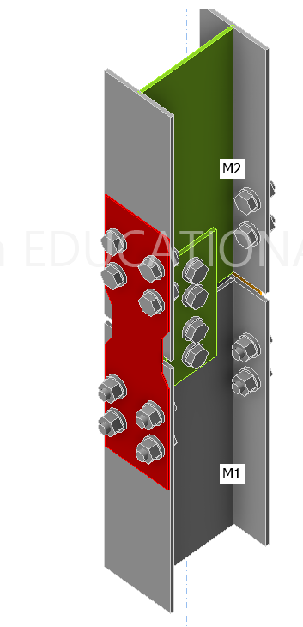
Proposed Setup
Using Reduced Plate

Slide 7
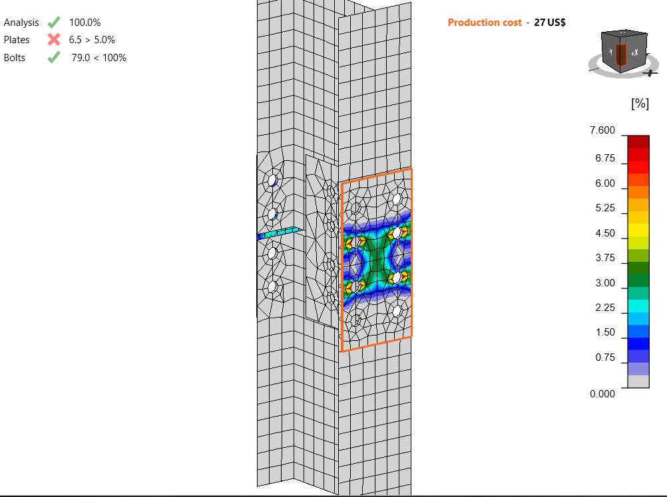
Proposed Setup
Using Galvanized Steel Plates 1/16” in (link)

Slide 8
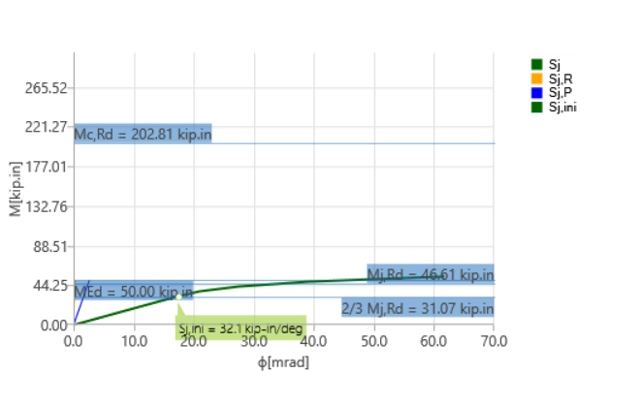
Proposed Setup
Classified as a pinned connection not fixed
Notes:
1-Double curvature will not hold. 2- even without double curvature assumption thee reference model will be different.
Maybe consider partially rigid connection

Slide 9
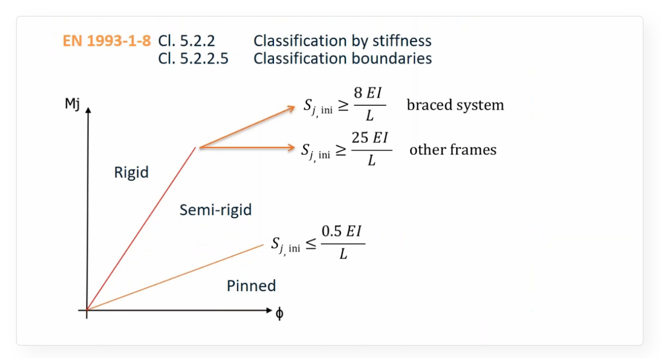
Proposed Setup

Slide 10
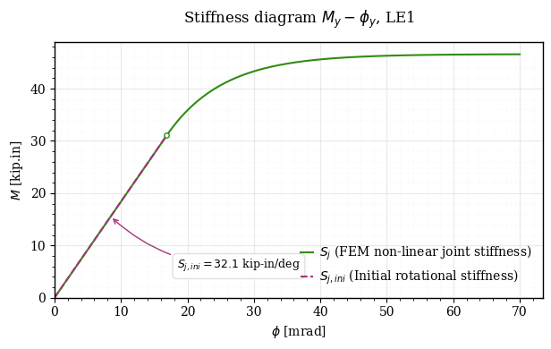
Proposed Setup

Slide 11
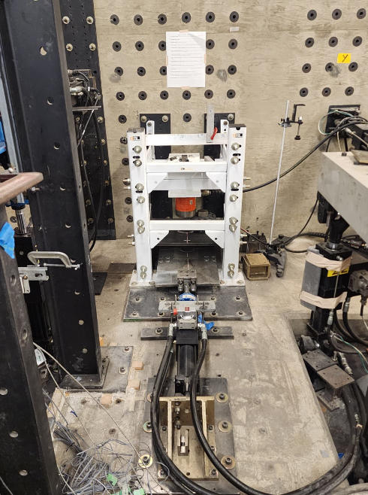
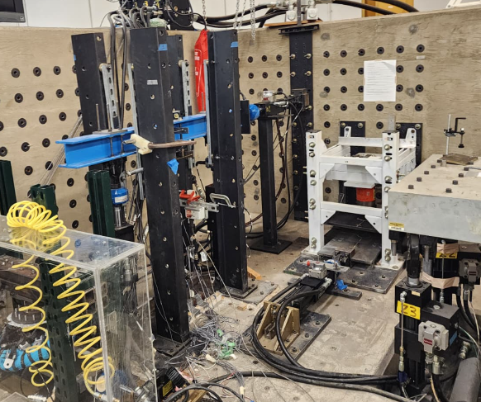
Proposed Setup

Slide 12
Proposed Setup
Next Steps?
Check how indicator evolves with the predicted stiffness
Design a base plate
Fit a bouc-wen model to the predicted stiffness
Update the numerical model
Update the physical model using the bouc-wen
Run simulations

Slide 13
AN ONLINE STABILITY INDICATOR FOR REAL-TIME HYBRID SIMULATION
Mohamed Gomaa
04/06/2026

Slide 14
Proposed Setup
Next Steps?
Check how indicator evolves with the predicted stiffness
Design a base plate
Fit a bouc-wen model to the predicted stiffness
Update the numerical model
Update the physical model using the bouc-wen
Run simulations

Slide 15
Proposed Setup
Classified as a pinned connection not fixed
Notes:
1-Double curvature will not hold. 2- even without double curvature assumption thee reference model will be different.
Maybe consider partially rigid connection

Slide 16
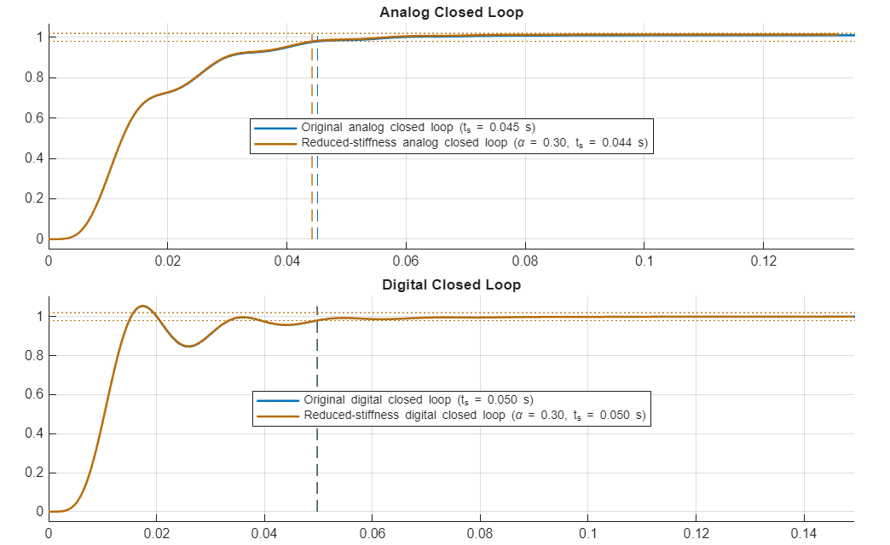
Proposed Setup
Notes:
Not going o be stable: 1- we need high initial stiffness 2- we need mass
Watch for the settling time hre

Slide 17
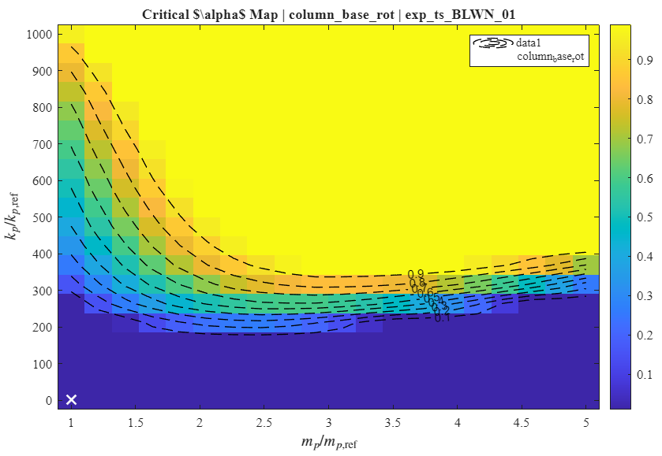
Proposed Setup
Notes:
Sensitivity analysis showing we will need a lot
Thee red dot example in the next slide

Slide 18
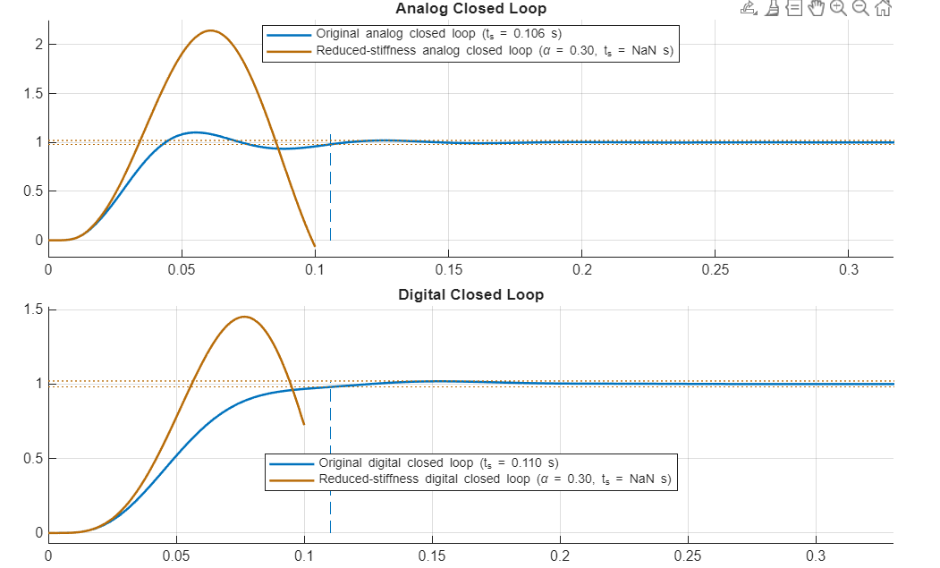
Proposed Setup
Based on the red dot in the previous plot

Slide 19
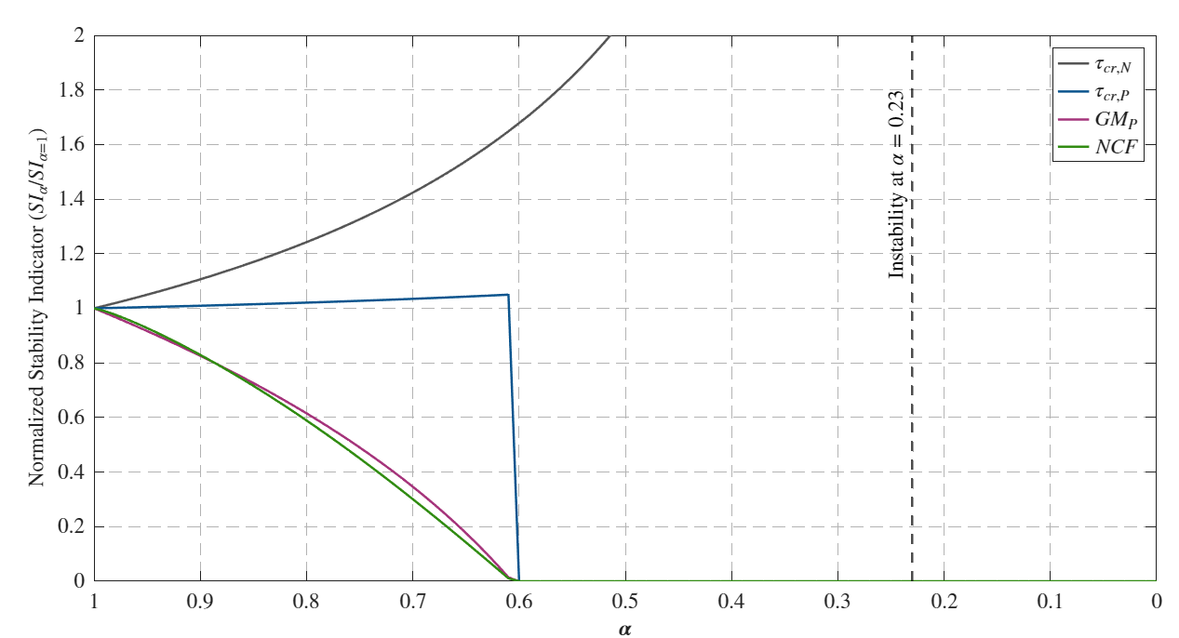
Proposed Setup
Notes:
The don’t look the same at every point but this is an example
Good but this is too much so I thought about trying different tuning criteria

Slide 20
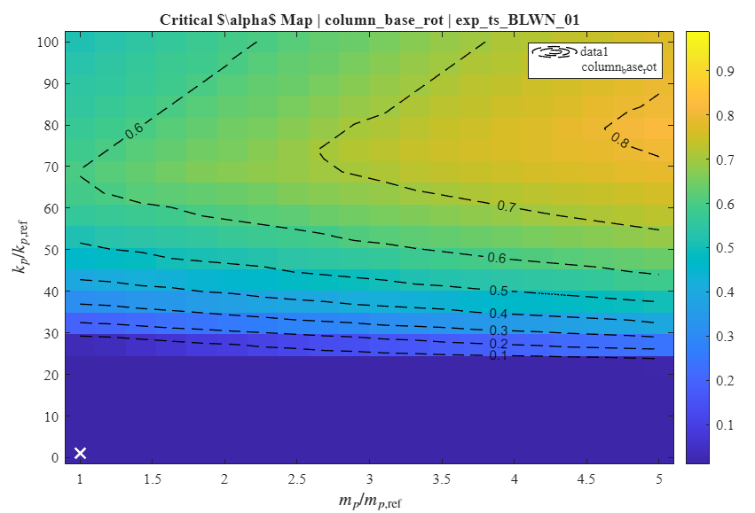
Proposed Setup
Better, but surprisingly, this is based on much slower controllers

Slide 21
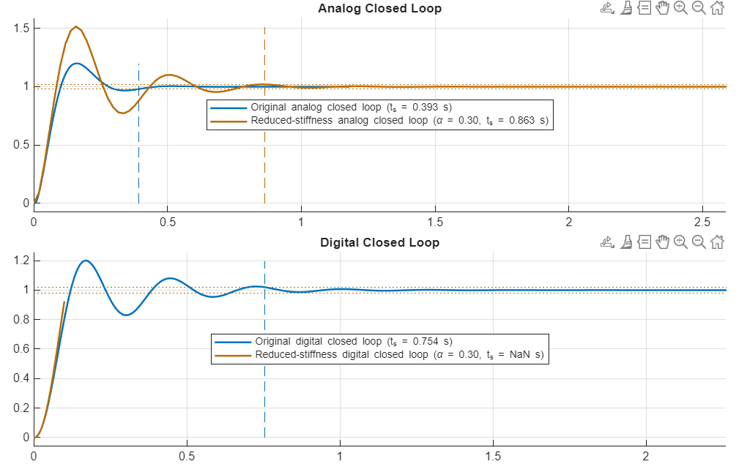
Proposed Setup

Slide 22
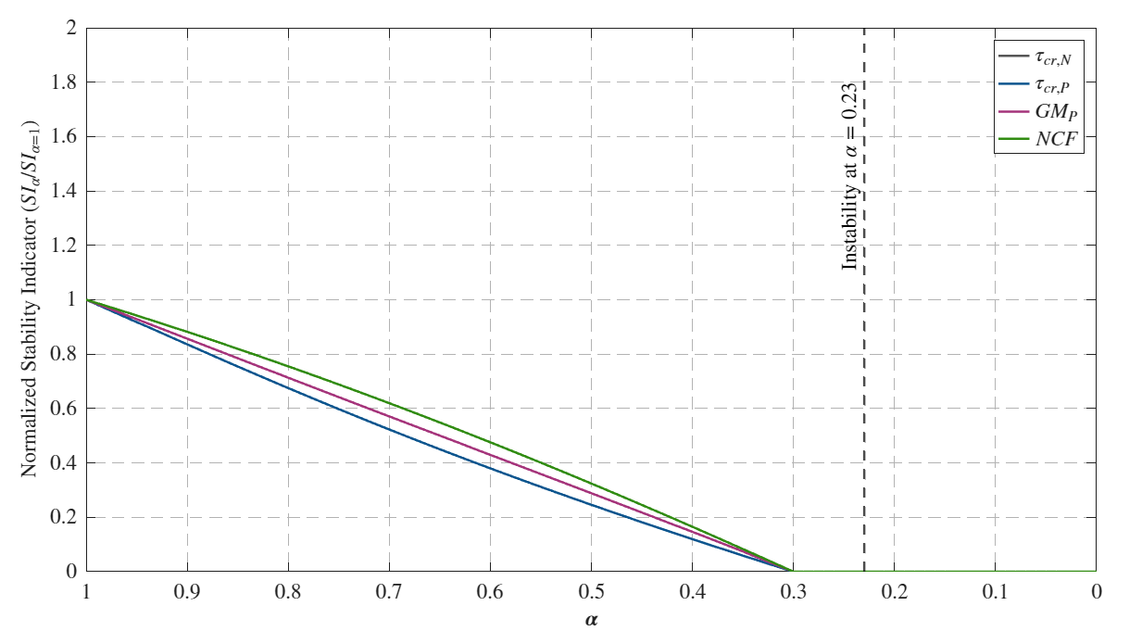
Proposed Setup
We need 70% reduction, or actually less !

Slide 23
Proposed Setup
This now has two problems needs to be addressed:
30 times the stiffness is doable but not breakable (Actuator Capacity)
Is it reasonable to test RTHS with slow controllers?

Slide 24
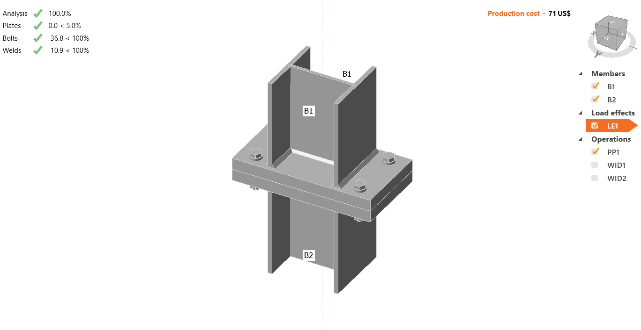
Proposed Setup
This connection type is much stiffer, even if designed with the same strength
But too strong for the actuator

Slide 25
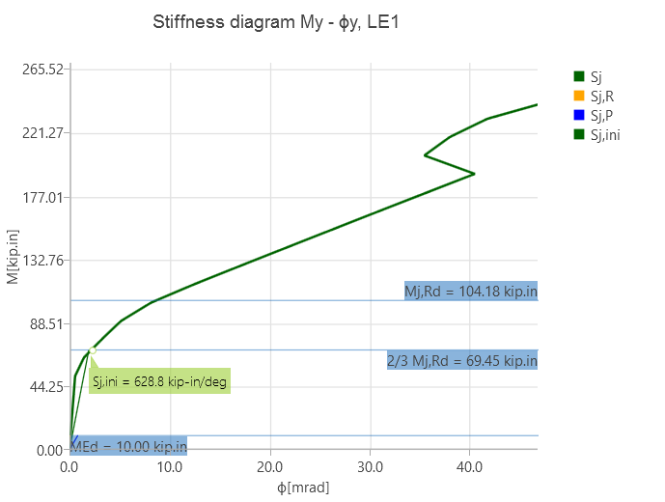
Proposed Setup
Initial stiffness is 47 times greater
At 2 times the capacity of the actuator the stiffness reduces by 75% to 414 kip-in/deg

Slide 26
AN ONLINE STABILITY INDICATOR FOR RTHS
EXPERIMENTAL DESIGN
Mohamed Gomaa
04/20/2026

Slide 27
Connection Design
Design Criteria:
The indicator should indicate susceptibility to instability during the experiment. (This requires high initial stiffness)
The Inner and the outer controller designs should be reasonable at the beginning of the experiment
Stiffness should degrade significantly at a load below than the actuator design capacity
The maximum displacement within the linear rang should be sufficient for system identification

Slide 28
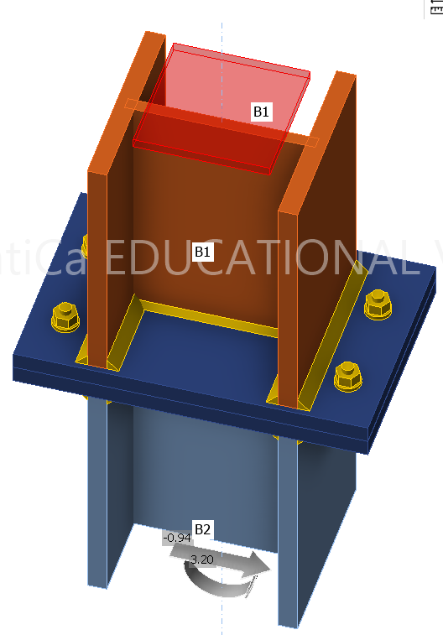
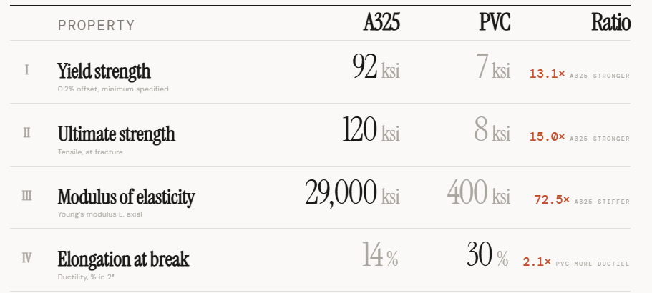
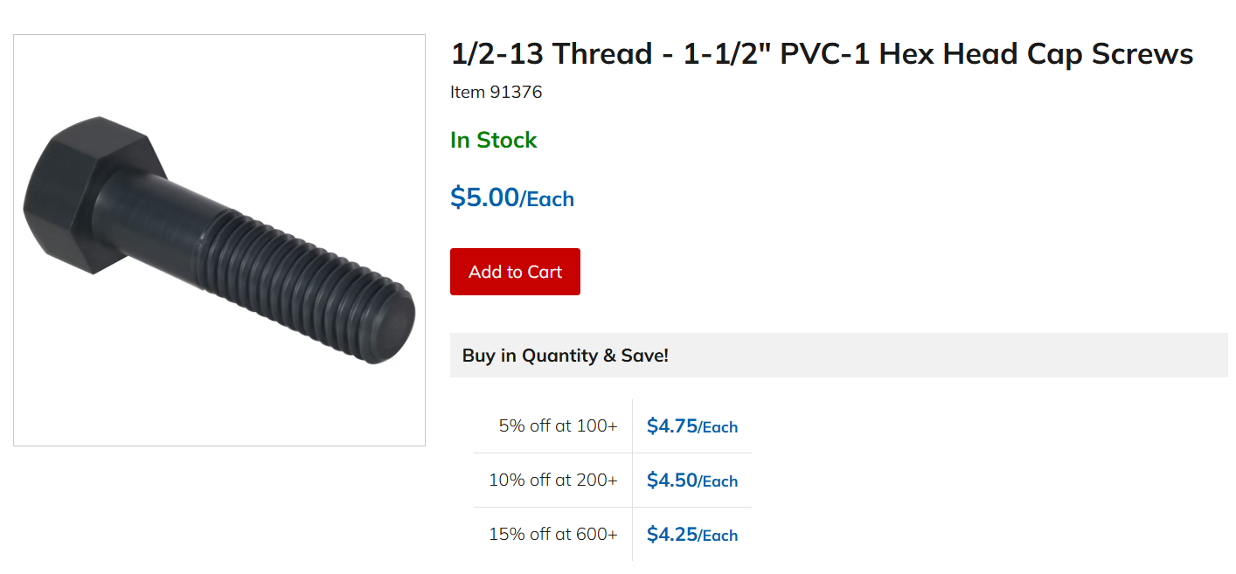
Connection Design

Slide 29
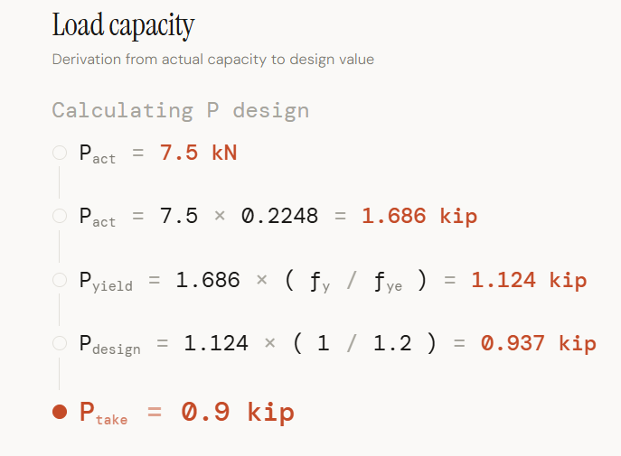
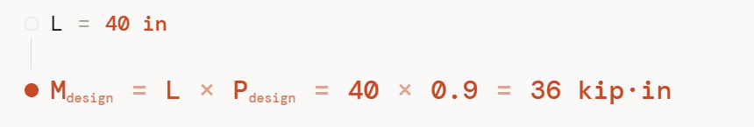
Connection Design

Slide 30
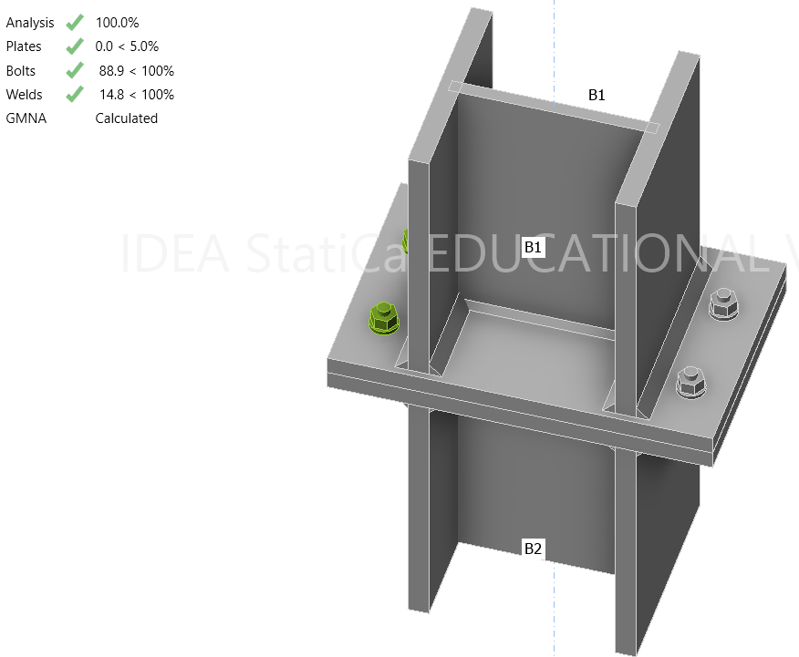
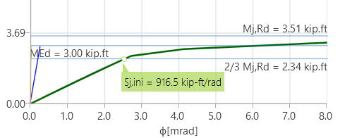
Connection Design
Criterion 3 is met

Slide 31
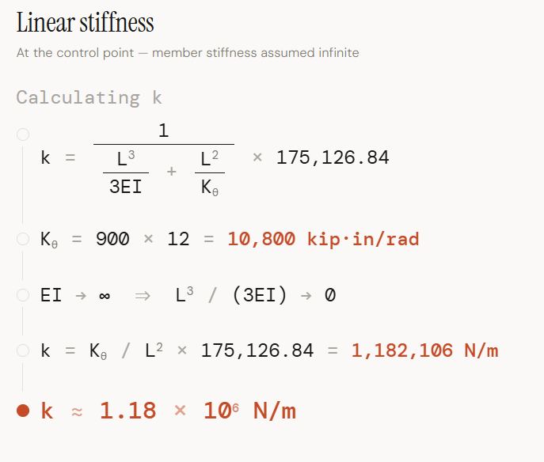
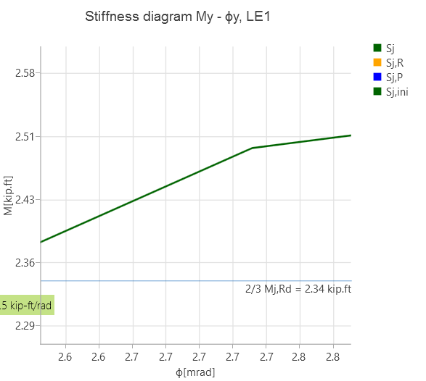
Connection Design
Used in the stability analysis

Slide 32
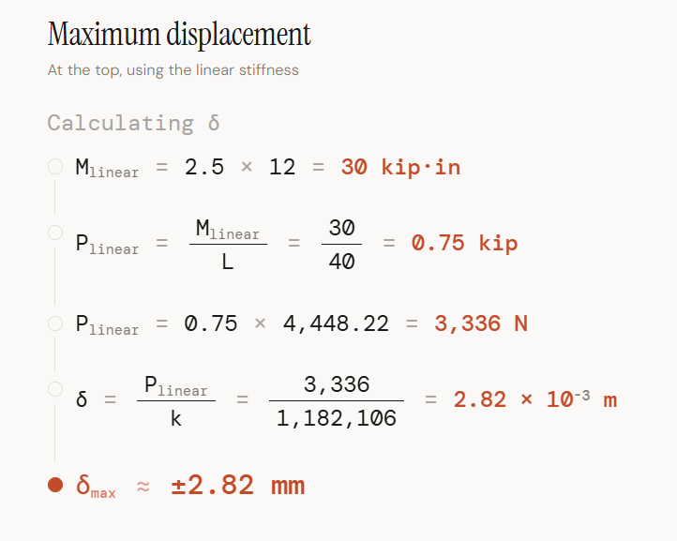
Connection Design
Criterion 4 is met

Slide 33
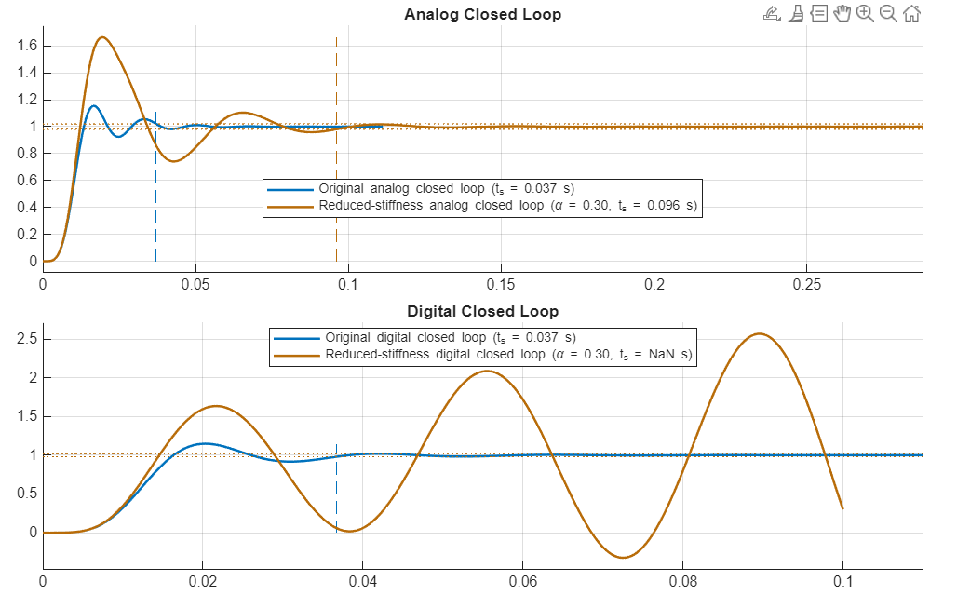
Connection Design
Criterion 2 is met

Slide 34
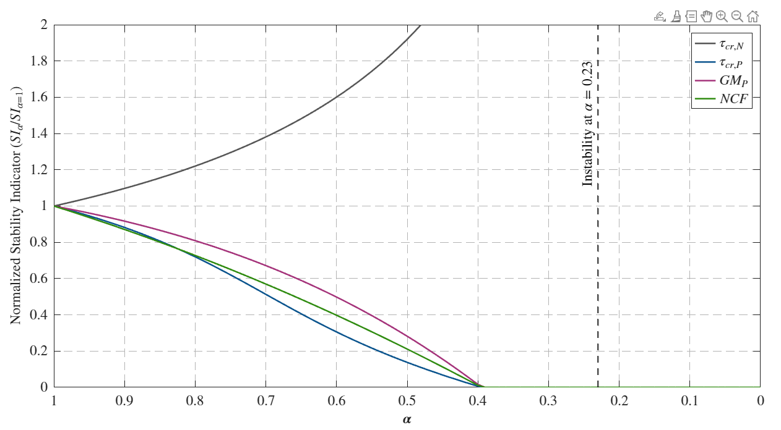
Connection Design
Criterion 1 is met

Slide 35
Connection Design
Sources of uncertainties:
Modeling uncertainties in estimating the connection rotational stiffness (High)
Estimated Actuator parameters (High)
Infinitely Fixed Base (High)
PVC Bolts specifications (Moderate)
Welding size and quality (Moderate)
Plates and members sizing (Low)

Slide 36
Connection Design
Next Steps?
Design a base plate
Fit a Bouc-Wen model to the estimated stiffness behavior
Update the numerical model
Update the physical model using the Bouc-Wen
Design online stiffness estimator
Run simulations
Collect accurate measurements
Order parts

Slide 37
AN ONLINE STABILITY INDICATOR FOR REAL-TIME HYBRID SIMULATION
Mohamed Gomaa
05/18/2026

Slide 38
Connection Design
Next Steps?
Design a base plate
Fit a Bouc-Wen model to the estimated stiffness behavior
Update the numerical model
Update the physical model using the Bouc-Wen
Design online stiffness estimator
Run simulations
Collect accurate measurements
Order parts

Slide 39
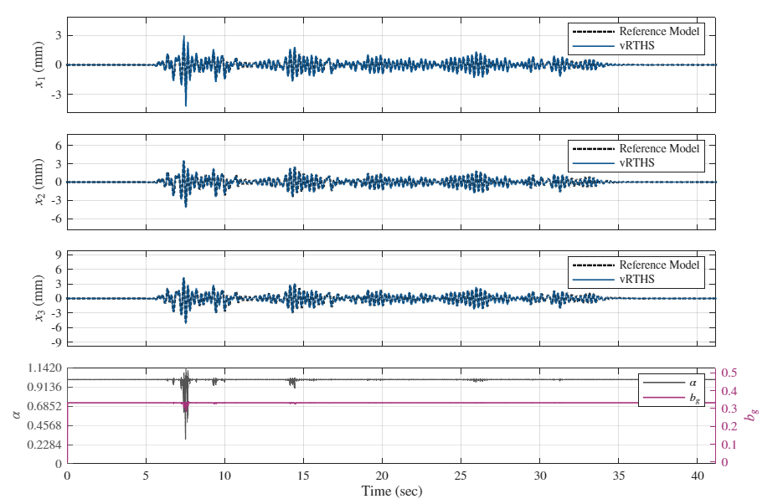
Simulink Update

Slide 40
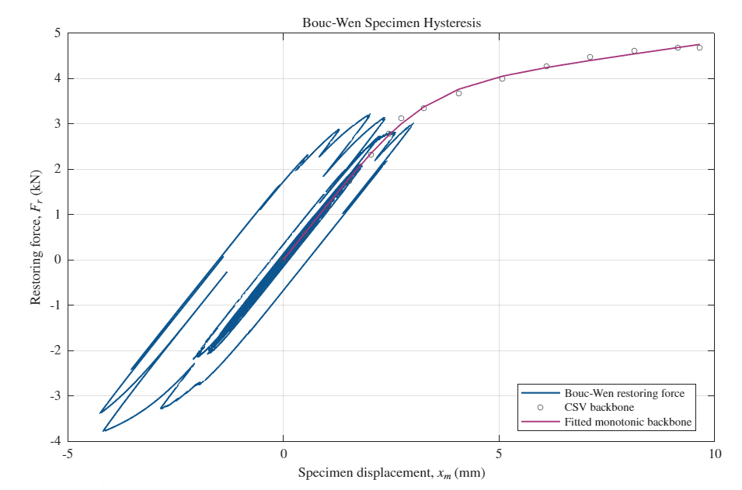
Simulink Update

Slide 41
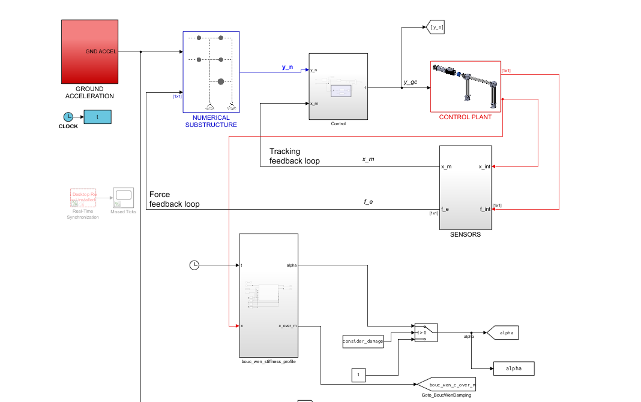
Simulink Update

Slide 42
AN ONLINE STABILITY INDICATOR FOR REAL-TIME HYBRID SIMULATION
Mohamed Gomaa
05/25/2026

Slide 43
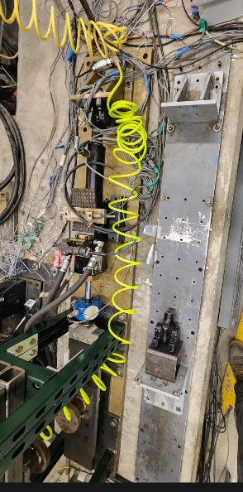
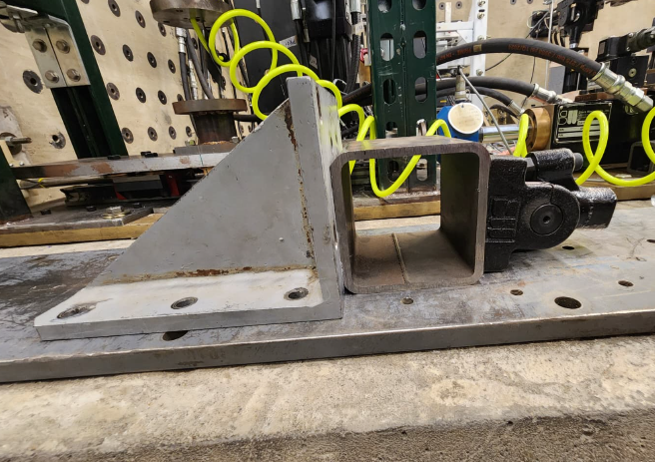
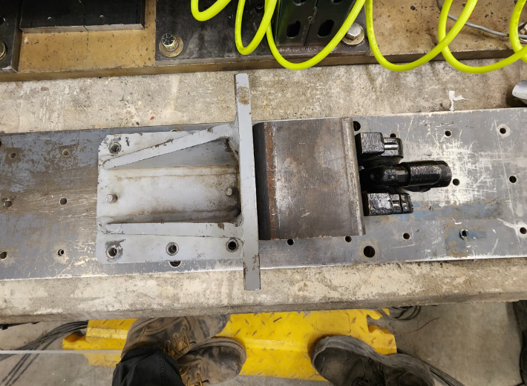
Simulink Update

Slide 44
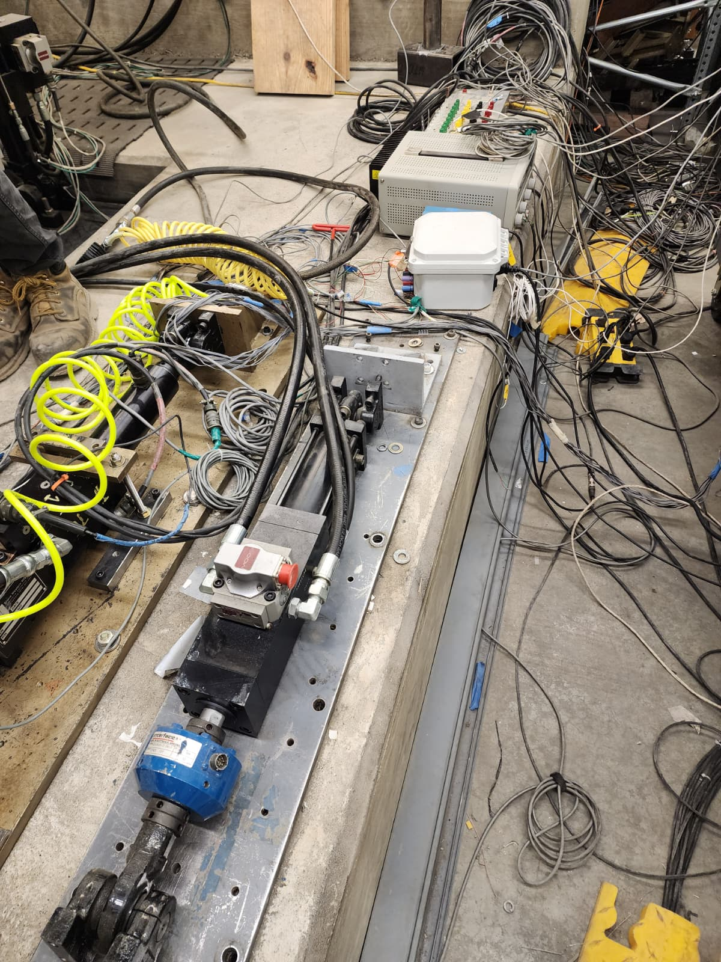
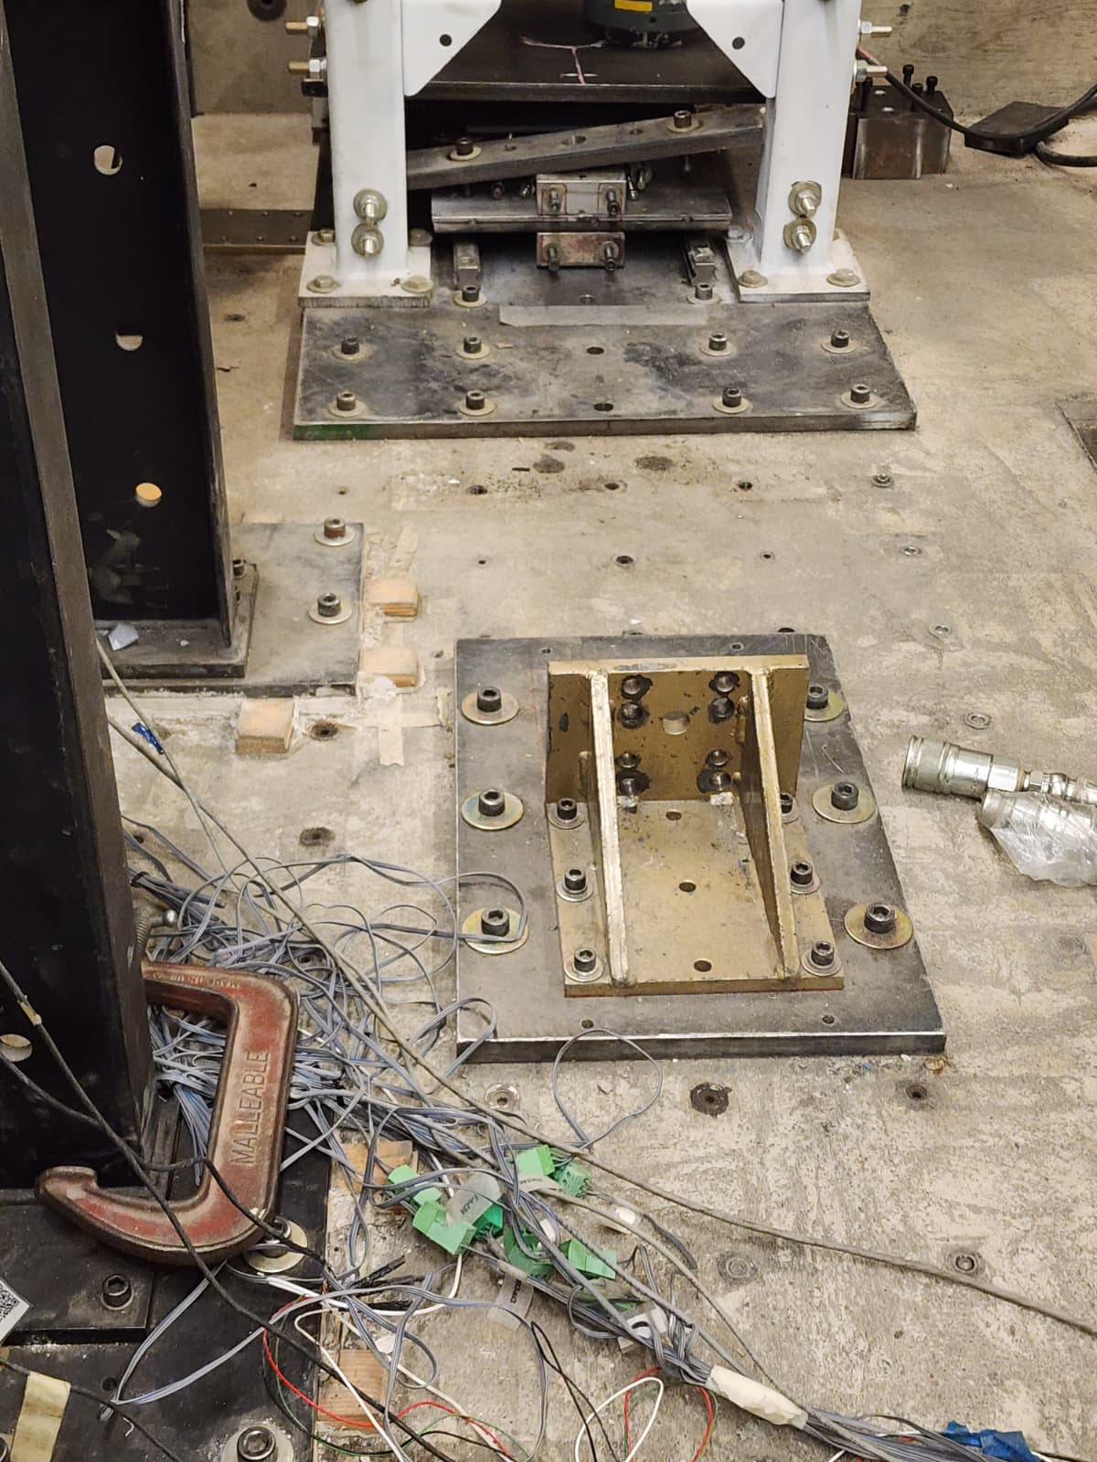
Setup 1 : Bolts Testing

Slide 45
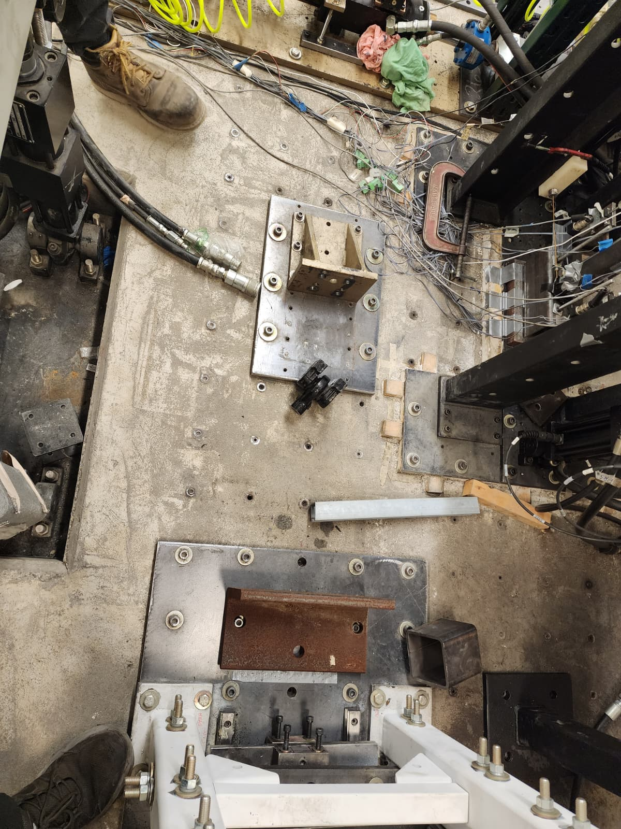
Setup 1 : Bolts Testing

Slide 46
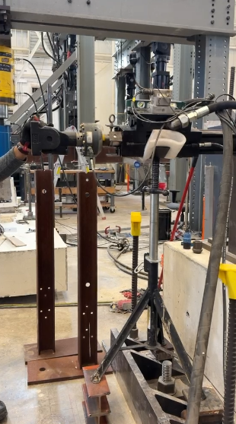
Setup 2 : Gaurave’s Setup
Current Status
Actuator Connected (Not fixed yet)
DAQ will not be available (we will rely on Speedgoat readings)
5 Specimens are available (Not the same)
Timeline: Until the mid of July

Slide 47
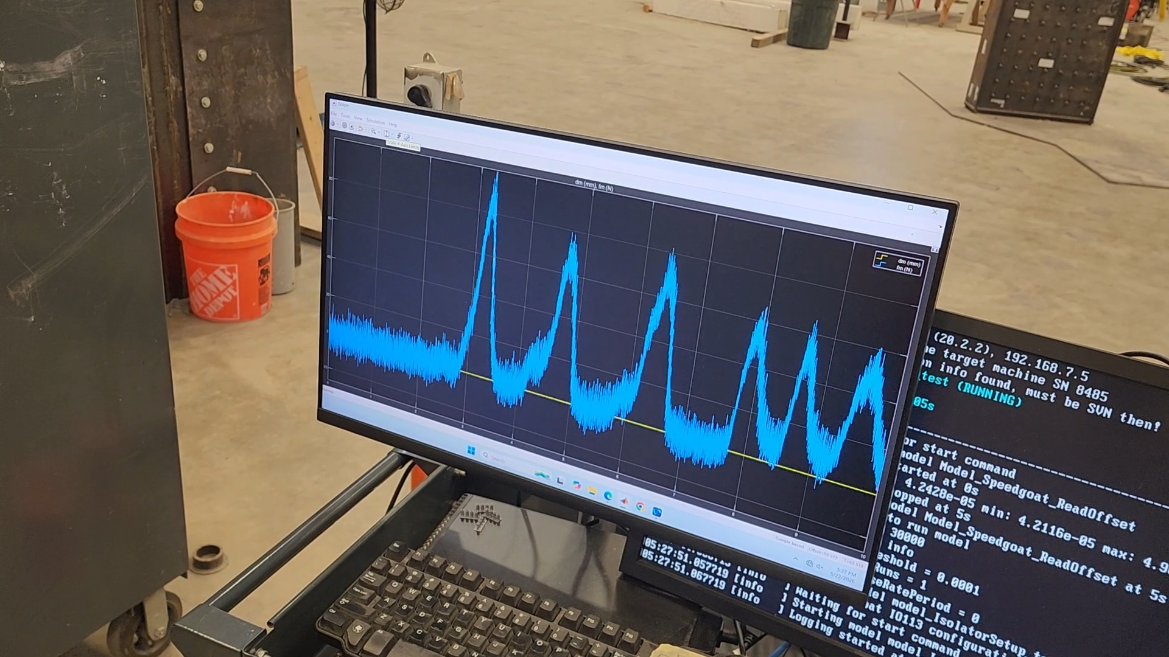
Setup 2 : Gaurave’s Setup
Completed
Simulink file for the identification is ready
Readings are configured with the setup (force is tested and working)
Calibration is still needed

Slide 48
Setup 2 : Gaurave’s Setup
Next Steps
Configure external commands
Calibrate all Speedgoat signals
Disconnected specimen
  Tuning
  Identification
Connected specimen
  Tuning
  Identification
  Designing outer controller
Analytical Analysis
  Designing num substructure
  Stability Analysis
  Online stiffness estimator
Concerns
Coordinating with Kevin
I would like to install an accelerometer, but it seems that there is no signal conditioner available

Slide 49
AN ONLINE STABILITY INDICATOR FOR REAL-TIME HYBRID SIMULATION
Mohamed Gomaa
06/04/2026

Slide 50
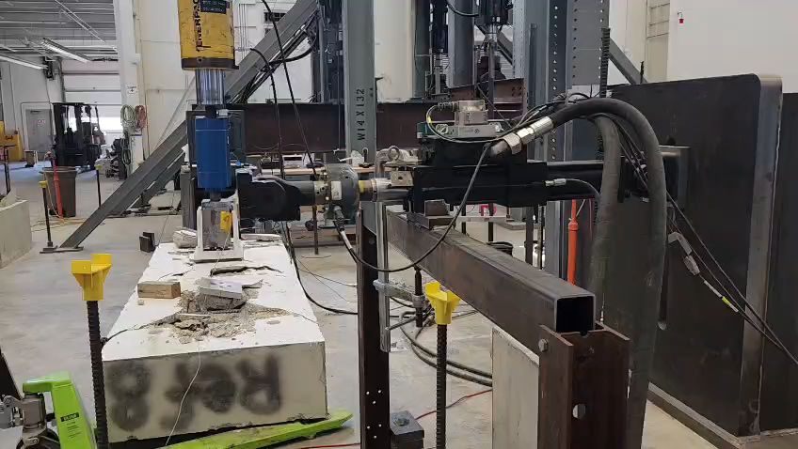
System Identification

Slide 51
System Identification
BLWN
- Amplitude is selected to achieve SNR (Signal to Noise Ratio) above 10 which was around 2 to 3mm
- Frequency was increased gradually
20 Hz was achieved (while RTHS is expected to be at around 5 to 10Hz)

Slide 52
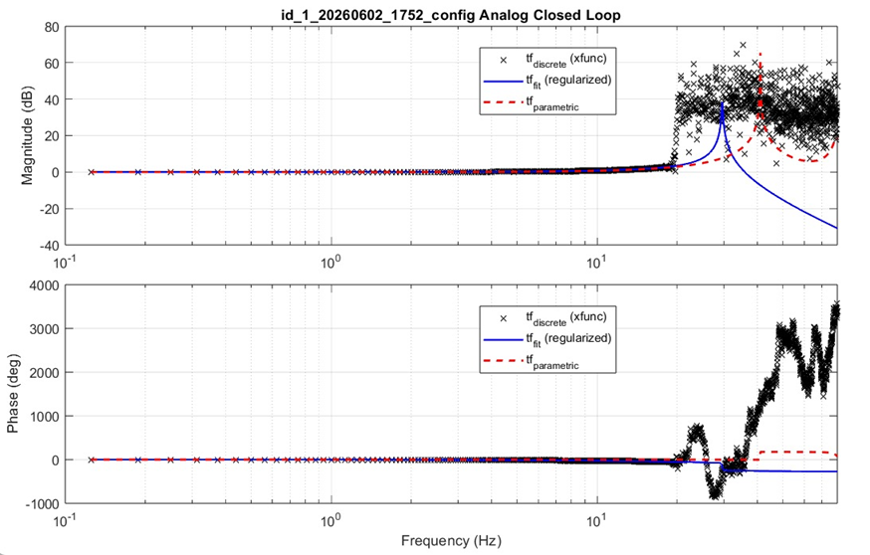
System Identification

Slide 53
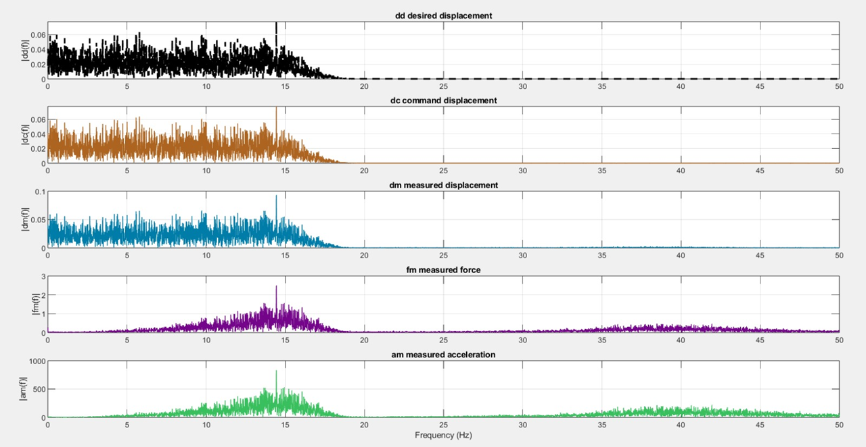
System Identification

Slide 54


System Identification

Slide 55



System Identification
50% OS

Slide 56

System Identification

Slide 57


System Identification

Slide 58

Acceleration

Slide 59
AN ONLINE STABILITY INDICATOR FOR REAL-TIME HYBRID SIMULATION
Mohamed Gomaa
06/18/2026

Slide 60

Steel Column Setup
Outline
Simulink Features
Test Procedure
Tuning
  Inner Controller
  Outer Controller
Parametric Model Issue
Online Stiffness Estimation
Initial Stability Analysis Methodology
Next Steps

Slide 61

Simulink

Slide 62

Simulink
Added Features:
Ability to zero measurements after running the program

Slide 63

Simulink
Added Features:
2. Changing between different signals smoothly

Slide 64

Simulink
Added Features:
3. Pause / Resume the test

Slide 65

Simulink
Added Features:
4. Turn the outer controller on/off or reset

Slide 66

Simulink
Added Features:
5. Finishing the test and return to the initial position smoothly

Slide 67

Test Procedure

Slide 68

Tuning
Tuning the inner controller was done gradually by increasing P then finding I
The Parametric Model is different
Good inner control gains are not necessarily safe for the outer controller
Tuning the outer controller is tricky and was time consuming
Too low or too high inner controller gain can drive the system to instability
I gain is essential to eliminate steady stat error
Very low D gain (0.001) improved stability
Couldn’t get the outer controller to be as fast as the inner one

Slide 69


Tuning

Slide 70

Identification

Slide 71


Online stiffness estimation
TSE with LSE fallback

Slide 72

Online stiffness estimation
TSE with LSE fallback

Slide 73

Online stiffness estimation
TSE with LSE fallback

Slide 74

Initial Online Stability Analysis Approach
Varying inner P gain online (BLWN 80 Hz)

Slide 75

Initial Online Stability Analysis Approach
Varying inner P gain online (BLWN 5 Hz)

Slide 76
Thank You

