Slide 1
Management Yesterday and Today
Chapter 2

Slide 2
L E A R N I N G O U T L I N E Follow this Learning Outline as you read and study this chapter.
Historical Background of Management
Explain why studying management history is important.
Describe some early evidences of management practice.
Scientific Management
Describe the important contributions made by Fredrick W. Taylor and Frank and Lillian Gilbreth.
Explain how today’s managers use scientific management.

Slide 3
L E A R N I N G O U T L I N E (cont’d) Follow this Learning Outline as you read and study this chapter.
General Administrative Theory
Discuss Fayol’s contributions to management theory.
Describe Max Weber’s contribution to management theory.
Explain how today’s managers use general administrative theory.
Quantitative Approach
Explain what the quantitative approach has contributed to the field of management.
Discuss how today’s managers use the quantitative approach.

Slide 4
L E A R N I N G O U T L I N E (cont’d) Follow this Learning Outline as you read and study this chapter.
Toward Understanding Organizational Behavior
Describe the contributions of the early advocates of OB.
Explain the contributions of the Hawthorne Studies to the field of management.
Discuss how today’s managers use the behavioral approach.
The Systems Approach
Describe an organization using the systems approach.
Discuss how the systems approach helps us management.

Slide 5
L E A R N I N G O U T L I N E (cont’d) Follow this Learning Outline as you read and study this chapter.
The Contingency Approach
Explain how the contingency approach differs from the early theories of management.
Discuss how the contingency approach helps us understand management.
Current Issues and Trends
Explain why we need to look at the current trends and issues facing managers.
Describe the current trends and issues facing managers.

Slide 6
Historical Background of Management
Ancient Management
Egypt (pyramids) and China (Great Wall)
Venetians (floating warship assembly lines)
Adam Smith
Published “The Wealth of Nations” in 1776
Advocated the division of labor (job specialization) to increase the productivity of workers
Industrial Revolution
Substituted machine power for human labor
Created large organizations in need of management

Slide 7
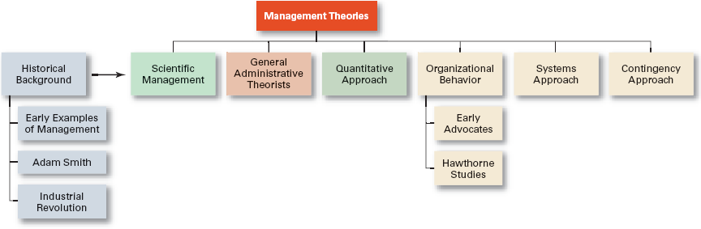
Exhibit 2–1 Development of Major Management Theories

Slide 8
Major Approaches to Management
Scientific Management
General Administrative Theory
Quantitative Management
Organizational Behavior
Systems Approach
Contingency Approach

Slide 9
Scientific Management
Fredrick Winslow Taylor
The “father” of scientific management
Published Principles of Scientific Management (1911)
The theory of scientific management
Using scientific methods to define the “one best way” for a job to be done:
Putting the right person on the job with the correct tools and equipment.
Having a standardized method of doing the job.
Providing an economic incentive to the worker.

Slide 10
Exhibit 2–2 Taylor’s Four Principles of Management
Develop a science for each element of an individual’s work, which will replace the old rule-of-thumb method.
Scientifically select and then train, teach, and develop the worker.
Heartily cooperate with the workers so as to ensure that all work is done in accordance with the principles of the science that has been developed.
Divide work and responsibility almost equally between management and workers. Management takes over all work for which it is better fitted than the workers.

Slide 11
Scientific Management (cont’d)
Frank and Lillian Gilbreth
Focused on increasing worker productivity through the reduction of wasted motion
Developed the microchronometer to time worker motions and optimize work performance
How Do Today’s Managers Use Scientific Management?
Use time and motion studies to increase productivity
Hire the best qualified employees
Design incentive systems based on output

Slide 12
General Administrative Theory
Henri Fayol
Believed that the practice of management was distinct from other organizational functions
Developed fourteen principles of management that applied to all organizational situations
Max Weber
Developed a theory of authority based on an ideal type of organization (bureaucracy)
Emphasized rationality, predictability, impersonality, technical competence, and authoritarianism

Slide 13
Exhibit 2–3 Fayol’s 14 Principles of Management
Division of work.
Authority.
Discipline.
Unity of command.
Unity of direction.
Subordination of individual interests to the general interest.
Remuneration.
Centralization.
Scalar chain.
Order.
Equity.
Stability of tenure of personnel.
Initiative.
Esprit de corps.

Slide 14
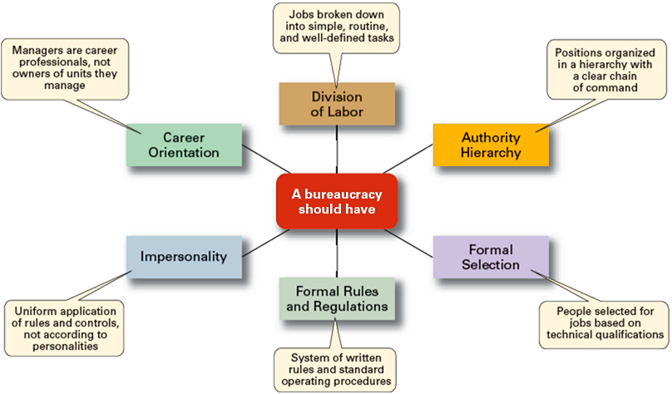
Exhibit 2–4 Weber’s Ideal Bureaucracy

Slide 15
Quantitative Approach to Management
Quantitative Approach
Also called operations research or management science
Evolved from mathematical and statistical methods developed to solve WWII military logistics and quality control problems
Focuses on improving managerial decision making by applying:
Statistics, optimization models, information models, and computer simulations

Slide 16
Understanding Organizational Behavior
Organizational Behavior (OB)
The study of the actions of people at work; people are the most important asset of an organization
Early OB Advocates
Robert Owen
Hugo Munsterberg
Mary Parker Follett
Chester Barnard

Slide 17
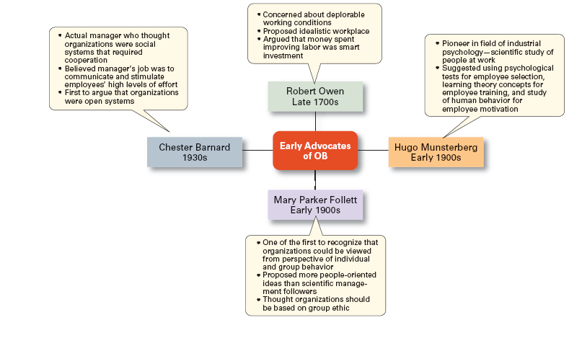
Exhibit 2–5 Early Advocates of OB

Slide 18
The Hawthorne Studies
A series of productivity experiments conducted at Western Electric from 1927 to 1932.
Experimental findings
Productivity unexpectedly increased under imposed adverse working conditions.
The effect of incentive plans was less than expected.
Research conclusion
Social norms, group standards and attitudes more strongly influence individual output and work behavior than do monetary incentives.

Slide 19
The Systems Approach
System Defined
A set of interrelated and interdependent parts arranged in a manner that produces a unified whole.
Basic Types of Systems
Closed systems
Are not influenced by and do not interact with their environment (all system input and output is internal).
Open systems
Dynamically interact to their environments by taking in inputs and transforming them into outputs that are distributed into their environments.

Slide 20
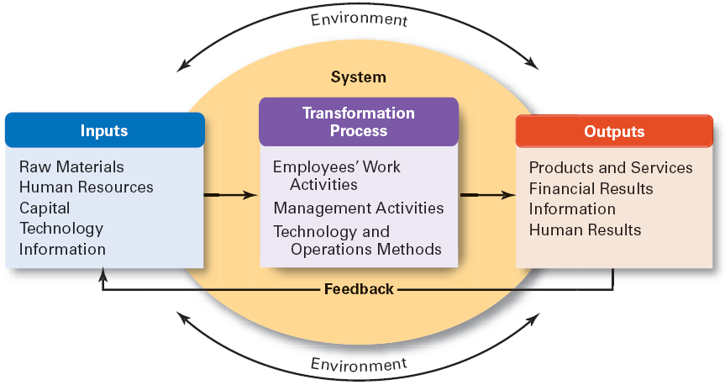
Exhibit 2–6 The Organization as an Open System

Slide 21
Implications of the Systems Approach
Coordination of the organization’s parts is essential for proper functioning of the entire organization.
Decisions and actions taken in one area of the organization will have an effect in other areas of the organization.
Organizations are not self-contained and, therefore, must adapt to changes in their external environment.

Slide 22
The Contingency Approach
Contingency Approach Defined
Also sometimes called the situational approach.
There is no one universally applicable set of management principles (rules) by which to manage organizations.
Organizations are individually different, face different situations (contingency variables), and require different ways of managing.

Slide 23
Exhibit 2–7 Popular Contingency Variables
Organization size
As size increases, so do the problems of coordination.
Routineness of task technology
Routine technologies require organizational structures, leadership styles, and control systems that differ from those required by customized or nonroutine technologies.
Environmental uncertainty
What works best in a stable and predictable environment may be totally inappropriate in a rapidly changing and unpredictable environment.
Individual differences
Individuals differ in terms of their desire for growth, autonomy, tolerance of ambiguity, and expectations.

Slide 24
Current Trends and Issues
Globalization
Ethics
Workforce Diversity
Entrepreneurship
E-business
Knowledge Management
Learning Organizations
Quality Management

Slide 25
Current Trends and Issues (cont’d)
Globalization
Management in international organizations
Political and cultural challenges of operating in a global market
Working with people from different cultures
Coping with anticapitalist backlash
Movement of jobs to countries with low-cost labor
Ethics
Increased emphasis on ethics education in college curriculums
Increased creation and use of codes of ethics by businesses

Slide 26
Exhibit 2–8 A Process for Addressing Ethical Dilemmas
Step 1: What is the ethical dilemma?
Step 2: Who are the affected stakeholders?
Step 3: What personal, organizational, and external factors are important to my decision?
Step 4: What are possible alternatives?
Step 5: Make a decision and act on it.

Slide 27
Current Trends and Issues (cont’d)
Workforce Diversity
Increasing heterogeneity in the workforce
More gender, minority, ethnic, and other forms of diversity in employees
Aging workforce
Older employees who work longer and do not retire
The increased costs of public and private benefits for older workers
An increasing demand for products and services related to aging.

Slide 28
Current Trends and Issues (cont’d)
Entrepreneurship Defined
The process of starting new businesses, generally in response to opportunities.
Entrepreneurship process
Pursuit of opportunities
Innovation in products, services, or business methods
Desire for continual growth of the organization

Slide 29
Current Trends and Issues (cont’d)
E-Business (Electronic Business)
The work preformed by an organization using electronic linkages to its key constituencies
E-commerce: the sales and marketing aspect of an e-business
Categories of E-Businesses
E-business enhanced organization
E-business enabled organization
Total e-business organization

Slide 30
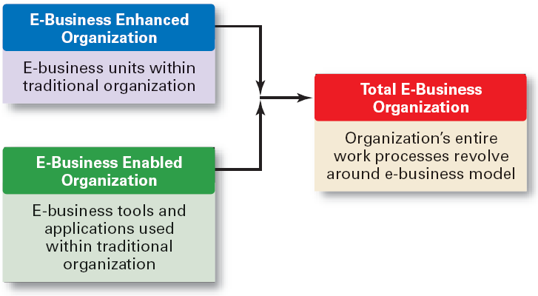
Exhibit 2–9 Categories of E-Business Involvement

Slide 31
Current Trends and Issues (cont’d)
Learning Organization
An organization that has developed the capacity to continuously learn, adapt, and change.
Knowledge Management
The cultivation of a learning culture where organizational members systematically gather and share knowledge with others in order to achieve better performance.

Slide 32
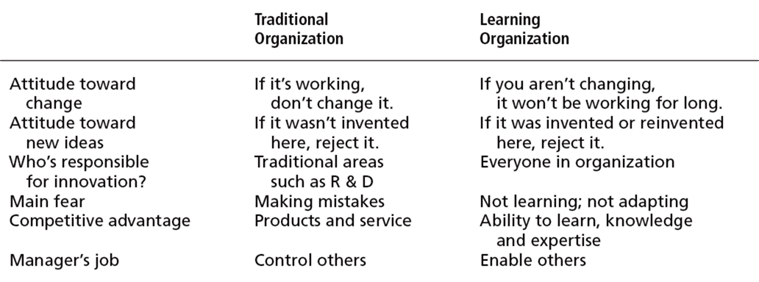
Exhibit 2–10 Learning Organization versus Traditional Organization

Slide 33
Current Trends and Issues (cont’d)
Quality Management
A philosophy of management driven by continual improvement in the quality of work processes and responding to customer needs and expectations
Inspired by the total quality management (TQM) ideas of Deming and Juran
Quality is not directly related to cost
Poor quality results in lower productivity

Slide 34
Exhibit 2–11 What is Quality Management?
Intense focus on the customer.
Concern for continual improvement
Process-focused.
Improvement in the quality of everything.
Accurate measurement.
Empowerment of employees.

Slide 35
Terms to Know
division of labor (or job specialization)
Industrial Revolution
scientific management
therbligs
general administrative theory
principles of management
bureaucracy
quantitative approach
organizational behavior (OB)
Hawthorne Studies
system
closed systems
open systems
contingency approach
workforce diversity
entrepreneurship
e-business (electronic business)
e-commerce (electronic commerce)
intranet
learning organization
knowledge management
quality management

