Slide 1
Organizational Culture and Environment: The Constraints
Chapter 3

Slide 2
L E A R N I N G O U T L I N E Follow this Learning Outline as you read and study this chapter.
The Manager: Omnipotent or Symbolic
Contrast the action of manager according to the omnipotent and symbolic views.
Explain the parameters of managerial discretion.
The Organization’s Culture
Describe the seven dimensions of organizational culture.
Discuss the impact of a strong culture on organizations and managers.
Explain the source of an organization’s culture.
Describe how culture is transmitted to employees.
Describe how culture affects managers.

Slide 3
L E A R N I N G O U T L I N E (cont’d) Follow this Learning Outline as you read and study this chapter.
Current Organizational Cultural Issues Facing Managers
Describe the characteristics of an ethical culture, an innovative culture, and a customer-responsive culture.
Discuss why workplace spirituality seems to be an important concern.
Describe the characteristics of a spiritual organization.

Slide 4
L E A R N I N G O U T L I N E (cont’d) Follow this Learning Outline as you read and study this chapter.
The Environment (cont’d)
Describe the components of the specific and general environments.
Discuss the two dimensions of environmental uncertainty.
Identify the most common organizational stakeholders.
Explain the four steps in managing external stakeholder relationships.

Slide 5
The Manager: Omnipotent or Symbolic?
Omnipotent View of Management
Managers are directly responsible for an organization’s success or failure.
The quality of the organization is determined by the quality of its managers.
Managers are held accountable for an organization’s performance yet it is difficult to attribute good or poor performance directly to their influence on the organization.

Slide 6
The Manager: Omnipotent or Symbolic?
Symbolic View of Management
Much of an organization’s success or failure is due to external forces outside of managers’ control.
The ability of managers to affect outcomes is influenced and constrained by external factors.
The economy, customers, governmental policies, competitors, industry conditions, technology, and the actions of previous managers
Managers symbolize control and influence through their action.

Slide 7
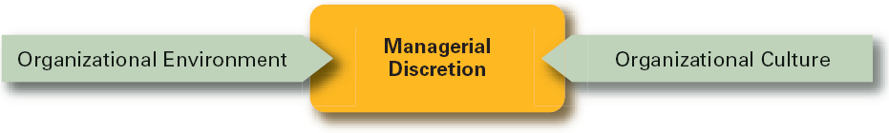
Exhibit 3–1 Parameters of Managerial Discretion

Slide 8
The Organization’s Culture
Organizational Culture
A system of shared meanings and common beliefs held by organizational members that determines, in a large degree, how they act towards each other.
“The way we do things around here.”
Values, symbols, ritual and practices
Implications:
Culture is a perception.
Culture is shared.
Culture is descriptive.

Slide 9
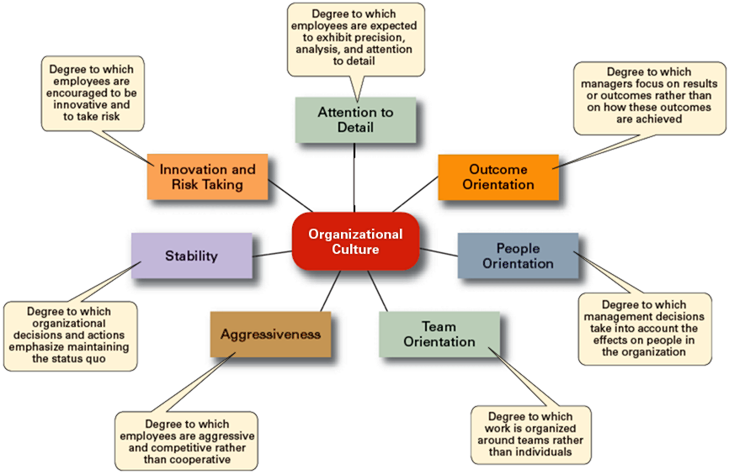
Exhibit 3–2 Dimensions of Organizational Culture

Slide 10
Exhibit 3–3 Contrasting Organizational Cultures
Dimension | Organization A | Organization B
Attention to Detail | High | Low
Outcome Orientation | Low | High
People Orientation | Low | High
Team Orientation | Low | High
Aggressiveness | Low | High
Stability | High | Low
Innovation and Risk Taking | Low | High

Slide 11
Strong versus Weak Cultures
Strong Cultures
Are cultures in which key values are deeply held and widely held.
Have a strong influence on organizational members.
Factors Influencing the Strength of Culture
Size of the organization
Age of the organization
Rate of employee turnover
Strength of the original culture
Clarity of cultural values and beliefs

Slide 12
Benefits of a Strong Culture
Creates a stronger employee commitment to the organization.
Aids in the recruitment and socialization of new employees.
Fosters higher organizational performance by instilling and promoting employee initiative.

Slide 13
Organizational Culture
Sources of Organizational Culture
The organization’s founder
Vision and mission
Past practices of the organization
The way things have been done
The behavior of top management
Continuation of the Organizational Culture
Recruitment of like-minded employees who “fit”
Socialization of new employees to help them adapt to the culture

Slide 14
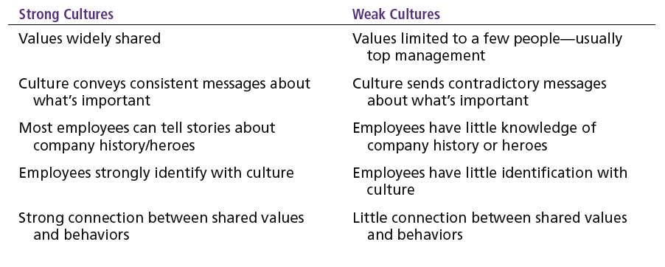
Exhibit 3–4 Strong versus Weak Organizational Cultures

Slide 15
How Employees Learn Culture
Stories
Narratives of significant events or actions of people that convey the spirit of the organization
Rituals
Repetitive sequences of activities that express and reinforce the values of the organization
Material Symbols
Physical assets distinguishing the organization
Language
Acronyms and jargon of terms, phrases, and word meanings specific to an organization

Slide 16
How Culture Affects Managers
Cultural Constraints on Managers
Whatever managerial actions the organization recognizes as proper or improper on its behalf
Whatever organizational activities the organization values and encourages
The overall strength or weakness of the organizational culture
Simple rule for getting ahead in an organization:
Find out what the organization rewards and do those things.

Slide 17
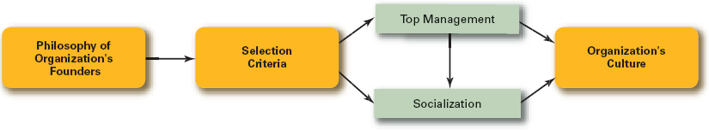
Exhibit 3–5 How an Organization’s Culture Is Established and Maintained

Slide 18
Exhibit 3–6 Managerial Decisions Affected by Culture
Planning
The degree of risk that plans should contain
Whether plans should be developed by individuals or teams
The degree of environmental scanning in which management will engage
Organizing
How much autonomy should be designed into employees’ jobs
Whether tasks should be done by individuals or in teams
The degree to which department managers interact with each other

Slide 19
Exhibit 3–6 Managerial Decisions Affected by Culture (cont’d)
Leading
The degree to which managers are concerned with increasing employee job satisfaction
What leadership styles are appropriate
Whether all disagreements—even constructive ones—should be eliminated
Controlling
Whether to impose external controls or to allow employees to control their own actions
What criteria should be emphasized in employee performance evaluations
What repercussions will occur from exceeding one’s budget

Slide 20
Organization Culture Issues
Creating an Ethical Culture
High in risk tolerance
Low to moderate aggressiveness
Focus on means as well as outcomes
Creating an Innovative Culture
Challenge and involvement
Freedom
Trust and openness
Idea time
Playfulness/humor
Conflict resolution
Debates
Risk-taking

Slide 21
Exhibit 3–7 Suggestions for Managers: Creating a More Ethical Culture
Be a visible role model.
Communicate ethical expectations.
Provide ethics training.
Visibly reward ethical acts and punish unethical ones.
Provide protective mechanisms so employees can discuss ethical dilemmas and report unethical behavior without fear.

Slide 22
Organization Culture Issues (cont’d)
Creating a Customer-Responsive Culture
Hiring the right type of employees (ones with a strong interest in serving customers)
Having few rigid rules, procedures, and regulations
Using widespread empowerment of employees
Having good listening skills in relating to customers’ messages
Providing role clarity to employees to reduce ambiguity and conflict and increase job satisfaction
Having conscientious, caring employees willing to take initiative

Slide 23
Exhibit 3–8 Suggestions for Managers: Creating a More Customer-Responsive Culture
Hire service-contact people with the personality and attitudes consistent with customer service—friendliness, enthusiasm, attentiveness, patience, concern about others, and listening skills.
Train customer service people continuously by focusing on improving product knowledge, active listening, showing patience, and displaying emotions.
Socialize new service-contact people to the organization’s goals and values.
Design customer-service jobs so that employees have as much control as necessary to satisfy customers.
Empower service-contact employees with the discretion to make day-to-day decisions on job-related activities.
As the leader, convey a customer-focused vision and demonstrate through decisions and actions the commitment to customers.

Slide 24
Spirituality and Organizational Culture
Workplace Spirituality
The recognition that people have an inner life that nourishes and is nourished by meaningful work that takes place in the context of community.
Characteristics of a Spiritual Organization
Strong sense of purpose
Focus on individual development
Trust and openness
Employee empowerment
Toleration of employees’ expression

Slide 25
Benefits of Spirituality
Improved employee productivity
Reduction of employee turnover
Stronger organizational performance
Increased creativity
Increased employee satisfaction
Increased team performance
Increased organizational performance

Slide 26
Defining the External Environment
External Environment
Those factors and forces outside the organization that affect the organization’s performance.
Components of the External Environment
Specific environment: external forces that have a direct and immediate impact on the organization.
General environment: broad economic, socio-cultural, political/legal, demographic, technological, and global conditions that may affect the organization.

Slide 27
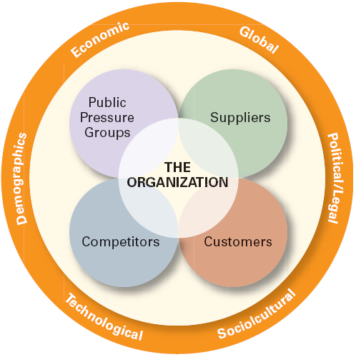
Exhibit 3–9 The External Environment

Slide 28
Exhibit 3–10 Selected U.S. Legislation Affecting Business
Occupational Safety and Health Act of 1970
Consumer Product Safety Act of 1972
Equal Employment Opportunity Act of 1972
Worker Adjustment and Retraining Notification Act of 1988
Americans with Disabilities Act of 1990
Civil Rights Act of 1991
Family and Medical Leave Act of 1993
Child Safety Protection Act of 1994
U.S. Economic Espionage Act of 1996
Electronic Signatures in Global and National Commerce Act of 2000
Sarbanes-Oxley Act of 2002
Fair and Accurate Credit Transactions Act of 2003

Slide 29
How the Environment Affects Managers
Environmental Uncertainty
The extent to which managers have knowledge of and are able to predict change their organization’s external environment is affected by:
Complexity of the environment: the number of components in an organization’s external environment.
Degree of change in environmental components: how dynamic or stable the external environment is.

Slide 30
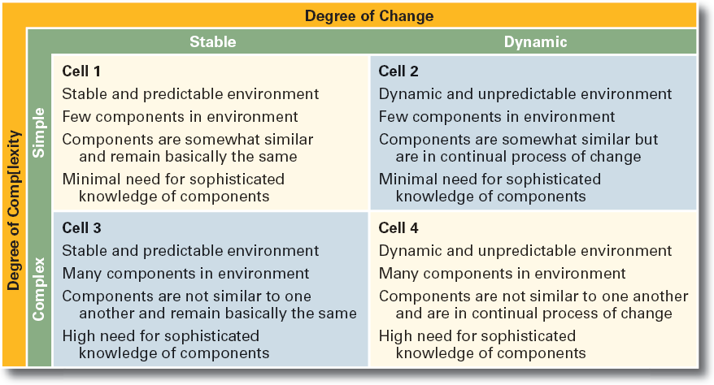
Exhibit 3–11 Environmental Uncertainty Matrix

Slide 31
Stakeholder Relationships
Stakeholders
Any constituencies in the organization’s environment that are affected by the organization’s decisions and actions
Why Manage Stakeholder Relationships?
It can lead to improved organizational performance.
It’s the “right” thing to do given the interdependence of the organization and its external stakeholders.

Slide 32
Managing Stakeholder Relationships
Identify the organization’s external stakeholders.
Determine the particular interests and concerns of the external stakeholders.
Decide how critical each external stakeholder is to the organization.
Determine how to manage each individual external stakeholder relationship.

Slide 33
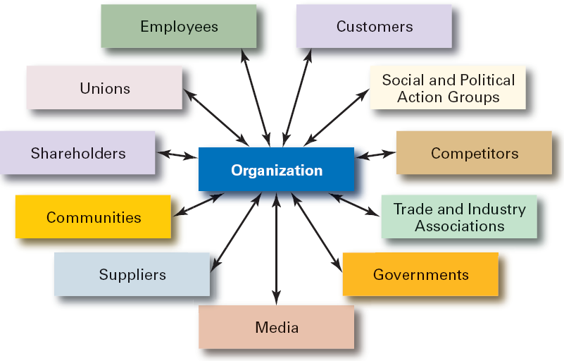
Exhibit 3–12 Organizational Stakeholders

Slide 34
Terms to Know
omnipotent view of management
symbolic view of management
organizational culture
strong cultures
socialization
workplace spirituality
external environment
specific environment
general environment
environmental uncertainty
environmental complexity
stakeholders

