Slide 1
Managing in a Global Environment
Chapter 4

Slide 2
L E A R N I N G O U T L I N E Follow this Learning Outline as you read and study this chapter.
What’s Your Global Perspective?
Define parochialism.
Contrast ethnocentric, polycentric, and geocentric attitudes towards global business.
Explain why it’s important for managers to be sensitive to global differences
Understanding the Global Environment
Describe the current status of the European Union.
Discuss the North American Free Trade Agreement and other regional trade alliances in Latin America.
Tell about the Association of Southeast Asian Nations.

Slide 3
L E A R N I N G O U T L I N E (cont’d) Follow this Learning Outline as you read and study this chapter.
Understanding the Global Environment
Explain the interdependence that globalization involves.
Discuss the role of the WTO.
Doing Business Globally
Contrast multinational, multidomestic, global, transnational, and born global organizations.
Describe the different ways organizations can go international.
Define global sourcing, exporting, importing, licensing, and franchising.
Describe global strategic alliances, joint ventures, and foreign subsidiaries.

Slide 4
L E A R N I N G O U T L I N E (cont’d) Follow this Learning Outline as you read and study this chapter.
Managing in a Global Environment (cont’d)
Explain how the global legal-political and economic environments affect managers.
Discuss Hofstede’s five dimensions for assessing cultures.
Explain the nine GLOBE dimensions for assessing cultures.
Discuss the challenges of doing business globally in today’s world.

Slide 5
The Global Marketplace
Opportunities and Challenges
Coping with the sudden appearance of new competitors
Acknowledging cultural, political, and economic differences
Dealing with increased uncertainty, fear, and anxiety
Adapting to changes in the global environment
Avoiding parochialism

Slide 6
What’s Your Global Perspective?
Parochialism
Is viewing the world solely through its own eyes and perspectives.
Is not recognizing that others have different ways of living and working.
Is a significant obstacle for managers working in a global business world.
Is falling into the trap of ignoring others’ values and customs and rigidly applying an attitude of “ours is better than theirs” to foreign cultures.

Slide 7
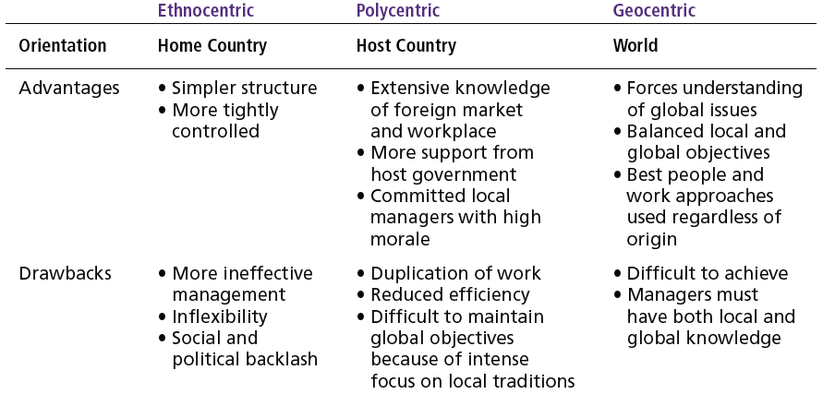
Exhibit 4–1 Key Information About Three Global Attitudes

Slide 8
Adopting a Global Perspective
Ethnocentric Attitude
The parochialistic belief that the best work approaches and practices are those of the home country.
Polycentric Attitude
The view that the managers in the host country know the best work approaches and practices for running their business.
Geocentric Attitude
A world-oriented view that focuses on using the best approaches and people from around the globe.

Slide 9
Regional Trading Agreements
The European Union (EU)
A unified economic and trade entity
Belgium, Denmark, France, Greece, Ireland, Italy, Luxembourg, the Netherlands, Portugal, Spain, the United Kingdom, Germany, Austria, Finland, and Sweden
Economic and monetary union (Euro)
North American Free Trade Agreement (NAFTA)
Eliminated barriers to free trade (tariffs, import licensing requirements, and customs user fees)
United States, Canada, and Mexico

Slide 10
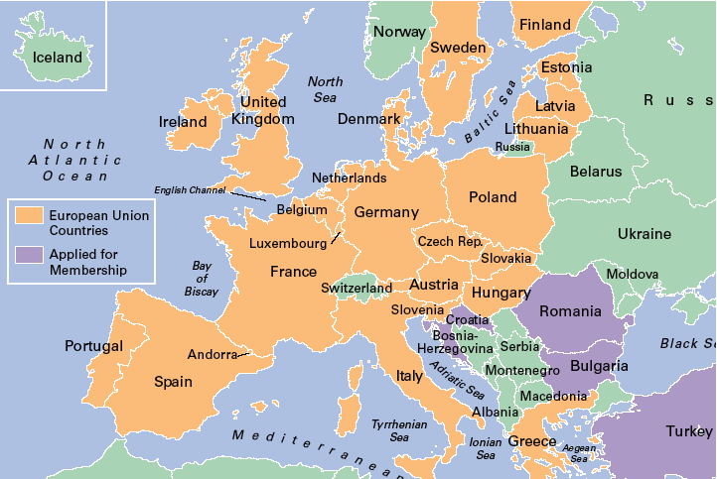
Exhibit 4–3 European Union Countries

Slide 11
Regional Trading Agreements (cont’d)
U.S.-Central America Free Trade Agreement (CAFTA)
Free Trade Area of the Americas
Southern Cone Common Market (Mercosur)
Association of Southeast Asian Nations (ASEAN)
Trading alliance of 10 Southeast Asian nations
African Union
South Asian Association for Regional Cooperation (SARRC)

Slide 12
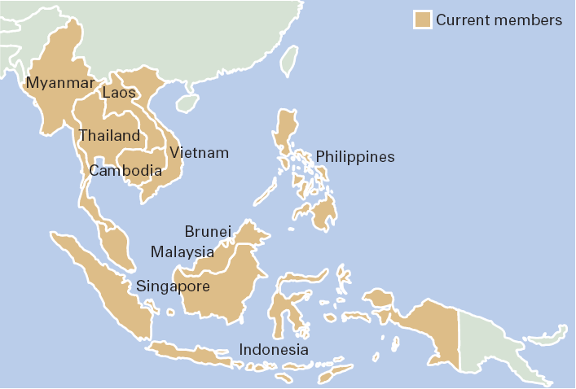
Exhibit 4–4 ASEAN Members
Source: Based on J. McClenahen and T. Clark, “ASEAN at Work,” IW. May 19, 1997, p. 42.

Slide 13
The World Trade Organization (WTO)
Evolved from the General Agreement on Tariffs and Trade (GATT) in 1995.
Functions as the only global organization dealing with the rules of trade among nations.
Has 149 member nations and 32 observer governments.
Monitors and promotes world trade.

Slide 14
Different Types of International Organizations
Multinational Corporation (MNC)
Maintains operations in multiple countries.
Multidomestic Corporation
Is an MNC that decentralizes management and other decisions to the local country.
Global Company
Is an MNC that centralizes its management and other decisions in the home country.

Slide 15
Different Types of International Organizations (cont’d)
Transnational Corporation (Borderless Organization)
Is an MNC that has eliminated structural divisions that impose artificial geographic barriers and is organized along business lines that reflect a geocentric attitude.
Born Globals/International New Ventures (INVs)
Commit resources upfront (material, people, financing) to doing business in more than one country.

Slide 16
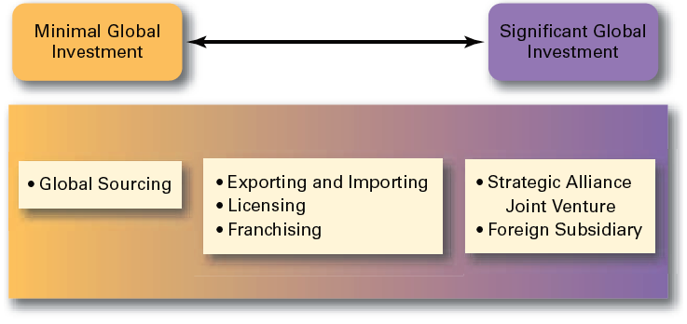
Exhibit 4–5 How Organizations Go Global

Slide 17
Other Forms of Globalization
Strategic Alliances
Partnerships between and organization and a foreign company in which both share resources and knowledge in developing new products or building new production facilities.
Joint Venture
A specific type of strategic alliance in which the partners agree to form a separate, independent organization for some business purpose.
Foreign Subsidiary
Directly investing in a foreign country by setting up a separate and independent production facility or office.

Slide 18
Managing in A Global Environment
The Legal Environment
Stability or instability of legal and political systems
Legal procedures are established and followed
Fair and honest elections held on a regular basis
Differences in the laws of various nations
Effects on business activities
Effects on delivery of products and services

Slide 19
The Economic Environment
Economic Systems
Market economy
An economy in which resources are primarily owned and controlled by the private sector.
Command economy
An economy in which all economic decisions are planned by a central government.
Monetary and Financial Factors
Currency exchange rates
Inflation rates
Diverse tax policies

Slide 20
The Cultural Environment
National Culture
Is the values and attitudes shared by individuals from a specific country that shape their behavior and their beliefs about what is important.
May have more influence on an organization than the organization culture.

Slide 21
Exhibit 4–6 What Are Americans Like
Americans are very informal.
Americans are direct.
Americans are competitive.
Americans are achievers.
Americans are independent and individualistic.
Americans are questioners.
Americans dislike silence.
Americans value punctuality.
Americans value cleanliness.
Sources: Based on M. Ernest (ed.), Predeparture Orientation Handbook: For Foreign Students and Scholars Planning to Study in the United States (Washington, DC: U.S. Information Agency, Bureau of Cultural Affairs, 1984), pp. 103–05; A. Bennett, “American Culture Is Often a Puzzle for Foreign Managers in the U.S.,” Wall Street Journal, February 12, 1986, p. 29; “Don’t Think Our Way’s the Only Way,” The Pryor Report, February 1988, p. 9; and B.J. Wattenberg, “The Attitudes behind American Exceptionalism,” U.S. News & World Report, August 7, 1989, p. 25.

Slide 22
Hofstede’s Framework for Assessing Cultures
Individualism versus Collectivism
Long-Term versus Short-Term Orientation
Power Distance
Culture
Achievement versus Nurturing
Uncertainty Avoidance

Slide 23
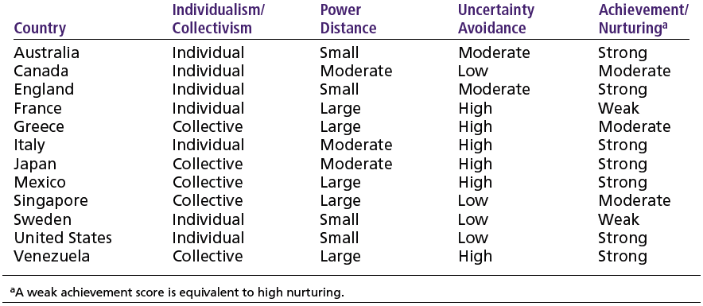
Exhibit 4–7 Examples of Hofstede’s Cultural Dimensions
Source: Based on G. Hofstede, “Motivation, Leadership, and Organization: Do American Theories Apply Abroad?” Organizational Dynamics, Summer 1980, pp. 42–63.

Slide 24
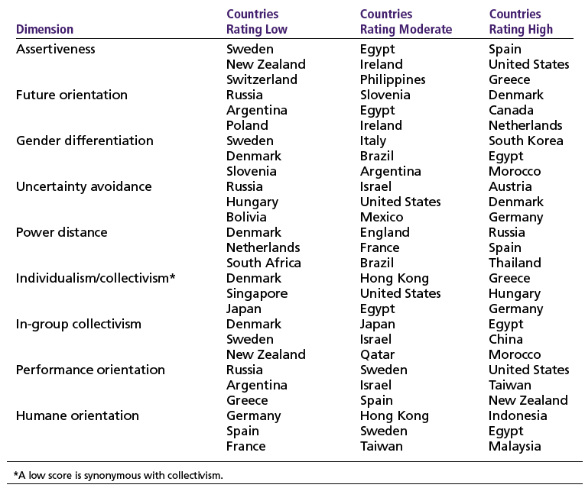
Exhibit 4–8 GLOBE Highlights
Source: M. Javidan and R. J. House, “Cultural Acumen for the Global Manager: Lessons from Project GLOBE,” Organizational Dynamics, Spring 2001, pp. 289–305. Copyright © 2001. Reprinted with permission from Elsevier.

Slide 25
Global Management in Today’s World
Challenges
Openness associated with globalization
Significant cultural differences (e.g., Americanization)
Adjusting leadership styles and management approaches
Risks
Loss of investments in unstable countries
Increased terrorism
Economic interdependence

Slide 26
Terms to Know
parochialism
ethnocentric attitude
polycentric attitude
geocentric attitude
European Union (EU)
Euro
North American Free Trade Agreement (NAFTA)
Association of Southeast Asian Nations (ASEAN)
World Trade Organization (WTO)
multinational corporations (MNCs)
multidomestic corporation
global company
transnational or borderless organization
born globals
global sourcing
exporting
importing
licensing
franchising
strategic alliances
joint venture
foreign subsidiary
market economy
command economy
national culture
GLOBE
wikis
blogs

