Slide 1
Decision-Making: The Essence of the Manager’s Job
Chapter 6

Slide 2
L E A R N I N G O U T L I N E Follow this Learning Outline as you read and study this chapter.
The Decision-Making Process
Define decision and decision-making process.
Describe the eight steps in the decision-making process.
The Manager as Decision Maker
Discuss the assumptions of rational decision making.
Describe the concepts of bounded rationality, satisficing, and escalation of commitment.
Explain intuitive decision making.
Contrast programmed and nonprogrammed decisions.

Slide 3
L E A R N I N G O U T L I N E (cont’d) Follow this Learning Outline as you read and study this chapter.
The Manager as Decision Maker (cont’d)
Contrast the three decision-making conditions.
Explain maximax, maximin, and minimax decision choice approaches.
Describe the four decision making styles.
Discuss the twelve decision-making biases managers may exhibit.
Describe how manager can deal with the negative effects of decision errors and biases.
Explain the managerial decision-making model.

Slide 4
L E A R N I N G O U T L I N E (cont’d) Follow this Learning Outline as you read and study this chapter.
Decision Making for Today’s World
Explain how managers can make effective decisions in today’s world.
List six characteristics of an effective decision-making process.
Describe the five habits of highly reliable organizations.

Slide 5
Decision Making
Decision
Making a choice from two or more alternatives.
The Decision-Making Process
Identifying a problem and decision criteria and allocating weights to the criteria.
Developing, analyzing, and selecting an alternative that can resolve the problem.
Implementing the selected alternative.
Evaluating the decision’s effectiveness.

Slide 6
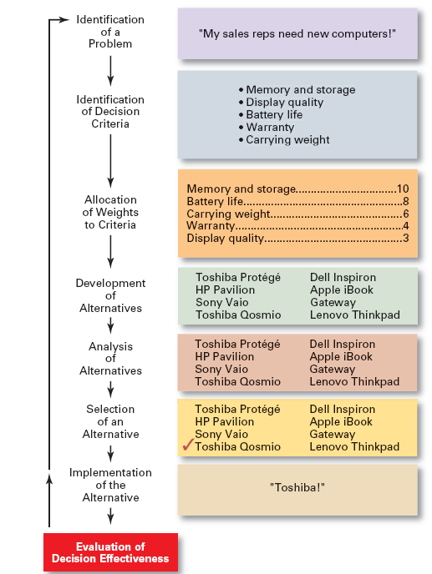
Exhibit 6–1 The Decision-Making Process

Slide 7
Step 1: Identifying the Problem
Problem
A discrepancy between an existing and desired state of affairs.
Characteristics of Problems
A problem becomes a problem when a manager becomes aware of it.
There is pressure to solve the problem.
The manager must have the authority, information, or resources needed to solve the problem.

Slide 8
Step 2: Identifying Decision Criteria
Decision criteria are factors that are important (relevant) to resolving the problem.
Costs that will be incurred (investments required)
Risks likely to be encountered (chance of failure)
Outcomes that are desired (growth of the firm)
Step 3: Allocating Weights to the Criteria
Decision criteria are not of equal importance:
Assigning a weight to each item places the items in the correct priority order of their importance in the decision making process.

Slide 9
Exhibit 6–2 Criteria and Weights for Computer Replacement Decision
Criterion Weight
Memory and Storage 10
Battery life 8
Carrying Weight 6
Warranty 4
Display Quality 3

Slide 10
Step 4: Developing Alternatives
Identifying viable alternatives
Alternatives are listed (without evaluation) that can resolve the problem.
Step 5: Analyzing Alternatives
Appraising each alternative’s strengths and weaknesses
An alternative’s appraisal is based on its ability to resolve the issues identified in steps 2 and 3.

Slide 11
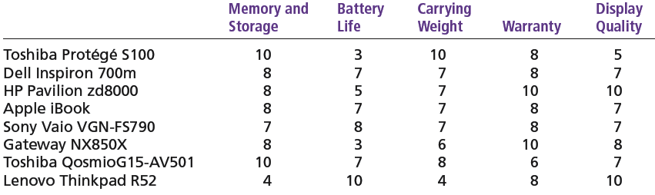
Exhibit 6–3 Assessed Values of Laptop Computers Using Decision Criteria

Slide 12
Step 6: Selecting an Alternative
Choosing the best alternative
The alternative with the highest total weight is chosen.
Step 7: Implementing the Alternative
Putting the chosen alternative into action.
Conveying the decision to and gaining commitment from those who will carry out the decision.

Slide 13
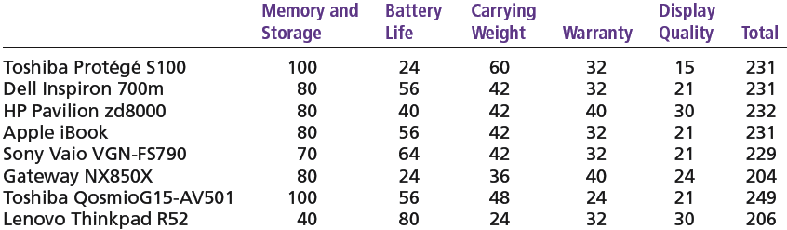
Exhibit 6–4 Evaluation of Laptop Alternatives Against Weighted Criteria

Slide 14
Step 8: Evaluating the Decision’s Effectiveness
The soundness of the decision is judged by its outcomes.
How effectively was the problem resolved by outcomes resulting from the chosen alternatives?
If the problem was not resolved, what went wrong?

Slide 15
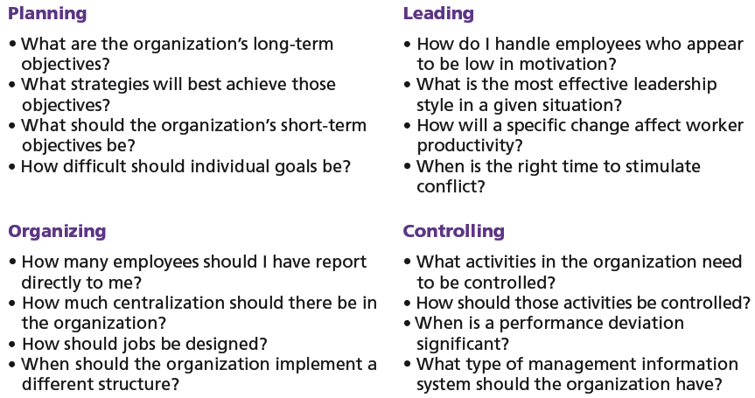
Exhibit 6–5 Decisions in the Management Functions

Slide 16
Making Decisions
Rationality
Managers make consistent, value-maximizing choices with specified constraints.
Assumptions are that decision makers:
Are perfectly rational, fully objective, and logical.
Have carefully defined the problem and identified all viable alternatives.
Have a clear and specific goal
Will select the alternative that maximizes outcomes in the organization’s interests rather than in their personal interests.

Slide 17
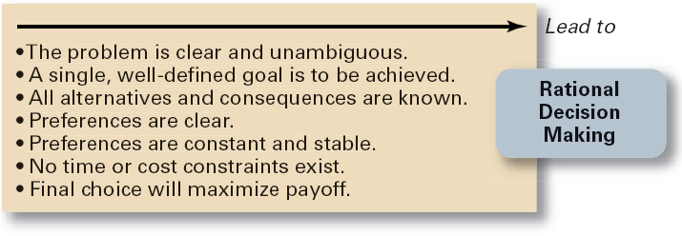
Exhibit 6–6 Assumptions of Rationality

Slide 18
Making Decisions (cont’d)
Bounded Rationality
Managers make decisions rationally, but are limited (bounded) by their ability to process information.
Assumptions are that decision makers:
Will not seek out or have knowledge of all alternatives
Will satisfice—choose the first alternative encountered that satisfactorily solves the problem—rather than maximize the outcome of their decision by considering all alternatives and choosing the best.
Influence on decision making
Escalation of commitment: an increased commitment to a previous decision despite evidence that it may have been wrong.

Slide 19
The Role of Intuition
Intuitive decision making
Making decisions on the basis of experience, feelings, and accumulated judgment.

Slide 20
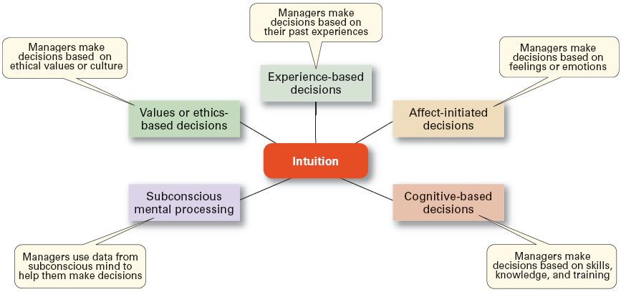
Exhibit 6–7 What is Intuition?
Source: Based on L. A. Burke and M. K. Miller, “Taking the Mystery Out of Intuitive Decision Making,” Academy of Management Executive, October 1999, pp. 91–99.

Slide 21
Types of Problems and Decisions
Structured Problems
Involve goals that clear.
Are familiar (have occurred before).
Are easily and completely defined—information about the problem is available and complete.
Programmed Decision
A repetitive decision that can be handled by a routine approach.

Slide 22
Types of Programmed Decisions
Policy
A general guideline for making a decision about a structured problem.
Procedure
A series of interrelated steps that a manager can use to respond (applying a policy) to a structured problem.
Rule
An explicit statement that limits what a manager or employee can or cannot do.

Slide 23
Policy, Procedure, and Rule Examples
Policy
Accept all customer-returned merchandise.
Procedure
Follow all steps for completing merchandise return documentation.
Rules
Managers must approve all refunds over $50.00.
No credit purchases are refunded for cash.

Slide 24
Problems and Decisions (cont’d)
Unstructured Problems
Problems that are new or unusual and for which information is ambiguous or incomplete.
Problems that will require custom-made solutions.
Nonprogrammed Decisions
Decisions that are unique and nonrecurring.
Decisions that generate unique responses.

Slide 25
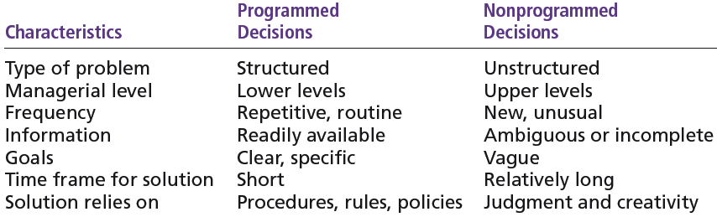
Exhibit 6–8 Programmed versus Nonprogrammed Decisions

Slide 26
Decision-Making Conditions
Certainty
A situation in which a manager can make an accurate decision because the outcome of every alternative choice is known.
Risk
A situation in which the manager is able to estimate the likelihood (probability) of outcomes that result from the choice of particular alternatives.

Slide 27
Exhibit 6–9 Expected Value for Revenues from the Addition of One Ski Lift
Expected Expected × Probability = Value of Each Event Revenues Alternative
Heavy snowfall $850,000 0.3 = $255,000
Normal snowfall 725,000 0.5 = 362,500
Light snowfall 350,000 0.2 = 70,000 $687,500

Slide 28
Decision-Making Conditions
Uncertainty
Limited information prevents estimation of outcome probabilities for alternatives associated with the problem and may force managers to rely on intuition, hunches, and “gut feelings”.
Maximax: the optimistic manager’s choice to maximize the maximum payoff
Maximin: the pessimistic manager’s choice to maximize the minimum payoff
Minimax: the manager’s choice to minimize maximum regret.

Slide 29
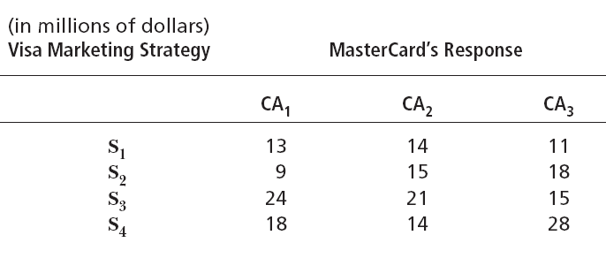
Exhibit 6–10 Payoff Matrix

Slide 30
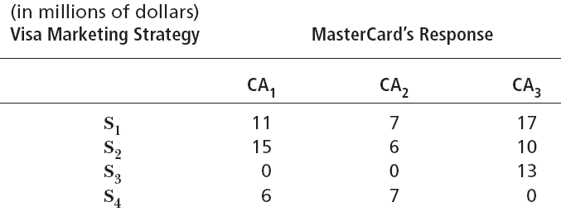
Exhibit 6–11 Regret Matrix

Slide 31
Decision-Making Styles
Dimensions of Decision-Making Styles
Ways of thinking
Rational, orderly, and consistent
Intuitive, creative, and unique
Tolerance for ambiguity
Low tolerance: require consistency and order
High tolerance: multiple thoughts simultaneously

Slide 32
Decision-Making Styles (cont’d)
Types of Decision Makers
Directive
Use minimal information and consider few alternatives.
Analytic
Make careful decisions in unique situations.
Conceptual
Maintain a broad outlook and consider many alternatives in making decisions.
Behavioral
Avoid conflict by working well with others and being receptive to suggestions.

Slide 33
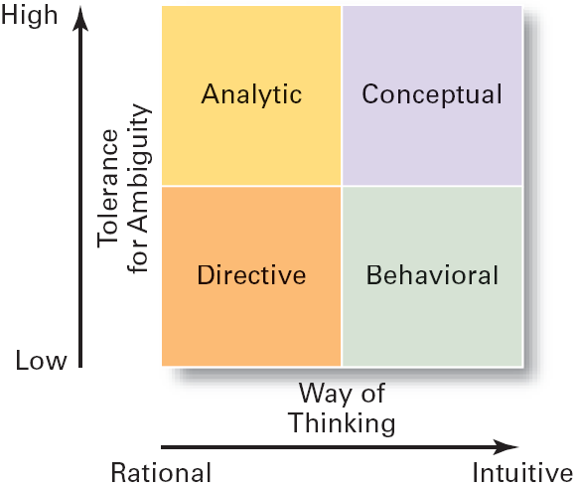
Exhibit 6–12 Decision-Making Matrix

Slide 34
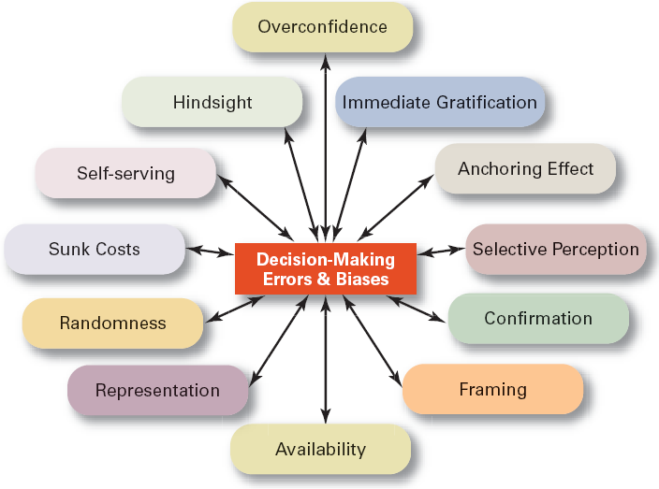
Exhibit 6–13 Common Decision-Making Errors and Biases

Slide 35
Decision-Making Biases and Errors
Heuristics
Using “rules of thumb” to simplify decision making.
Overconfidence Bias
Holding unrealistically positive views of one’s self and one’s performance.
Immediate Gratification Bias
Choosing alternatives that offer immediate rewards and that to avoid immediate costs.

Slide 36
Decision-Making Biases and Errors (cont’d)
Anchoring Effect
Fixating on initial information and ignoring subsequent information.
Selective Perception Bias
Selecting organizing and interpreting events based on the decision maker’s biased perceptions.
Confirmation Bias
Seeking out information that reaffirms past choices and discounting contradictory information.

Slide 37
Decision-Making Biases and Errors (cont’d)
Framing Bias
Selecting and highlighting certain aspects of a situation while ignoring other aspects.
Availability Bias
Losing decision-making objectivity by focusing on the most recent events.
Representation Bias
Drawing analogies and seeing identical situations when none exist.
Randomness Bias
Creating unfounded meaning out of random events.

Slide 38
Decision-Making Biases and Errors (cont’d)
Sunk Costs Errors
Forgetting that current actions cannot influence past events and relate only to future consequences.
Self-Serving Bias
Taking quick credit for successes and blaming outside factors for failures.
Hindsight Bias
Mistakenly believing that an event could have been predicted once the actual outcome is known (after-the-fact).

Slide 39
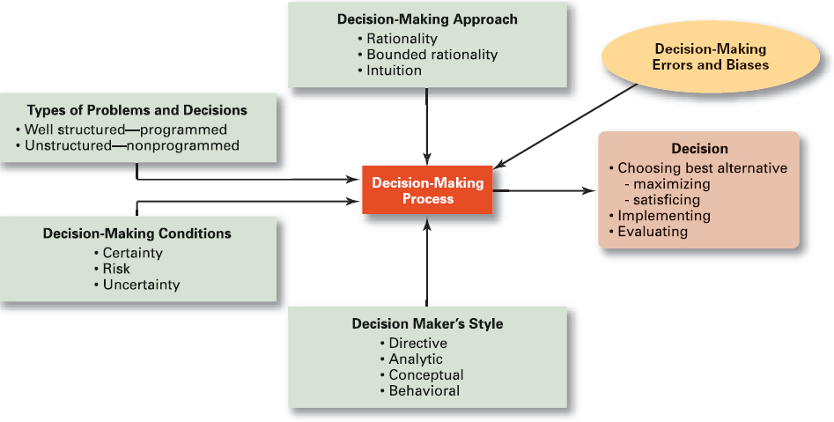
Exhibit 6–14 Overview of Managerial Decision Making

Slide 40
Decision Making for Today’s World
Guidelines for making effective decisions:
Understand cultural differences.
Know when it’s time to call it quits.
Use an effective decision-making process.
Habits of highly reliable organizations (HROs)
Are not tricked by their success.
Defer to the experts on the front line.
Let unexpected circumstances provide the solution.
Embrace complexity.
Anticipate, but also anticipate their limits.

Slide 41
Characteristics of an Effective Decision-Making Process
It focuses on what is important.
It is logical and consistent.
It acknowledges both subjective and objective thinking and blends analytical with intuitive thinking.
It requires only as much information and analysis as is necessary to resolve a particular dilemma.
It encourages and guides the gathering of relevant information and informed opinion.
It is straightforward, reliable, easy to use, and flexible.

Slide 42
Terms to Know
decision
decision-making process
problem
decision criteria
rational decision making
bounded rationality
satisficing
escalation of commitment
intuitive decision making
structured problems
programmed decision
procedure
rule
policy
unstructured problems
nonprogrammed decisions
certainty
risk
uncertainty
directive style
analytic style
conceptual style
behavioral style
heuristics
business performance management (BPM) software

