Slide 1


SOC Analyst
AI Agent
Mohamad Hassan Ibrahim 6321
Reem Kanaan 6315

Slide 2

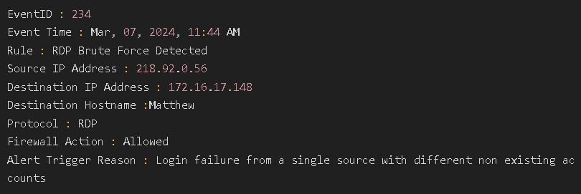
SOC
SOC Analyst investigates
Alert

Slide 3













System Architecture
Enrichment
AI Agent
Output
Alert Received
Isolation
TP/FP
Attack Type
Severity
Summary of steps followed
Reasoning
Recommendations
IOCs/Artifacts
Tools
Virustotal
Abuseipdb
ipinfo
Logs
Playbook

Slide 4
System Workflow
Choose Playbook
Choose Tools
Final Output

Slide 5

DEMO

Slide 6


