Slide 1

Credit Risk Analysis
End-to-end portfolio evaluation — SQL extraction, Python modeling, Power BI reporting
32,581 APPLICANTS
21.82% DEFAULT RATE

Slide 2
Portfolio at a Glance
32,581
7,108
Total Applicants
Total Defaults
21.82%
$66K
Default Rate
Mean Annual Income
Median: $55,000
11.01%
5.8
Mean Interest Rate
Avg Credit History (yrs)
Loan-to-income concentration, risk-grade, and homeownership are the top default predictors.

Slide 3
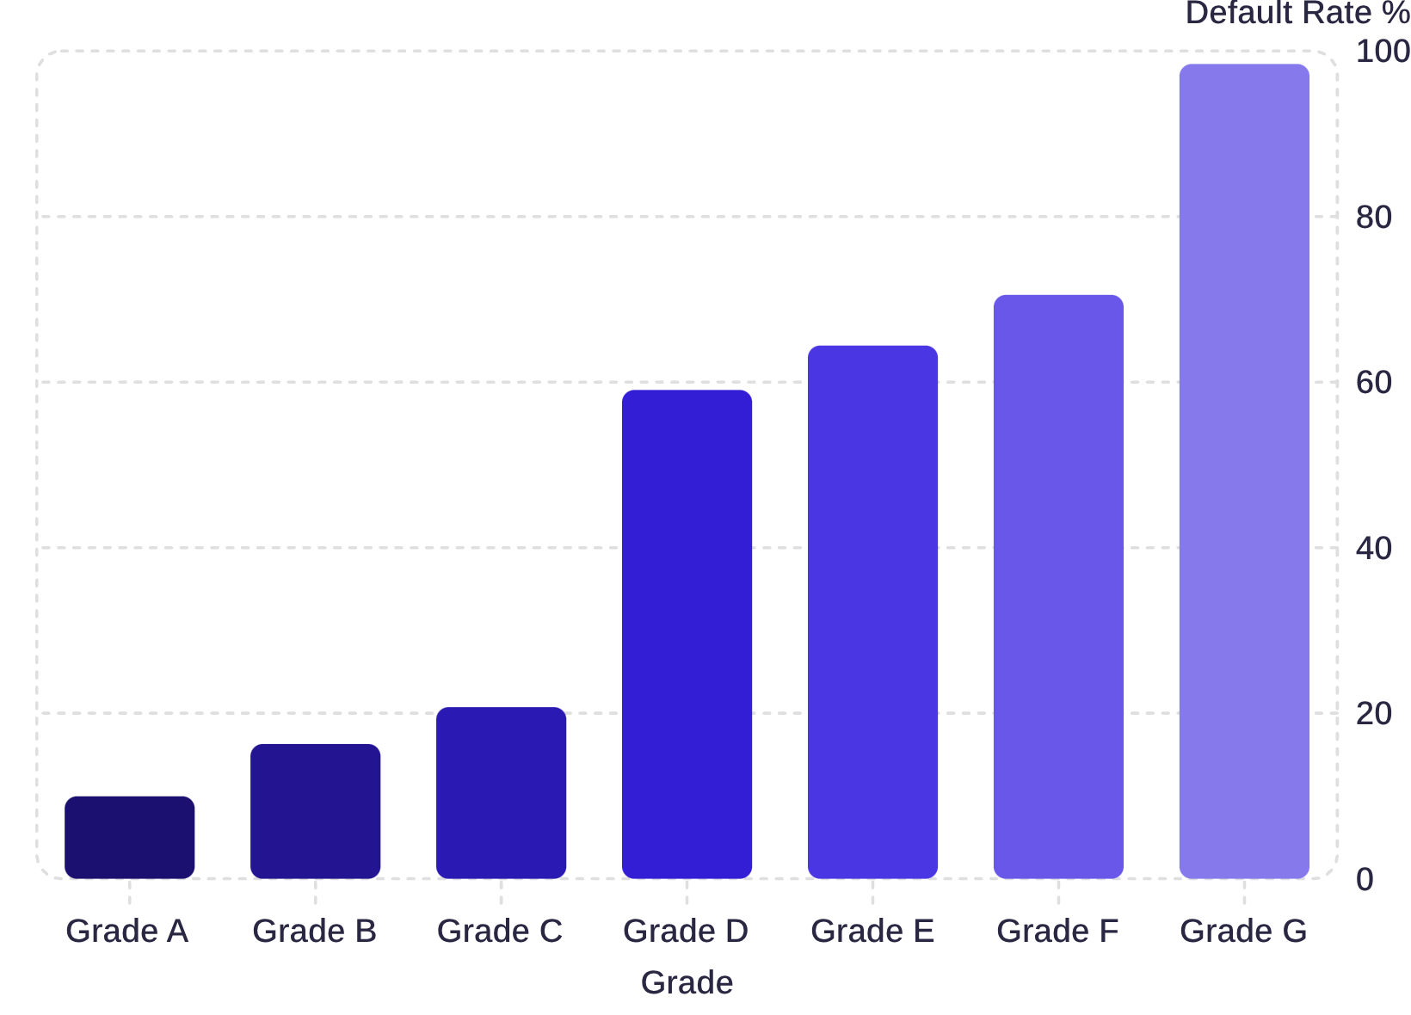

Default Rate by Loan Grade
Steep Risk Escalation
Default rates jump from ~10% (Grade A) to 98% (Grade G) — a near-vertical risk curve.
Grades D–G account for the majority of portfolio losses despite fewer loans.

Slide 4
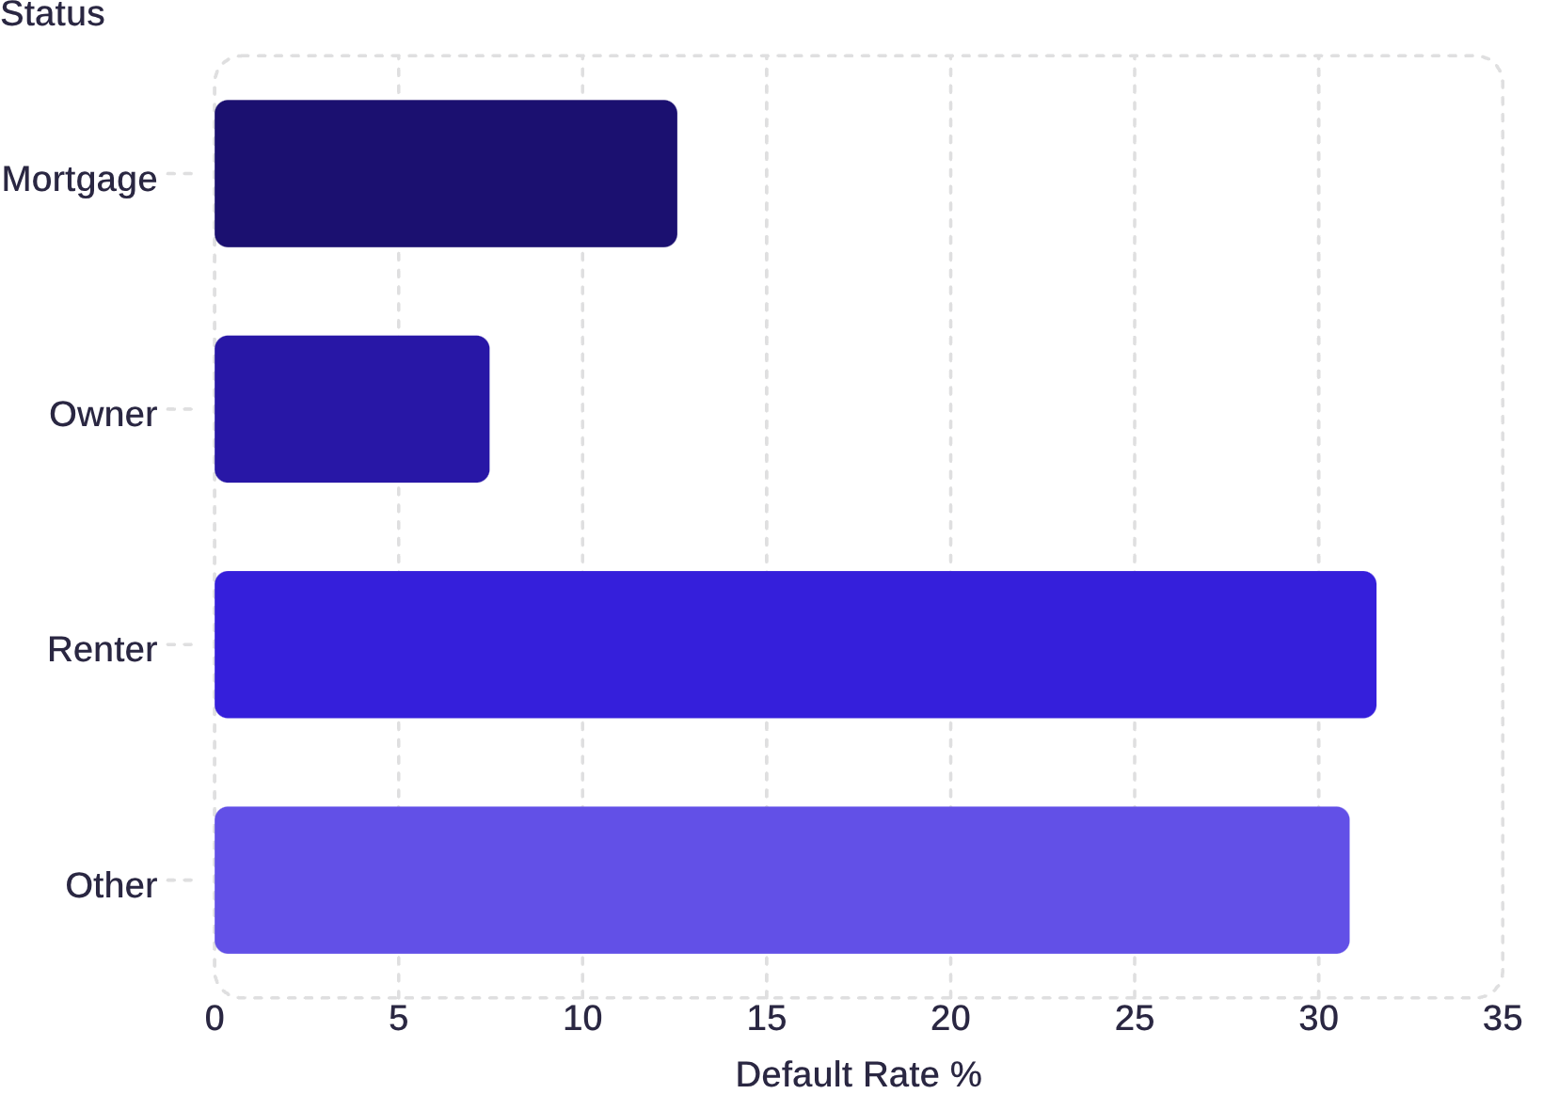
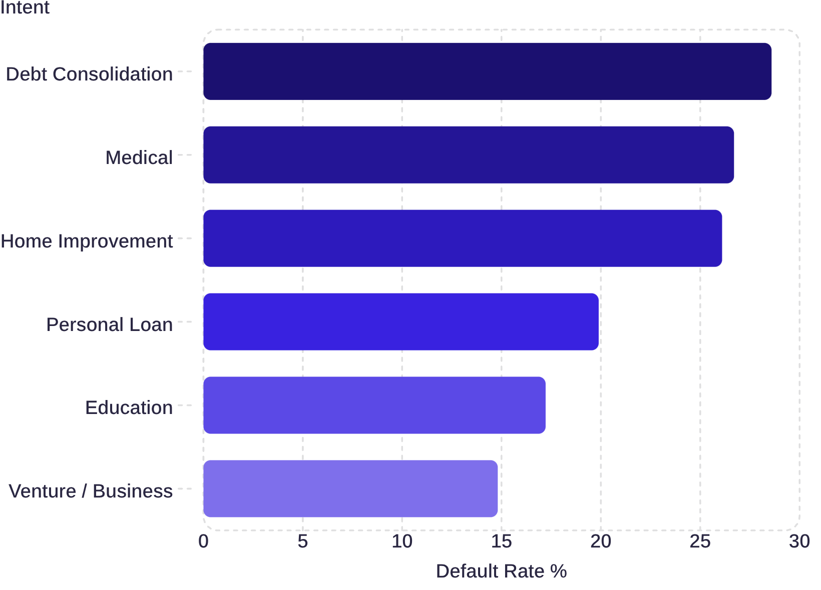
Homeownership & Loan Purpose
Default Rate by Homeownership
Default Rate by Loan Intent

Slide 5
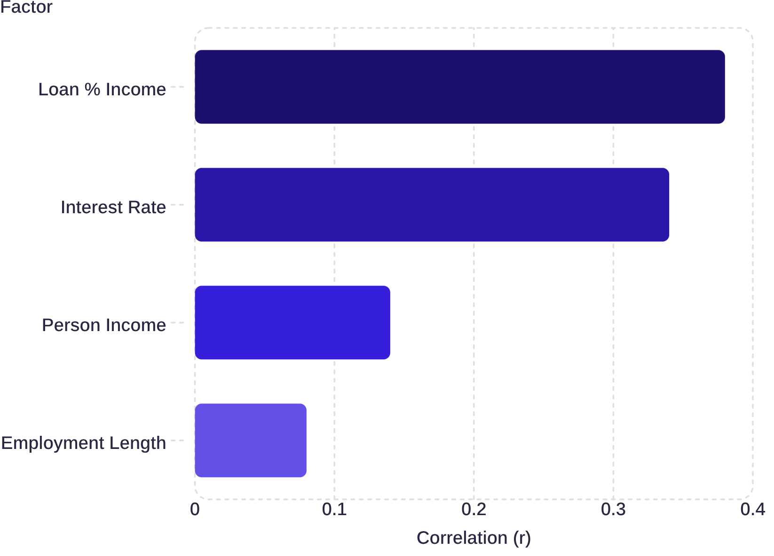


Correlation Drivers of Default
Top Risk Signals
Loan % Income r = 0.38
Interest Rate r = 0.34
Strongest positive driver — high debt-to-income severely threatens repayment
Risk-based pricing scales rates upward for distressed profiles
Person Income r = −0.14
Employment Length r = −0.08
Higher income reduces default probability
Longer job tenure marginally reduces default likelihood

Slide 6

Default Rate by Income Quartile
Q1 — Lowest Income
39.70% default rate
Q2
21.32% default rate
Q3
17.07% default rate
Q4 — Highest Income
9.11% default rate
Financial capacity is a powerful risk buffer — Q1 defaults are 4× higher than Q4.

Slide 7
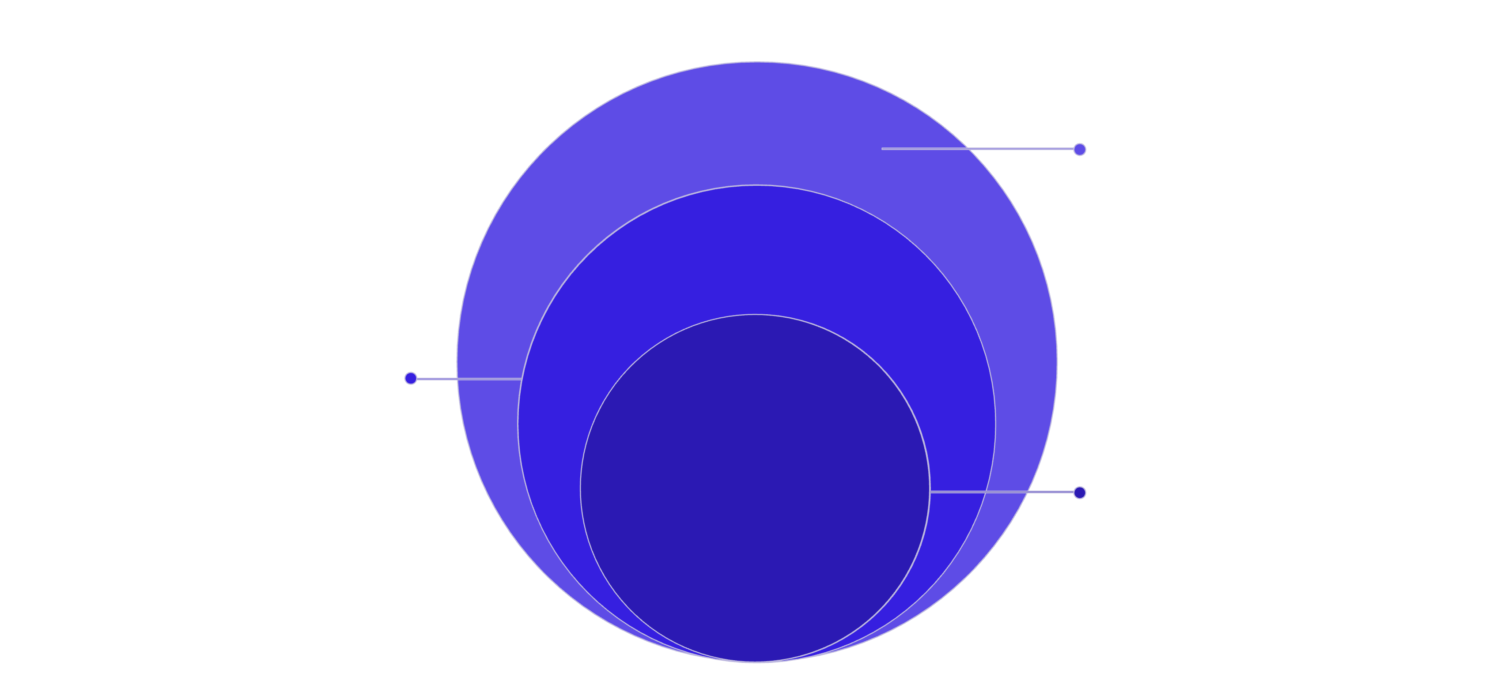
Technical Architecture
Presentation & Exec
Power BI dashboards, KPI cards, slicers by grade and intent
Modeling Layer
Python cleaning, feature engineering, Random Forest/XGBoost
Core: Database
SQL ingestion, outlier filtering, KPI aggregation
End-to-end pipeline: SQL for data extraction → Python for modeling → Power BI for interactive dashboards.

Slide 8



Strategic Recommendations
Tighten Underwriting on Renters
1
31%+ default rate — require liquidity buffers or co-signers for rental applicants
Cap Debt-to-Income Exposure
2
Auto-flag loans exceeding 30% of verified income (r = 0.38)
Re-evaluate Grade D–G Pricing
3
59–98% default rates — current rates may not offset losses; tighten credit filters

