Slide 1
Abstraction

Slide 2
Abstraction
Abstraction is the process of hiding certain details and showing only essential information to the user.
Abstraction is the process of hiding the internal details of an application from the outer world. Abstraction is used to describe things in simple terms. It’s used to create a boundary between the application and the client programs.
Abstract class: is a restricted class that cannot be used to create objects (to access it, it must be inherited from another class).
Abstract method: can only be used in an abstract class, and it does not have a body. The body is provided by the subclass (inherited from).

Slide 3
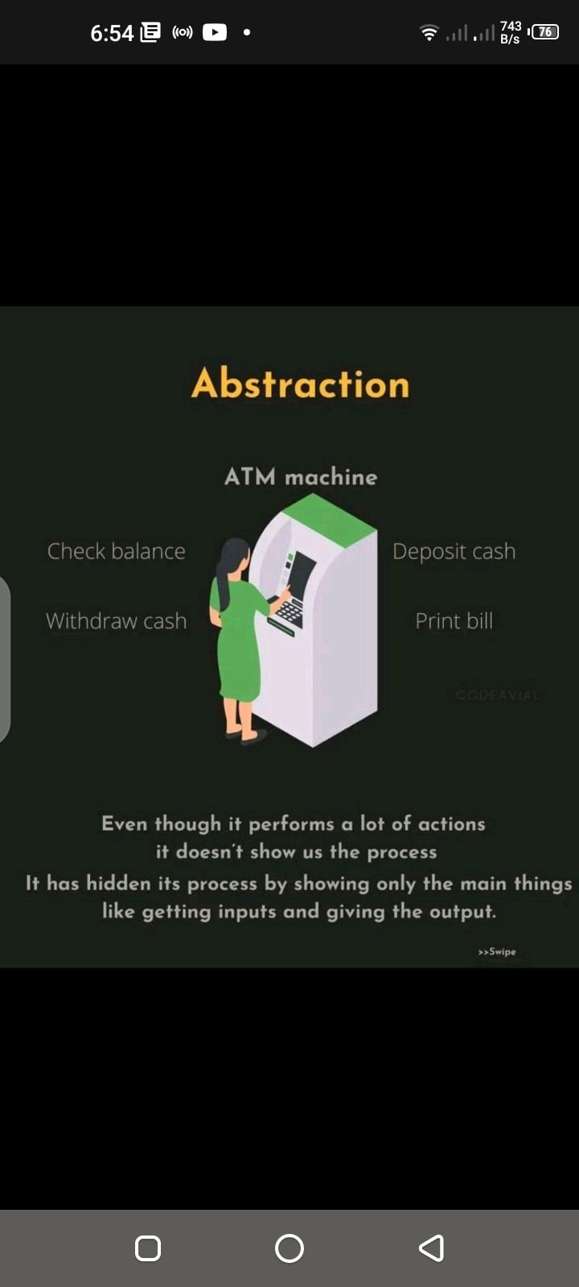

Slide 4
Types of Abstraction
Data Abstraction:
When the object data is not visible to the outer world, it creates data abstraction. If needed, access to the Objects’ data is provided through some methods.
Process Abstraction:
We don’t need to provide details about all the functions of an object. When we hide the internal implementation of the different functions involved in a user operation, it creates process abstraction.

Slide 5
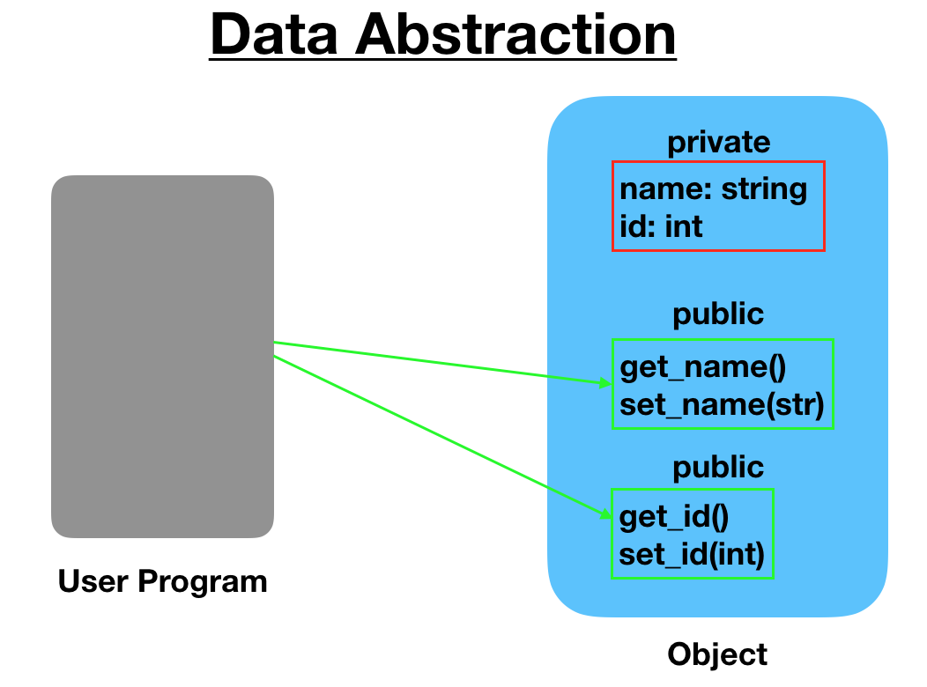

Slide 6
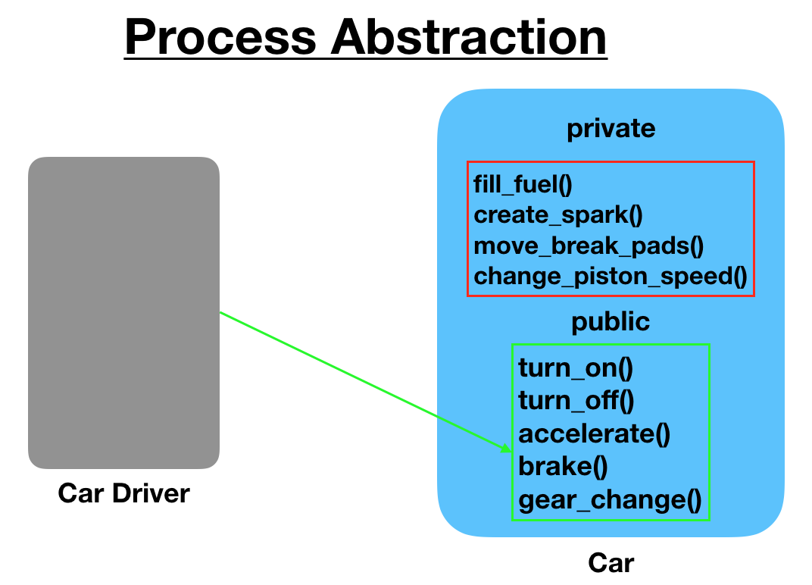

Slide 7
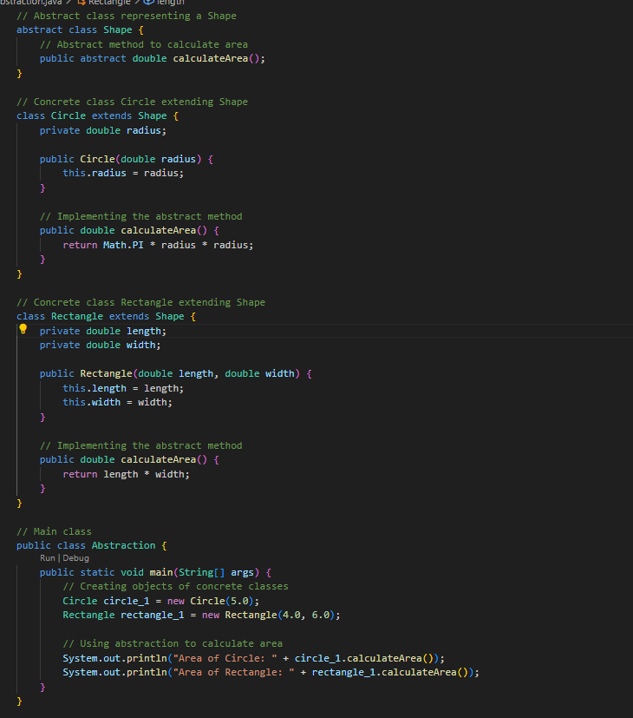
In Java…………!

Slide 8
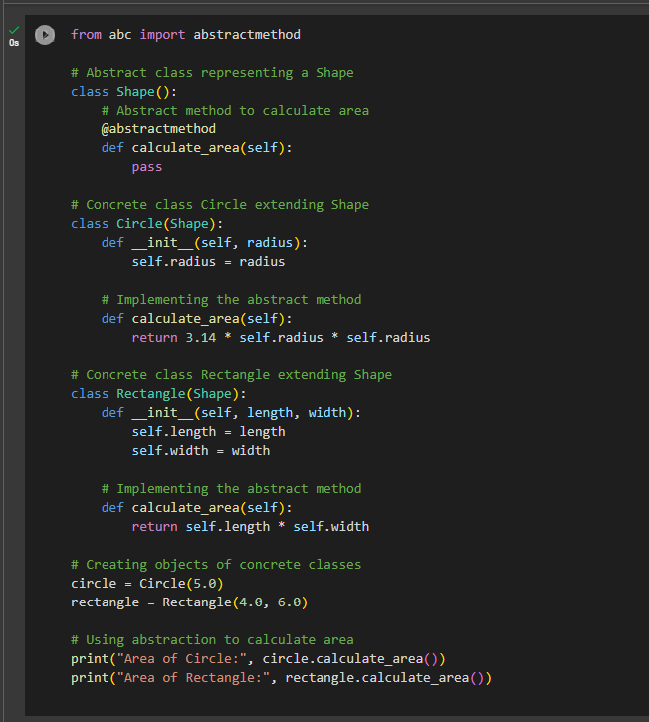
In Python…………..!

Slide 9
Task……….!!!!!!
Animal Abstraction:
Create an abstract class Animal with abstract methods makeSound() and eat().
Implement concrete classes Dog and Cat that extend the Animal class.
Implement the makeSound() and eat() methods for each animal.
Create objects of both classes and invoke their methods.
Vehicle Abstraction:
Define an abstract class Vehicle with abstract methods start() and stop().
Create concrete classes Car and Motorcycle that extend the Vehicle class.
Implement the start() and stop() methods for each vehicle type.
Create objects of both classes and test their start and stop functionality.

