Slide 1
Attributes/Methods

Slide 2
Attributes…..
we used the term "variable" for x in the example.
It is actually an attribute of the class.
Or you could say that class attributes are variables within a class

Slide 3
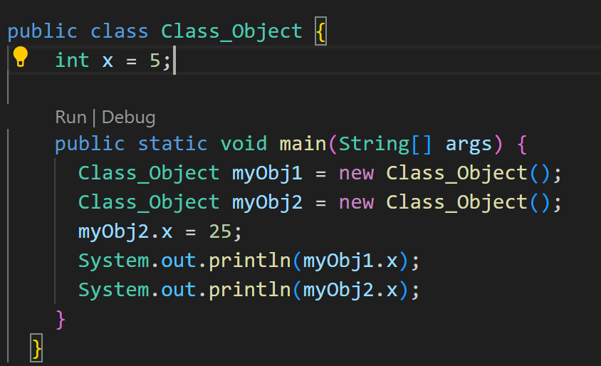
In Java Modify…

Slide 4
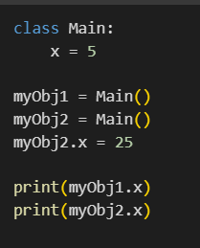
In Python Modify…

Slide 5
Methods and Functions..
A method/function is a block of code which only runs when it is called.
You can pass data, known as parameters, into a function.
Methods are used to perform certain actions, and they are also known as functions.

Slide 6
Static vs. Public
we created a static method, which means that it can be accessed without creating an object of the class, unlike public, which can only be accessed by objects.

Slide 7
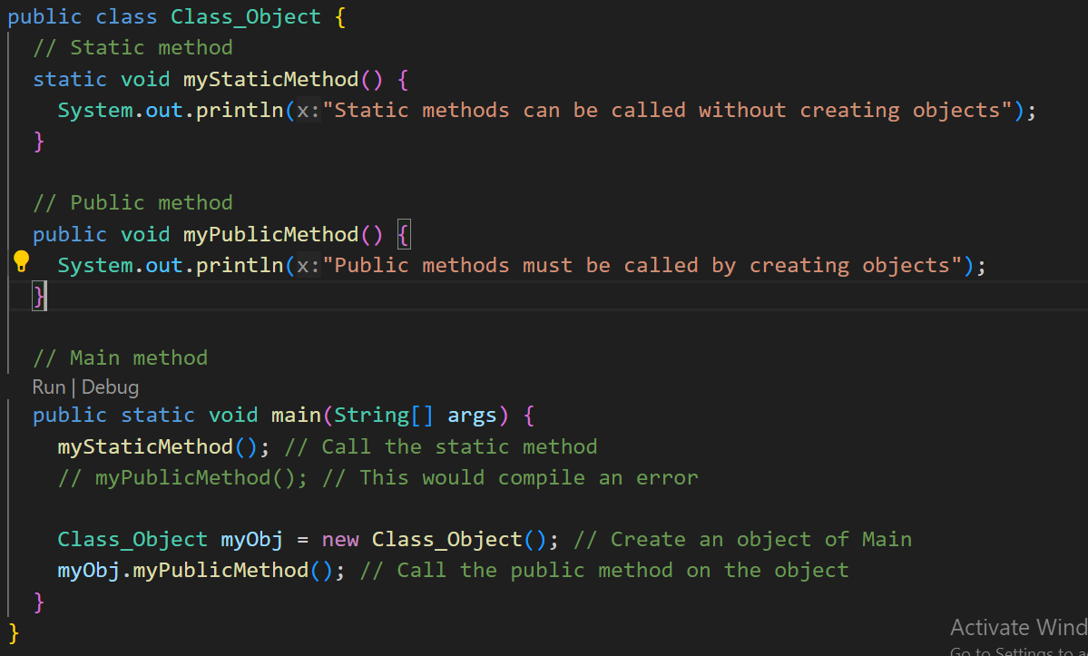
In Java….

Slide 8
In Python…
Don't have the concept of static methods in the same way as in Java. Instead, you can use a regular method and then decide how to call it.

Slide 9
Constructors
A constructor is a special method that is used to initialize objects.
The constructor is called when an object of a class is created.
It can be used to set initial values for object attributes
Also note that the constructor is called when the object is created.

Slide 10
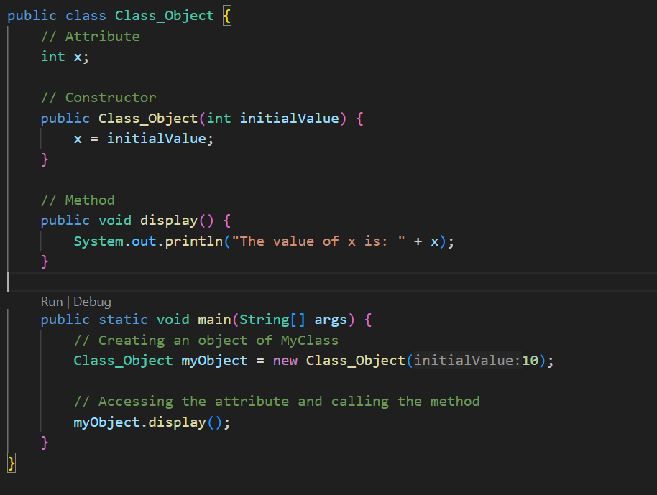
In Java….

Slide 11
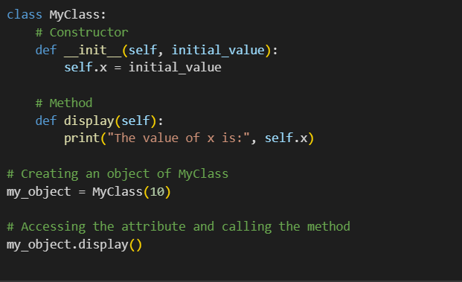
In Python….

Slide 12
Task…..
Task: Bank Account Management
Create a BankAccount class with attributes like accountNumber, accountHolder, and balance.
Implement a constructor to initialize these attributes.
Include methods to deposit, withdraw, and display the account details.
Task: Online Shopping Cart
Design a Product class with attributes like productName, price, and quantity.
Implement a constructor to initialize these attributes.
Include methods to calculate the total cost of items in the cart and display the product details.
Task: Car Rental System
Create a Car class with attributes such as carModel, rentalRate, and availability.
Implement a constructor to initialize these attributes.
Include methods to rent a car, return a car, and display the car details.

Slide 13
Task…..
Task: Student Record System
Create a Student class with attributes such as studentID, name, and grades (an array or list).
Implement a constructor to initialize these attributes.
Include methods to calculate the average grade and display student information.
Task: Library Catalog
Design a Book class with attributes like title, author, and publicationYear.
Implement a constructor to initialize these attributes.
Include methods to check out a book and return a book, along with displaying book details.

Slide 14
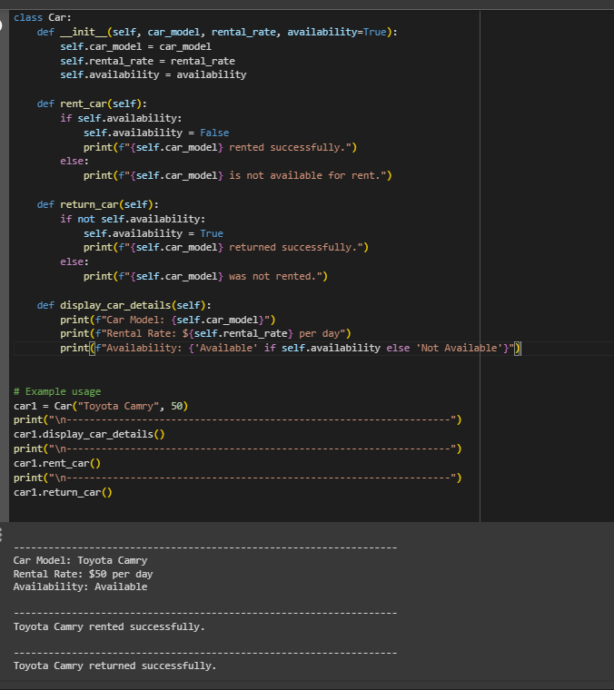
Sample……..

