Slide 1
Encapsulation

Slide 2
Encapsulation
The meaning of Encapsulation, is to make sure that "sensitive" data is hidden from users.
encapsulation describes bundling data and methods that work on that data within one unit.
encapsulation refers to the bundling of data with the mechanisms or methods that operate on the data. It may also refer to the limiting of direct access to some of that data
As one example, encapsulation can be used to hide the values or state of a structured data object inside a class, preventing direct access to them by clients in a way that could expose hidden implementation details or violate state invariance maintained by the methods.

Slide 3
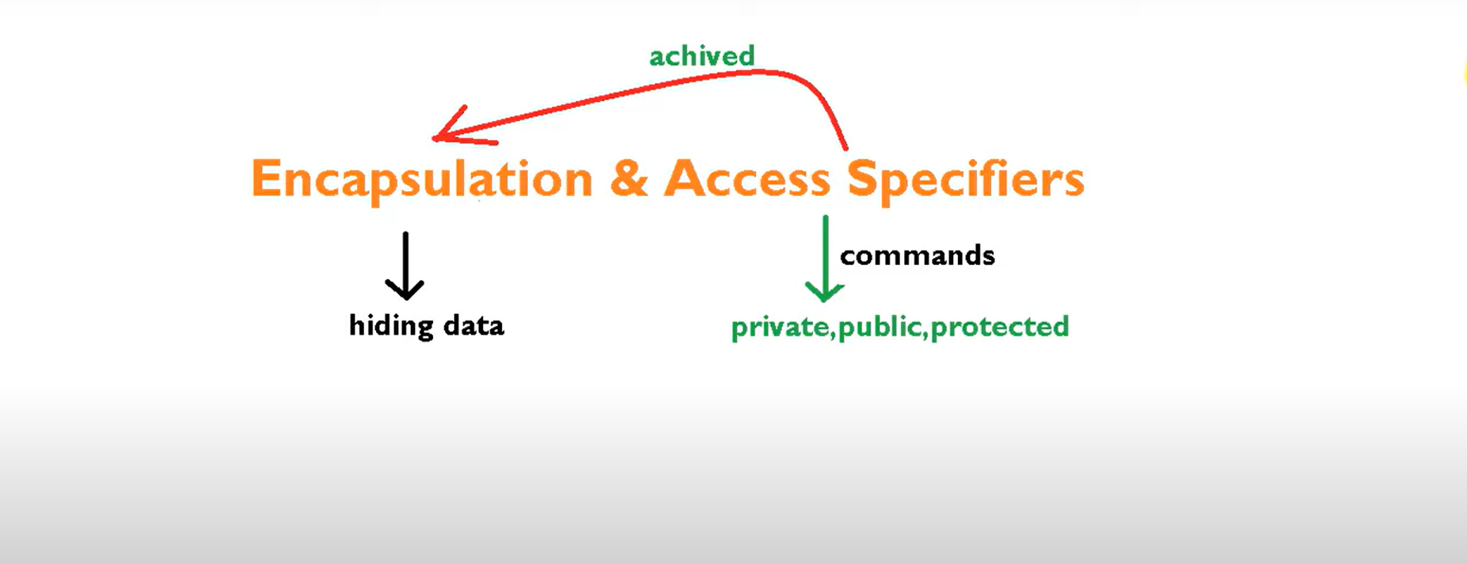

Slide 4
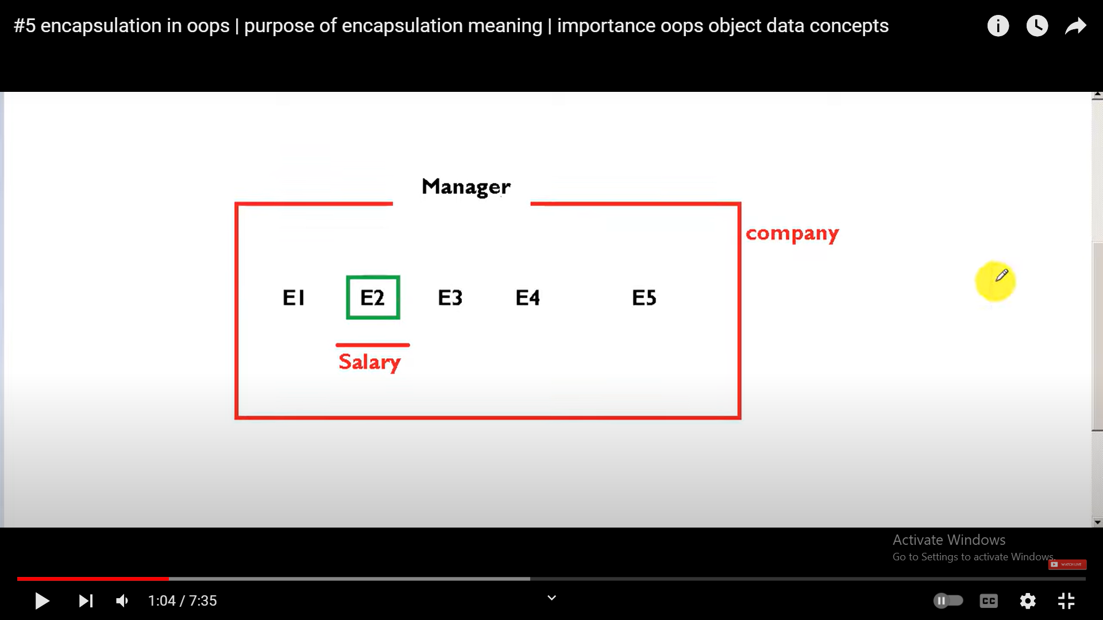

Slide 5


Slide 6
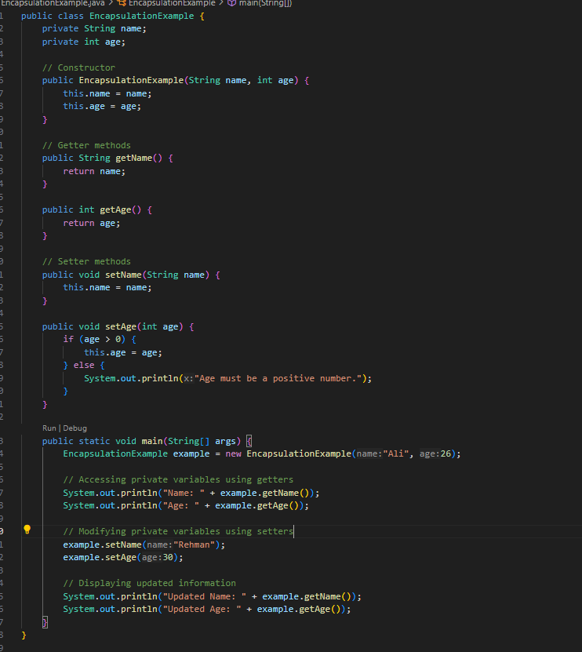
In java

Slide 7
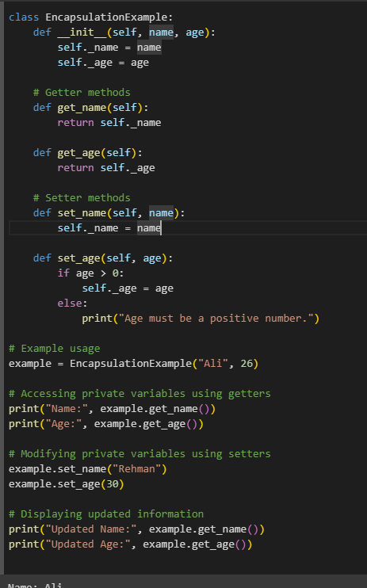
In Python..

Slide 8
Why Encapsulation?
Better control of class attributes and methods
Class attributes can be made read-only (if you only use the get method), or write-only (if you only use the set method)
Flexible: the programmer can change one part of the code without affecting other parts
Increased security of data

Slide 9
Task…..!
Task: Employee Information System
Design an Employee class with private attributes like employeeId, employeeName, and salary. Provide methods to access employee details and update the salary. Implement encapsulation to protect the integrity of employee data.
Task: Student Enrollment System
Develop a Student class with private attributes such as studentId, studentName, and coursesEnrolled. Implement methods to display student information and add or remove courses. Apply encapsulation to control access to the student's data.
Task: Product Inventory System
Create a Product class with private attributes such as productCode, productName, and quantityInStock. Utilize encapsulation to provide methods for updating stock, checking stock availability, and displaying product information.

