Slide 1
Inheritance

Slide 2
Inheritance
it is possible to inherit attributes and methods from one class to another. We group the "inheritance concept" into two categories:
subclass (child) - the class that inherits from another class
superclass (parent) - the class being inherited from

Slide 3


Slide 4
Types of Inheritance:
Single Inheritance: A class can inherit from only one superclass.
Multiple Inheritance: A class can inherit from more than one superclass.
Multilevel Inheritance: A class can inherit from another class, and then another class can inherit from the derived class.
Hierarchical Inheritance: Multiple classes inherit from a single superclass.

Slide 5
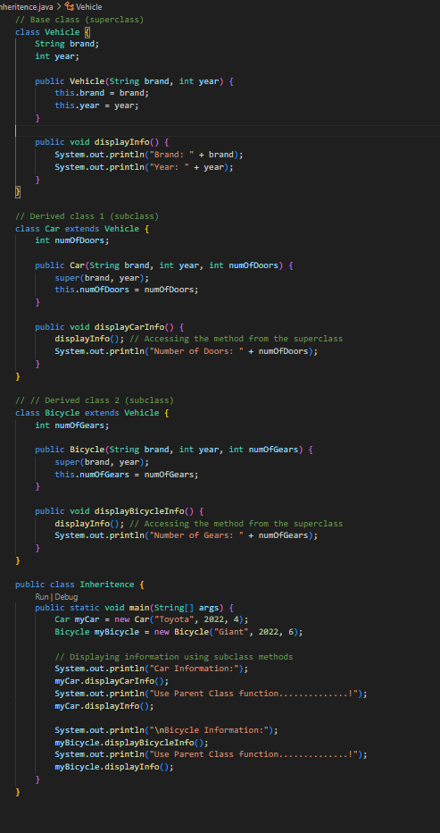

Slide 6
Task.
Task 2: Employee Inheritance
Create a base class Employee with attributes like name and employeeID. Implement a constructor to initialize these attributes. Create a subclass Manager that inherits from the Employee class. The Manager class should have an additional attribute department and a method to display the manager's information.

