Slide 1
Math

Slide 2
Java Math
The Math.max(x,y) method can be used to find the highest value of x and y
The Math.min(x,y) method can be used to find the lowest value of x and y
The Math.sqrt(x) method returns the square root of x
The Math.abs(x) method returns the absolute (positive) value of x
Math.random() returns a random number between 0.0 (inclusive), and 1.0 (exclusive)
import java.lang.Math;

Slide 3
Python Math
The min() and max() functions can be used to find the lowest or highest value in an iterable
The abs() function returns the absolute (positive) value of the specified number:
The pow(x, y) function returns the value of x to the power of y (x^y)
Python has also a built-in module called math, which extends the list of mathematical functions. To use it, you must import the math module.
Import math

Slide 4
C++ Math
The max(x,y) function can be used to find the highest value of x and y
And the min(x,y) function can be used to find the lowest value of x and y.
Other functions, such as sqrt (square root), round (rounds a number) and log (natural logarithm), can be found in the <cmath> header file.
#include <cmath>

Slide 5
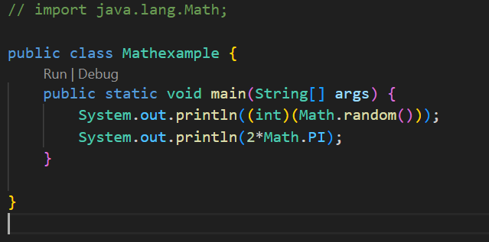
Java:-

Slide 6
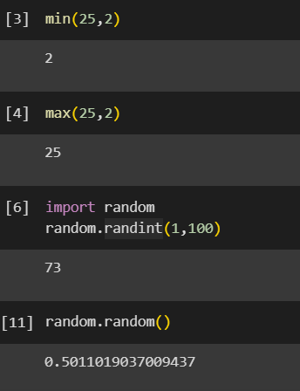
Python:-

Slide 7
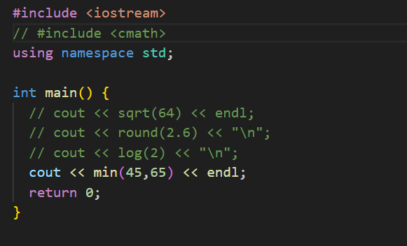
C++:-

Slide 8
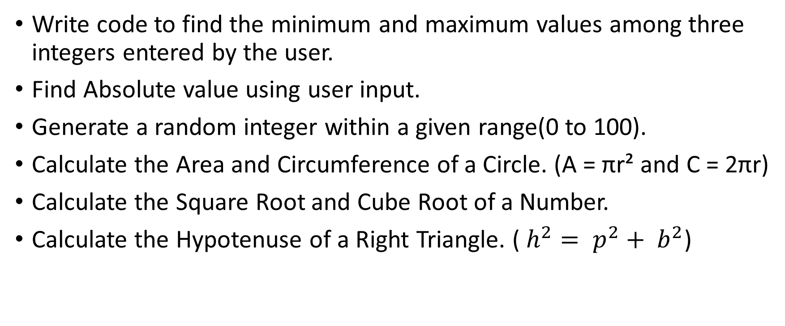
Task…..
Write code to find the minimum and maximum values among three integers entered by the user.
Find Absolute value using user input.
Generate a random integer within a given range(0 to 100).
Calculate the Area and Circumference of a Circle. (A = πr² and C = 2πr)
Calculate the Square Root and Cube Root of a Number.
Calculate the Hypotenuse of a Right Triangle. ( $h^{2}= p^{2}+ b^{2}$)

