Slide 1
Module

Slide 2
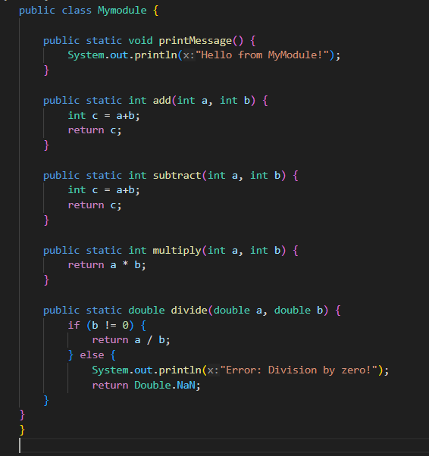
In Java

Slide 3
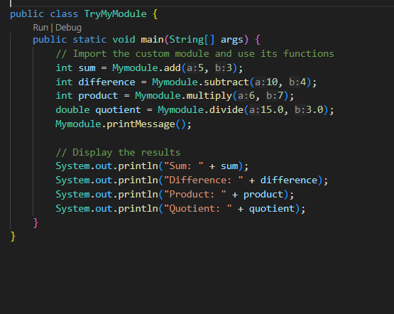

Slide 4
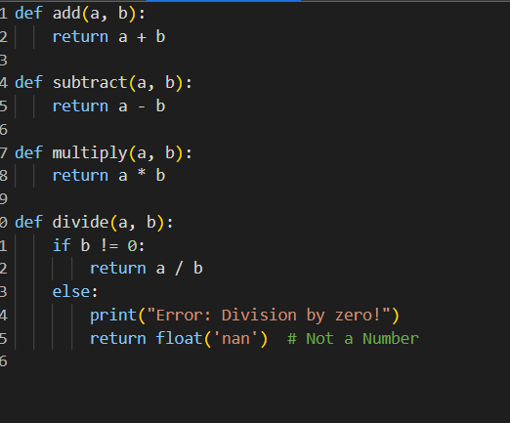
In Python

Slide 5
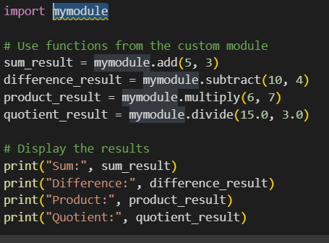

Slide 6
Task…
Write a function called calculateSum that takes two integers as parameters and returns their sum. Implement this in one module.
Create a function named findMax that takes three numbers as arguments and returns the maximum value among them. Implement this in one module.
Develop a function called printMessage that accepts a string and an integer as parameters and prints the string a number of times specified by the integer. Implement this in one module.
Design a function named isEven that takes an integer as an argument and returns true if the number is even and false otherwise. Implement this in one module.
Write a function called calculateArea that computes the area of a rectangle. It should take two parameters - length and width - and return the area. Implement this in one module.

