Slide 1
PRIVACY MIDDLEWARE FOR AGENT TOOL CALLS
Veil
The agent works while Veil controls what crosses the tool boundary — and you can inspect what the tool actually received.
Demo key: TICKET-DEMO-1042 • synthetic data only
Deterministic offline • Optional Gemini • Simulated local helpdesk
START ▶
1 / 8 • Veil demo
NEXT ▶

Slide 2
INTERACTIVE MENU
Pick a section — click any card
Every card jumps straight to its slide. Each slide has HOME + NEXT buttons.
03
Architecture
04
Step-by-step flow
05
Gateway zoom
06
Detectors
07
Agents & UIs
08
Proof & results
Tip: press F5 to present — hyperlinks work while presenting. Add Morph transitions in PowerPoint for animation.

Slide 3
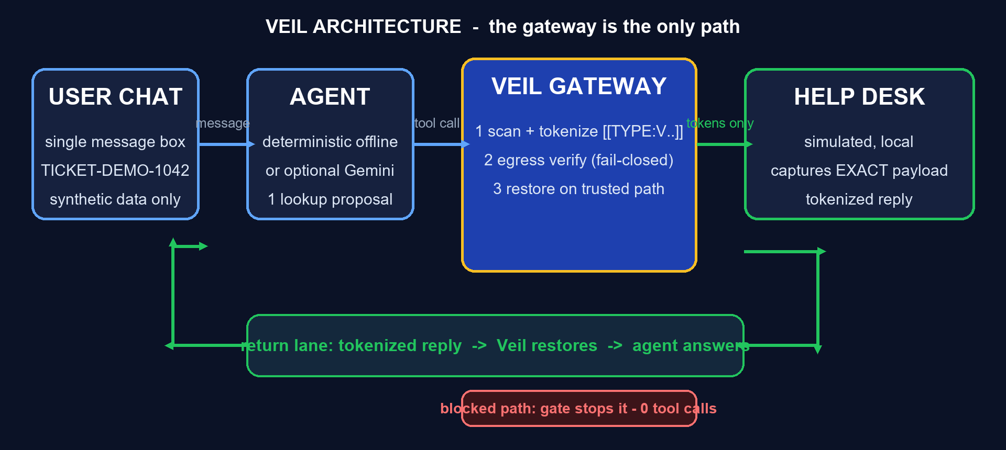
03 • ARCHITECTURE
HOME
The gateway is the only path
Agent can never call the tool directly.
3 / 8 • Veil demo
NEXT ▶

Slide 4
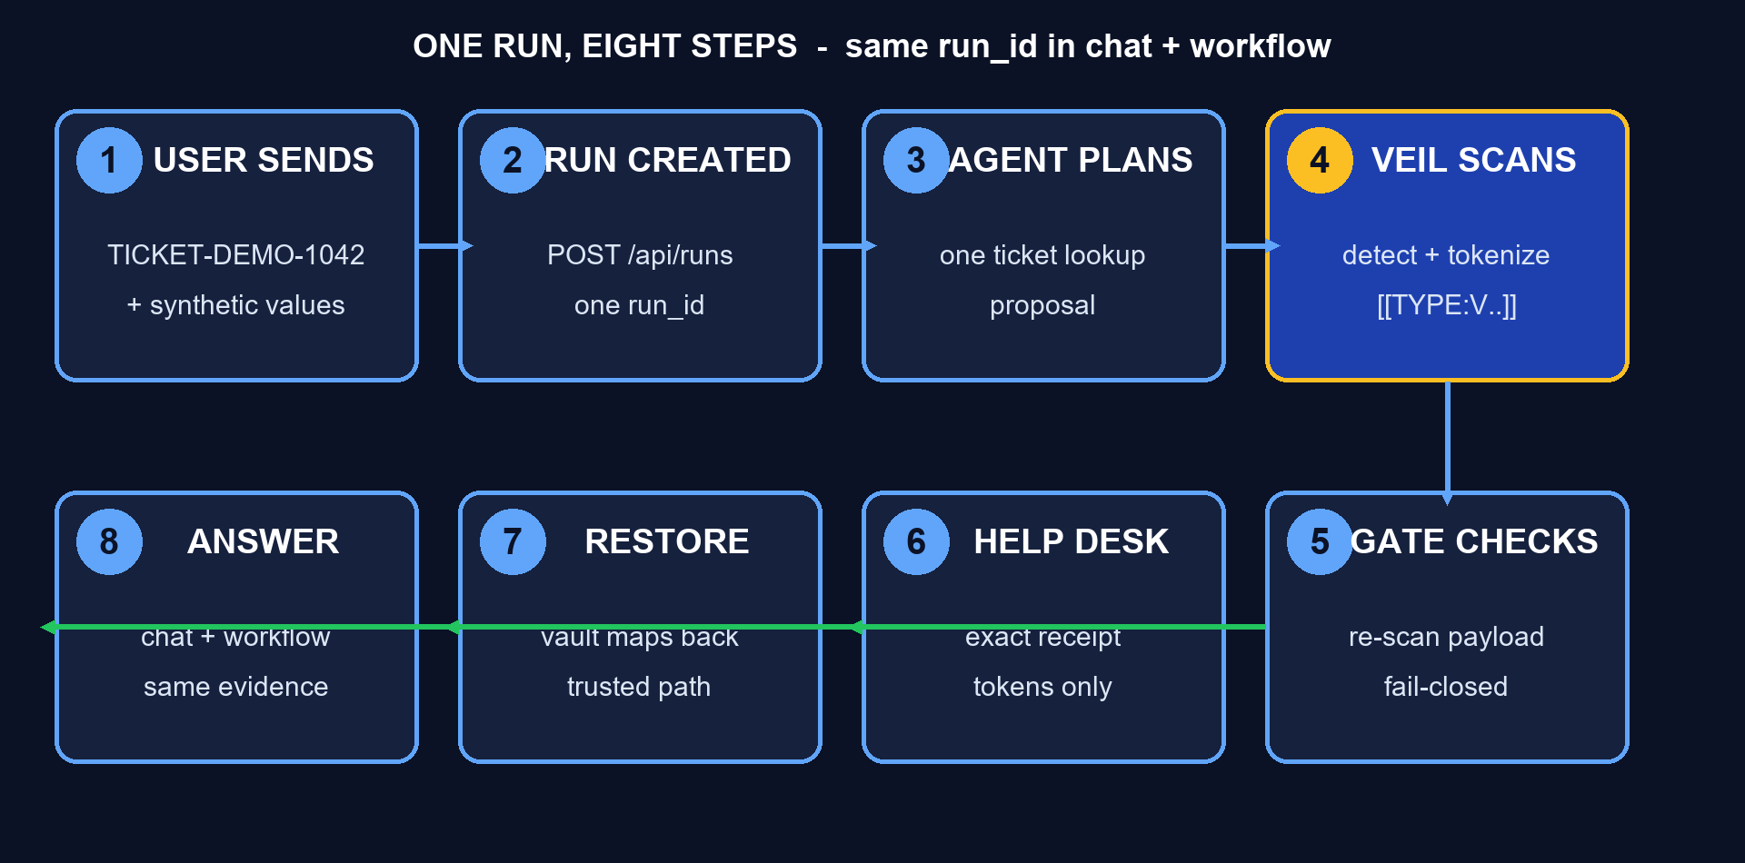
04 • STEP-BY-STEP FLOW
HOME
One run, eight steps, one run_id
Chat and workflow pages share the same backend run.
4 / 8 • Veil demo
NEXT ▶

Slide 5
05 • GATEWAY ZOOM
HOME
Scan → verify → dispatch → restore
VeilGateway.call_tool — every agent-to-tool call passes here.
1 SCAN
Recursive text+JSON scan
tokens like [[EMAIL:V..]]
2 VERIFY
Re-scan exact payload
fail-closed on residue
3 DISPATCH
Helpdesk sees tokens
EXACT receipt captured
4 RESTORE
Vault maps back
trusted path only
▶
▶
▶
Blocked path: gate stops the run — 0 tool calls, 0 receipts, no invented answer.
5 / 8 • Veil demo
NEXT ▶

Slide 6
06 • DETECTORS
HOME
11 selected patterns + custom literals
Deterministic regex + checksum — limited by design, never universal.
EMAIL
RFC-like
PHONE
formatted+label
PERSON
lexicon+context
AADHAAR
labelled only
BANK AC
labelled only
UPI ID
VPA handles
CARD
Luhn check
IBAN
mod-97 shortest
PAN
5L+4D+1L
IFSC
4L+0+6AN
STU ID
STU-DEMO-5d
CUSTOM
exact literals
Priority + overlap resolution stop a card substring becoming a phone hit. Tokens are pseudonyms, NOT encryption.
6 / 8 • Veil demo
NEXT ▶

Slide 7
07 • AGENTS & SCREENS
HOME
Same run, two pages
POST /api/runs once — chat shows the answer, workflow proves it.
DETERMINISTIC (default)
Offline local agent.
No key, no network.
Repeatable judge run.
CHAT / : one message box.
Prefilled TICKET-DEMO-1042 example.
GEMINI (optional)
Server-side key only.
Sees ONLY tokenized prompt.
Proposes 1 allowlisted lookup.
Still passes Veil + local tool.
WORKFLOW /runs/{id}
6 connected stages.
Exact helpdesk receipt.
Tokenized vs restored reply.
Blocked = 'not reached'.
7 / 8 • Veil demo
NEXT ▶

Slide 8
08 • PROOF & RESULTS
HOME
Zero leaks on the synthetic corpus
Small fixed corpus — strong signal, not a universal claim.
49/49
dev spans found
26/26
held-out found
0
literal leaks at tool
100%
restoration
99.19 / 98.48
F2 dev / held-out
2 + 2
phone lookalike FPs
Shot 1: chat + answer
[ paste screenshot ]
Shot 2: 6-stage workflow
[ paste screenshot ]
Shot 3: exact tool receipt
[ paste screenshot ]
Shot 4: blocked + Streamlit
[ paste screenshot ]
Dev: 33 cases / 49 spans • Held-out: 26 / 26 • 2026-10-10 • re-run on the judging laptop for its own latency.
8 / 8 • Veil demo

