Slide 1
Tokyo analysis – Where to set a new business?
Final assignment for the Capstone Project – Applied Data Science
Author: Joao Nunes
Date: 20/06/2021

Slide 2
INTRODUCTION
Tokyo is the capital of Japan and the most populated prefecture in the entire country: 13,960,236 people across 23 special wards. Accordingly, its density reaches around 6,363 people/km².
Densely populated areas tend to lead to a highly diversified market demand for food and other catering services.
⚔ This can easily turn into a double-edged sword ⚔
Furthermore, new businesses have an even harder time to enter this already established ecosystem.
Successful businesses can thrive at a faster pace and expand,
Businesses have increasingly added pressure to cater to new customer needs to out-compete their massive competition.
however...
Location, location, location. Where should one start?
Example case study: Where would a new bakery owner choose to establish itself?

Slide 3
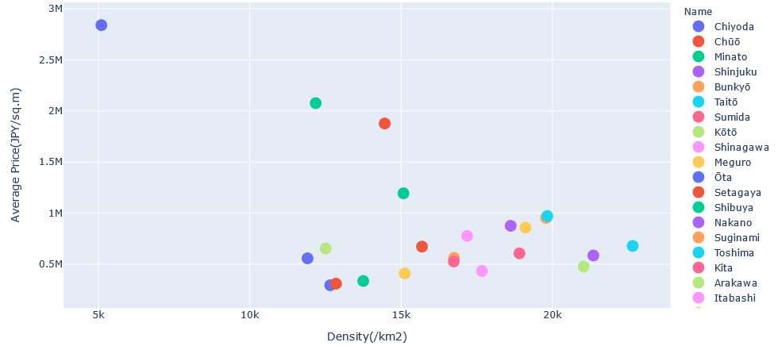
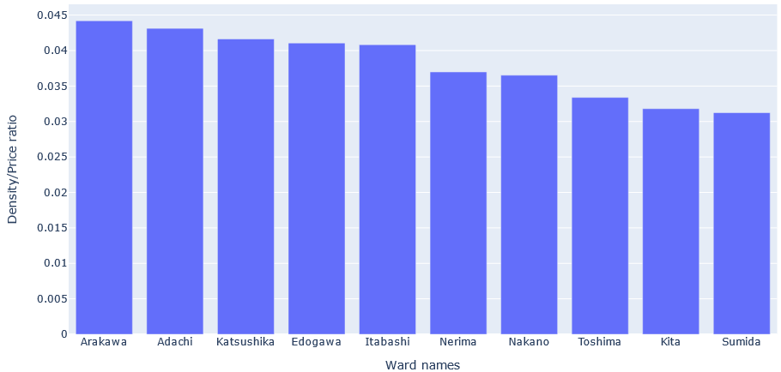
METHODOLOGY - STEP ONE:
Figure 1 - Tokyo ward analysis. The left plot corresponds to all wards within Tokyo regarding their density versus average price. The right plot exhibits the top 10 wards with the highest density/average price ratio.
Publicly available data for density and land price values were used to narrow down the list from 23 to one potential ward.
In this scenario, Arakawa ward was chosen as having the highest density/land value ratio.

Slide 4
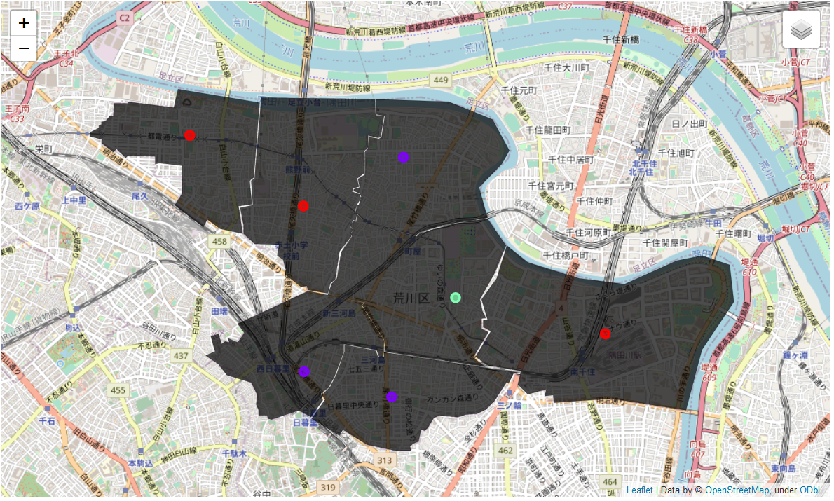
METHODOLOGY - STEP TWO:
Figure 2 - Arakawa ward choropleth. A total of 7 neighborhoods were clustered together with k = 3 using K-Means clustering algorithm based on their respective venue information. Cluster order/color: (1) Red - Higashiogu, Minamisenju and Nishiogu; (2) Purple - Higashinippori, Machiya and Nishinippori; (3) Green - Arakawa.
Each neighborhood exhibited a similar venue structure with only slight differences. Arakawa (green cluster) was mainly separated from the others due to a higher number of green areas (e.g. parks). Red clusters exhibited a higher number of train/tram stations than all the other neighborhoods. Lastly, purple clusters seem to have been aggregated due to the presence of supermarkets.

Slide 5
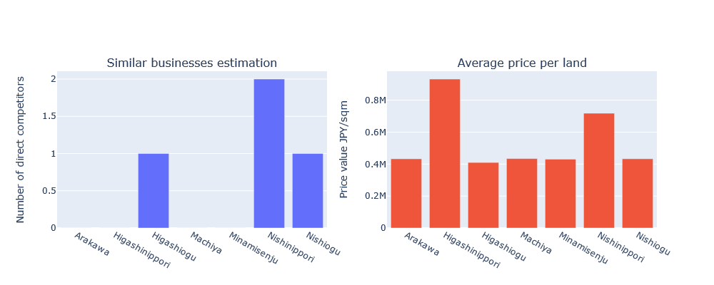
METHODOLOGY - STEP THREE:
Figure 3 - Neighborhood analysis. The left bar plot shows the potential direct competitors for a new bakery. The right bar plot displays the average land price for each neighborhood in Japanese Yen ¥ per square mile.
Analysed each neighborhood’s potential direct competitors (left plot) and average price per land value (right plot).
From this data, two assumptions were made:
Higashinippori was excluded due to the high land price value (> 800,000¥);
Higashiogu, Nishinippori and Nishiogu were also excluded because similar businesses were already established (bakery, sandwich or pastry shop).
Therefore, potential neighborhoods to establish a new bakery should either be: Arakawa, Machiya or Minaminseju since they would have very similar land cost values and no established direct competition at present.

Slide 6
DISCUSSION
Tokyo is a city with enormous potential for new businesses, however, it is a high risk, high reward kind of situation. When starting a new business in such a competitive established market, location and access to target customers are key for the longevity of the business.
Through this analysis, I have used public data to narrow the number of options down to the neighborhood area. I am aware that some assumptions made about the chosen "bakery" study case may need to be re-adapted for other businesses that could have different priorities.
Further research could involve data regarding:
Commuting numbers in/out of each neighborhood: some services may want to establish themselves at a location where the masses converge to during the working week. Restaurants, for example, could want to target workers during their lunch break, thus, areas with the highest number of companies/number of employees ratio could be attractive in this situation.
The average age population within each neighborhood: some services have a target age group, which was not accounted for in this analysis.

Slide 7
CONCLUSION
REFERENCES
In such competitive ecosystems, it is difficult for a newcomer to know where to start a new business. It can also be challenging for investors to gauge how well a new business could perform in the short-mid term due to a multitude of variables. This analysis is not by far exhaustive, but hopefully can shed some insight on potential factors that could help in the decision or evaluation making process.
[1] Tokyo Information -> https://en.wikipedia.org/wiki/Tokyo [2] Tokyo density numbers -> https://www.metro.tokyo.lg.jp/tosei/hodohappyo/press/2021/01/28/01.html [3] Tokyo Ward list -> https://en.wikipedia.org/wiki/Special_wards_of_Tokyo#List_of_special_wards [4] Market value for land in Tokyo -> https://utinokati.com/en/details/land-market-value/area/Tokyo/ [5] Japan Postcode finder -> https://japan-postcode.810popo.net/tokyoto/ [6] Geocoder -> https://geocoder.readthedocs.io/ [7] Foursquare -> https://foursquare.com/ [8] Google Maps -> https://www.google.com/maps (To obtain coordinates for each neighborhood as an alternative) [9] Geojson file creator -> https://geojson.io/#map=20/35.75063/139.74093 (To create my own Choropleth)
[1-5] - Accessed on the 13/06/2021.

