Slide 1

COFFE SHOP CHAIN
Damian Wieczorek
Hubert Gibasiewicz
Mateusz Kacprowicz

Slide 2
COFFE SHOP CHAIN
Damian Wieczorek
Hubert Gibasiewicz
Mateusz Kacprowicz

Slide 3
TABLE OF CONTENTS
Company
Database Schema
01
03
User stories
02
Proposed database schema
Company and market sector description
Architecture Scope
04
Needs of the company executives
Proposed AWS services
Data Flow
05
Connections of system and data

Slide 4
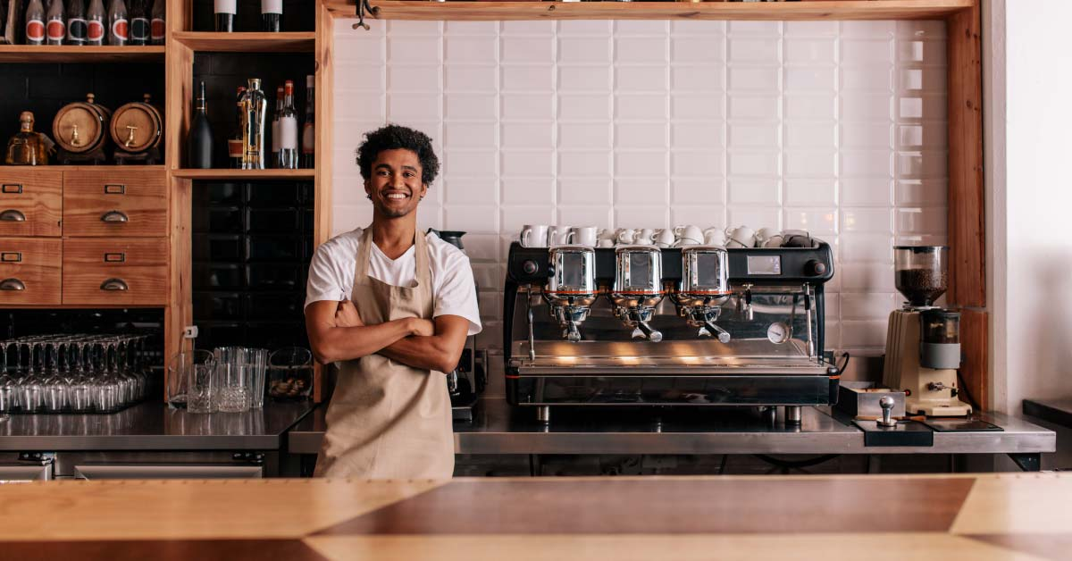
The Bros Coffee Shop
The Bros Coffee Shop is a chain of coffee shops located in New York City. It currently operates 3 coffee shops and employs 25 people.

Slide 5
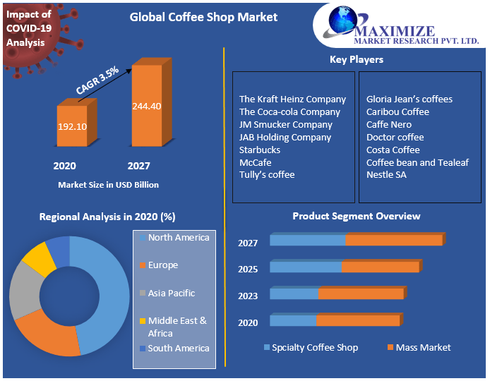
Coffee Market
Global Coffee Shop Market size was valued at US$ 192 Bn.
Coffee is the highest traded agricultural commodity across the globe.
In the US with a total number of coffee shops accounted 37,189 in 2020.
Coffee is the most preferable drink in the US and has the highest consumption after carbonates and bottled water

Slide 6



HOBBIES
User Stories
GENERAL MANAGER
I don’t know the sales of the stores
MARKETING MANAGER
I don’t know the demographic data of our customers
SUPPLY CHAIN MANAGER
I don’t know which products are wasted the most
HR MANAGER
I don’t know which employees are the best sellers and which are underperforming

Slide 7

Database schema

Slide 8
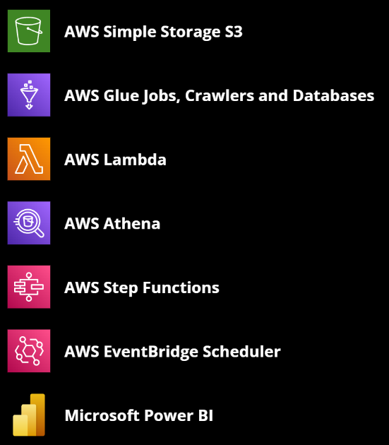
Architecture scope

Slide 9
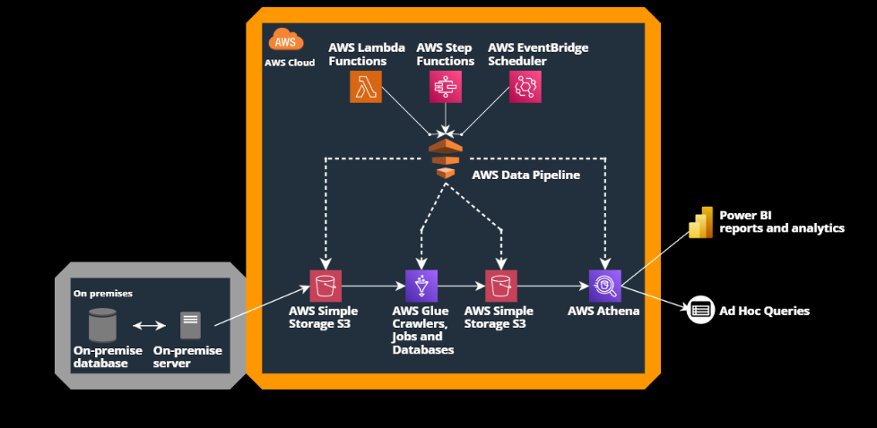
Data Flow

Slide 10
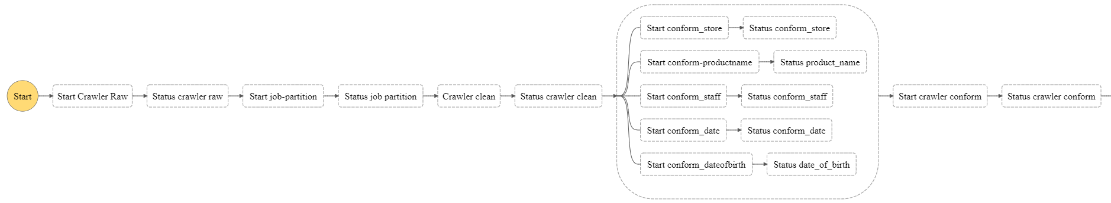
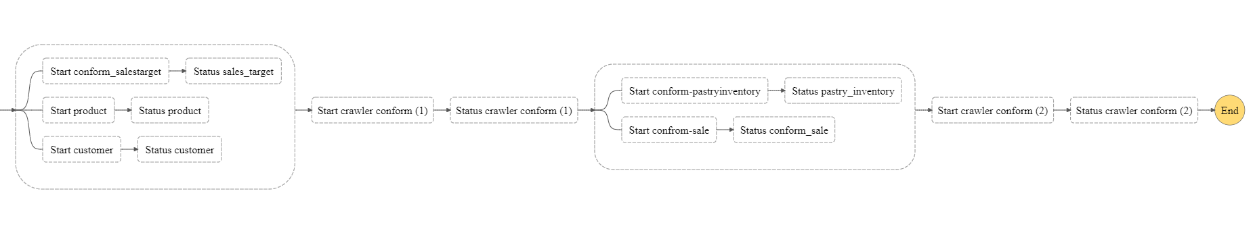
AWS Step Function

Slide 11
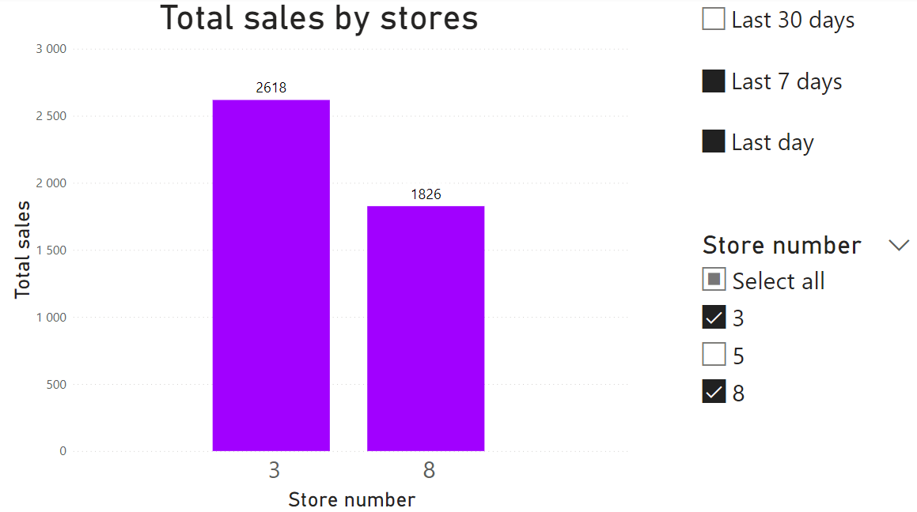
Power BI report

Slide 12
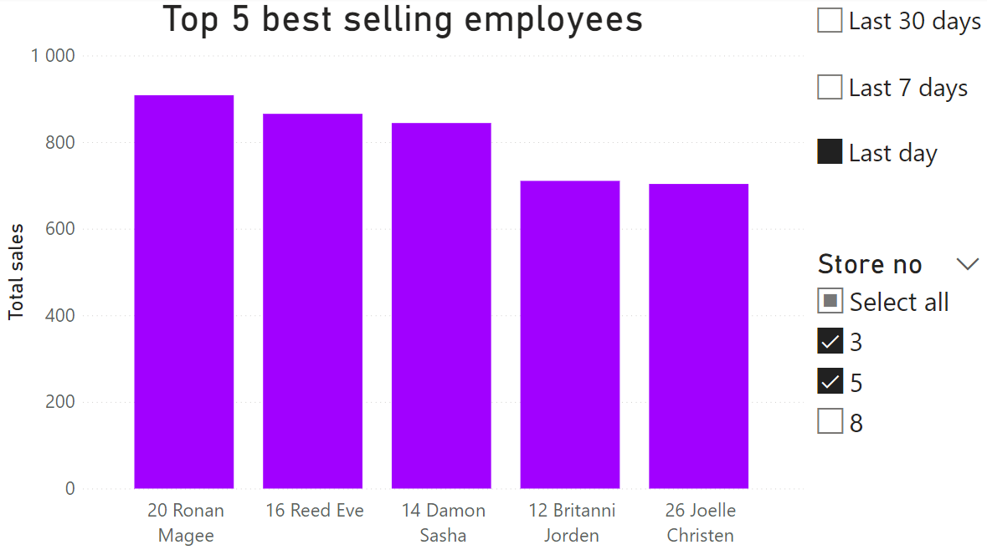
Power BI report

Slide 13
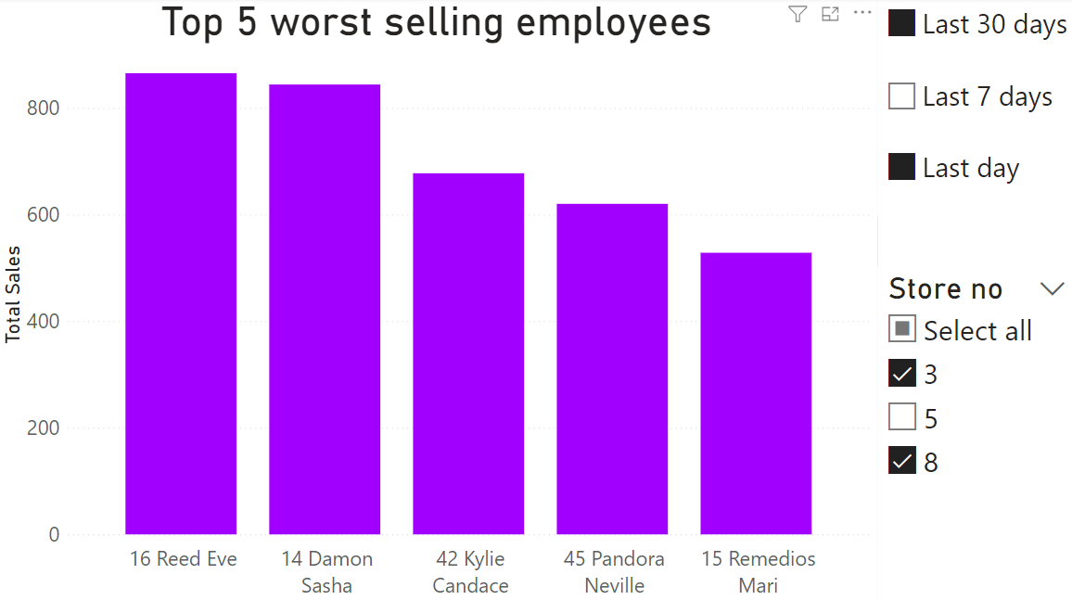
Power BI report

Slide 14
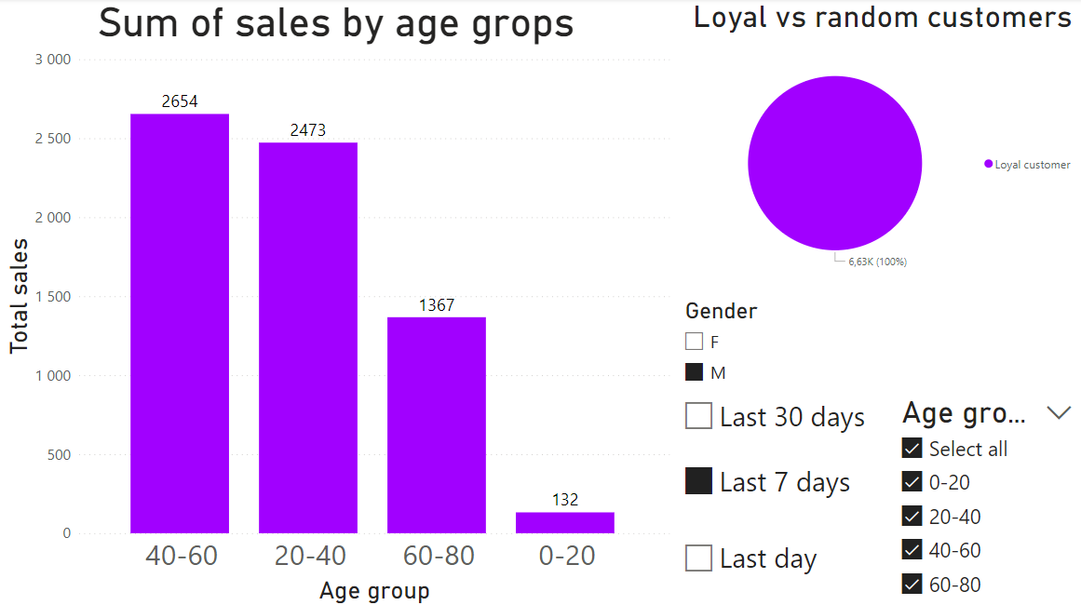
Power BI report

Slide 15
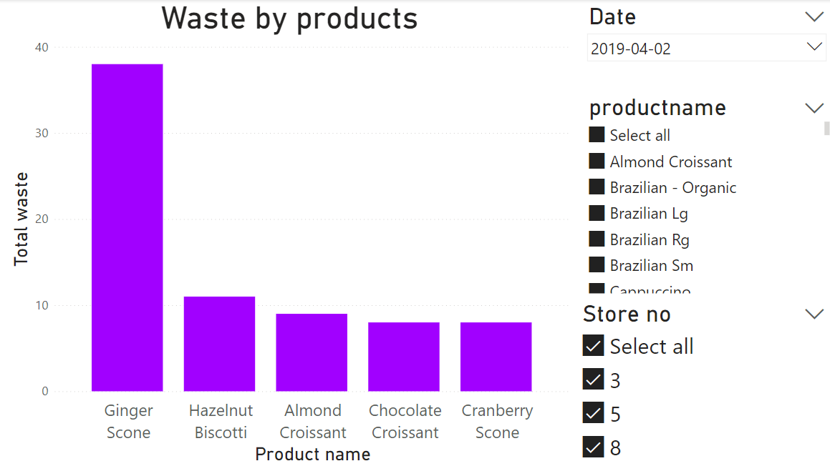
Power BI report

Slide 16

Thank you for your attention

