Slide 1
Tomato Classification for Quality Assessment Using CNN with Attention Mechanism in Python
Done by
23CSEG09(Kamalakannan M)
23CSEG31(Suji D)
23CSEG32(Sujitha A)
23CSEG33(Sumaiya S ) 23CSEG19(Nivetha C)
1

Slide 2
TABLE OF CONTENT
Abstract
Introduction
Problem Statement
Literature Review
Methodology
Result and Discussion
Conclusion
Reference

Slide 3
ABSTRACT
Tomato quality assessment using CNN with Attention Mechanism in Python.The process begins with extensive preprocessing, including image resizing, scaling, and augmentation, to increase dataset variability and robustness. A CNN model is designed with multiple convolutional layers, followed by an attention layer to capture spatial dependencies. The model is then trained and validated on a labeled dataset, with evaluation metrics including accuracy, precision, recall, and F1-score. Results demonstrate that the attention-enhanced CNN outperforms traditional CNN models in terms of accuracy and classification quality, making it a promising tool for automated tomato quality assessment.

Slide 4
INTRODUCTION
Tomato quality assessment is a critical task in the agricultural industry, impacting both consumer satisfaction and supply chain efficiency.
In this work, present a deep learning-based solution for the classification of tomatoes into four quality categories: Ripe, Unripe, Old, and Damaged, using an image dataset.
A CNN model is designed with multiple convolutional layers, followed by an attention layer to capture spatial dependencies.
The model is then trained and validated on a labeled dataset, with evaluation metrics including accuracy, precision, recall, and F1-score.

Slide 5
PROBLEM STATEMENT
The manual inspection of tomatoes, which classifies them into categories like ripe, unripe, old, and damaged, is both labor-intensive and prone to human error. This can lead to inefficiencies, such as misclassification, product waste, and inconsistent quality in the market.
To address these challenges, automated systems using image classification techniques have become increasingly important.

Slide 6
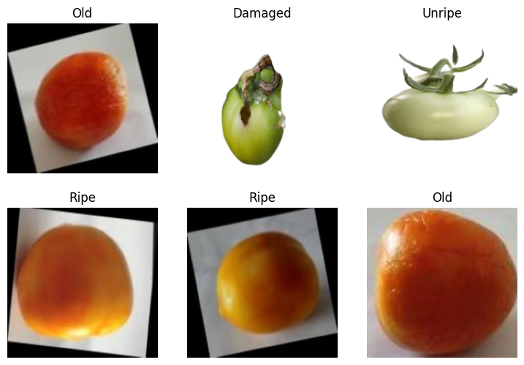
DIFFERENT CLASS

Slide 7
Some of the important factors
Shape
Color
Texture
Here for identify and extract sensitive features ,so Attention mechanism plays a very crucial role for accurately classify .

Slide 8
Literature Review
The article "Attention mechanisms in computer vision: A survey" by Meng-Hao Guo et al. offers a detailed examination of attention mechanisms and their transformative role in computer vision. The authors categorize various attention methods based on their operational domains rather than specific applications, providing a structured understanding of these mechanisms. The survey traces the evolution of attention mechanisms through four key phases: the initial use of recurrent neural networks (RNNs), explicit region prediction, implicit attention processes, and the rise of self-attention methods.
The authors highlight the advantages of attention-based models over traditional convolutional neural networks (CNNs), particularly in terms of flexibility and performance on diverse image sizes.

Slide 9
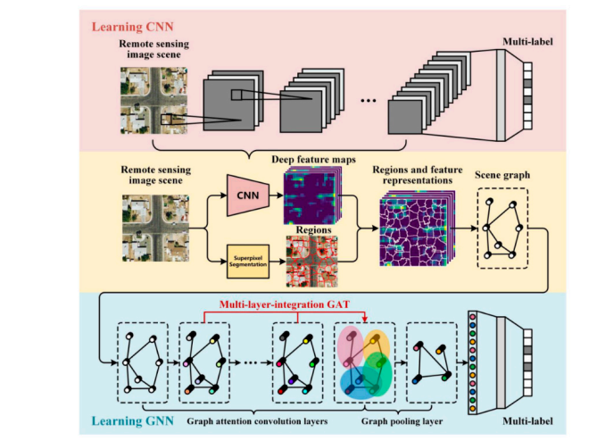
Fig 1 - Source : https://link.springer.com/article/10.1007/s41095-022-0271-y#preview

Slide 10
2. Deep learning-based approach for tomato classification in
complex scenes
This paper presents a research study focused on developing an automated system for classifying the maturity of tomatoes using deep learning techniques. The study highlights the importance of product quality in the agricultural industry, particularly in optimizing harvesting and post-harvest processes. Traditional inspection methods are often manual, time-consuming, and subjective, prompting the need for automated solutions.
The proposed system utilizes a deep neural network to classify tomato images into five maturity categories: green, brittle, pink, pale red, and mature red. The dataset for training the model consists of images collected from various online sources in multiple languages. The research emphasizes the integration of machine learning methodologies to enhance the accuracy and efficiency of tomato classification.

Slide 11
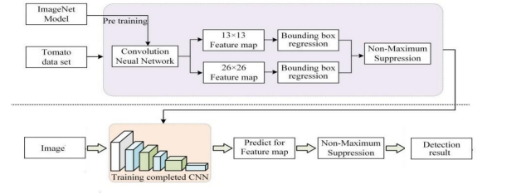
Fig 2 - Source : https://arxiv.org/pdf/2401.15055

Slide 12
Workflow and Methodology
Step | Workflow (What) | Methodology (How)
1. Problem Definition | Define the classification task: ripe, unripe, old, or damaged tomatoes. | Implement a CNN with an attention mechanism to capture relevant features.
2. Data Collection | Collect and preprocess images of tomatoes in the four categories. | Resize images to 224x224 pixels, normalize pixel values, and apply data augmentation (e.g., rotation, flip, zoom).

Slide 13
3. Model Architecture | Design the neural network for classification. | Use a CNN architecture (e.g., Relu) with an added attention mechanism (softmax).
4. Training the Model | Train the CNN on the labeled tomato images. | Utilize categorical multi cross-entropy as the loss function and Adam optimizer for training.
5. Evaluation | Assess the model's classification performance | Evaluate with accuracy(90%), precision, recall, F1-score, and visualize results using a confusion matrix.

Slide 14
6. Fine-tuning & Optimization | Refine the model for optimal performance. | Refine the model for optimal performance.
7. Deployment | Deploy the trained model for real-time classification. | Save the model as a TensorFlow SavedModel and develop an inference pipeline for runtime image classification.

Slide 15
Model Architecture
Input Layer: (150, 150, 3)
Conv2D (32 filters, 3x3): Output Shape: (148, 148, 32)
MaxPooling2D (2x2): Output Shape: (74, 74, 32)
Conv2D (64 filters, 3x3): Output Shape: (72, 72, 64)
MaxPooling2D (2x2): Output Shape: (36, 36, 64)
Conv2D (128 filters, 3x3): Output Shape: (34, 34, 128)
MaxPooling2D (2x2): Output Shape: (17, 17, 128)

Slide 16
Attention Block: Output Shape: (17, 17, 128) (multiplied by attention map)
Flatten: Output Shape: (36992,)
Dense (512 units): Output Shape: (512,)
Output Dense (4 units, softmax): Output Shape: (4,)

Slide 17
RESULT AND DISCUSSION
COLAB LINK: https://colab.research.google.com/drive/1ylkYjNXQQlyFOu9Ha1qF8RN6Pq8a0w_U?usp=sharing
Correct Classifications: The diagonal of the confusion matrix shows the number of correct predictions for each class:
Damaged: 10 correct predictions
Old: 84 correct predictions
Ripe: 74 correct predictions
Unripe: 50 correct predictions
Misclassifications:
Damaged tomatoes were often misclassified as Old, Ripe, or Unripe.
Old tomatoes were misclassified as Ripe or Unripe.
Ripe tomatoes were also misclassified as Old or Unripe.
Unripe tomatoes were mistaken for other classes at a moderate rate.

Slide 18
CONCLUSION
The model achieves a promising validation accuracy of 88.12%, indicating that it performs well on the tomato classification task. However, the confusion matrix analysis reveals areas where the model struggles, particularly in distinguishing between classes with overlapping features such as Old and Ripe or Unripe tomatoes. By incorporating additional data augmentation, advanced architectures, and more sophisticated attention mechanisms, the model's performance could be further improved.

Slide 19
Reference
https://link.springer.com/article/10.1007/s41095-022-0271-y#preview
https://arxiv.org/pdf/2401.15055
https://philarchive.org/archive/ALATOT
https://www.mdpi.com/2223-7747/12/4/790
https://www.ijisae.org/index.php/IJISAE/article/view/2538

Slide 20
THANK YOU

