Slide 1
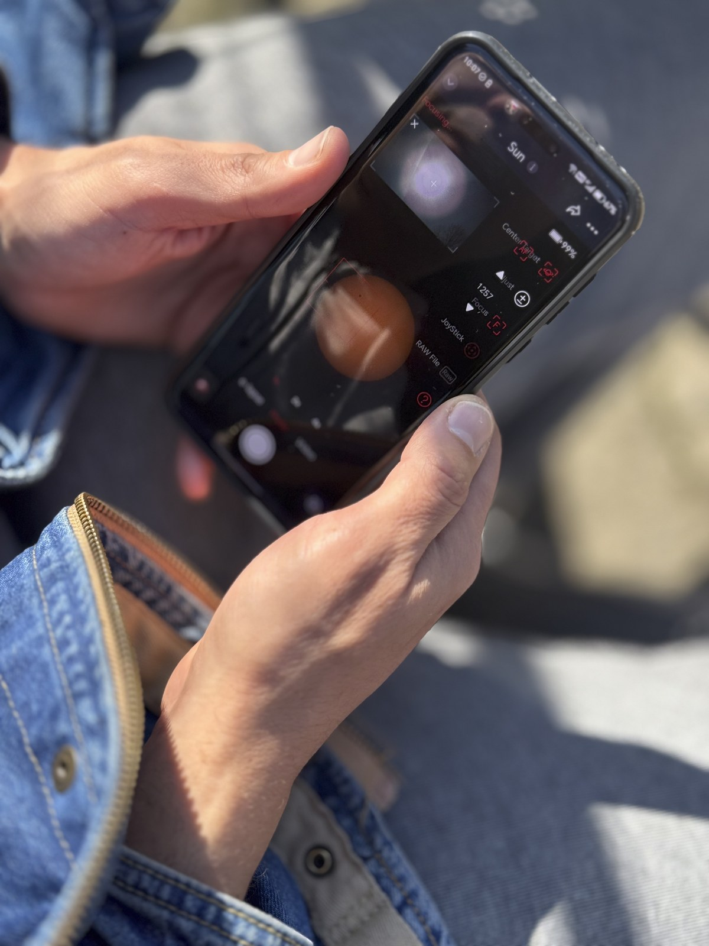
SMART LIVING / ACCESSIBILITY TECH • iQOO HACKATHON 2026
Drishti
दृष्टि • Phone-First On-Device AI Sensory Companion
“An instant, private, offline sensory companion for the visually impaired”
INSTANT REACTION
Zero cloud latency lag
100% PRIVATE
Zero video leaves device
FULLY OFFLINE
Verified in Airplane Mode
SMART LIVING
Everyday independence
PHONE-FIRST ASSISTIVE TECH
Transforming everyday smartphone cameras into instant, private spatial sensory prosthetics.

Slide 2
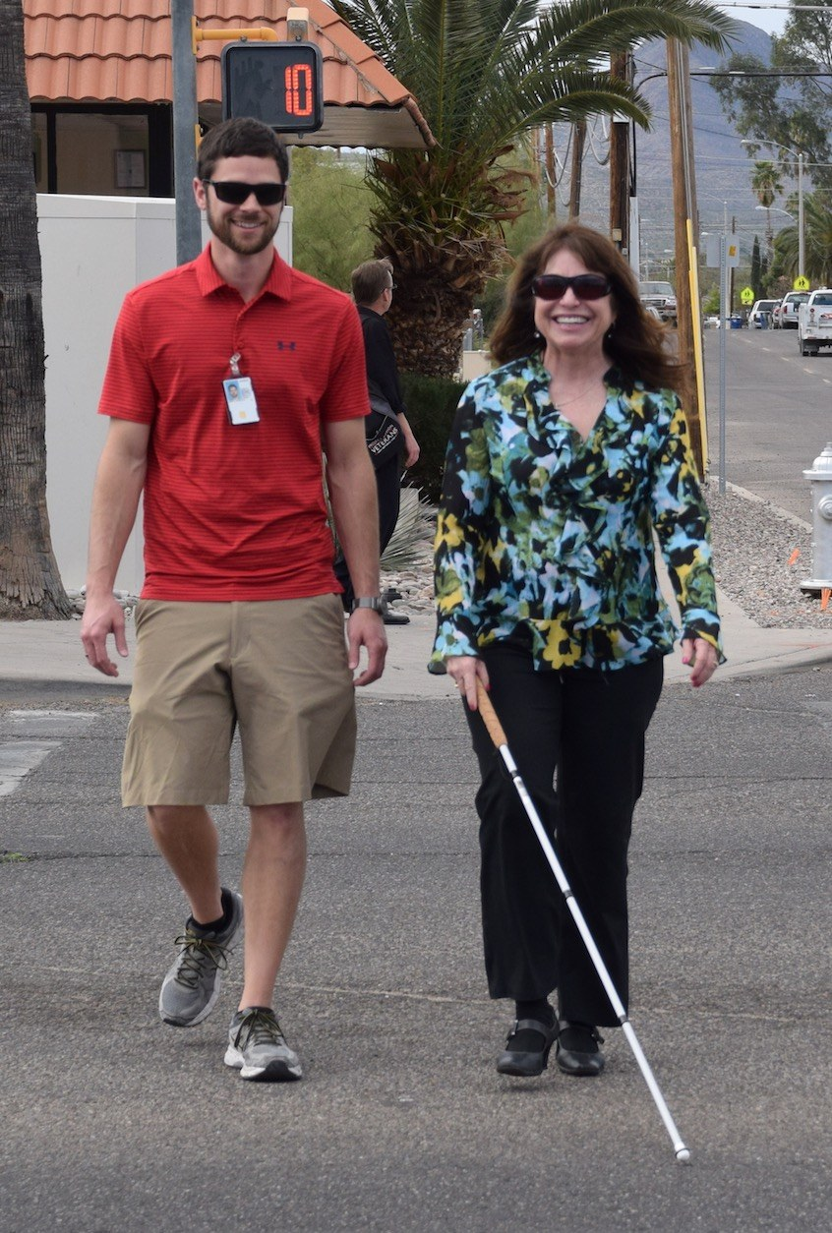
THE REAL-WORLD CRISIS
The Problem: Why Existing Assistive Tech Fails
Over 40 million people in India live with severe visual impairment. Cloud-dependent aids fail them in 3 critical ways:
01 Cloud Latency is Dangerous
• Cloud vision APIs take 2 to 5 seconds per request.
• A pedestrian moving at 1.2 m/s travels 4 to 6 feet in that delay window.
• In obstacle avoidance, that delay causes collisions with poles, doors, and stairs.
02 Severe Privacy Vulnerability
• Users must upload live camera feeds of private bedrooms, bathrooms, and IDs.
• Transmits sensitive documents (Aadhaar, prescriptions) to 3rd-party servers.
• Users should never have to surrender their privacy just to achieve basic mobility.
03 Connectivity Fragility
• Essential transit corridors (metro stations, elevators, rural zones) lack internet.
• The moment connection drops, cloud-tethered apps instantly disable.
• Leaves visually impaired users stranded and functionally blinded when they need help most.
THE EVERYDAY HAZARD
Navigating city crosswalks requires sub-second reflex. A 2-second cloud vision lag causes physical injury and collisions.

Slide 3

FULLY ON-DEVICE AI COMPANION
The Solution: What Drishti Does
Runs 100% offline on local phone silicon with zero cloud calls across 4 core accessibility capabilities:
01 Spatial & Scene Guidance
• Real-time obstacle narration via local quantized VLM.
• 12 clock-face sectors ('Obstacle at 2 o'clock, 3 ft').
• Directional linear haptic pulses guide around hazards.
02 Smart-Scan for Medicine
• On-device OCR + local LLM filters noisy blister packs.
• Isolates Drug Name, Dosage, and Expiry Date.
• Vocalizes vernacular directions ('Take after food').
03 'Who's Near Me' Contact Scan
• On-device contact recognition for trusted individuals.
• 128-d local embeddings stored only on-device.
• Whispers proximity alert with heartbeat haptic pulse.
04 Pure Tactile & Voice UX
• Eyes-free high-contrast OLED interface.
• Spatial audio + localized Indian speech engines.
• Proximity vibrations guide hands directly to targets.
MEDICINE SMART-SCAN IN ACTION
Reads noisy pharmaceutical strips, dosage, and expiry dates offline in sub-second time.

Slide 4
CORE DIFFERENTIATORS
What Makes Drishti Different
Engineering decisions purpose-built for real Indian living conditions and hardware accessibility:
01 Tiered Model Strategy
• Standard Model: Runs on flagship NPU (iQOO devices) for rich contextual description.
• Lite Model: Optimized for budget & mid-range chips (Dimensity 6300/7300, Snapdragon 6).
• Ensures accessibility across all economic demographics, not just flagship buyers.
02 Live Real-World Latency Benchmark
• Not simulated or mocked: fires a real HTTP network call against local stopwatch.
• Demonstrates local processing is an order of magnitude faster than cloud round-trips.
• Includes cached replay fallback if convention Wi-Fi is completely down.
03 100% Offline-Verifiable (Airplane Mode)
• Airplane mode toggle proves zero network calls during live evaluation.
• Operates flawlessly in basements, elevators, underground metros, and remote regions.
• Zero cloud dependency: guaranteed reliability when it matters most.
04 Local Encrypted Face Recognition
• 128-dimensional vector embeddings stored strictly on-device.
• Encrypted at rest with WebCrypto AES-GCM 256-bit encryption.
• Zero biometric data ever transmitted or uploaded to external servers.

Slide 5
SIMPLE, VISUAL, ZERO CLOUD
Technical Architecture: Fully On-Device Pipeline
Pure on-device edge pipeline converting raw camera & motion frames into spatial speech and haptics:
01 Sensory Input Layer
• Low-latency 640x480 frame capture
• Accelerometer tilt & back-tap detection
• Zero frame buffering or disk writing
02 On-Device Inference
• Quantized VLM for spatial scene analysis
• On-device OCR for medicine labels
• Local LLM for text summarization
03 Multi-Sensory Output
• Clock-face spatial audio guidance
• Pan-Indian speech (Telugu, Hindi, etc.)
• Proximity vibration pulse sequences
HARDWARE SCALING & AIR-GAPPED PRIVACY GUARANTEE
• Standard Tier (NPU): Leverages mobile NPU hardware (iQOO flagship chips) for multi-object spatial reasoning.
• Lite Tier (Edge CPU/GPU): Streamlined quantized weights running on affordable mid-range Indian smartphones.
• 100% Air-Gapped Autonomy: Zero network sockets, zero telemetry tracking, zero server infrastructure costs.

Slide 6
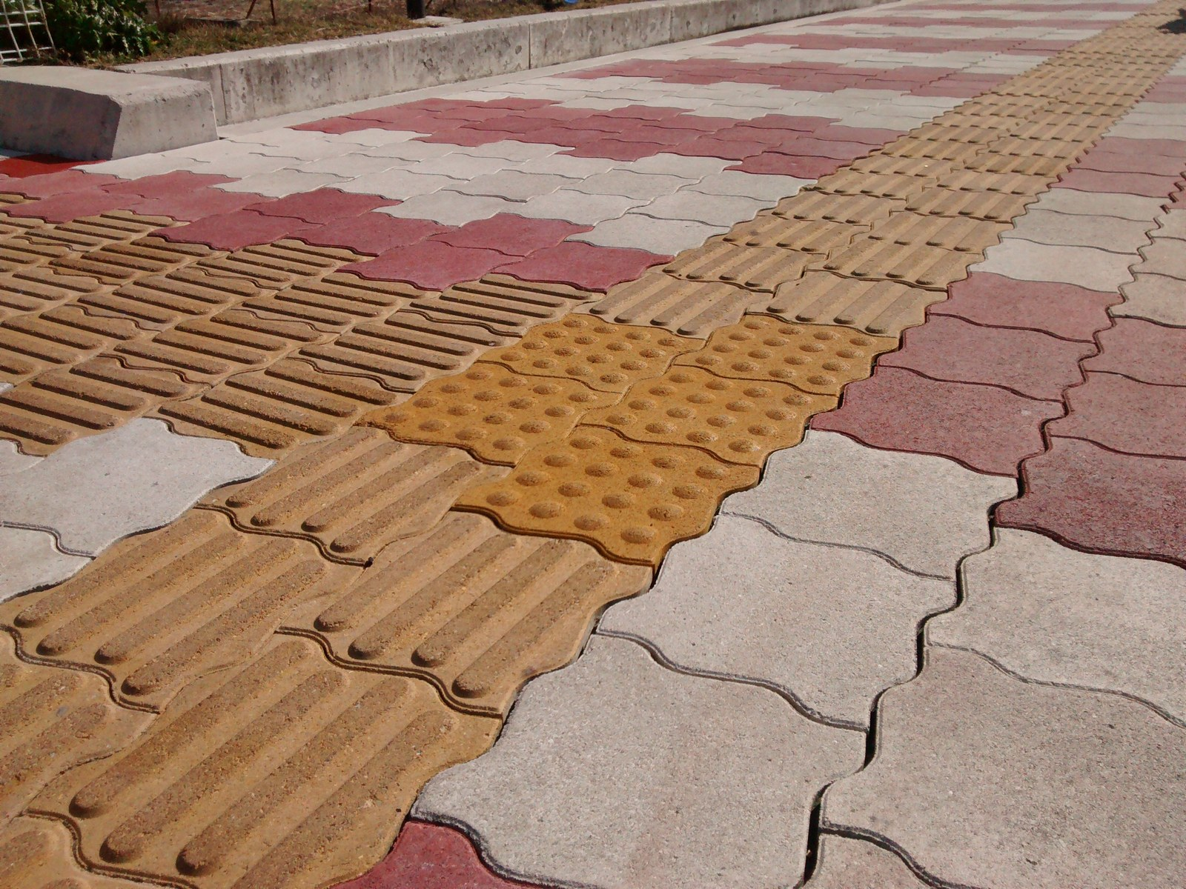
STAGE DEMO SCRIPT
Live Demo Flow: 5-Step Stage Sequence
Concise, bulleted 3-minute stage pitch sequence demonstrating instant, zero-cloud capability:
Step 1: Eyes-Free Navigation
Start in Eyes-Free Mode — phone camera scans stage, vocalizing 'Podium 4ft at 12 o'clock' with haptic feedback.
Step 2: The Airplane Mode Proof
Flip phone to Airplane Mode live on stage. Demonstrate continuous real-time guidance with zero Wi-Fi/cellular.
Step 3: Medicine Label Smart-Scan
Hold up a medicine strip (Dolo 650). Instantly reads brand name, dosage, and expiry date — no packaging clutter.
Step 4: 'Who's Near Me' Face Recognition
Teammate steps into frame. Phone vibrates distinct double-heartbeat and whispers contact name discreetly.
Step 5: Live Latency Benchmark
Trigger side-by-side benchmark comparing on-device execution vs. real cloud request to visually prove latency superiority.
TACTILE ACCESSIBILITY PROOF
100% verifiable offline operation in Airplane Mode — zero dependence on venue Wi-Fi or cellular networks.

Slide 7

REAL-WORLD PURPOSE
Impact & Why It Matters: Smart Living For All
Drishti transforms smartphones into private, reliable sensory prosthetics that empower everyday independence:
01 Real Everyday Independence
• Enables visually impaired individuals to navigate unfamiliar indoor/outdoor spaces safely.
• Empowers independent reading of daily medicines, food packaging, and transit signs.
• Restores personal dignity without relying on sighted assistants or chaperones.
02 Works on Budget Phones
• Not locked behind expensive $1,000+ proprietary smart glasses or flagship silicon.
• Tiered model strategy ensures accessibility on budget and mid-range devices across India.
• Democratizes assistive technology for underserved socio-economic communities.
03 Zero Subscriptions & Zero Data Harvesting
• Zero recurring monthly API fees or corporate subscription paywalls.
• Zero monetization of sensitive user camera feeds or personal biometric data.
• Complete reliability in offline transit corridors, rural villages, and emergency situations.
EVERYDAY INDEPENDENCE
Enabling elderly and low-vision individuals to read prescriptions, verify dosages, and navigate independently.

Slide 8
SMART LIVING • iQOO HACKATHON 2026 (HYDERABAD)
Drishti
दृष्टि • On-Device AI Sensory Companion
“Built entirely on-device.
Built entirely for independence.”
TEAM: [Team Name / Team Members]
Track: Smart Living / Accessibility Tech (Hyderabad City Battle)
GitHub: https://github.com/M-L-Arjun/drishti-ai
Live App: https://drishti-seven-mu.vercel.app
AUTONOMY IN SMART LIVING
Restoring mobility, safety, and personal dignity through zero-cloud on-device intelligence.

