Slide 1

Notes:
Diskette Drive

Slide 2
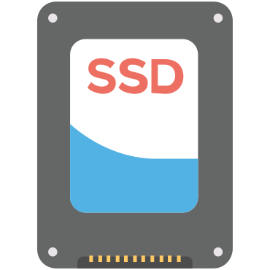
Notes:
Internal

Slide 3

Notes:
USB Storage Device

Slide 4

Notes:
CD/DVD/CD-RW Drive

Slide 5

Notes:
OnBoard NIC

