Slide 1
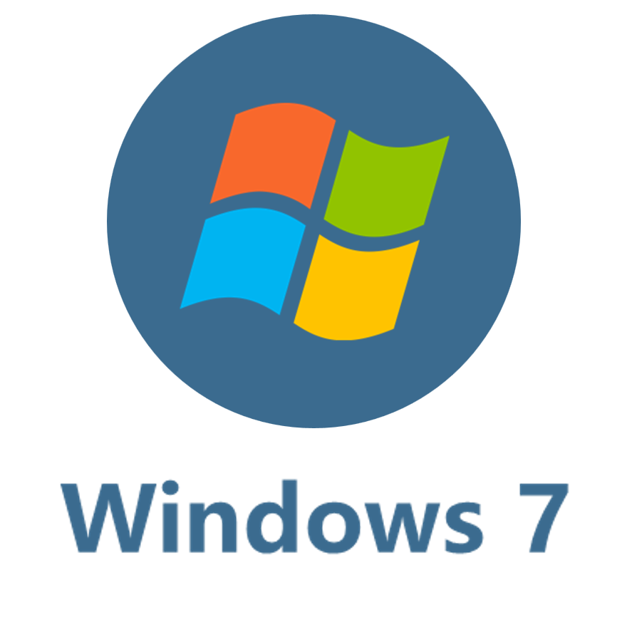


Microsoft
Notes:
Editor

Slide 2

Notes:
PNG

Slide 3



Windows 11
Notes:
Editor

Slide 4
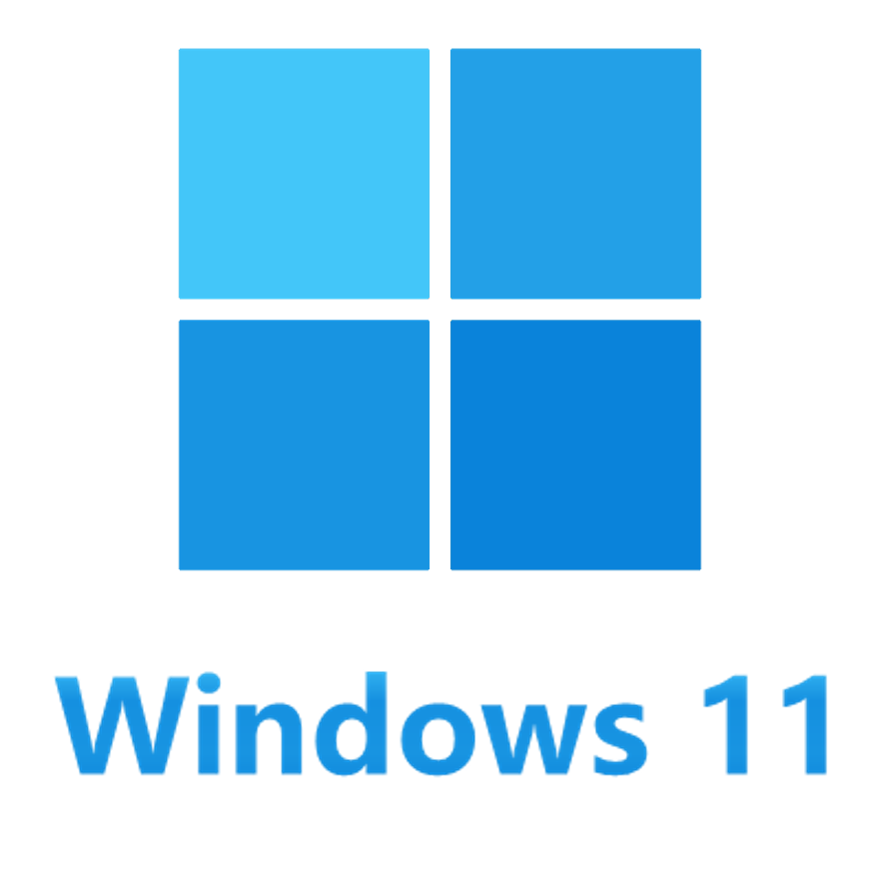
Notes:
PNG

Slide 5

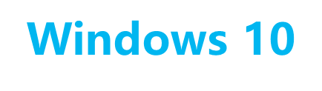
Windows 10
Notes:
Editor

Slide 6
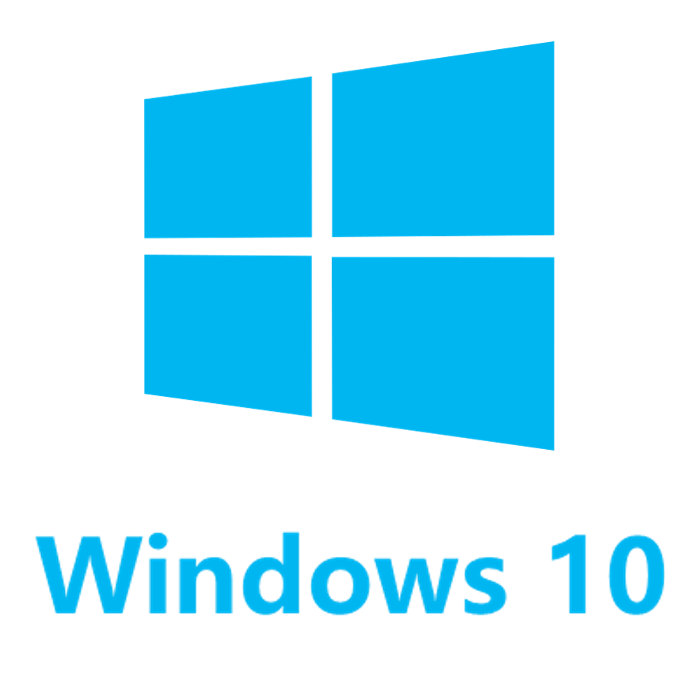
Notes:
PNG

Slide 7

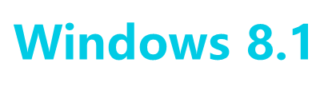
Windows 8.1
Notes:
Editor

Slide 8
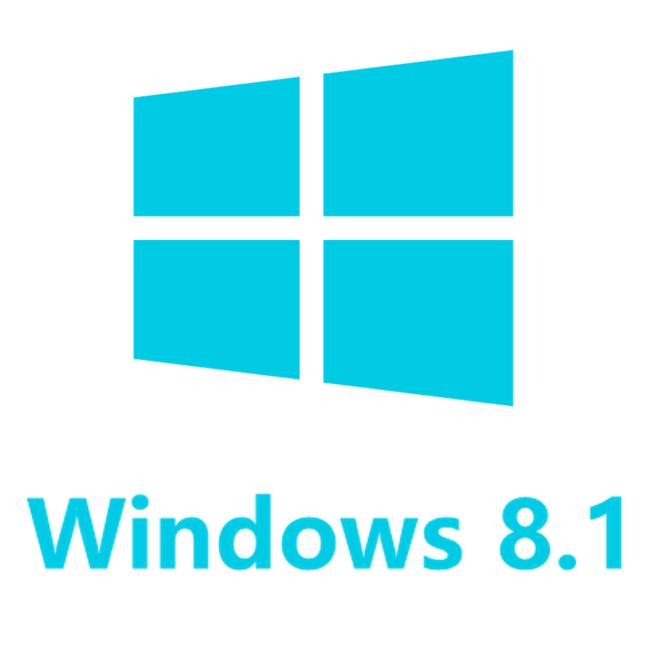
Notes:
PNG

Slide 9


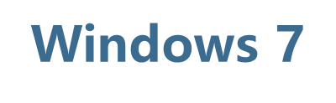
Windows 7
Notes:
Editor

Slide 10
Notes:
PNG

Slide 11

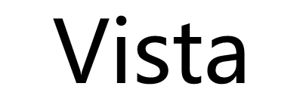
Vista
Notes:
Editor

Slide 12

Notes:
PNG

