Slide 1
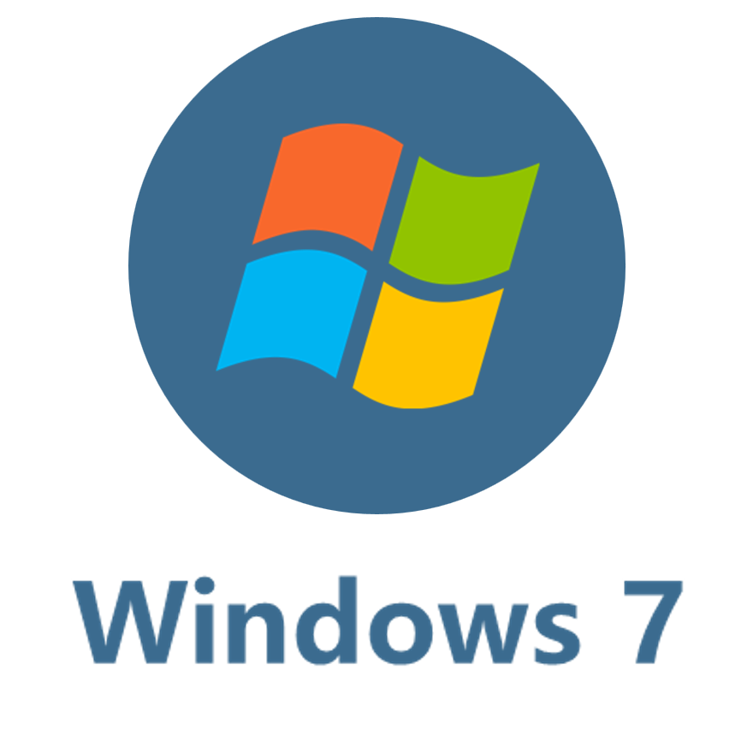


Microsoft
Notes:
Editor

Slide 2

Notes:
PNG

Slide 3



Windows 11
Notes:
Editor

Slide 4
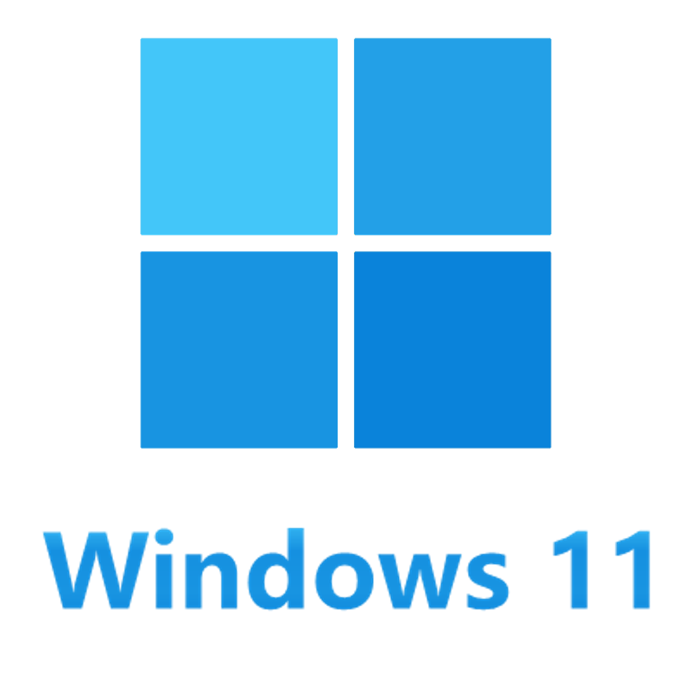
Notes:
PNG

Slide 5

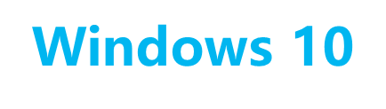
Windows 10
Notes:
Editor

Slide 6
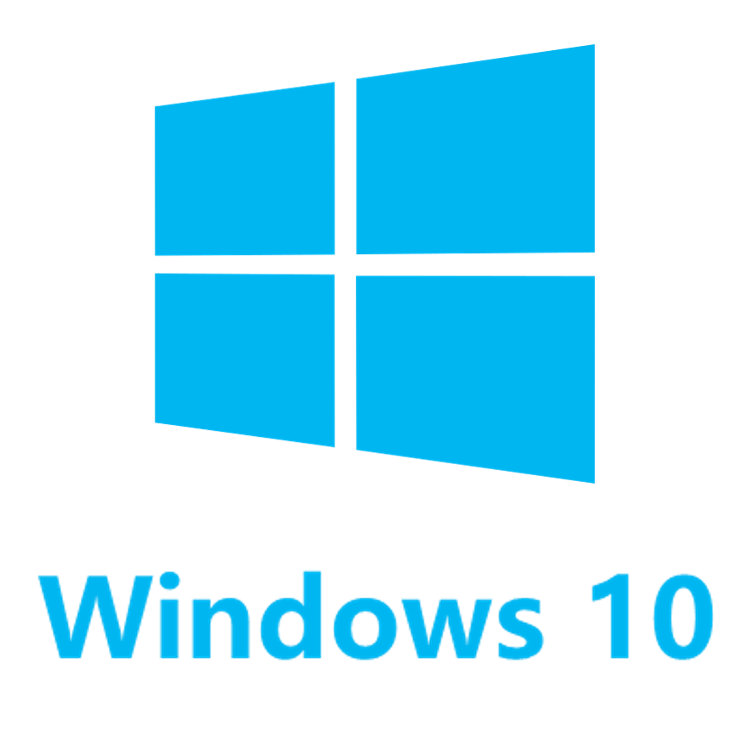
Notes:
PNG

Slide 7

Server
Notes:
Editor

Slide 8

Notes:
PNG

Slide 9

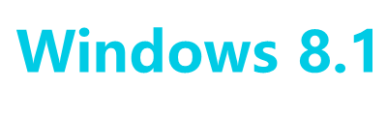
Windows 8.1
Notes:
Editor

Slide 10
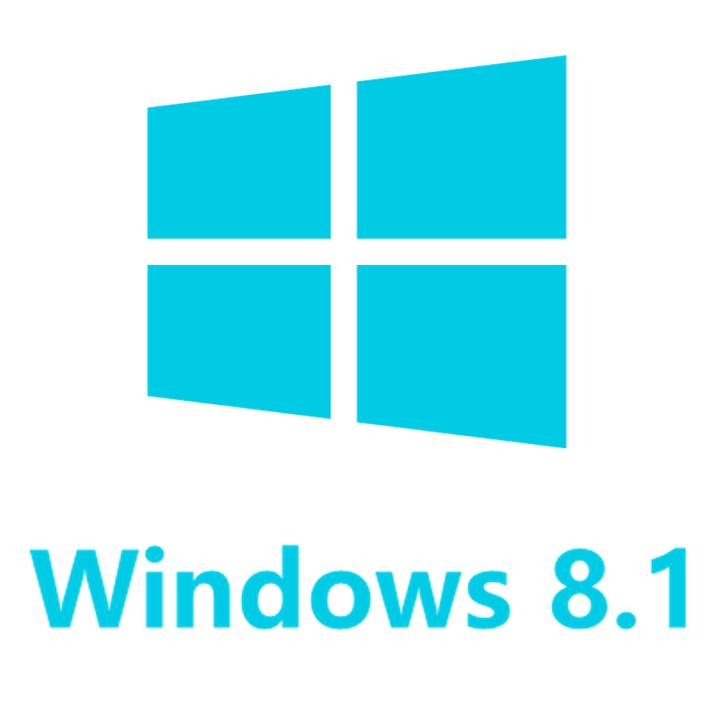
Notes:
PNG

Slide 11


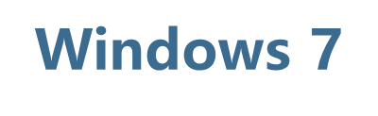
Windows 7
Notes:
Editor

Slide 12
Notes:
PNG

Slide 13


Vista
Notes:
Editor

Slide 14

Notes:
PNG

