Slide 1


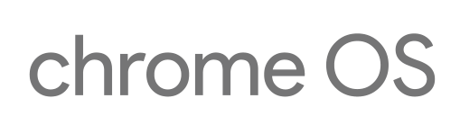


booting on chromebook
Notes:
Editor

Slide 2
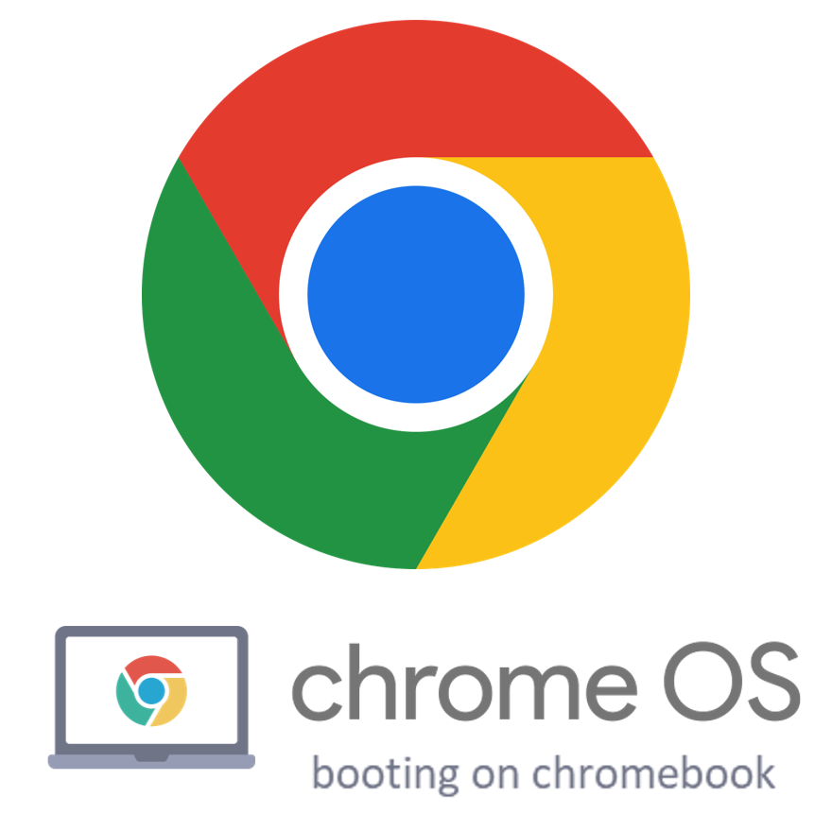
Notes:
PNG

Slide 3


chromeOS Flex
Notes:
Editor

Slide 4
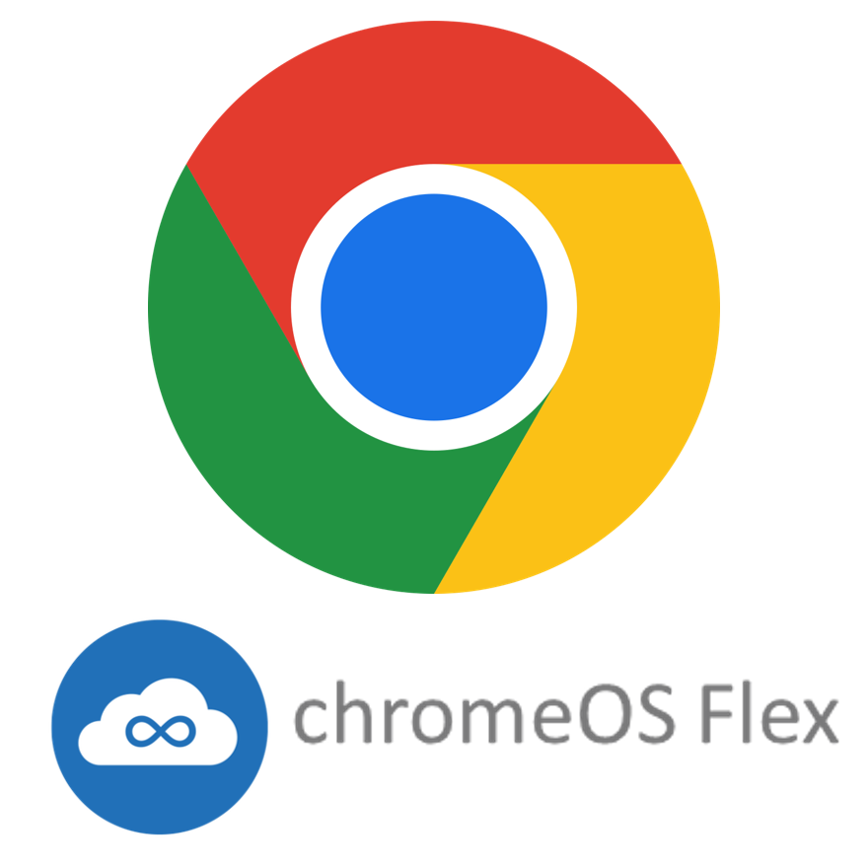
Notes:
PNG

Slide 5


booted by BrunchFramework
Notes:
Editor

Slide 6

Notes:
PNG

Slide 7




fydeOS dualboot
Notes:
Editor

Slide 8

Notes:
PNG

Slide 9
Notes:
Editor

Slide 10
Notes:
PNG

