Slide 1
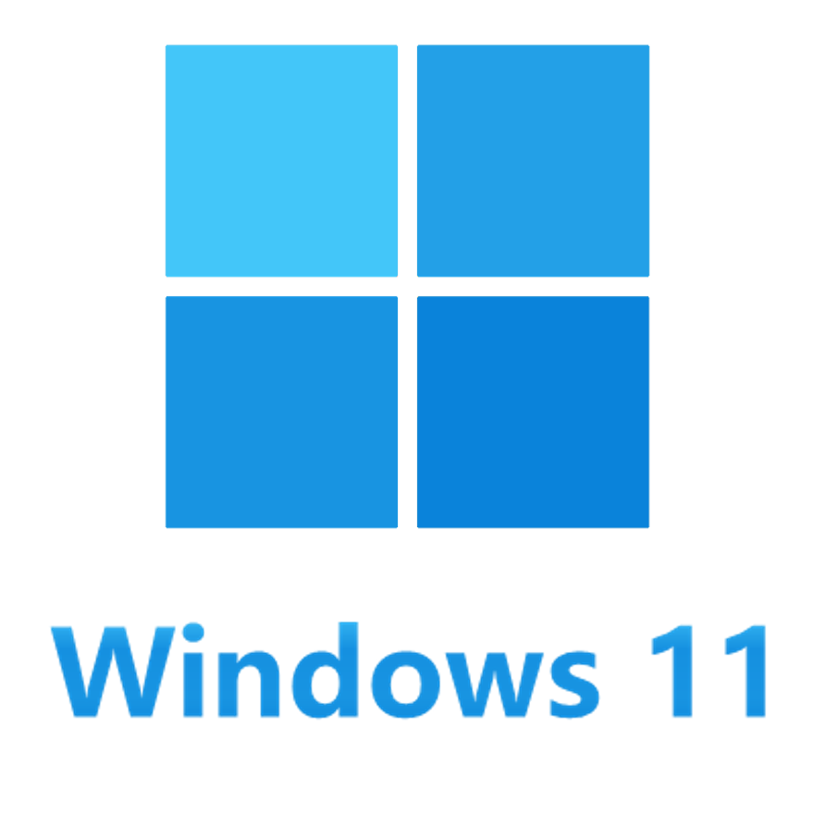





booting on Macintosh
macOS
Notes:
Editor

Slide 2

Notes:
PNG

Slide 3
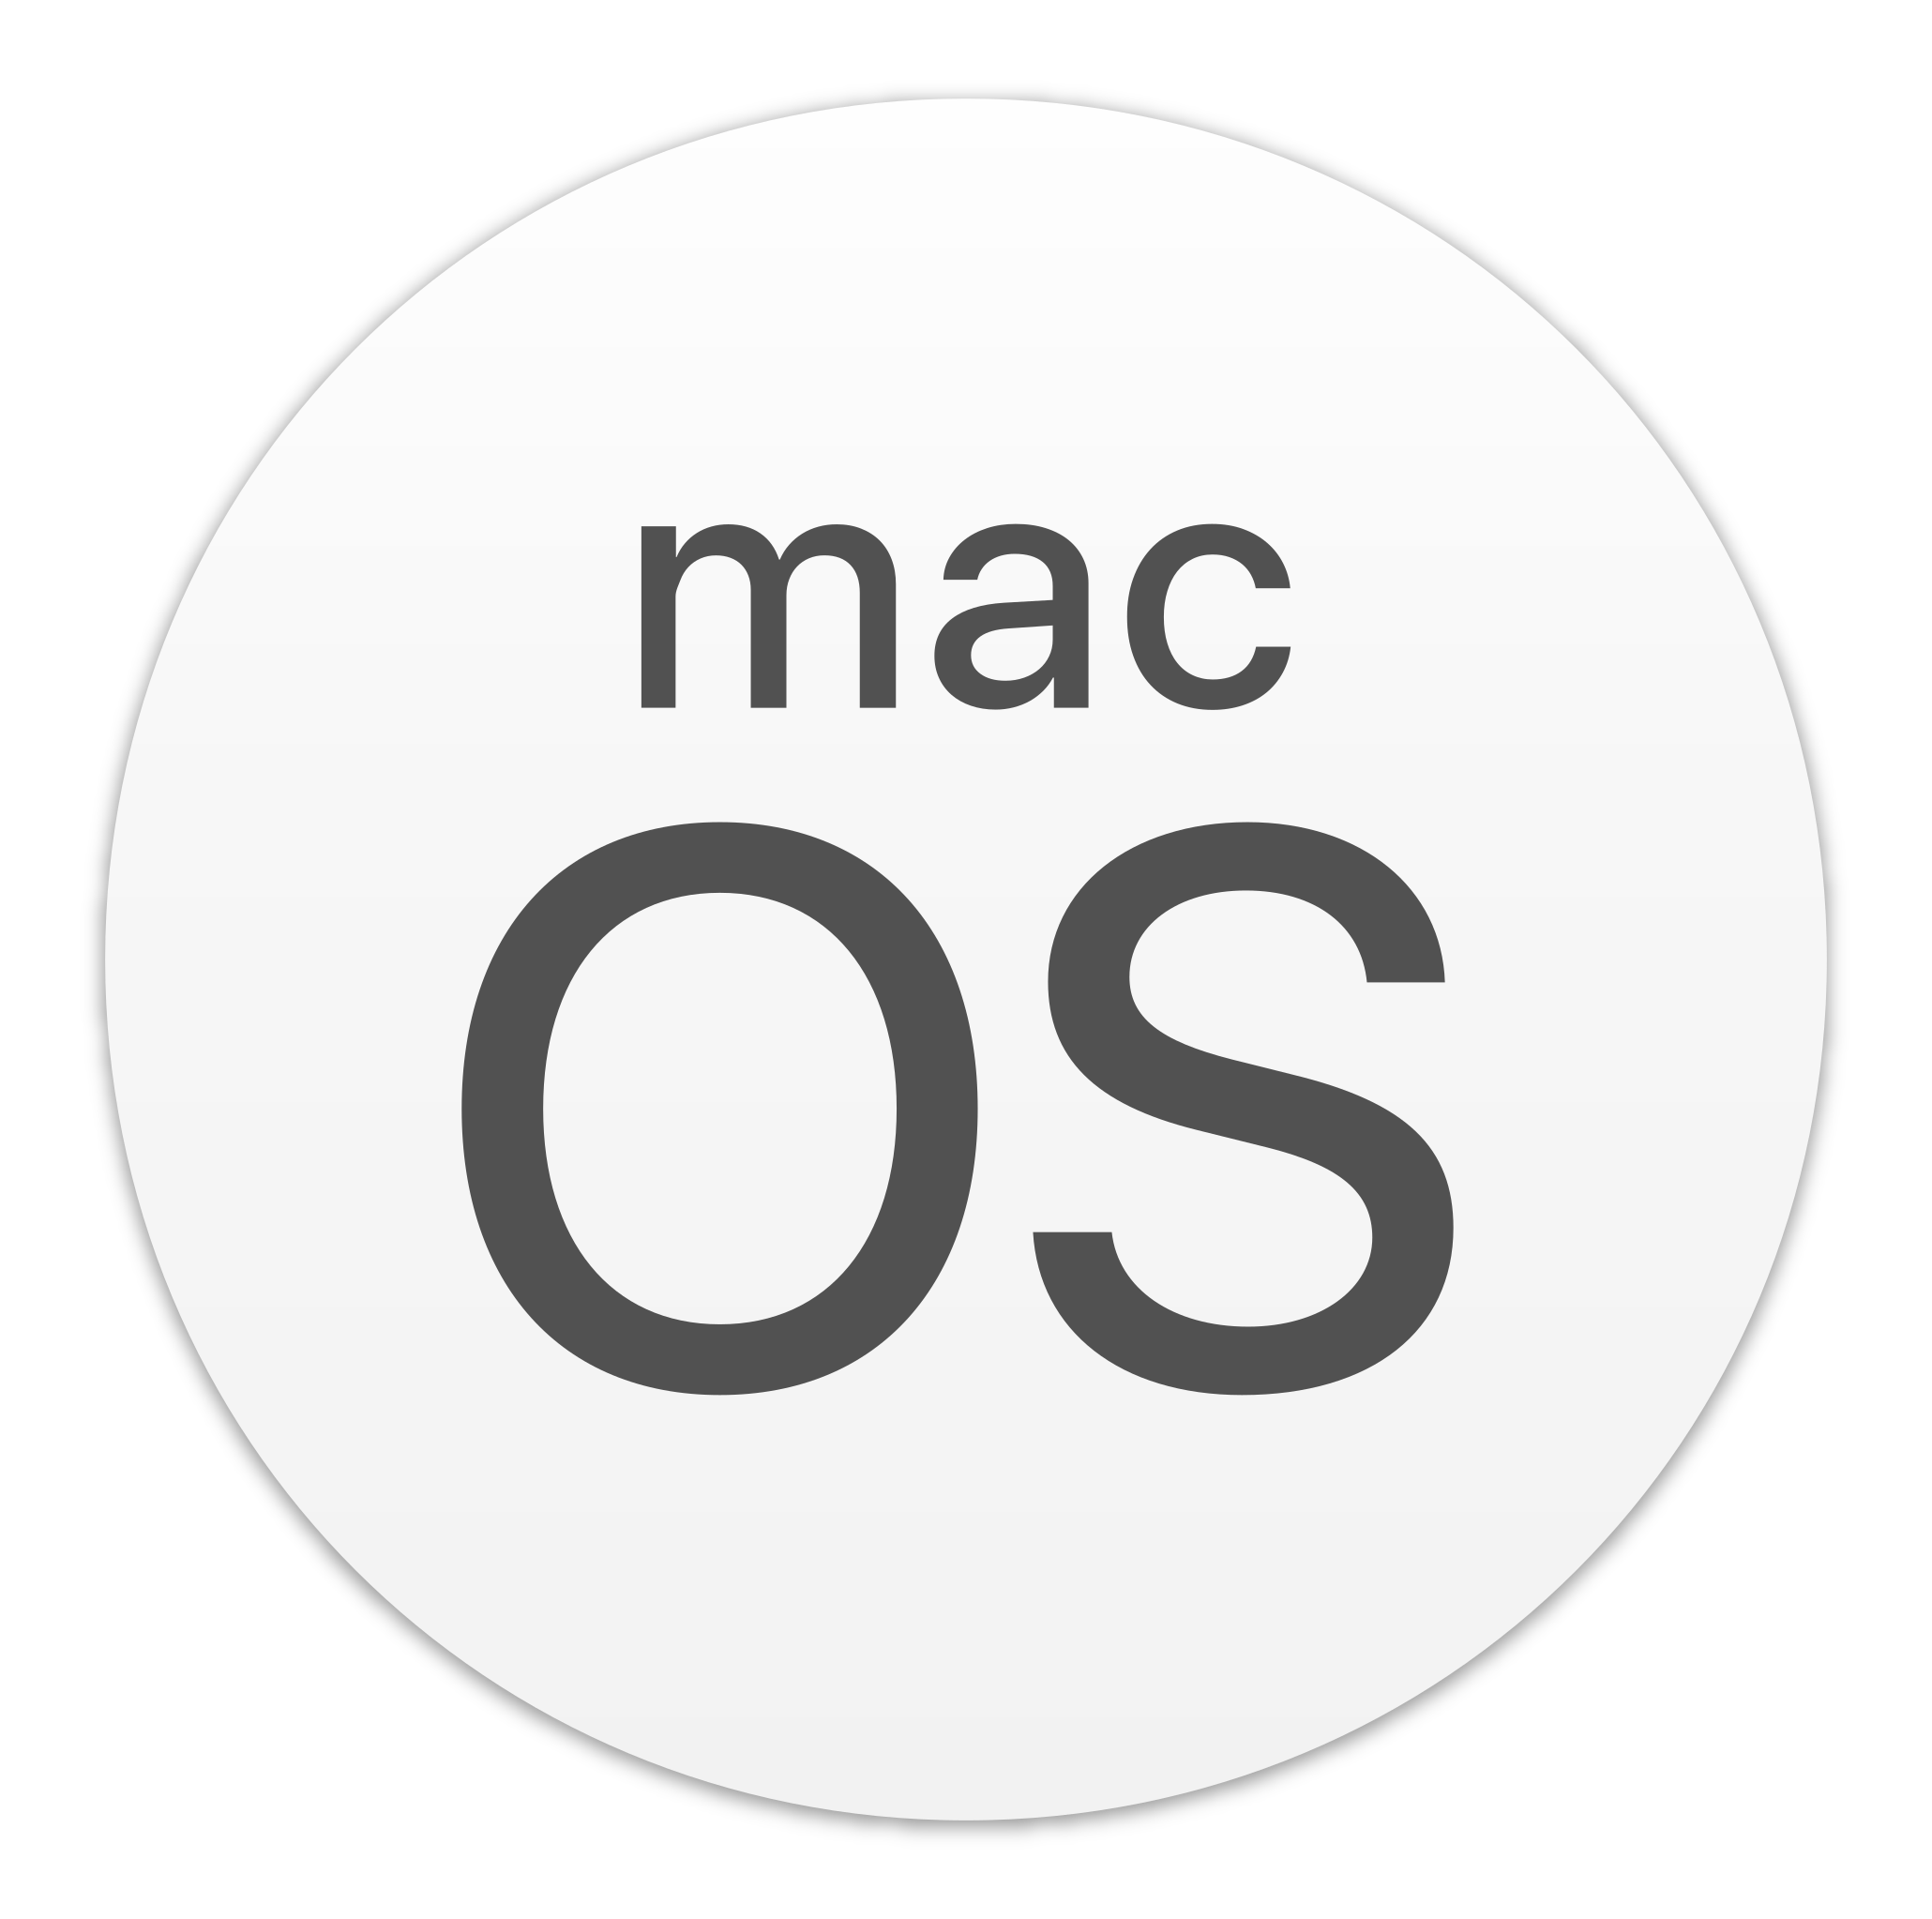
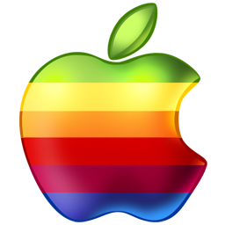
Notes:
Editor

Slide 4
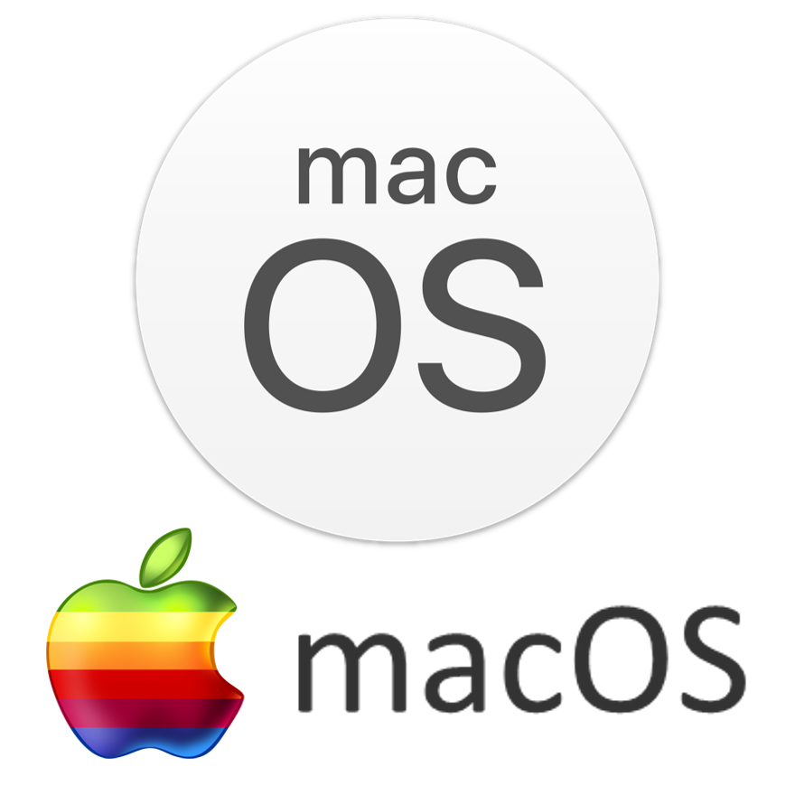
Notes:
PNG

Slide 5



booted by OpenCore
Notes:
Editor

Slide 6

Notes:
PNG

Slide 7



booted by CloverBootloader
Notes:
Editor

Slide 8

Notes:
PNG

Slide 9

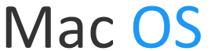
Mac OS
Notes:
Editor

Slide 10
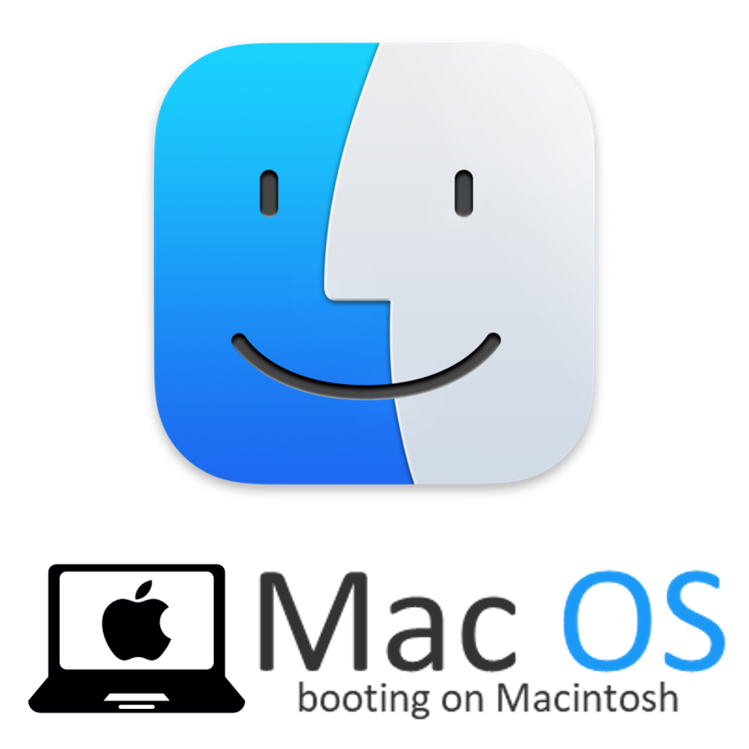
Notes:
PNG

Slide 11
Mac OS
Notes:
Editor

Slide 12
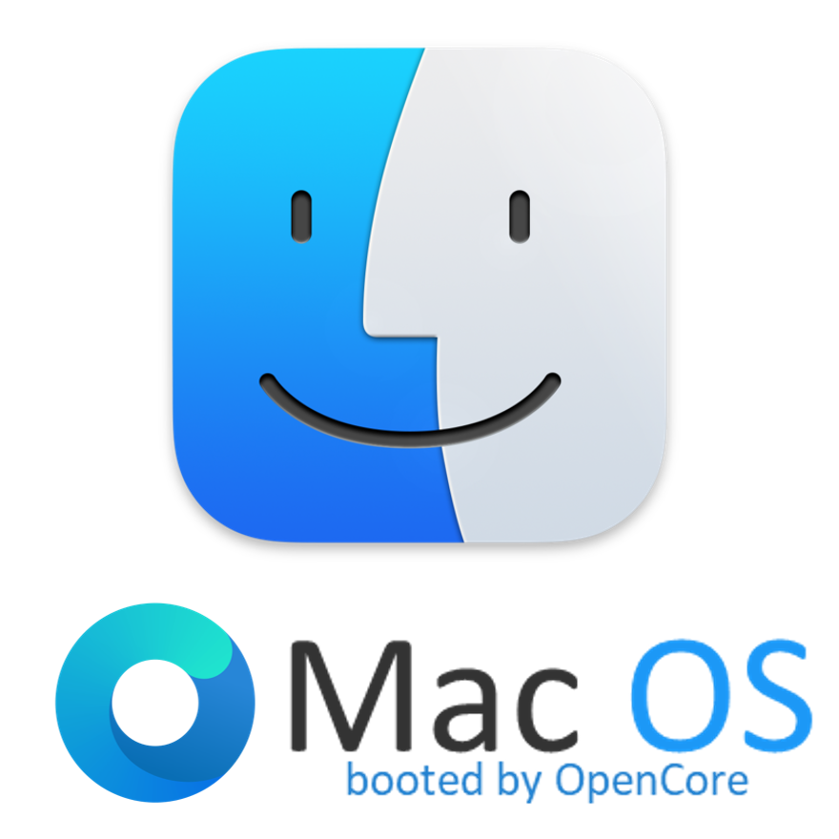
Notes:
PNG

Slide 13
Mac OS
Notes:
Editor

Slide 14
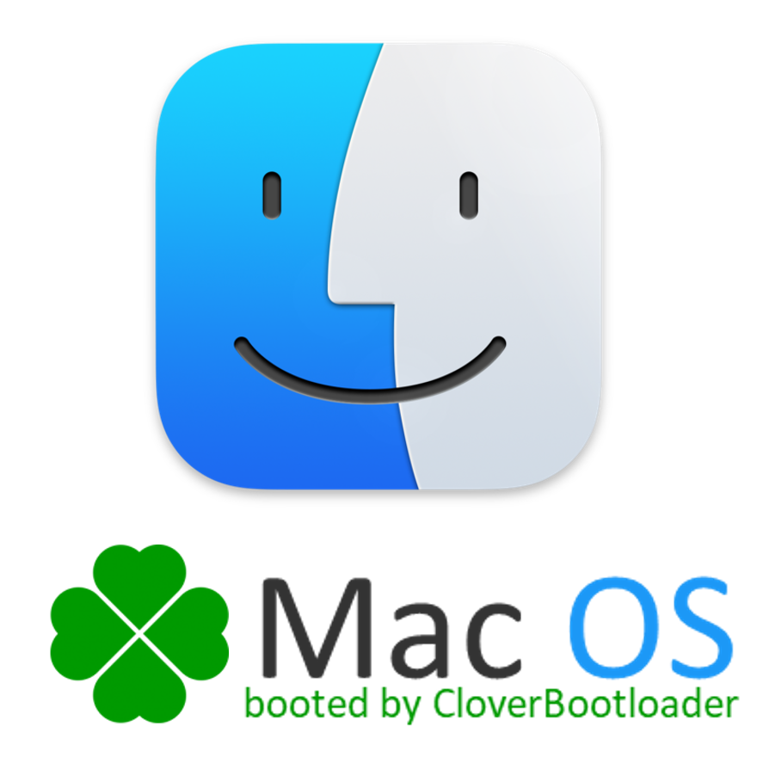
Notes:
PNG

Slide 15
Notes:
Editor

Slide 16
Notes:
PNG

Slide 17
Notes:
PNG

Slide 18
Notes:
PNG

