Slide 1
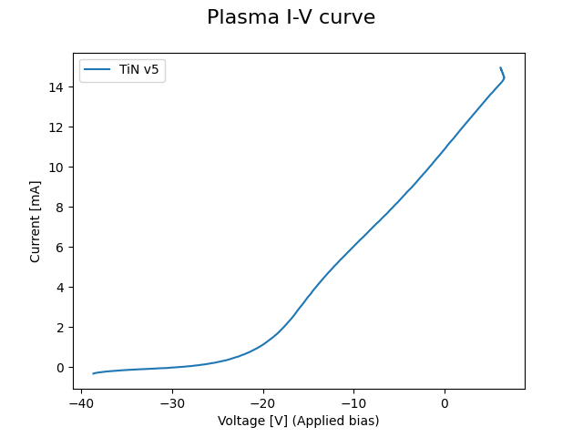
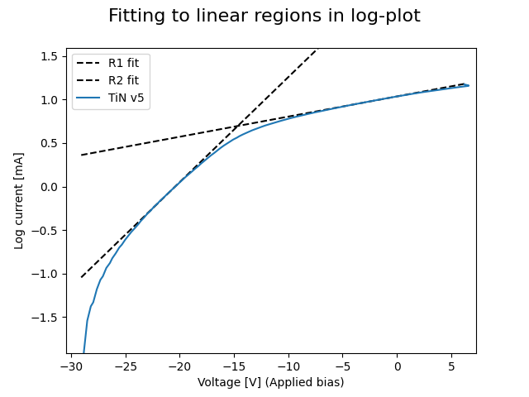
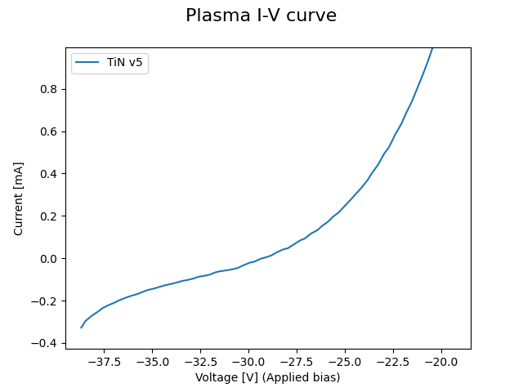
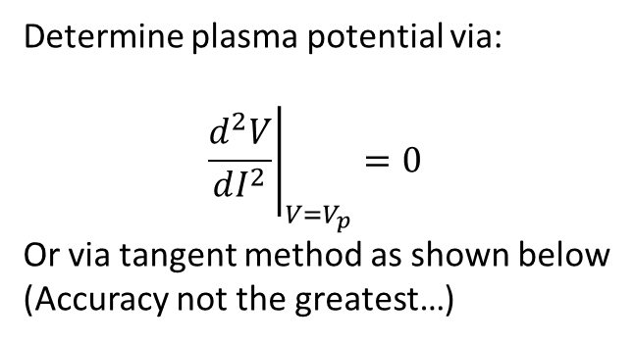
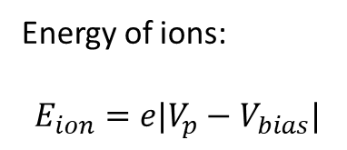
Langmuir probe measurements
Determine plasma potential via:
$${\left.\frac{d^{2}V}{dI^{2}}\right|}_{V=V_{p}}=0$$
Or via tangent method as shown below
(Accuracy not the greatest…)
Energy of ions:
$$E_{ion}=e|V_{p}−V_{bias}|$$
Linear
Log scale
V_{float}
V_{plasma}

Slide 2
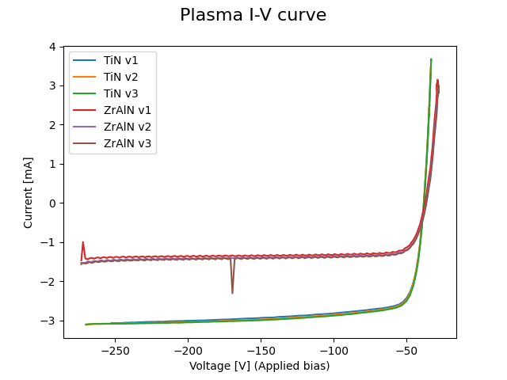

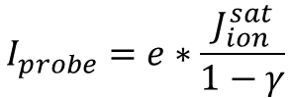
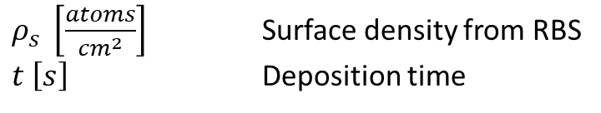

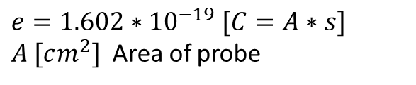
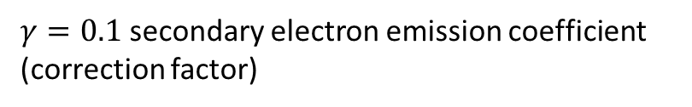

Area probe measurements
$γ=0.1$ secondary electron emission coefficient (correction factor)
$$I_{probe}=e∗\frac{J_{ion}^{sat}}{1−γ}$$
$e=1.602∗{10}^{−19} [C=A∗s]$
$A [cm^{2}]$ Area of probe
$J_{ion}^{sat}=\frac{\left(1−γ\right)}{A}∗\frac{I_{probe}}{e} \left[\frac{ions}{s∗cm^{2}}\right]$
$ρ_{s} \left[\frac{atoms}{cm^{2}}\right]$ Surface density from RBS
$t \left[s\right]$ Deposition time
I_{probe}
$$J_{atoms}=\frac{ρ_{s}}{t} \left[\frac{atoms}{s∗cm^{2}}\right]$$
$$\frac{J_{ions}}{J_{atoms}}=\frac{ions}{atoms}$$

