Slide 1

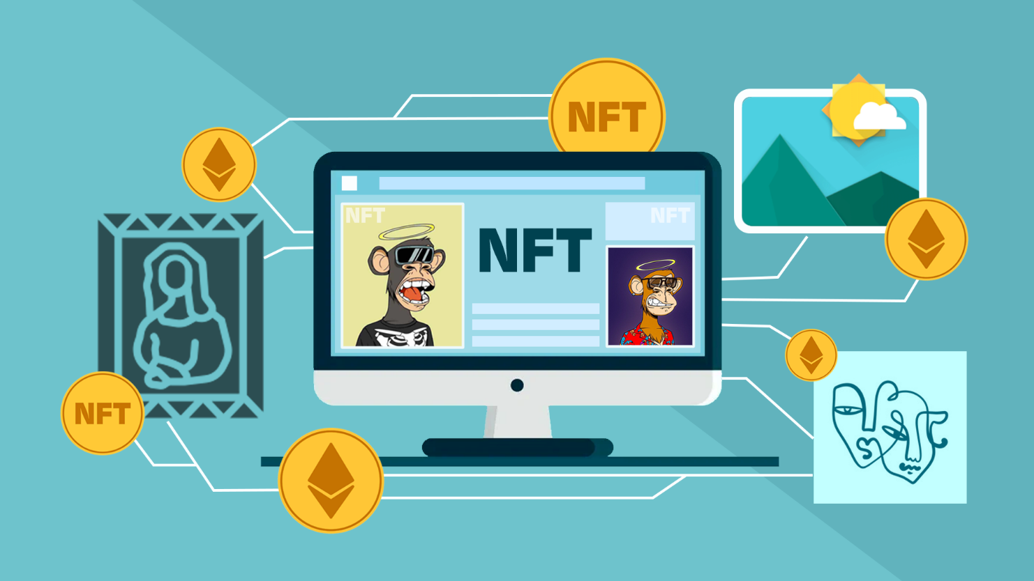
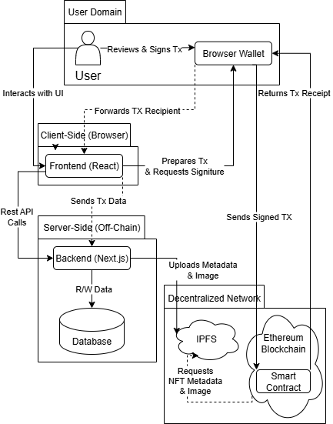
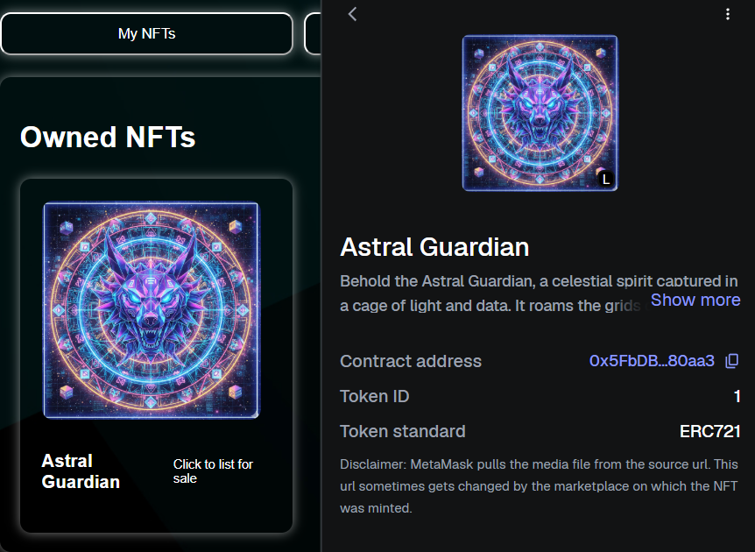
پلتفرم خرید و فروش توکن‌های غیرقابل معاوضه(NFT) مبتنی بر بلاکچین
نام و نام خانوادگی: محمدرضا ماجد
استاد راهنما: دکتر فانیان
1. Introduction
3. Implementation
Concept:
This project introduces a decentralized marketplace for Non-Fungible Tokens (NFTs), built upon blockchain technology. The core of the platform is a solid smart contract that autonomously manages all on-chain logic, including asset ownership, sale processes, and financial transactions, ensuring a transparent and immutable environment for trading digital assets.
Problem:
While the NFT market has grown significantly, many existing platforms present considerable challenges for users, such as complex user interfaces and high transaction fees. This creates a barrier for artists, creators, and collectors who are not familiar with blockchain technology, highlighting the need for a more accessible and simplified solution.
Project Goal:
The goal of this project is to develop a seamless and secure platform for trading NFTs that bridges the gap between blockchain's complexity and the user's need for simplicity. We aim to create a decentralized marketplace where the core logic is governed by a transparent smart contract, while providing a user-friendly interface that feels as intuitive as a standard web application.
Smart Contract:
The core logic is encapsulated in a smart contract developed with Solidity and the Hardhat framework. To ensure security and standardization, it inherits from OpenZeppelin's libraries, implementing the ERC-721 standard for NFTs. Key security patterns like ReentrancyGuard and Pausable are integrated to protect user assets. The contract’s public functions (createToken, createMarketSale, withdraw) govern all on-chain market activities, ensuring transparent and autonomous operation.
Backend & Database:
The off-chain backend is built using Next.js API Routes, providing a serverless environment for managing application data. Prisma is utilized as a modern ORM for type-safe interaction with a database. It ensures data integrity through atomic transactions, which are crucial for synchronizing the off-chain database with on-chain events after a transaction is confirmed.
Frontend & Web3 Integration:
The frontend, built with React and Next.js, serves as an intuitive gateway to the blockchain. The connection to the blockchain is handled by a robust Web3 stack:
Wagmi & Viem: These libraries provide powerful and efficient hooks for reading from and writing to the smart contract.
RainbowKit: Integrated to offer a seamless and user-friendly multi-wallet connection experience.
NextAuth.js: Implements secure, passwordless authentication using the SIWE protocol, allowing users to log in simply by signing a message with their wallet.
2. System Design
User Requirements:
The system is designed to meet key functional and non-functional requirements for an NFT marketplace. Functionally, it supports wallet-based authentication, the complete token lifecycle (creation, listing, and purchase), and financial operations like fund withdrawals. Non-functional requirements prioritize security through re-entrancy guards and role-based access, and an emergency-stop mechanism in the contract.
Architecture:
The platform uses a multi-layer dApp architecture that separates on-chain and off-chain logic for optimal performance and security.
On-Chain Layer (Smart Contract): The core of the system, this contract can be deployed on the Ethereum blockchain. It governs all critical operations, including asset ownership, market rules, and the secure handling of funds.
Off-Chain Layer (Backend & Frontend): A Next.js backend manages user data, authentication, and communication with the IPFS storage system. The React-based frontend provides a dynamic user interface that allows users to interact with the backend and, via their wallets, execute transactions on the smart contract.
4. Conclusions
This project successfully achieved its primary goal of designing and implementing a full-stack, decentralized marketplace for NFTs. The final platform provides a user-friendly and secure solution that allows users to manage the entire lifecycle of their digital assets, from creation to sale, within an on-chain environment.
Key achievements include the implementation of a secure Solidity smart contract governing all market logic, an off-chain backend for data management, and a dynamic frontend that ensures a user-friendly experience. By integrating technologies like IPFS for decentralized storage and SIWE for wallet-based authentication, the project delivers a robust and practical example of a modern decentralized application that effectively bridges the gap between blockchain's complexity and user accessibility.

