Slide 1
Confronto Dataset
Musicali

Slide 2
Emotify
A. Aljanaki, F. Wiering, R. C. Veltkamp. Studying emotion induced by music through a crowdsourcing game. Information Processing & Management, 2015.
400 canzoni da 1 minuto
4 generi (rock, classico, pop, elettronica)
9 Emozioni (GEMS scale)
File audio + metadati

Slide 3
Emotify: data
A. Aljanaki, F. Wiering, R. C. Veltkamp. Studying emotion induced by music through a crowdsourcing game. Information Processing & Management, 2015.
id file musicale
genere musicale
9 Emozioni (1 se l’emozione è stata confermata dalla maggior parte dei partecipanti, 0 altrimenti)
mood dei partecipanti prima dell’ascolto
like/dislike
età, genere e lingua

Slide 4
PMEmo
Kejun Zhang, Hui Zhang, Simeng Li, Changyuan Yang, and Lingyun Sun. 2018. The PMEmo Dataset for Music Emotion Recognition. Proceedings of the 2018 ACM on International Conference on Multimedia Retrieval. Association for Computing Machinery, New York, NY, USA, 135–142. DOI:https://doi.org/10.1145/3206025.3206037
794 clip musicali (top 100 itunes, billboard hot 100, ecc.)
Emozioni etichettate manualmente (Arousal-Valence)
Segnali fisiologici (EDA)
File audio (clip) + metadati

Slide 5
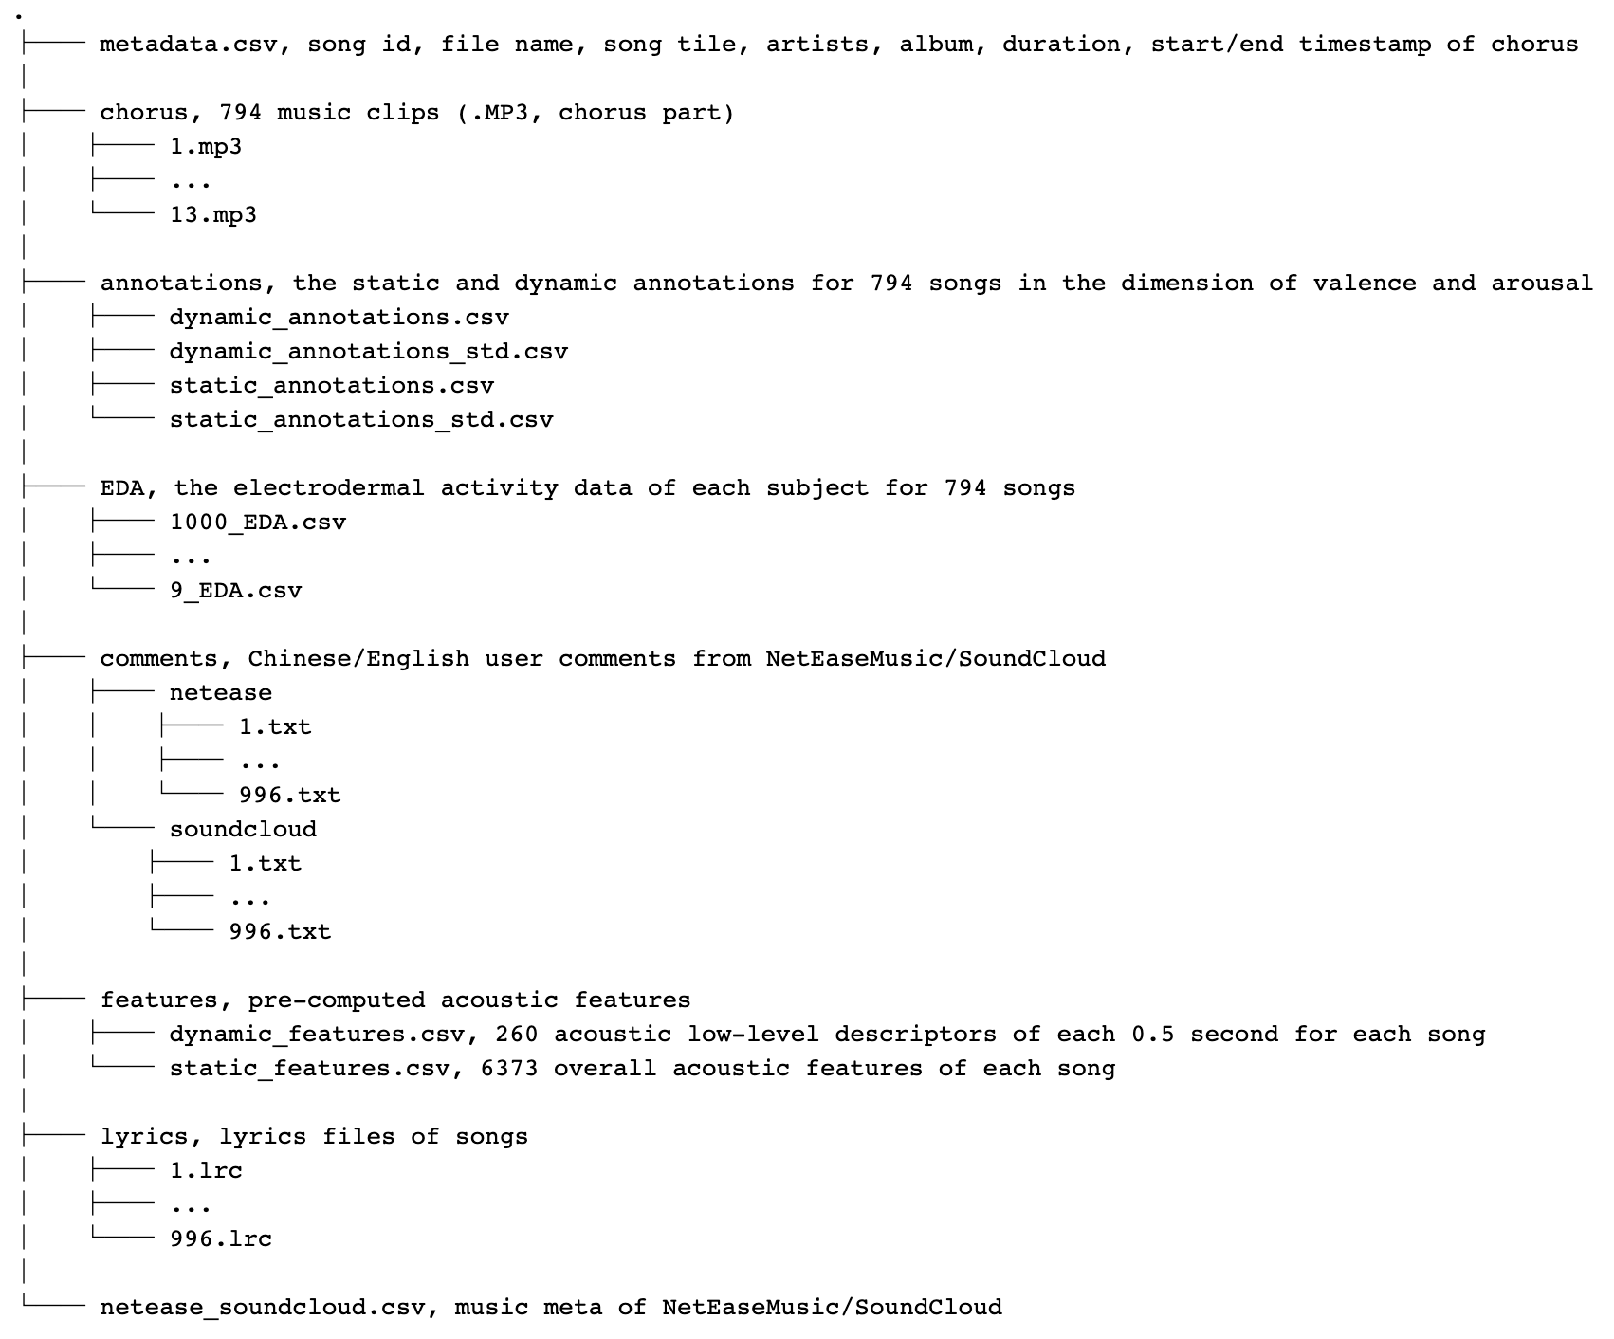
PMEmo: data

Slide 6
4Q-emotion
Panda, P., Malheiro, R. & Paiva, R. P. (2018). “Novel audio features for music emotion recognition”. IEEE Transactions on Affective Computing (accepted for publication).
900 canzoni da 30 secondi
Canzoni suddivise nei 4 quadranti Arousal-Valence
File audio + metadati

Slide 7
4Q-emotion: data
Panda, P., Malheiro, R. & Paiva, R. P. (2018). “Novel audio features for music emotion recognition”. IEEE Transactions on Affective Computing (accepted for publication).
900 canzoni suddivise in: Q1 (A+V+), Q2 (A+V-), Q3(A-V-), Q4 (A-V+)
Metadati: song, artist, title, Moods, Genres, ecc.

Slide 8
Million Song Dataset
Thierry Bertin-Mahieux, Daniel P.W. Ellis, Brian Whitman, and Paul Lamere.
The Million Song Dataset. In Proceedings of the 12th International Society
for Music Information Retrieval Conference (ISMIR 2011), 2011.
Cluster di diversi dataset musicali
Un milione di canzoni contemporanee
Tantissimi dettagli relativi ad ogni canzone
Non vengono analizzate le emozioni
Solo metadati, file audio non inclusi ma solo le features derivate.

Slide 9
Million Song Dataset:
Data
Thierry Bertin-Mahieux, Daniel P.W. Ellis, Brian Whitman, and Paul Lamere.
The Million Song Dataset. In Proceedings of the 12th International Society
for Music Information Retrieval Conference (ISMIR 2011), 2011.
Esempio descrizione di una traccia: http://millionsongdataset.com/pages/example-track-description/
Dettaglio campi dataset: http://millionsongdataset.com/pages/field-list/

