Slide 1
Consensus in Blockchain
Distributed Optimization and Learning
2023-11
By Mohammad Mashreghi

Slide 2
Agenda
What is blockchain (DLT)?
What are categories of blockchains?
Consensus in Blockchain (DLT) vs what we have seen in class: how they compare?
What is blockchain trilemma?
Flavor
Two generals problem (AKA Chinese generals problem)
Byzantine generals problem
This is only a brief introduction!

Slide 3
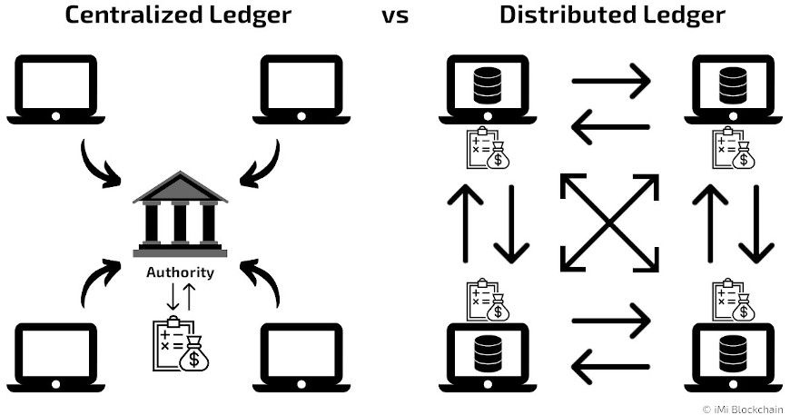
What is blockchain (DLT)?
DLT: Distributed Ledger Technology
A system to saves the ledger (database) in a distributed manner.

Slide 4
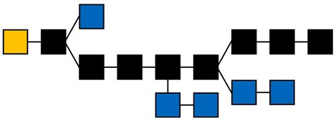
What is blockchain (DLT)?
Blockchain is one way of implementing a distributed ledger.
Notes:
Blockchain is the data structure. Other options? DAG (directed acyclic graph)

Slide 5
What are categories of blockchains?
Public vs Private
Permissioned vs Permissionless
Consensus Algorithm
PoW vs PoS vs DPoS vs PBFT vs …
Notes:
PoW: Proof of Work, PoS: Proof of Stake, DPoS: Delegated PoS, PBFT: Practical Byzantine Fault Tolerance

Slide 6
Consensus in Blockchain (DLT) vs what we have seen in class: how they compare?
How does the consensus discussed in class compare with blockchain consensus?
Goal of consensus?
It’s all about assumptions.
Assumptions of discussed consensus in class?
Change assumptions a little and get a new problem!
Fault in communication, fault in nodes, asynchronous communication, malicious actors, time limits, computation limits, communication limits, and many more.
We shall see 2 simple versions later.
What are our goals?

Slide 7
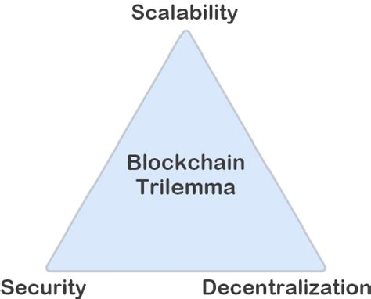
What is blockchain trilemma?
CAP theorem:
it is impossible for a distributed data network to at the same time provide more than 2 out of 3 guarantees: consistency, availability, and partition tolerance

Slide 8
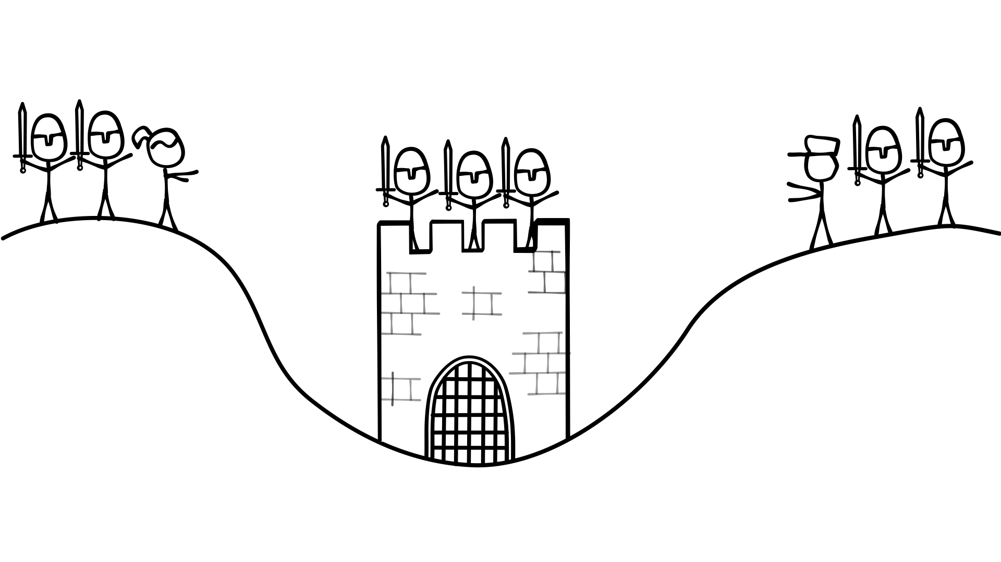
Flavor 1 (Two generals problem)
Two generals want to attack the city
Only if 2 of them agree on time of attack, the attack will succeed. If only one general attacks, they die!

Slide 9
Flavor 1 (Two generals problem)
Always make sure the assumptions are clear!
They can send messages but the messenger might die on the way!
The message will not be tampered with.

Slide 10
Flavor 1 (Two generals problem)
After each step, think about this question: will any of them attack?
G1 to G2: Let’s attack at down!
G2 receives the message.
G2 to G1: Agreed. Let’s kill them all at down!
G1 receives the message.
Probabilistic consensus

Slide 11

Flavor 2 (Byzantine generals problem)
What is the problem?
N generals want to attack the city. Some of them might be traitors
What is the goal?
Reach consensus amount loyal generals.
What are the assumptions? Difference between solution or not!
Some assumptions are obvious without solution:
If most of the generals are traitors, there is no hope. Or is there?

Slide 12
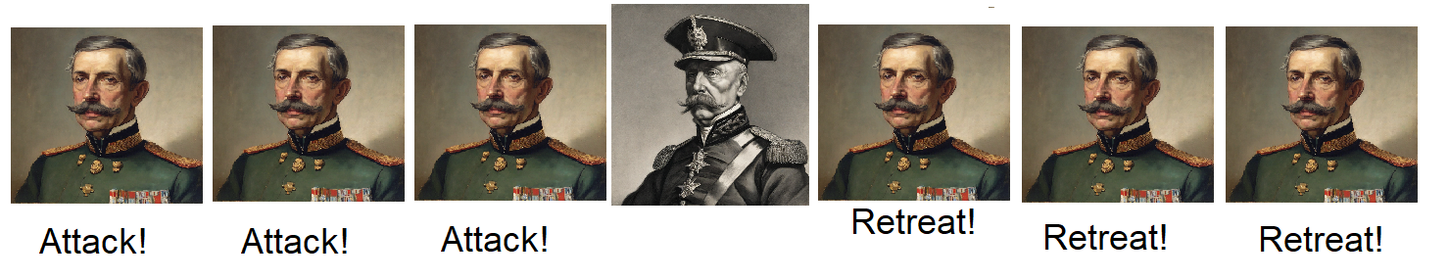
Flavor 2 (Byzantine generals problem)
What are the assumptions? Difference between solution or not!
How should we reach the goal under the assumptions?
A possible not very good solution. Ask from your neighbors and then majority vote.
If time permits, continue from presentation by Siqiu Yao.

