Slide 1
AI for MIS Opportunities, Challenges, and Future Directions
Fardin Abbasi & Mohammad Mashreghi,
College of Management,
University of Tehran
Spring 2024

Slide 2
Presentation Overview
1
2
3
Intro
AI in MIS
Conculution
What is MIS & AI?
Pros & Cons
History & Future

Slide 3
1
INTRODUCTION

Slide 4
With the global AI SaaS market expected to grow tenfold in value to over USD two trillion by 2030, artificial intelligence (AI) has become an increasingly popular topic of research and discussion within the management information systems community.
It has been claimed that AI technology has the potential to be the most disruptive technological force with the largest transformational potential within the organizational and business setting for the next decade.
The question of the applicability of large language models (LLMs), generative pretrained transformers (GPTs), and AI tools in general to large-scale automation for business use has been raised in recent years within the ERP and business management software (BMS) research and development communities.
Given that LLMs and GPTs are heavily data-driven technologies, bias in training data sets is a rising concern with respect to their application in critical sectors such as healthcare and law enforcement, where data privacy and security are a necessity
Notes:
AI SaaS stands for "Artificial Intelligence Software as a Service.
ERP stands for "Enterprise Resource Planning

Slide 5

AI in information systems lacks of clarity concerning the concept and classification of AI!

Slide 6
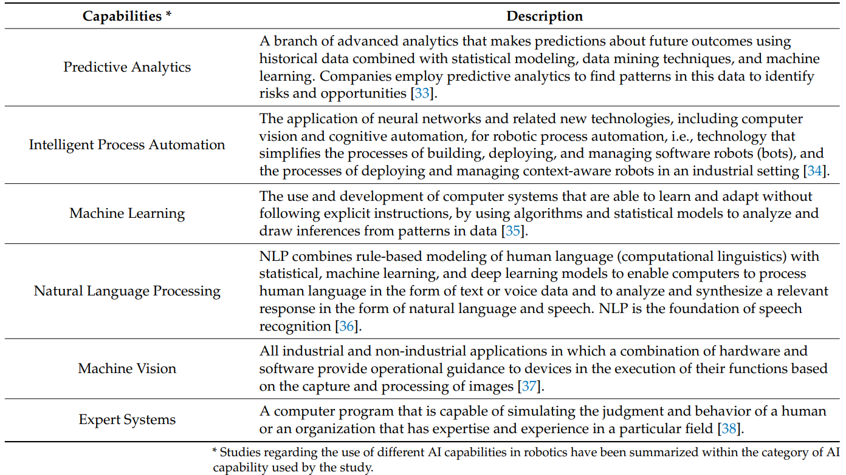
AI Capabilities

Slide 7

MIS
MIS are information systems used for decision-making, coordination, control, analysis, and visualization of information regarding the processes, people, and technology employed within an organizational setting.

Slide 8
2
AI in MIS?

Slide 9
AI Implementations in Business Settings
Finance and Accounting
Information management
Human resource management
Decision-making
Forecasting
Conversational agents

Slide 10

Challenges & Benefits of Adoption of AI in MIS

Slide 11
Source of Business Value: Process Automation
Benefits
Ease of implementation and rapid return on investment.
Allow human resources to focus their attention on value-added taks.
Challenges
To achieve benefits through the use of AI in automation, a unified digital business strategy must be developed and implemented at all company locations.
Decision logic and business rules must be integrated.

Slide 12
Source of Business Value: Analytical Insight
Benefits
Deep learnig and machine learning techniques can extract patterns from large volumes of generated data at a speed that a human being cannot achieve.
AI tools are much more suited than human operators to perform predictive analytics for high-velocity data generation domains.
Challenges
Some AI technologies rely on human experts to establish a working hypothesis and identify relevant features, but the fear of job elimination can derive operators to be unwilling to share knowledge and provide expertise for AI model creation.

Slide 13
Source of Business Value: Cognitive Interaction
Benefits
AI applications can create competitive advantages by improving customer’s experience and engagement through digital assistants and conversational agents.
Onboarding and on-the-job learning processes can be supported by intelligent AI assistants built to provide responses to promt-like queries.
Challenges
Resulting changes in workforce structure and possible job reductions with respect to instructors and HR specialists.
Overal lack of confidence in AI decisions based on negative previous experience.
Barriers to engagement with intelligent digital assistants.
Notes:
Engagement barriers: access to the Internet and AI tools as well as at least a basic understanding of prompting techniques and general technical competence.

Slide 14
3
Conclusion

Slide 15
Notable increase in the number of studies focused on predictive analytics and natural language processing.
While most AI implementations are facilitated by using cloud or on-premises data centers for the necessary training and data aggregation, an exciting new research trend has focused on AI applications at the edge of industrial networks and the development of federated learning methodologies.
The need for more studies focusing on guidelines and frameworks for the adoption of AI in MIS is highlighted, especially in terms of ethics, data privacy, and security.

Slide 16
THANKS!
Do you have any questions?
Please keep this slide for attribution

Slide 17
Resources
Stoykova, S., & Shakev, N. (2023). Artificial intelligence for Management Information Systems:
Opportunities, challenges, and future directions. Algorithms, 16(8), 357.

