Slide 1
Sequential Data Processing with RNN
By: Amin Heydarian, Mohammad Mashreghi, Reyhane Zare, Victor Reyes, Zhiyuan Yuan
Magnificent Lupin, Group B

Slide 2

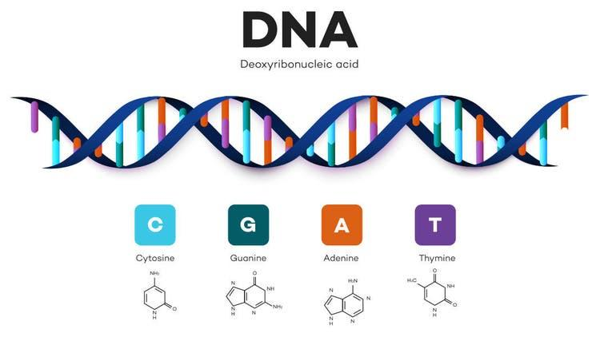
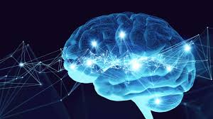
Introduction
Processing sequential data:
Models on sequential data:
State Space Models: By capturing the dynamics of neural populations over time we can explain the neural activity in a low-dimensional state space.
Latent Variable Models: By inferring latent variables, we can explain the high-dimensional neural activity.

Slide 3
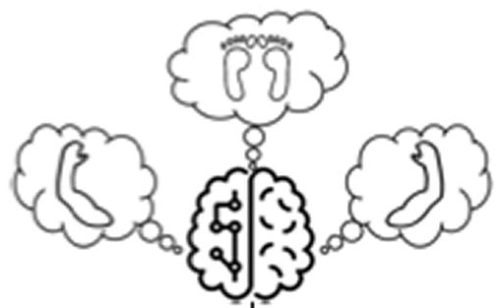
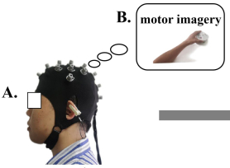
2. Research Question
How activity in motor areas relates to the motor imagery of specific body movements and how that information is encoded in such activity?
Hypothesis: motor region’s activity for basic body movements are similar between subjects, so we could train the RNN with the data of multiple subjects and try to predict the labels of the last subject’s data.

Slide 4
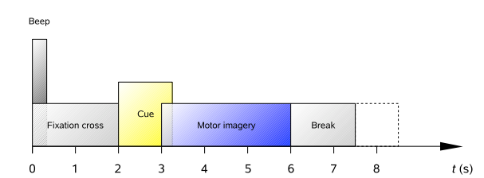
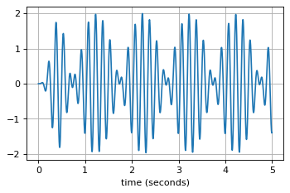
3. Methods
BCI Graz data set
Cued motor signal of 9 subjects
25 channels (22 EEG + 3 EOG) of 250 Hz
Bandpass-filtered between 0.5 Hz and 100 Hz
Preprocessing
Bandpassing filters to flatten signals
Strict to range with stable frequency response (4-40Hz)
0.5 to 3.5s after cue given for L/R hand

Slide 5
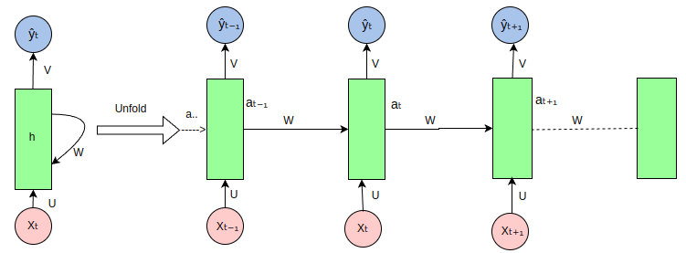
3. Methods
Model: RNN (& CNN)
80% data for training; rest for testing
2 layers with 256 labels each
Regularization with dropout rate = 0.5

Slide 6
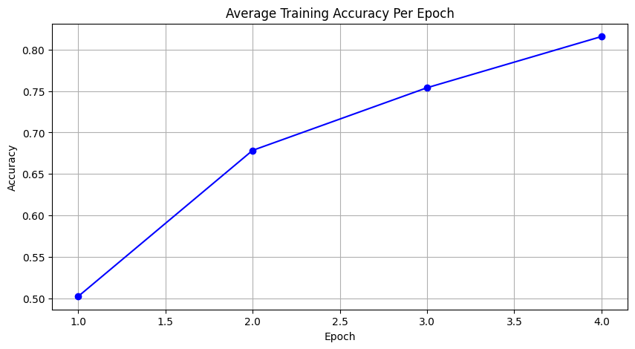
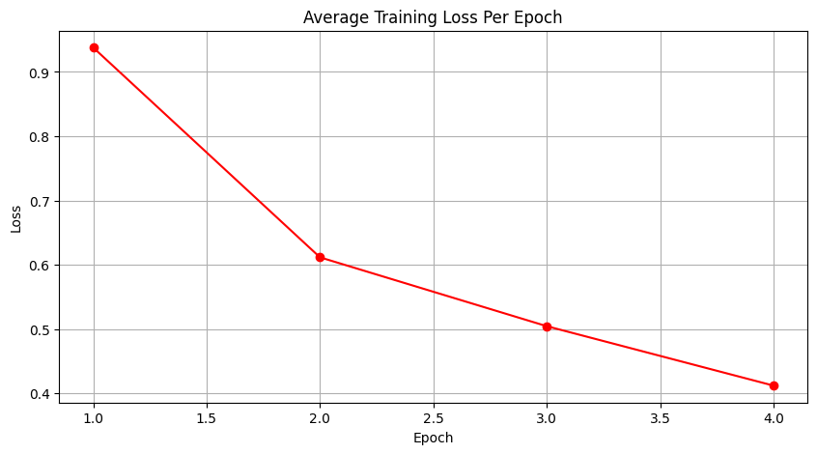
4. RNN training
Accuracy across epochs Loss across epochs

Slide 7
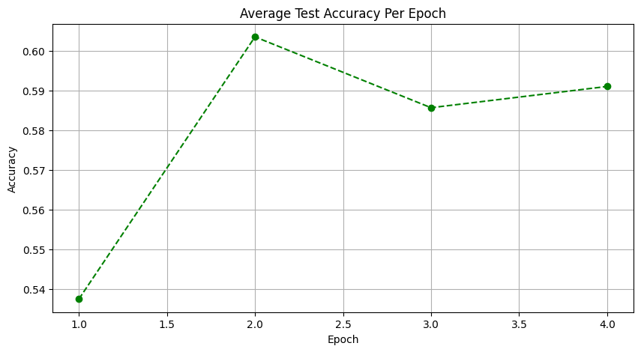
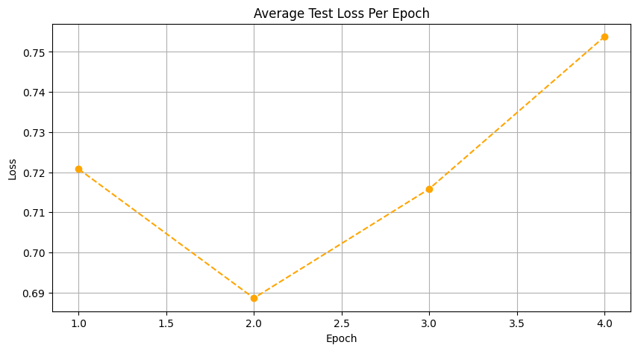
5. RNN test
Accuracy across epochs Loss across epochs

Slide 8
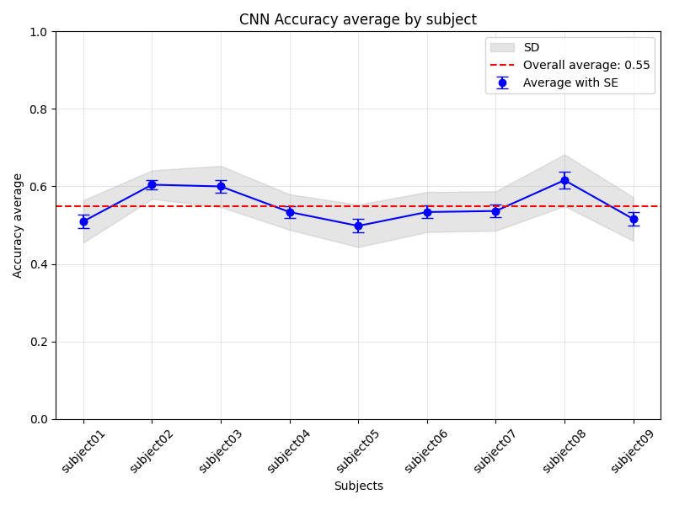
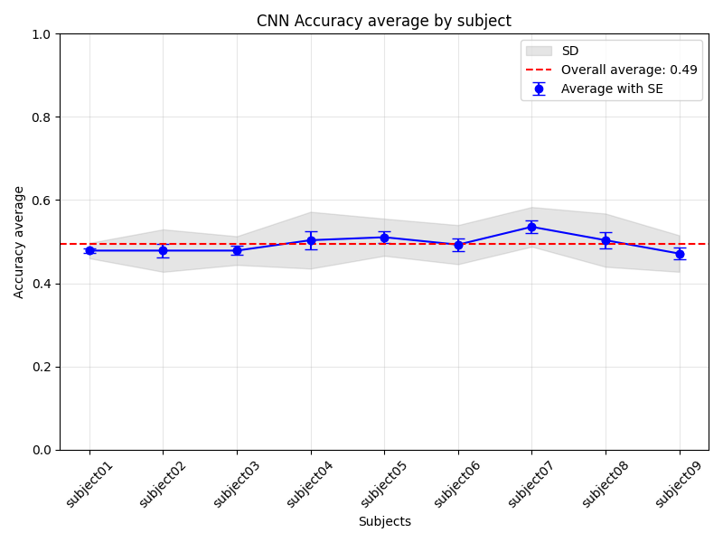
6. RNN vs CNN Performance
The classification accuracy dropped with the grouped data
To investigate the effects of individual differences, we plotted the accuracies across the subjects.
RNN VS. CNN

Slide 9
7. Generalization
In this part, we want to know that we can use our trained model on unseen subject and compare the acc of model that trained only with that subject
Trained on 3 subjects and tested on 20% of 4th subject | Trained only on 80% data of 4th subjects and test it on rest of it
51.70% ± 2.4% | 50.57% ± 2.6%

Slide 10
8. Generalization
In this part we train each subject separately and getting avg of the result can compare it to the model which trained with all subjects together
Separate training and getting avg of their accuracy | All subject together
51.2% ± 1.4% | 59.1% ± 6.8%

Slide 11
9. Conclusion
Key results:
RNN can better classify the EEG data regarding different motor imagery
The necessity of preprocessing on EEG
Enhancement by hyperparameter tunings to process noisy data
Implications of the study
The result can be a potential contribution in the field of BCI.

Slide 12
Thank you!

Slide 13
Table of Contents -
Introduction - Reyhane
Research Questions - Reyhane
Method - Zhiyuan
Result1 - Victor RNN VS CNN
Result2 - Victor
Result3 - Mohammad
Conclusion / Discussion - Amin

