Slide 1
Chapter 3 Evaluating a Company’s External Environment
CHAPTER 3
Evaluating a Company’s External Environment

Slide 2
Learning Objectives
Identify factors in a company’s broad macro-environment that may have strategic significance.
Recognize the factors that cause competition in an industry to be fierce, normal, or relatively weak.
Map market positions of key groups of industry rivals.
Determine whether an industry’s outlook presents a company with sufficiently attractive opportunities for growth and profitability.

Slide 3
The First Test of a Winning Strategy: “How well does the current strategy fit the company’s situation?”
Two facets of the company’s situation
Its external environment— industry and competitive environments in which it operates
Its internal environment—the company’s resources and organizational capabilities

Slide 4
Assessing the Company’s Industry and Competitive Environment
Do macro-environmental factors and industry characteristics offer sellers opportunities for growth and attractive profits?
What kinds and strengths of competitive forces are present in the industry?
How will forces driving change in the industry impact its competitive intensity and profitability?
Which rivals are strongly positioned in the market and which are not?
What strategic moves are rivals likely to make next?
What are the key factors of competitive success?
Does the industry outlook offer good prospects for profitability?

Slide 5
Question 1: What Are the Strategically Relevant Components of a Company’s Macro-Environment?
Relevant Factors
Play a significant role in shaping management’s decisions regarding the company’s long-term direction, objectives, strategy, and business model
Are on the immediate inner ring industry and competitive environment of the company—competitive pressures, the actions of rivals firms, buyer behavior, supplier-related considerations, and so on

Slide 6
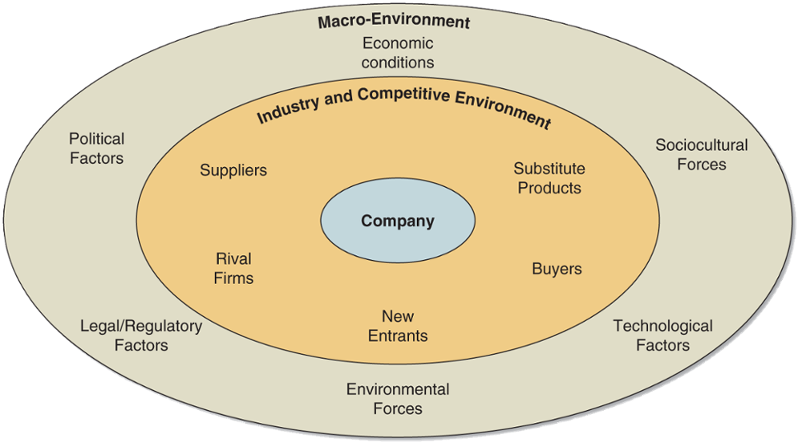
FIGURE 3.1 The Components of a Company’s External Environment
Jump to Appendix 1 for long description.

Slide 7
Core Concepts: Macro-Environment and PESTEL Analysis
The macro-environment encompasses the broad environmental context in which a firm is situated and is comprised of six principal components: political factors, economic conditions, sociocultural forces, technological factors, environmental factors, and legal/regulatory conditions.
PESTEL analysis can be used to assess the strategic relevance of the six principal components of the macro-environment: political, economic, social, technological, environmental, and legal forces.

Slide 8
The Six Components of the Macro-Environment Included in a PESTEL Analysis
Political factors
Economic conditions
Technological factors
Sociocultural factors
Environmental forces
Legal and regulatory factors

Slide 9
Question 2: How Strong Are the Industry’s Competitive Forces?
State of Competition: Where are we now?
The dynamics of competition are not the same from one industry to another.
The Five-forces Model of Competition
It is the most powerful and widely used tool for assessing the strength of the competitive forces that affect an industry’s attractiveness.

Slide 10
The Five Competitive Forces Affecting Industry Attractiveness
Competitive pressures:
Bargaining power of buyers
Substitute products of firms in other industries
Bargaining power of suppliers
The threat of new entrants into the market
Rivalry among competing sellers

Slide 11
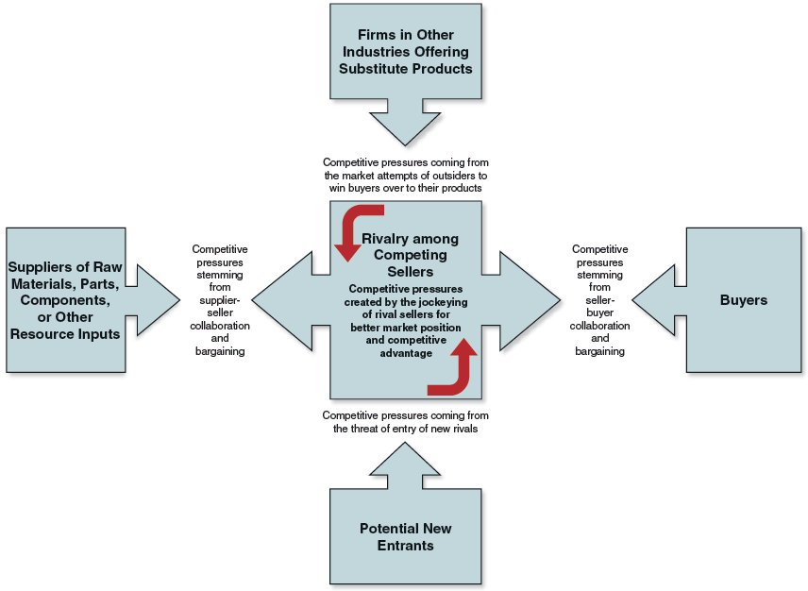
FIGURE 3.2 The Five-Forces Model of Competition
Jump to Appendix 2 for long description.

Slide 12
The Competitive Force of Buyer Bargaining Power
Whether seller-buyer relationships represent a minor or significant competitive force in limiting industry profitability depends on:
Some or many buyers having sufficient bargaining leverage to obtain price concessions and other favorable terms
The extent to which buyers are price sensitive

Slide 13
When Is the Bargaining Power of Buyers Stronger?
Buyers gain bargaining leverage when:
Their costs of switching to competing brands or substitutes are relatively low.
Their large size allows them to demand concessions.
They are few in number, control market access or, if a buyer-customer is particularly important to a seller.
Weak buyer demand creates a “buyers’ market.”
Buyers are well informed about products, prices, and costs.
Buyers can integrate backward into the business of sellers.

Slide 14
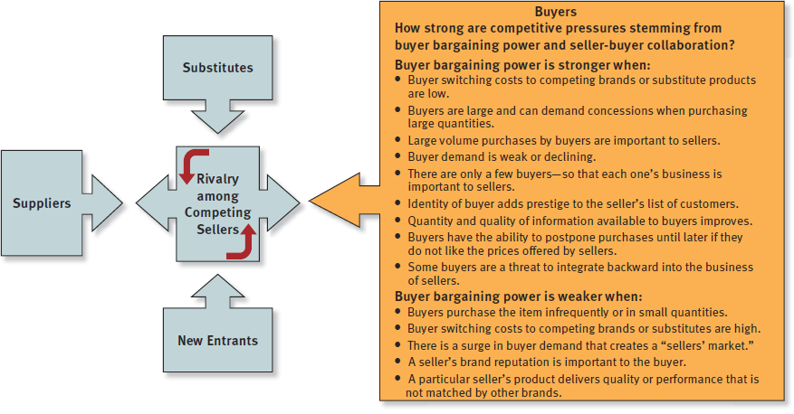
FIGURE 3.3 Factors Affecting the Strength of Buyer Bargaining Power
Jump to Appendix 3 for long description.

Slide 15
The Competitive Force of Substitute Products
The strength of competitive pressures from the sellers of substitute products depends on whether:
Substitutes are readily available and attractively priced.
Buyers view the substitutes as comparable or better in terms of quality, performance, and other relevant attributes.
The costs that buyers incur in switching to the substitutes are high or low.

Slide 16
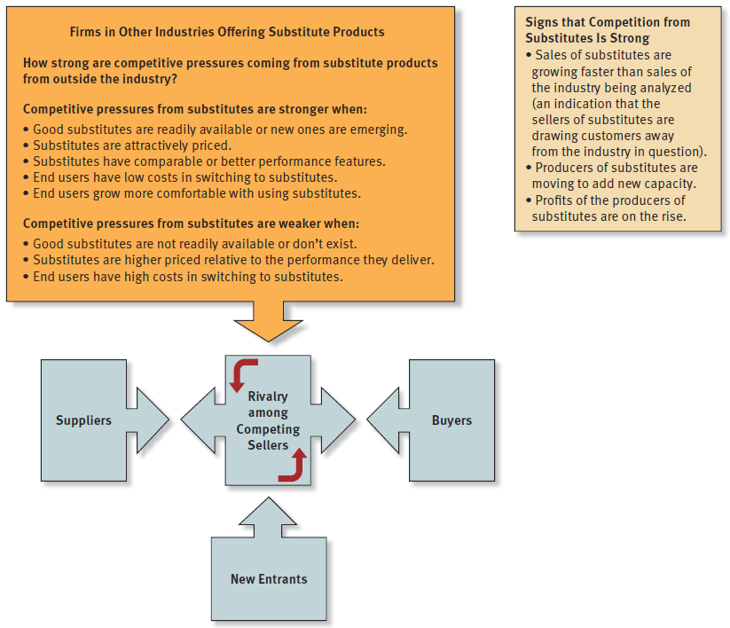
FIGURE 3.4 Factors Affecting Competition from Substitute Products
Jump to Appendix 4 for long description.

Slide 17
The Competitive Force of Supplier Bargaining Power (1 of 2)
Industry suppliers can exert substantial bargaining power or leverage if:
The supplied item is not a commodity readily available from many suppliers.
Industry members cannot switch their purchases to another supplier or switch to attractive substitutes.
Certain required inputs are in short supply.
Certain suppliers provide a differentiated item that enhances the desired performance, quality, or image of the industry’s product.

Slide 18
The Competitive Force of Supplier Bargaining Power (2 of 2)
Industry suppliers can exert substantial bargaining power or leverage when:
They provide specialized equipment or services that yield cost savings to industry members in conducting their operations.
A large fraction of the costs of the buyer industry’s product is accounted by the cost of a particular input.
Industry members are not major or large customers of suppliers.
It does not make good economic sense for industry members to vertically integrate backward.

Slide 19
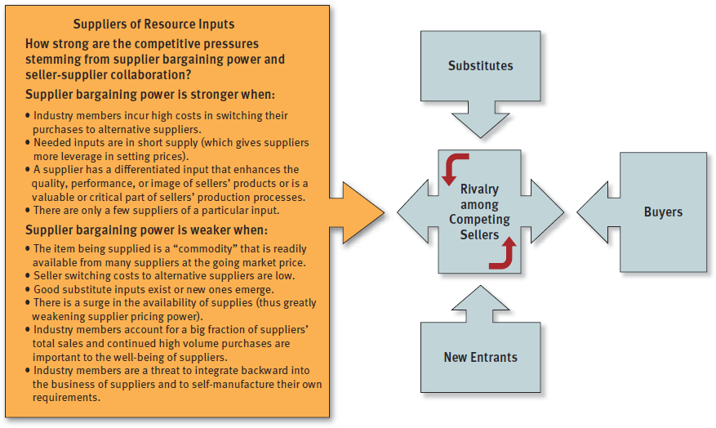
FIGURE 3.5 Factors Affecting the Strength of Suppliers
Jump to Appendix 5 for long description.

Slide 20
The Competitive Force of Potential New Entrants
The threat of entrants into the marketplace presents significant competitive pressure when:
There is a sizable pool of likely entry candidates.
Potential entrants have ample entry resources at their command.
Current industry participants are looking beyond their current markets for growth opportunities.
When the industry is growing, offers attractive profit opportunities, and its barriers to entry are low.

Slide 21
What Are the Barriers to Entry?
Barriers to Entry
Sizable economies of scale in production or other areas of operation
Cost and resource disadvantages not related to scale of operation
Strong brand preferences and customer loyalty
High capital requirements
Restrictive regulatory policies
Difficulties in building a network of distributors-retailers and securing space on retailers’ shelves
Tariffs and international trade restrictions
Industry incumbents that can launch initiatives to block a successful entry

Slide 22
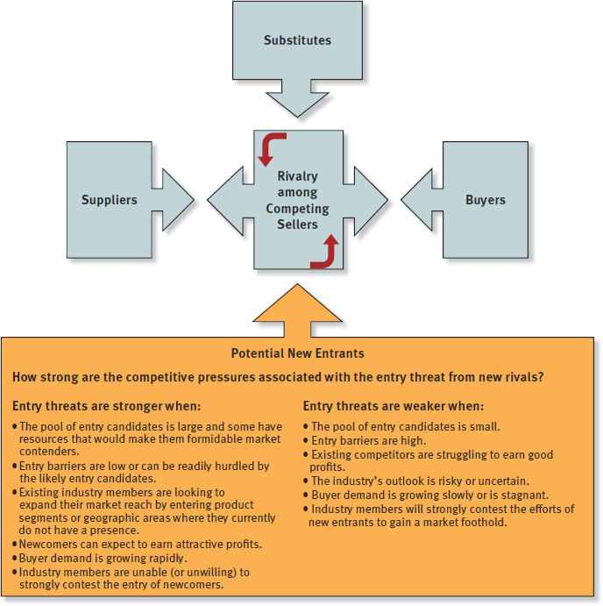
FIGURE 3.6 Factors Affecting the Threat of Entry
Jump to Appendix 6 for long description.

Slide 23
When Is the Competitive Force of Rivalry Most Intense among Competing Sellers?
Rivals can boost market standing and business performance.
Competitors are equal in size and capability.
Market growth slows or declines and lower demand results in no growth opportunities, excess capacity and inventory.
It has become less costly for buyers to switch brands.
Products of rival sellers have become more standardized.
Industry conditions tempt competitors to use price cuts or other competitive weapons to boost unit volume.
Competitors are dissatisfied with their market position.
Strong outside firms acquire weak firms in the industry and launch aggressive, well-funded moves to build market share.

Slide 24
When Is the Competitive Force of Rivalry Among Competing Sellers Weak?
The rivalry among industry competitors is usually weaker in industries where:
The products of industry rivals become more differentiated.
Markets or market segments are expanding and fast-growing.
Markets are comprised of vast numbers of small rivals; likewise, it is often weak when there are fewer than five competitors.

Slide 25
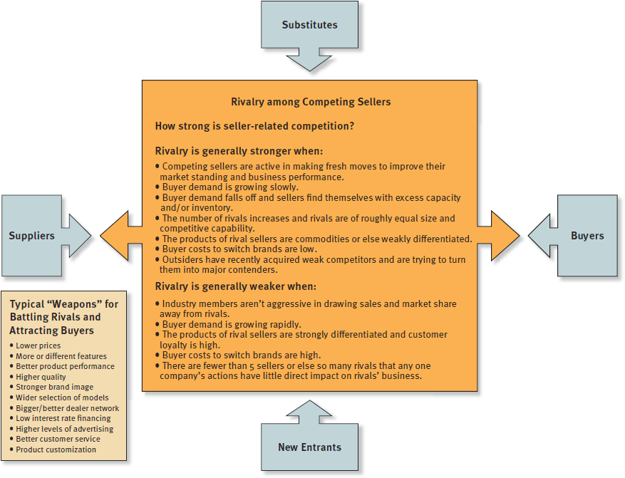
FIGURE 3.7 Factors Affecting the Strength of Competitive Rivalry
Jump to Appendix 7 for long description.

Slide 26
Industry Rivalry
Cutthroat (Brutal)
Competitors engage in protracted price wars or employ other aggressive tactics mutually destructive to profitability.
Fierce (Strong)
A vigorous market share battle reduces the profit margins of most industry rivals to bare-bones levels.
Moderate (Normal)
Maneuvering among industry rivals, while lively and healthy, still allows most rivals to earn acceptable profits.
Weak
Industry rivals satisfied with their sales growth and market share rarely undertake offensives against their competitors.

Slide 27
The Collective Strengths of the Five Competitive Forces and Industry Profitability
As a rule, the stronger the collective impact of the five competitive forces, the lower the combined profitability of industry participants.
The stronger the forces of competition, the harder it becomes for industry members to earn attractive profits.

Slide 28
When Do the Five Competitive Forces Result in Attractive Industry Conditions?
The ideal competitive environment for earning superior profits occurs when:
Suppliers and customers are in weak bargaining positions.
There are no good substitutes.
High entry barriers deter entry of new competitors.
Internal rivalry produces moderate competitive pressure.

Slide 29
When Do the Five Competitive Forces Result in Unattractive Industry Conditions?
An industry is competitively unattractive when all five forces are producing strong competitive pressures.
Internal rivalry among competitors is strong.
Low entry barriers result in entry of new competitors.
Competition from substitutes is intense.
Suppliers and customers are in strong bargaining positions.

Slide 30
Question 3: What Are the Industry’s Driving Forces of Change and What Impact Will They Have?
Driving forces analysis has three steps:
Identifying the present driving forces, as only 3 to 4 factors qualify as real drivers of change
Assessing whether the drivers of change are, individually or collectively, acting to make the industry more or less attractive
Determining what strategy changes are needed to prepare for the impact of the driving forces

Slide 31
CORE CONCEPT: Driving Forces
Driving forces are the major underlying causes of change in industry and competitive conditions.
Some driving forces originate in the outer ring of the company’s macro-environment but most originate in the company’s more immediate industry and competitive environment.

Slide 32
Common Driving Forces
Driving Forces
Changes in the long-term industry growth rate
Increasing globalization
Emerging new Internet capabilities and applications
Changes in who buys the product and how they use it
Product innovation
Technological change and manufacturing process innovation
Marketing innovation
Entry or exit of major firms
Diffusion of technical know-how across more companies and more countries
Changes in cost and efficiency
Growing buyer preferences for differentiated products instead of a standardized commodity product (or for standardized products instead of strongly differentiated products)
Regulatory influences and government policy changes
Changing societal concerns, attitudes, and lifestyles

Slide 33
Question 4: How Are Industry Rivals Positioned?
Strategic Group Mapping
It is a useful technique for graphically displaying different market or competitive positions that rival firms occupy in the industry.
A Strategic Group
It is a cluster of industry rivals that have similar competitive approaches and market positions.

Slide 34
CORE CONCEPTS: Strategic Group Mapping and Strategic Groups
Strategic group mapping is a technique for displaying the different market or competitive positions that rival firms occupy in the industry.
A strategic group is a cluster of industry rivals that have similar competitive approaches and market positions.

Slide 35
Constructing a Strategic Group Map
Identify the competitive characteristics of strategic approaches used in the industry.
Typical variables: the price/quality range, geographic coverage, degree of vertical integration, product-line breadth, distribution channels, and degree of service offered.
Plot firms on a two-variable map based upon their strategic approaches.
Assign firms occupying the same map location to a common strategic group.
Draw circles around each strategic group proportional to the size of the group’s share of total industry sales revenues.

Slide 36
Guidelines for Strategic Group Map Construction
The variables used as map axes must not be highly correlated.
Variables must reflect large differences in how rivals are positioned to offer customer value in their marketplace.
Variables can be either quantitative or continuous; can be discrete variables or distinct classes and combinations.
Draw circle sizes proportional to combined sales of each strategic group to show the relative sizes of each strategic group.
Use various competitive variables as map axes, multiple maps can show different views of competitive positioning in the industry.

Slide 37
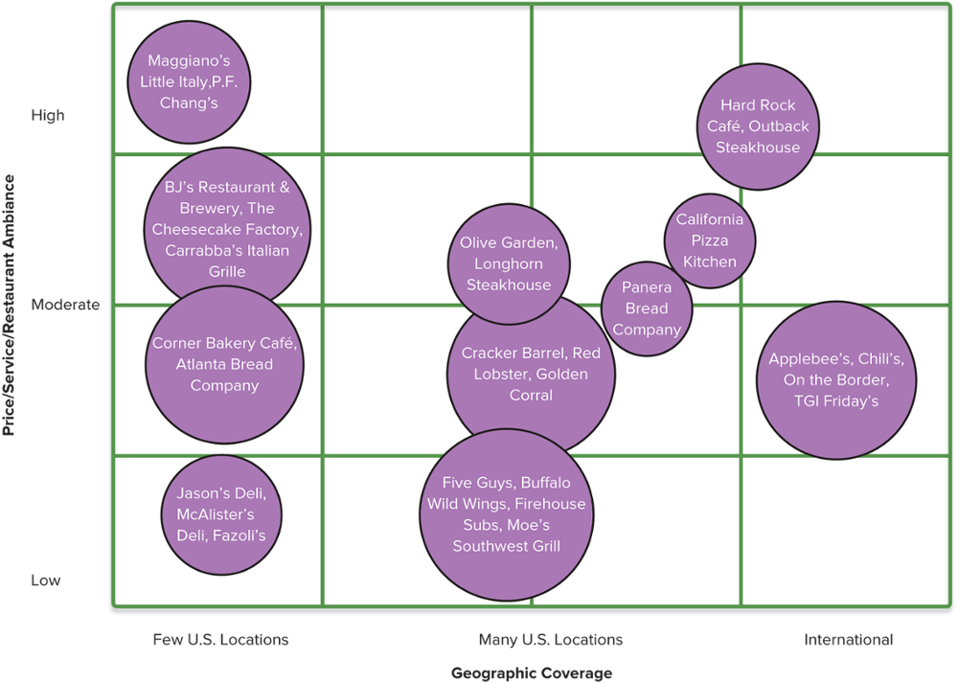
Concepts and Connections 3.1
Jump to Appendix 8 for long description.

Slide 38
The Value of Strategic Group Maps
The closer groups are to each other on the map, the stronger the cross-group rivalry.
Firms in groups that are far apart hardly compete.
Not all map positions are equally attractive.
Some groups are more favorably positioned because they confront weaker competitive forces.
Industry driving forces favor some groups over others.
Competitive pressures cause profit potential differences.

Slide 39
Question 5: What Strategic Moves Are Rivals Likely to Make Next?
Framework for Analysis of Rival Competitors
Current Strategy?
Rival’s market position, competitive advantage basis, and its investments in infrastructure, technology, or other resources
Objectives?
Its performance on current financial and strategic objectives
Capabilities?
Its current set of capabilities and efforts to acquire new capabilities related to future strategic moves
Assumptions?
Views and beliefs of rival’s top managers about their firm’s strategic situation can strongly impact their future behaviors

Slide 40
Question 6: What Are the Industry Key Success Factors?
Key Success Factors (KSFs) are competitive factors that most affect the ability of all industry firms to prosper.
KSFs include:
Specific product attributes
Necessary resources, competencies, and capabilities
Specific intangible assets
Competitive capabilities

Slide 41
CORE CONCEPT: Key Success Factors
Key success factors are the strategy elements, product attributes, competitive capabilities, or intangible assets with the greatest impact on future success in the marketplace.

Slide 42
Questions to Ask in Identifying Industry Key Success Factors
Which crucial product attributes do industry buyers consider when choosing between competing sellers?
Which resources and competitive capabilities must a company have to be competitively successful?
Which shortcomings are certain to put a company at a significant competitive disadvantage to its rivals?

Slide 43
TABLE 3.3 Common Types of Industry Key Success Factors (1 of 3)
Technology-related key success factors | Expertise in a particular technology or in scientific research (important in pharmaceuticals, Internet applications, mobile communications, and most high-tech industries) Proven ability to improve production processes (important in industries where advancing technology opens the way for higher manufacturing efficiency and lower production costs)
Manufacturing-related key success factors | Ability to achieve scale economies and/or capture experience curve effects (important to achieving low production costs) Quality control know-how (important in industries where customers insist on product reliability) High utilization of fixed assets (important in capital-intensive/high fixed-cost industries) Access to attractive supplies of skilled labor High labor productivity (important for items with high labor content) Low-cost product design and engineering (reduces manufacturing costs) Ability to manufacture or assemble products that are customized to buyer specifications

Slide 44
TABLE 3.3 Common Types of Industry Key Success Factors (2 of 3)
Distribution-related key success factors | A strong network of wholesale distributors/dealers Strong direct sales capabilities via the Internet and/or having company-owned retail outlets Ability to secure favorable display space on retailer shelves
Marketing-related key success factors | Breadth of product line and product selection A well-known and well-respected brand name Fast, accurate technical assistance Courteous, personalized customer service Accurate filling of buyer orders (few back orders or mistakes) Customer guarantees and warranties (important in mail-order and online retailing, big-ticket purchases, and new-product introductions) Clever advertising

Slide 45
TABLE 3.3 Common Types of Industry Key Success Factors (3 of 3)
Skills- and capability-related key success factors | A talented workforce (superior talent is important in professional services such as accounting and investment banking) National or global distribution capabilities Product innovation capabilities (important where rivals are racing to be first to market with new product attributes or performance features) Design expertise (important in fashion and apparel industries) Short delivery time capability Supply chain management capabilities Strong e-commerce capabilities—a user-friendly website and/or skills in using Internet applications to streamline internal operations
Other types of key success factors | Overall low costs (not just in manufacturing) to be able to meet low-price expectations of customers Convenient locations (important in many retailing businesses) Ability to provide fast, convenient, after-the-sale repairs and service A strong balance sheet and access to financial capital (important in newly emerging industries with high degrees of business risk and in capital-intensive industries) Patent protection

Slide 46
Examples of Industry Key Success Factors
Examples:
Expertise in a particular technology
Scale economies
Experience curve benefits
High capacity utilization
Strong network of wholesale distributors
Brand-building skills
Convenient retail locations

Slide 47
Question 7: Does the Industry Offer Good Prospects for Attractive Profits?
Factors that determine a firm’s prospects for attractive future profits in its industry include:
Both the firm’s and its industry’s growth potential
Effects of internal industry competition
Effects of prevailing and future driving forces
The firm’s competitive position in its industry vis-à-vis its rivals
The firm’s competence in performing the industry’s key success factors

Slide 48
Appendices
Long descriptions of images

Slide 49
Appendix 1 FIGURE 3.1 The Components of a Company’s External Environment
A graphic shows the levels of a company’s external environment. Surrounding a company is the inner ring, which focuses on industry and competitive environment. This ring includes substitute products, buyers, new entrants, rival firms, and suppliers. The outer ring, or macro-environment, encompasses economic conditions, sociocultural forces, technological factors, environmental forces, legal/regulatory factors, and political factors.
Return to slide.

Slide 50
Appendix 2 FIGURE 3.2 The Five-Forces Model of Competition
A model depicts how competitive forces affecting industry attractiveness go beyond internal rivalry among competing sellers and include pressures stemming from four coexisting external sources: 1) firms in other industries offering substitute products; 2) suppliers of raw materials, parts, components, or other resource inputs; 3) buyers; and 4) potential new entrants.
Return to slide.

Slide 51
Appendix 3 FIGURE 3.3 Factors Affecting the Strength of Buyer Bargaining Power
A figure shows the five competing forces (internal competition, substitutes, suppliers, new entrants, and buyers), and highlights buyers. Buyer bargaining power is stronger when: the costs of switching to competing brands or substitute are low; buyers are large and can demand concessions when buying in large quantities; a buyer's large volume purchase is important to the seller; buyer demand is weak/declining; there are only a few buyers; the buyer's identity adds to the seller's prestige; information quantity/quality improves; buyers can postpone purchases if they don't like the price; buyers threaten to integrate back into selling.
Buyer bargaining power is weaker when: buyers purchase items infrequently or in small quantities; the cost of switching to competing brands or substitutes are high; a surge in buyer demand creates a sellers' market; the seller's brand reputation is important to the buyer; a seller's product cannot be matched by other brands.
Return to slide.

Slide 52
Appendix 4 FIGURE 3.4 Factors Affecting Competition from Substitute Products
A figure shows the five competing forces (internal competition, substitutes, suppliers, new entrants, and buyers), and highlights substitute products. Competitive pressures from substitutes are stronger when: good substitutes are readily available/emerging; substitutes are attractively priced; substitutes have comparable or better features; costs to the end user are low when switching to substitutes; end users are more comfortable with the substitutes.
Competitive pressures from substitutes are weaker when: good substitutes don't exist/aren't readily available; substitutes are higher priced relative to their performance; switching to substitutes creates a higher cost for the end user.
Signs that competition from substitutes is strong: sales of substitutes are growing faster than sales of the industry being analyzed (as indication that the sellers of substitutes are drawing customers away from the industry in question); producers of substitutes are moving to add new capacity; and profits of the producers of substitutes are on the rise.
Return to slide.

Slide 53
Appendix 5 FIGURE 3.5 Factors Affecting the Strength of Suppliers
How strong are the competitive pressures stemming from supplier bargain power and seller-supplier collaboration?
A figure shows the five competing forces (internal competition, substitutes, suppliers, new entrants, and buyers), and highlights suppliers. Supplier bargaining power is stronger when: industry members incur high costs in switching to an alternative supplier; needed inputs are in short supply, so suppliers can set prices; a supplier has a differentiated input that enhances a product's quality or is valuable to a production process; there are only a few suppliers of a particular input.
Supplier bargaining power is weaker when: the supplied item is a commodity that is readily available; switching to an alternative supplier is lower cost; good substitutes or emerging inputs exist; a surge in availability weakens supplier pricing power; industry members and their high volume purchases become important for the suppliers' well-being; industry members threaten to turn back into suppliers and manufacture their own requirements.
Return to slide.

Slide 54
Appendix 6 FIGURE 3.6 Factors Affecting the Threat of Entry
How strong are the competitive pressures associated with the entry threat from new rivals?
A figure shows the five competing forces (internal competition, substitutes, suppliers, new entrants, and buyers), and highlights potential new entrants. Entry threats are stronger when: the entry candidate pool is large and some have resources that would make them formidable; entry barriers are low and can be hurdled by the least-likely candidates; existing industry members are aiming towards segments where they do not have a presence; newcomers can earn attractive profits; buyer demand is growing rapidly; industry members are unwilling/unable to contest newcomer entry.
Entry threats are weaker when: the entry candidate pool is small; entry barriers are high; existing competitors are struggling for good profits; the industry's outlook is risky/uncertain; buyer demand is slow or stagnant; industry members will strongly contest the new entrants' efforts for a market foothold.
Return to slide.

Slide 55
Appendix 7 FIGURE 3.7 Factors Affecting the Strength of Competitive Rivalry
A figure shows the five competing forces (internal competition, substitutes, suppliers, new entrants, and buyers), and highlights rivalry among competing sellers. Rivalry is stronger when: competing sellers are making fresh moves to improve market standing and business performance; buyer demand grows slowly; sellers have excess capacity due to buyer demand falling off; the number of equal rivals rises; rival products are commodities or weakly differentiated; switching brands is low cost to the buyer; outsiders acquired weak competitors and are trying to turn them into major contenders.
Rivalry is weaker when: industry members don't aggressively draw sales and market share away from rivals; buyer demand is growing steadily; customer loyalty is high towards one seller; buyer costs to switch brands are high; there are fewer than 5 sellers or so many rivals that one company's actions have no effect on another’s.
Typical “weapons” for battling rivals and attracting buyers: lower prices, more or different features, better product performance, higher quality, stronger brand image, wider selection of models, bigger and or better dealer network, low interest rate financing, higher levels of advertising, better customer service, and product customization.
Return to slide.

Slide 56
Appendix 8 Concepts and Connections 3.1
This example of a strategic group map shows the comparative market positions of selected companies in the casual dining industry. The restaurant chains are represented by different size circles, proportionally drawn based on revenues.
The y axis are the variables of price, service, restaurant ambiance, from low to high. The x axis is geographic coverage, from a few U.S. locations, to many U.S. locations, to international.
Jason’s Deli, McAlister’s Deli, and Fazoli’s are low in the three variables and have few U.S. locations.
Five Guys, Buffalo Wild Wings, Firehouse Subs, Moe’s Southwest Grill are low on the three variables and have many locations in the United States.
Corner Bakery Café and the Atlanta Bread Company rate moderately in the three variables and have few locations in the United States. Also in the moderate range of variables are Cracker Barrel, Red Lobster, and Golden Corral, but they have many locations in the United States. The international companies Applebee’s, Chili’s, On the Border, and T G I Friday’s rank in the moderate level of variables.
In the ranking of a higher moderate level of variables but with few U.S. locations are B. J.’s Restaurant and Brewery, The Cheesecake Factory, and Carrabba’s Italian Grille. Olive Garden, Longhorn Steakhouse, Panera Bread Company and California Pizza Kitchen all have high-moderate variables as well as many locations in the United States.
At the high end of the three variables are Maggiano’s Little Italy and P. F. Chang’s with just a few U.S. locations. Hard Rock Café and Outback Steakhouse also rank high in the three variables, but have many U.S. locations and some international locations.
Return to slide.

