Slide 1
CHAPTER 4 Evaluating a Company’s Resources, Capabilities, and Competitiveness

Slide 2
LEARNING OBJECTIVES
Assess how well a company’s strategy is working.
Understand why a company’s resources and capabilities are centrally important in giving the company a competitive edge over rivals.
Grasp how a company’s value chain activities can affect the company’s cost structure and customer value proposition.
Evaluate a company’s competitive strength relative to key rivals.
Understand how a comprehensive evaluation of a company’s external and internal situations can assist managers in making critical decisions about their next strategic moves.

Slide 3
Evaluating a Firm’s Internal Situation
Question 1 How well is the firm’s strategy working?
Question 2 What are the firm’s competitively important resources and capabilities?
Question 3 Are the firm’s cost structure and customer value proposition competitive?
Question 4 Is the firm competitively stronger or weaker than key rivals?
Question 5 Is the Company Able to Seize Market Opportunities and Nullify External Threats?
Question 6 What strategic issues and problems merit front-burner managerial attention?

Slide 4
Question 1: How Well Is the Company’s Strategy Working?
The two best indicators of how well a firm’s strategy is working are:
Whether the firm is recording gains in financial strength and profitability
Whether the firm’s competitive strength and market standing is improving

Slide 5
Other Strategy Performance Indicators
Indicators:
Trends in the firm’s sales and earnings growth
Trends in the firm’s stock price
The firm’s overall financial strength
The firm’s customer retention rate
The rate at which new customers are acquired
Changes in firm’s image and reputation with customers
Evidence of improvement in internal processes such as defect rate, order fulfillment, delivery times, days of inventory, and employee productivity

Slide 6
Question 2: What Are the Company’s Competitively Important Resources and Capabilities?
A company’s strategy and business model:
Must be well matched to its collection of resources and capabilities
Requires a tight fit with a company’s internal situation
Is strengthened when exploiting resources that are competitively valuable, rare, hard to copy, and not easily trumped to rivals’ equivalent substitute resources

Slide 7
CORE CONCEPTS: Resource and Capability
A resource is a competitive asset that is owned or controlled by a firm; a capability is the capacity of a firm to competently perform some internal activity.
Capabilities are developed and enabled through the deployment of a firm’s resources.

Slide 8
Resource and Capability Analysis
Analyzing the resources and capabilities of a company is a two-step process.
Identify the company’s most competitively important resources and capabilities.
Apply the four tests of competitive power to ascertain which resources and capabilities can support a sustainable competitive advantage over rival firms.

Slide 9
TABLE 4.1 Common Types of Tangible and Intangible Resources (1 of 2)
Tangible Resources | DESCRIPTION
Physical resources | State-of-the-art manufacturing plants and equipment, efficient distribution facilities, attractive real estate locations, or ownership of valuable natural resource deposits
Financial resources | Cash and cash equivalents, marketable securities, and other financial assets such as a company’s credit rating and borrowing capacity
Technological assets | Patents, copyrights, superior production technology, and technologies that enable activities
Organizational resources | Information and communication systems (servers, workstations, etc.), proven quality control systems, and strong network of distributors or retail dealers

Slide 10
TABLE 4.1 Common Types of Tangible and Intangible Resources (2 of 2)
Intangible Resources | DESCRIPTION
Human assets and intellectual capital | An experienced and capable workforce, talented employees in key areas, collective learning embedded in the organization, or proven managerial know-how
Brand, image, and reputational assets | Brand names, trademarks, product or company image, buyer loyalty, and reputation for quality, superior service
Relationships | Alliances or joint ventures that provide access to technologies, specialized know-how, or geographic markets, and trust established with various partners
Company culture | The norms of behavior, business principles, and ingrained beliefs within the company

Slide 11
Determining the Competitive Power of a Company’s Resources and Capabilities
VRIN Competitive Power Tests
Is the resource or capability competitively valuable?
Is the resource or capability rare—something rivals lack?
Is the resource or capability inimitable or hard to copy?
Is the resource or capability vulnerable to substitution from different types of resources and capabilities?

Slide 12
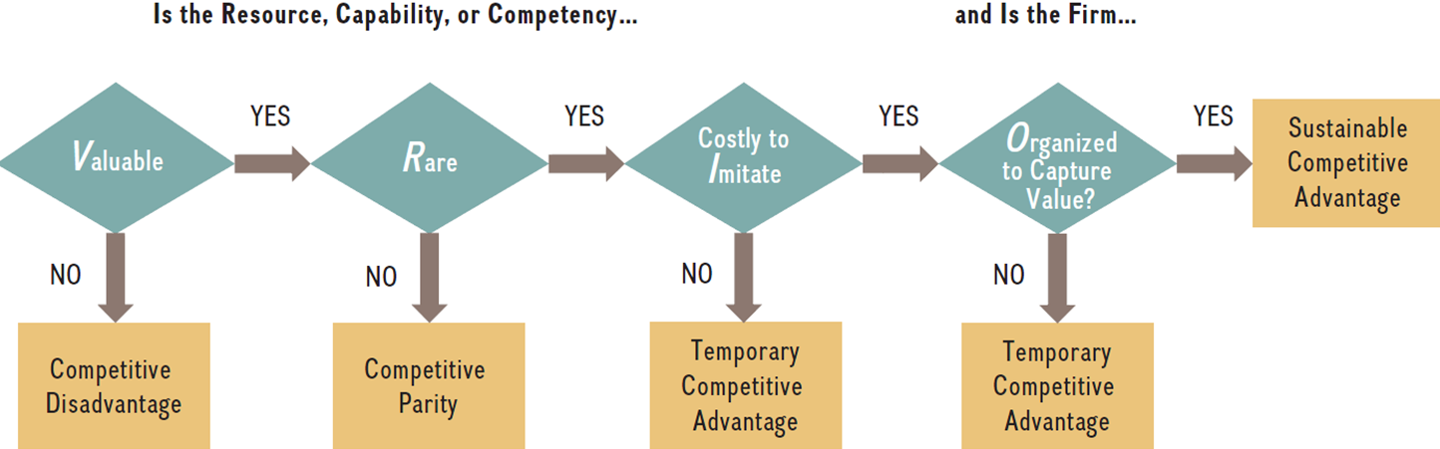
The VRIO Decision Tree

Slide 13
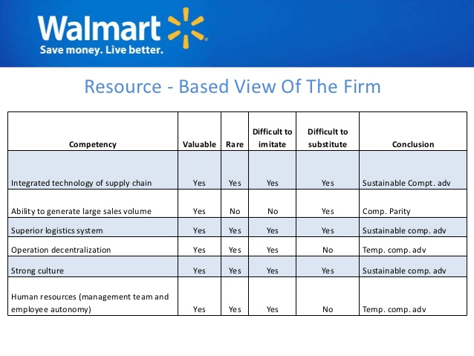
The VRIN Analysis Example

Slide 14
CORE CONCEPTS: VRIN tests for sustainable competitive advantage
The VRIN tests for sustainable competitive advantage asks if a resource or capability is valuable, rare, inimitable, and nonsubstitutable.

Slide 15
CORE CONCEPTS: Social Complexity and Causal Ambiguity
Social complexity and causal ambiguity are two factors that inhibit the ability of rivals to imitate a firm’s most valuable resources and capabilities. Causal ambiguity makes it very hard to figure out how a complex resource contributes to competitive advantage and therefore exactly what to imitate.

Slide 16
CORE CONCEPT: Resource Bundles
Companies that lack a standalone resource that is competitively powerful may nonetheless develop a competitive advantage through resource bundles that enable the superior performance of important cross-functional capabilities.

Slide 17
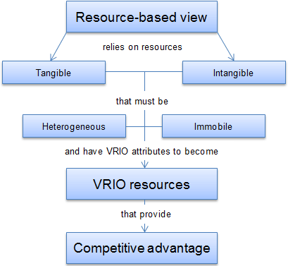
What is the Resource Based View (RBV)?
Notes:
Instructors:
The digital companion to this book McGraw-Hill Connect has a brief case exercise on this section of the textbook. It builds student confidence on VRIO elements of the resource based view (LO 4-4).

Slide 18
The Importance of Dynamic Capabilities in Sustaining Competitive Advantage
Management’s organization-building challenge has two elements.
Attending to ongoing strengthening and recalibration of existing capabilities and resources
Casting a watchful eye for opportunities to develop totally new capabilities for delivering better customer value and/or outcompeting rivals

Slide 19
CORE CONCEPT: Dynamic Capability
A dynamic capability is the ability to modify, deepen, or reconfigure the company’s existing resources and capabilities in response to its changing environment or market opportunities.

Slide 20
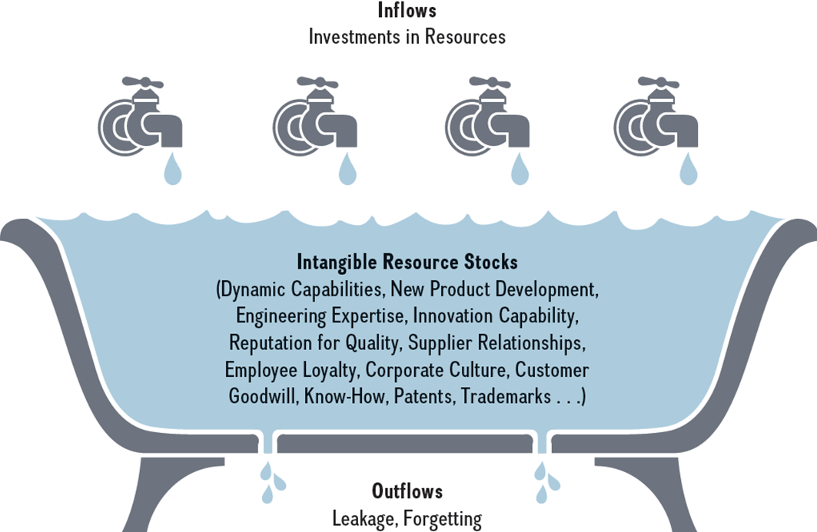
The Bathtub Metaphor
SOURCE: Figure based on metaphor used in I. Dierickx and K. Cool (1989), “Asset stock accumulation and sustainability of competitive advantage,” Management Science 35: 1504–1513.
Notes:
The amount of water in the bathtub indicates a company’s level of a specific intangible resource stock—such as its dynamic capabilities, new product development, engineering expertise, innovation capability, reputation for quality, and so on.
Intangible resource stocks are built through investments over time. These resource flows are represented in the drawing by the different faucets, from which water flows into the tub. These faucets indicate investments the firm can make in different intangible resources. Investments in building an innovation capability, for example, differ from investments made in marketing expertise. Each investment flow would be represented by a different faucet.
How fast the bathtub fills, however, also depends on how much water leaks out of the tub. The outflows represent a reduction in the firm’s intangible resource stocks. Resource leak-age might occur through employee turnover, especially if key employees leave. Significant re-source leakage can erode a firm’s competitive advantage. A reduction in resource stocks can occur if a firm does not engage in a specific activity for some time and forgets how to do this activity well.

Slide 21
Question 3: Are the Company’s Cost Structure and Customer Value Proposition Competitive?
Why are both cost structure and value important?
Delivering a profitable customer value proposition that maintains a competitive edge of over rivals requires effectively controlling the costs of differentiating features in industries where price competition is a dominant feature.
Useful analytical tools:
Value chain analysis
Benchmarking

Slide 22
CORE CONCEPT: Value Chain
A company’s value chain identifies the primary activities that create customer value and related support activities.

Slide 23
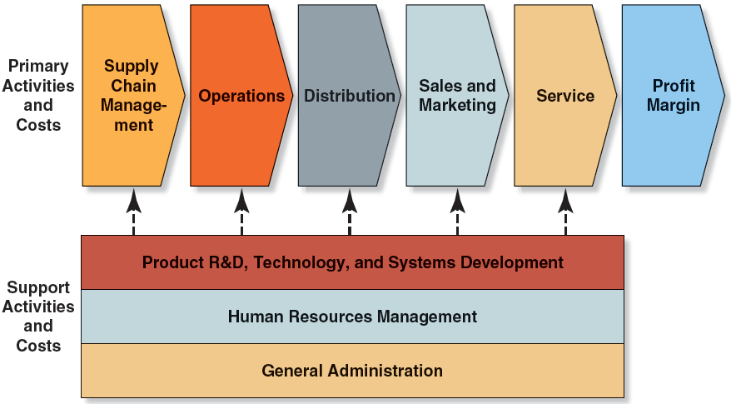
FIGURE 4.1 A Representative Company Value Chain (1 of 2)
Jump to Appendix 1 for long description.

Slide 24
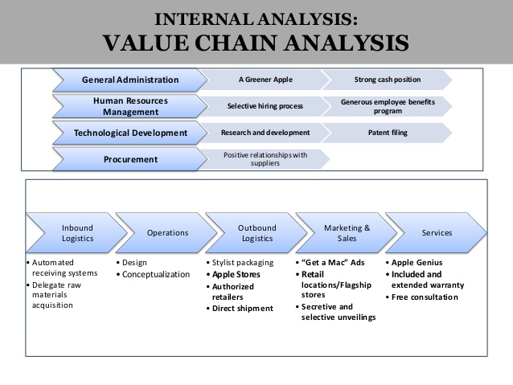
Apple Internal Value Chain

Slide 25
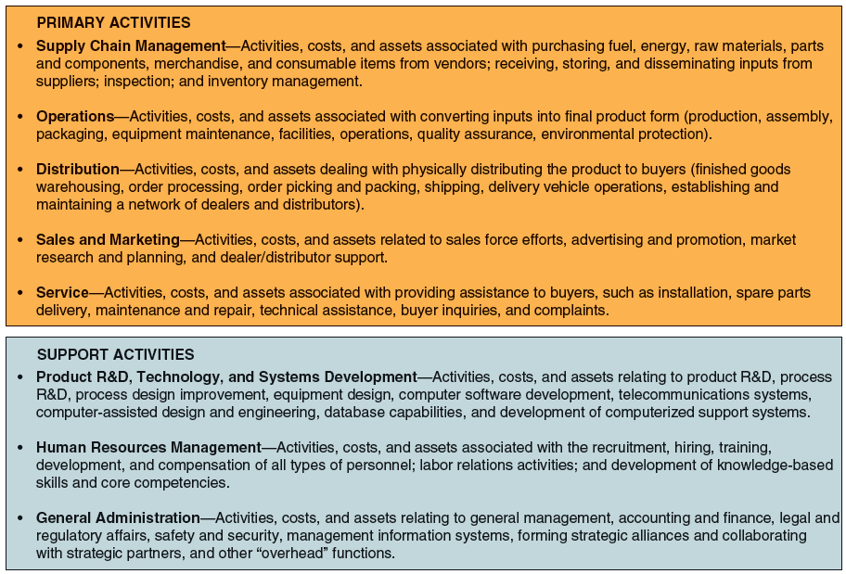
FIGURE 4.1 A Representative Company Value Chain (2 of 2)
Jump to Appendix 2 for long description.

Slide 26
Benchmarking: A Tool for Assessing Whether a Company’s Value Chain Activities Are Competitive
Benchmarking entails comparing how different firms perform various value chain maintenance and then making cross-firm comparisons of the costs and effectiveness of these activities.
How materials are purchased
How inventories are managed
How products are assembled
How customer orders are filled and shipped
How maintenance is performed

Slide 27
Core Concept: Benchmarking
Benchmarking is a potent tool for learning which companies are best at performing particular activities and then using their techniques (or “best practices”) to improve the cost and effectiveness of a company’s own internal activities.

Slide 28
FIGURE 4.2 Representative Value Chain for an Entire Industry
Jump to Appendix 3 for long description.

Slide 29
The Value Chain System for an Entire Industry
The value chains of forward channel partners are relevant because:
Costs and margins of the activities of distributors and retail dealers are part of the price the consumer pays and can strongly affect a firm’s customer value proposition.
Accurately assessing the competitiveness of a firm’s cost structure and value proposition helps its managers understand both an industry’s value chain system and its internal value chain.

Slide 30
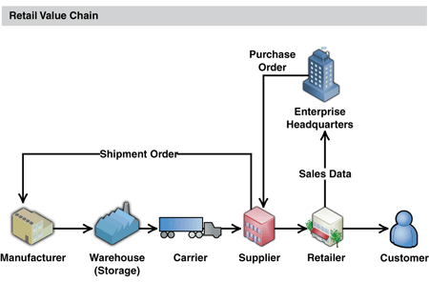

Slide 31
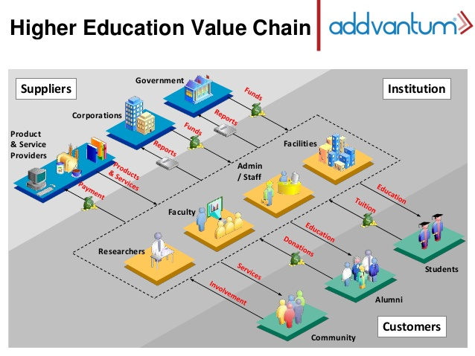

Slide 32
Strategic Options for Remedying a Cost or Value Disadvantage
There are three main areas of a firm’s overall value chain where cost differences with rivals can occur.
A firm’s own internal activities
Value chain activities performed by suppliers
Value chain activities performed by forward channel allies

Slide 33
Improving Internally Performed Value Chain Activities
Implement the use of best practices throughout the firm.
Eliminate cost-producing activities by revamping value chain.
Relocate high-cost internal activities to lower-cost areas.
Outsource internal activities to vendors or contractors to perform them more cheaply than in-house.
Invest in productivity-enhancing, cost-saving technology.
Find ways around activities or items where costs are high.
Redesign products and/or components to economize on manufacturing or assembly costs.
Reduce costs in supplier or forward portions of value chain system to make up for higher internal costs.

Slide 34
Improving Supplier-Related Value Chain Activities
Remedying Supplier-Related Cost Disadvantages
Pressure suppliers for lower prices.
Switch to lower-priced substitutes.
Collaborate closely with suppliers to identify mutual cost-saving opportunities.
Integrate backward into business of high-cost suppliers.
Enhancing the Customer Value Proposition
Select and retain best-quality performing suppliers.
Provide quality-based incentives to suppliers.
Integrate suppliers into the product design process.

Slide 35
Improving Value Chain Activities of Forward Channel Allies
Combat forward channel cost disadvantages by:
Pressuring dealer-distributors and other forward channel allies to reduce their costs and markups
Working with forward channel allies to identify win-win opportunities to reduce costs
Changing to a more economical distribution strategy or integrate forward into company-owned retail outlets
Improve the customer value proposition by:
Engaging in cooperative advertising and promotions
Providing training for dealers, distributors, or retailers to improve the purchasing experience or customer service
Creating and enforcing operating standards for resellers or franchisees to ensure consistent store operations

Slide 36
How Value Chain Activities Relate to Resources and Capabilities
A company’s value-creating activities are enabled by firm-specific resources and capabilities that are:
Valuable, rare and necessary preconditions for competitive advantage
Effectively deployed in a value-creating activity

Slide 37
Question 4: What Is the Company’s Competitive Strength Relative to Key Rivals?
Determining a company’s overall competitive position requires answering two questions.
How does the company rank relative to competitors on each of the important factors that determine market success?
Does the company have a net competitive advantage or disadvantage versus its major competitors?

Slide 38
Steps in a Competitive Strength Assessment
Step 1 List the industry’s key success factors and other measures of competitive strength or weakness (6 to 10 measures).
Step 2 Assign a weight to each measure of competitive strength based on its importance in shaping competitive success. (The sum of the weights for each measure must add up to 1.0.)
Step 3 Calculate strength ratings by scoring each competitor on each strength measure (use a scale where 1 is weak and 10 is strong) and multiplying the assigned rating by the assigned weight.
Step 4 Sum the weighted strength ratings on each factor to get an overall measure of competitive strength for each company being rated.
Step 5 Use the overall strength ratings to draw conclusions about the size and extent of the firm’s net competitive advantage or disadvantage and to take specific note of areas of strength and weakness.

Slide 39
TABLE 4.3 Illustration of a Competitive Strength Assessment
 |  | ABC CO. | RIVAL 1 | RIVAL 2 | RIVAL 3 | RIVAL 4
Key Success Factor/ Strength Measure | Importance Weight | Strength Rating | Weighted Score | Strength Rating | Weighted Score | Strength Rating | Weighted Score | Strength Rating | Weighted Score | Strength Rating | Weighted Score
Quality/product performance | 0.10 | 8 | 0.80 | 5 | 0.50 | 10 | 1.00 | 1 | 0.1 | 6 | 0.60
Reputation/image | 0.10 | 8 | 0.80 | 7 | 0.70 | 10 | 1.00 | 1 | 0.1 | 6 | 0.60
Manufacturing capability | 0.10 | 2 | 0.20 | 10 | 1.00 | 4 | 0.40 | 5 | 0.5 | 1 | 0.10
Technological skills | 0.05 | 10 | 0.50 | 1 | 0.05 | 7 | 0.35 | 3 | 0.15 | 8 | 0.40
Dealer network/distribution capability | 0.05 | 9 | 0.45 | 4 | 0.20 | 10 | 0.50 | 5 | 0.25 | 1 | 0.05
New-product innovation capability | 0.05 | 9 | 0.45 | 4 | 0.20 | 10 | 0.50 | 5 | 0.25 | 1 | 0.05
Financial resources | 0.10 | 5 | 0.50 | 10 | 1.00 | 7 | 0.70 | 3 | 0.3 | 1 | 0.10
Relative cost position | 0.30 | 5 | 1.50 | 10 | 3.00 | 3 | 0.95 | 1 | 0.3 | 4 | 1.20
Customer service capabilities | 0.15 | 5 | 0.75 | 7 | 1.05 | 10 | 1.50 | 1 | 0.15 | 4 | 0.60
Sum of importance weights | 1.00
Weighted overall strength rating |  |  | 5.95 |  | 7.70 |  | 6.85 |  | 2.10 |  | 3.70

Slide 40
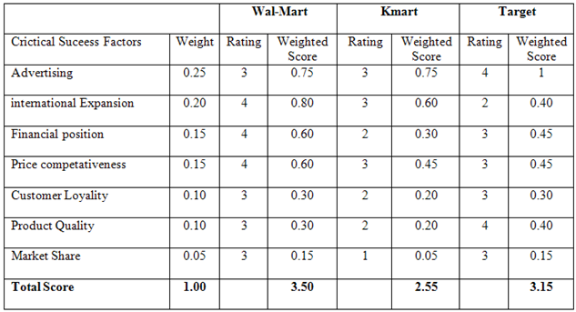
Competitive Strength Assessment for Wal-Mart

Slide 41
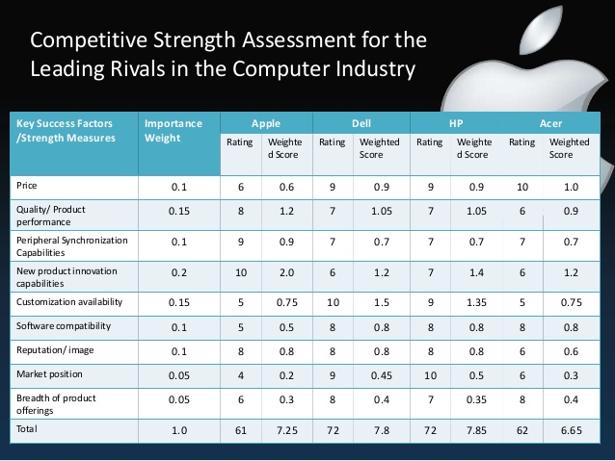

Slide 42
Interpreting the Competitive Strength Assessments
Show how a firm compares against its rivals, factor by factor or capability by capability.
Indicate whether a firm is at net competitive advantage or disadvantage against each rival.
Provide guidelines for designing wise offensive and defensive strategies.
Point to competitive weaknesses of the firm that will require defensive moves to correct.

Slide 43
Question 5: Is the Company Able to Seize Market Opportunities and Nullify External Threats?
SWOT represents the first letter in:
Strengths Weaknesses Opportunities Threats.
A well-conceived strategy is:
Matched to the firm’s resource strengths and weaknesses
Aimed at capturing the firm’s best market opportunities
Positioned to defend against external threats to its well-being

Slide 44
CORE CONCEPT: SWOT Analysis
SWOT analysis is a simple but powerful tool for sizing up a firm’s internal strengths and competitive deficiencies, its market opportunities, and the external threats to its future well-being.

Slide 45
SWOT Analysis
A framework that allows managers to synthesize insights obtained from an internal and external analysis to derive strategic implications
Internal Analysis
Strengths
Weaknesses
External Analysis
Opportunities
Threats

Slide 46
Strategic SWOT Questions
How can the firm use strengths to take advantage of opportunities?
How can the firm use strengths to reduce the likelihood and impact of threats?
How can the firm overcome weaknesses that prevent the firm from taking advantage of opportunities?
How can the firm overcome weaknesses that will make threats a reality?

Slide 47
The Value of a SWOT Analysis
The value of a SWOT analysis is in:
Drawing conclusions from SWOT listings about the firm’s overall situation and translating those conclusions into effective strategic actions that:
Better match the firm’s strategy to its strengths and market opportunities
Correct problematic weaknesses
Defend against worrisome external threats.

Slide 48
TABLE 4.2 Factors to Consider When Identifying a Company’s Strengths, Weaknesses, Opportunities, and Threats (1 of 4)
Potential Internal Strengths and Competitive Capabilities Core competencies in ____ . A strong financial condition; ample financial resources to grow the business. Strong brand name image/company reputation. Economies of scale and/or learning and experience curve advantages over rivals. Proprietary technology/superior technological skills/important patents. Cost advantages over rivals. Product innovation capabilities. Proven capabilities in improving production processes. Good supply chain management capabilities. Good customer service capabilities. Better product quality relative to rivals. Wide geographic coverage and/or strong global distribution capability. Alliances/joint ventures with other firms that provide access to valuable technology, competencies, and/or attractive geographic markets.

Slide 49
TABLE 4.2 Factors to Consider When Identifying a Company’s Strengths, Weaknesses, Opportunities, and Threats (2 of 4)
Potential Internal Weaknesses and Competitive Deficiencies No clear strategic direction. No well-developed or proven core competencies. A weak balance sheet; burdened with too much debt. Higher overall unit costs relative to key competitors. A product/service with features and attributes inferior to those of rivals. Too narrow a product line relative to rivals. Weak brand image or reputation. Weaker dealer network than key rivals. Behind on product quality, R&D, and/or technological know-how. Lack of management depth. Short on financial resources to grow the business and pursue promising initiatives.

Slide 50
TABLE 4.2 Factors to Consider When Identifying a Company’s Strengths, Weaknesses, Opportunities, and Threats (3 of 4)
Potential Market Opportunities Serving additional customer groups or market segments. Expanding into new geographic markets. Expanding the firm’s product line to meet a broader range of customer needs. Utilizing existing company skills or technological know-how to enter new product lines or new businesses. Falling trade barriers in attractive foreign markets. Acquiring rival firms or companies with attractive technological expertise or capabilities.

Slide 51
TABLE 4.2 Factors to Consider When Identifying a Company’s Strengths, Weaknesses, Opportunities, and Threats (4 of 4)
Potential External Threats to a Company’s Future Prospects Increasing intensity of competition among industry rivals—may squeeze profit margins. Slowdowns in market growth. Likely entry of potent new competitors. Growing bargaining power of customers or suppliers. Buyer needs and tastes shift away from the industry’s product. Adverse demographic changes that threaten to curtail demand for the industry’s product. Vulnerability to unfavorable industry driving forces. Restrictive trade policies on the part of foreign governments. Costly new regulatory requirements.

Slide 52
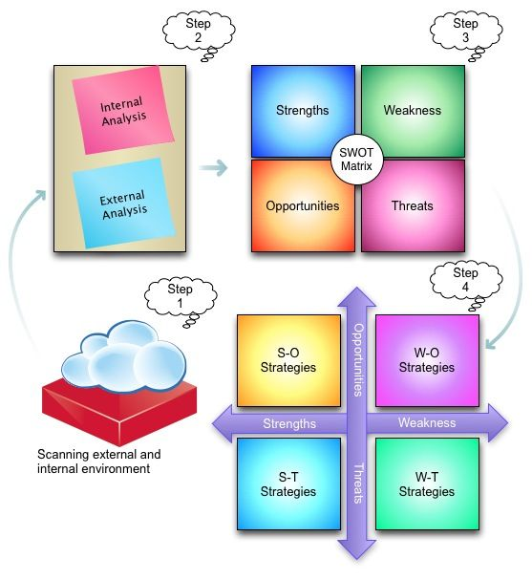
SWOT Analysis

Slide 53

SWOT Analysis for Walt Disney

Slide 54
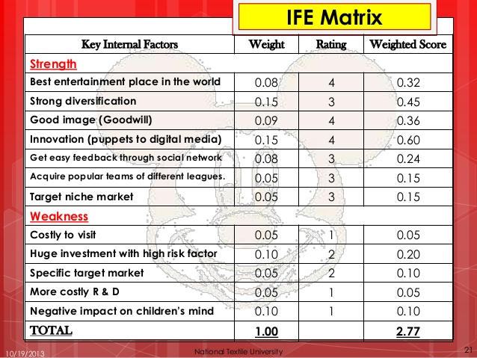
Evaluating S & W

Slide 55
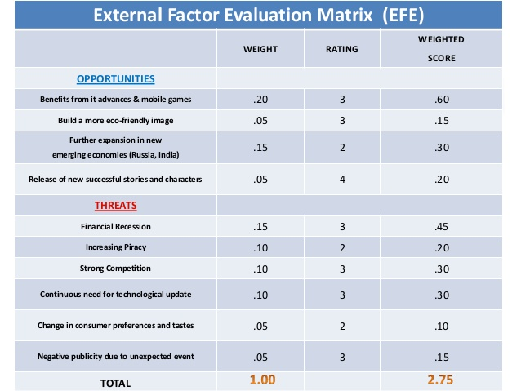
Evaluating O & T

Slide 56
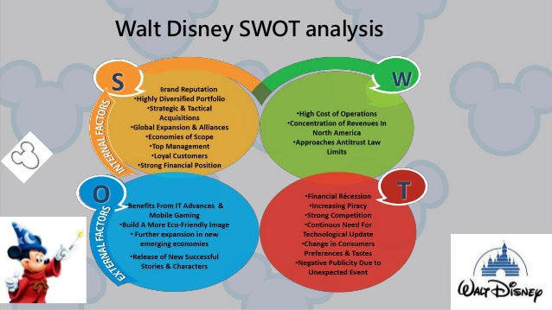
SWOT for Walt Disney

Slide 57
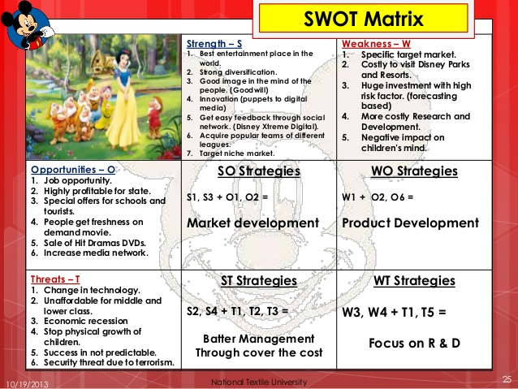
Developing strategy

Slide 58
Question 6: What Strategic Issues and Problems Must Be Addressed by Management?
The final and most important analytical step is to focus management on crucial strategic issues.
Precise pinpointing of problems sets the agenda for actions to take next to improve the firm’s performance and business outlook.
Compiling a “worry list” of problems and issues creates an agenda for managerial strategy making.

Slide 59
Appendices
Long descriptions of images

Slide 60
Appendix 1 FIGURE 4.1 A Representative Company Value Chain (1 of 2)
A figure shows that a company’s value chain consists of two broad categories of activities: the primary activities and costs, and the support activities and costs. The primary activities and costs are: supply chain management; operations; distribution; sales and marketing; service; and profit margin. The support activities and costs are: product R and D, technology, and systems development; human resources management; and general administration.
Return to slide.

Slide 61
Appendix 2 FIGURE 4.1 A Representative Company Value Chain (2 of 2)
Primary Activities | Description
Supply Chain Management | Activities, costs, and assets associated with purchasing fuel, energy, raw materials, parts and components, merchandise, and consumable items from vendors; receiving, storing, and disseminating inputs from suppliers; inspection; and inventory management.
Operations | Activities, costs, and assets associated with converting inputs into final product form (production, assembly, packaging, equipment maintenance, facilities, operations, quality assurance, environmental protection).
Distribution | Activities, costs, and assets dealing with physically distributing the product to buyers (finished goods warehousing, order processing, order picking and packing, shipping, delivery vehicle operations, establishing and maintaining a network of dealers and distributors).
Sales and Marketing | Activities, costs, and assets related to sales force efforts, advertising and promotion, market research and planning, and dealer and or distributor support.
Service | Activities, costs, and assets associated with providing assistance to buyers, such as installation, spare parts delivery, maintenance and repair, technical assistance, buyer inquiries, and complaints.
Support Activities | Description
Product R and D, Technology, and Systems Development | Activities, costs, and assets relating to product R and D, process R and D, process design improvement, equipment design, computer software development, telecommunications systems, computer-assisted design and engineering, database capabilities, and development of computerized support systems.
Human Resources Management | Activities, costs, and assets associated with the recruitment, hiring, training, development, and compensation of all types of personnel; labor relations activities; and development of knowledge-based skills and core competencies.
General Administration | Activities, costs, and assets relating to general management, accounting and finance, legal and regulatory affairs, safety and security, management information systems, forming strategic alliances and collaborating with strategic partners, and other “overhead” functions.
Return to slide.

Slide 62
Appendix 3 FIGURE 4.2 Representative Value Chain for an Entire Industry
A graphic depicts a value chain, consisting of: activities, costs, and margins of suppliers; internally performed activities, costs, and margins, activities, costs, and margins of forward channel allies and strategic partners; and buyer or end-user value chains. This chain can be applied to a supplier-related value chain, a company's own value chain, and a forward channel value chain.
Return to slide.

