Slide 1
CHAPTER 5 The Five Generic Competitive Strategies

Slide 2
LEARNING OBJECTIVES
Understand what distinguishes each of the five generic strategies and why some of these strategies work better in certain kinds of industry and competitive conditions than in others.
Explain the major avenues for achieving a competitive advantage based on lower costs.
Explain the major avenues for developing a competitive advantage based on differentiating a company’s product or service offering from the offerings of rivals.
Recognize the attributes of a best-cost provider strategy—a hybrid of low-cost provider and differentiation strategies.

Slide 3
Strategy and the Value Proposition
Competing to successfully gain a competitive advantage involves giving buyers what they perceive as superior value proposition by offering:
A good product at a lower price
A superior product that is worth paying more for
A best-value product that represents an attractive combination of price, features, quality, service, and other appealing attributes

Slide 4
Competitive Strategies and Market Positioning
Competitive Strategy
Deals exclusively with the specifics of management’s game plan for competing successfully in securing a particular competitive advantage over rivals that offers superior value to customers, strengthens its market position, and counters the maneuvers of its rivals
The two principal factors that distinguish one competitive strategy from another are:
Whether a firm’s market target is broad or narrow
Whether the firm is pursuing a competitive advantage linked to lower costs or differentiation

Slide 5
CORE CONCEPT: Competitive Strategy (1 of 2)
A competitive strategy concerns the specifics of management’s game plan for competing successfully and securing a competitive advantage over rivals in the marketplace.

Slide 6
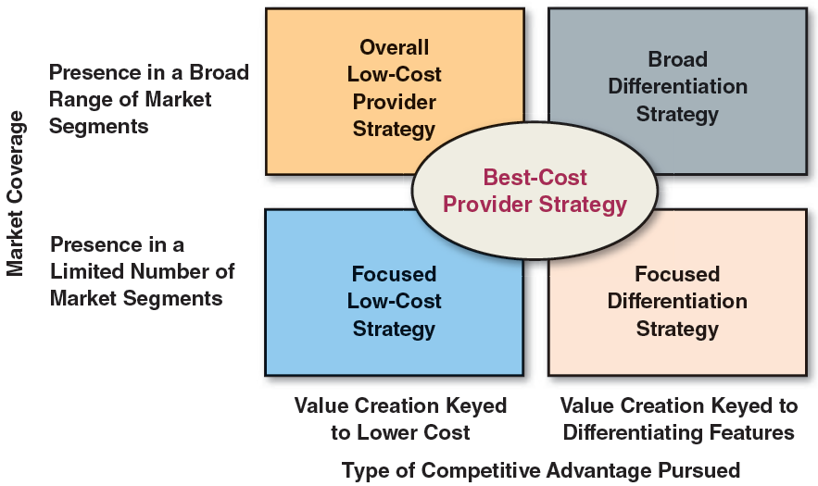
FIGURE 5.1 The Five Generic Competitive Strategies
Jump to Appendix 1 for long description.

Slide 7
The Five Generic Competitive Strategies
A low-cost provider strategy—striving to achieve lower overall costs than rivals and appealing to a broad spectrum of customers, usually by underpricing rivals
A broad differentiation strategy—seeking to differentiate the firm’s product or service from rivals’ in ways that will appeal to a broad spectrum of buyers
A focused low-cost strategy—concentrating on a narrow buyer segment (or market niche) and outcompeting rivals by having lower costs than rivals and thus being able to serve niche members at a lower price
A focused differentiation strategy—concentrating on a narrow buyer segment (or market niche) and outcompeting rivals by offering niche members customized attributes that meet their tastes and requirements better than rivals’ products
A best-cost provider strategy—giving customers more value for the money by satisfying buyers’ expectations on key quality/features/performance/service attributes while beating their price expectations. This option is a hybrid strategy that blends elements of low-cost provider and differentiation strategies; the aim is to have the lowest (best) costs and prices among sellers offering products with comparable differentiating attributes

Slide 8
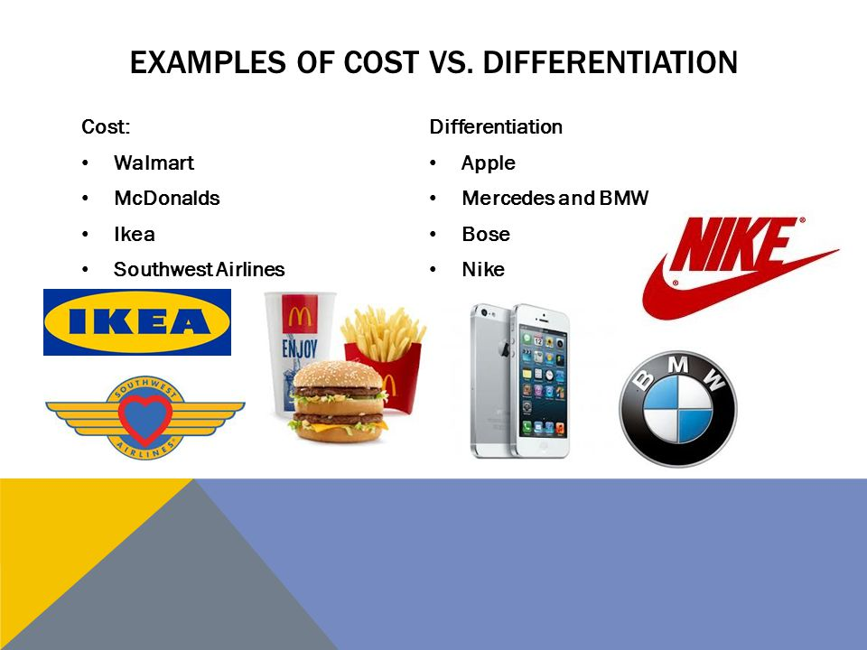
Generic Business Strategies

Slide 9

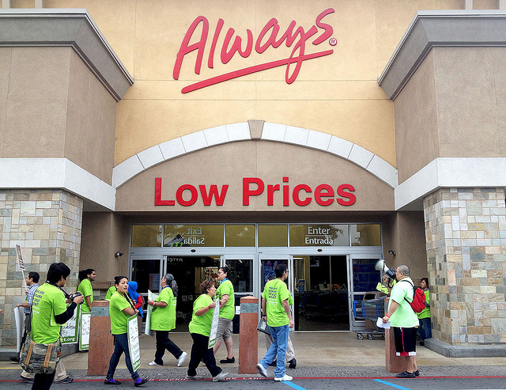
Low-Cost Provider Strategies

Slide 10
Low-Cost Provider Strategies
A powerful competitive approach with price-sensitive buyers when a firm’s offering:
Has meaningfully lower costs than rivals—but not necessarily the absolutely lowest possible cost
Includes features and services that buyers consider essential
Is viewed by buyers as offering equivalent or higher value even if priced lower than competing products
Notes:
10

Slide 11
CORE CONCEPT: Low-Cost Leader
A low-cost leader’s basis for competitive advantage is lower overall costs than competitors. Success in achieving a low-cost edge over rivals comes from eliminating and/or curbing “nonessential” activities and/or outmanaging rivals in performing essential activities.

Slide 12
Translating a Low-Cost Strategy into Attractive Profit Performance
Option 1:
Use a lower-cost edge to underprice competitors and attract price-sensitive buyers in great enough numbers to increase total profits
Option 2:
Maintain present price, be content with present market share, and use lower-cost edge to earn a higher profit margin on each unit sold

Slide 13
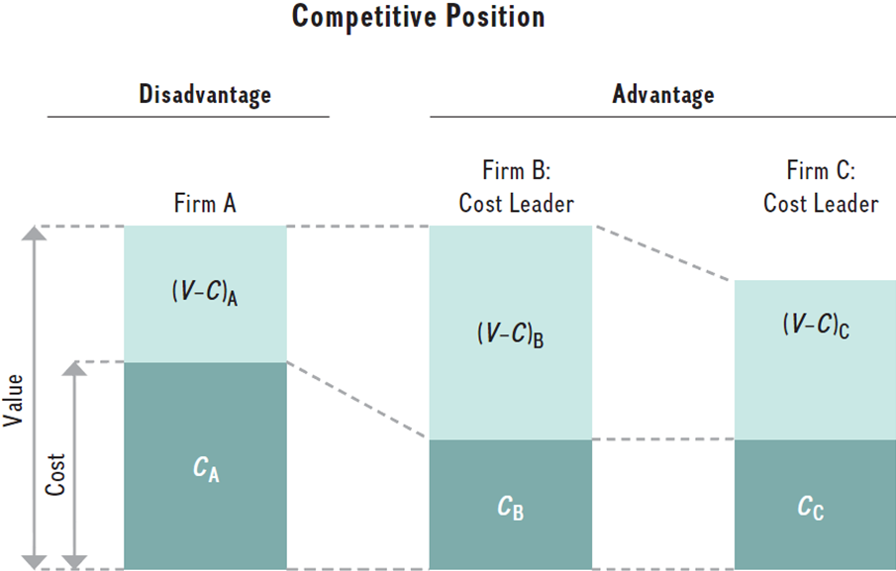
Achieving Competitive Advantage with a Low-Cost Strategy
Firms that keep their costs low while offering acceptable value gain a competitive advantage
Notes:
In both approaches to cost leadership in this image, Firm B’s economic value creation is greater than that of Firm A and Firm C. Yet, both firms B and C achieve a competitive advantage over Firm A. Either one can charge prices similar to its competitors and benefit from a greater profit margin per unit, or it can charge lower prices than its competition and gain higher profits from higher volume. Both variations of a cost-leadership strategy can result in competitive advantage. Although Firm B has a competitive advantage over both firms A and C, Firm C has a competitive advantage in comparison to Firm A.

Slide 14
The Two Major Avenues for Achieving Low-Cost Leadership
Performing essential value chain activities more cost-effectively than rivals
Revamping the firm’s overall value chain to eliminate or bypass some cost-producing activities altogether

Slide 15
Cost-Efficient Management of Value Chain Activities
Striving to capture all available economies of scale.
Taking full advantage of experience and learning curve effects.
Trying to operate facilities at full capacity.
Substituting lower-cost inputs whenever there is little or no sacrifice in product quality or product performance.
Employing advanced production technology and process design to improve overall efficiency.
Using communication systems and information technology to achieve operating efficiencies.
Using the company’s bargaining power vis-à-vis suppliers to gain concessions.
Being alert to the cost advantages of outsourcing and vertical integration.
Pursuing ways to boost labor productivity and lower overall compensation costs.

Slide 16
CORE CONCEPT: Cost Driver
A cost driver is a factor having a strong effect on the cost of a company’s value chain activities and cost structure.

Slide 17
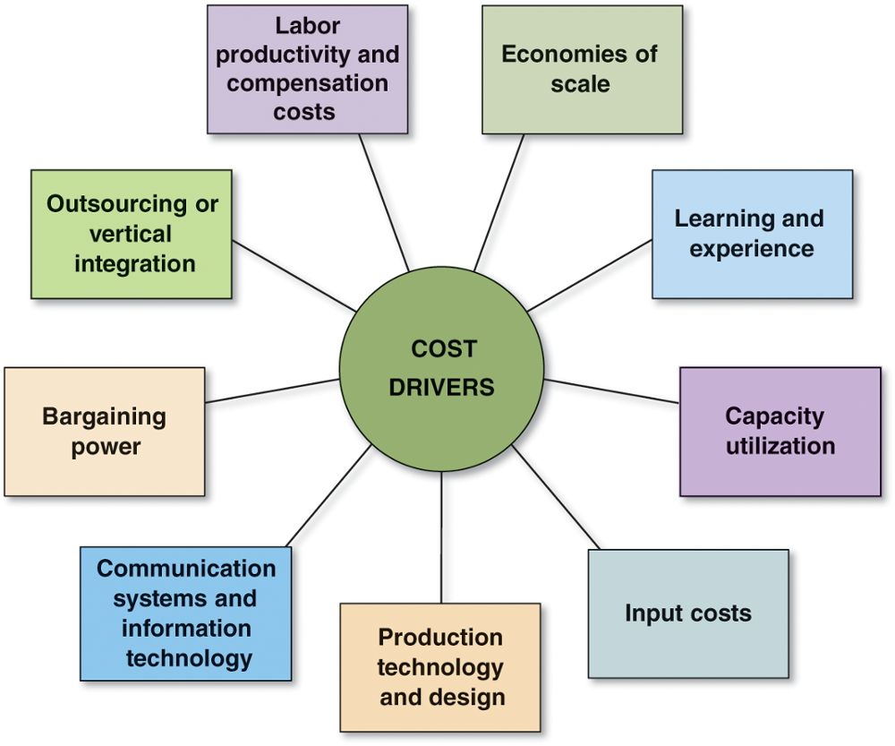
FIGURE 5.2 Important Cost Drivers in a Firm’s Value Chain
Jump to Appendix 2 for long description.

Slide 18
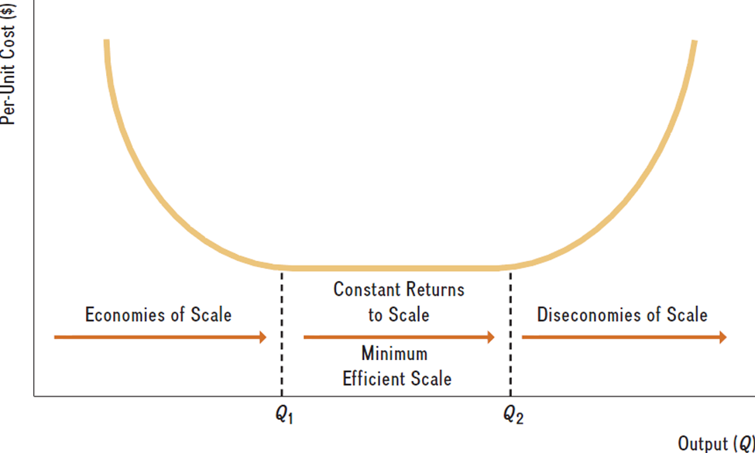
Economies of Scale
Decreases in per unit costs as output increases

Slide 19
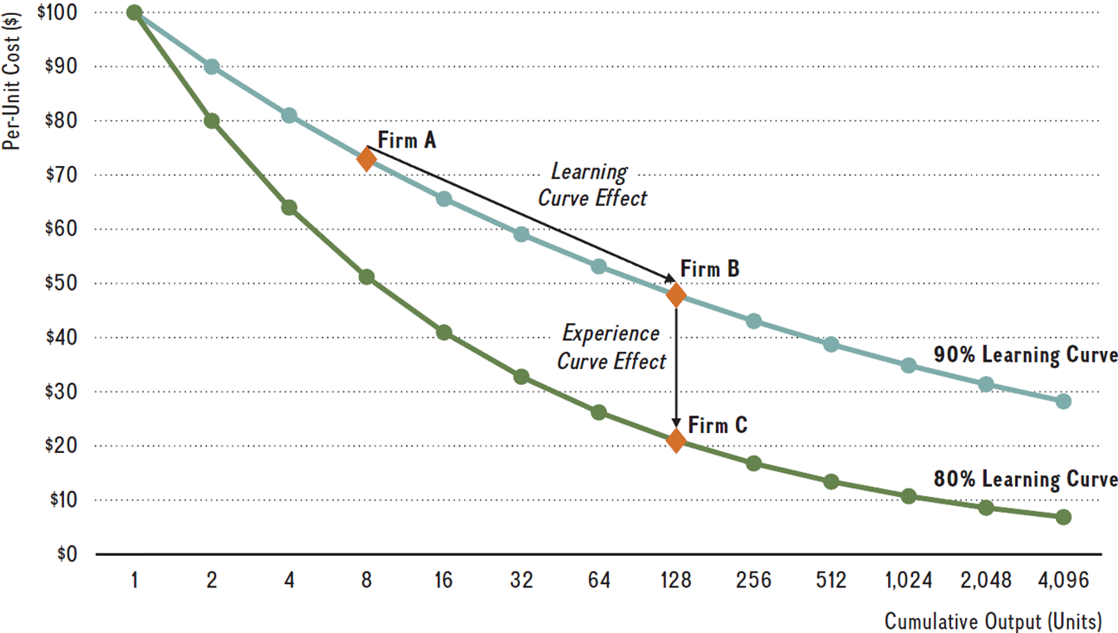
Learning Curve and Experience Curve Effects
Notes:
This image depicts a 90 percent and an 80 percent learning curve. In a 90 percent learning curve, per-unit cost drops 10 percent every time output is doubled. The steeper 80 percent learning curve indicates a 20 percent drop every time output is doubled. It is important to note that the learning-curve effect is driven by increasing cumulative output within the existing technology over time. That implies that the only difference between two points on the same learning curve is the size of the cumulative output. The underlying technology remains the same. The speed of learning determines the slope of the learning curve, or how steep the learning curve is (e.g., 80 percent is steeper than a 90 percent learning curve, because costs decrease by 20 percent versus a mere 10 percent each time output doubles).

Slide 20
Revamping the Value Chain
Reengineering the firm’s value chain by:
Selling directly to consumers and cutting out the activities and costs of distributors and dealers
Streamlining operations by eliminating low value-added or unnecessary work steps and activities
Collaborating with suppliers to improve supply chain efficiency by reducing materials handling, shipping and inventory costs

Slide 21
When a Low-Cost Strategy Works Best
Price competition among rival sellers is especially vigorous.
The products of rival sellers are essentially identical and are readily available from several sellers.
There are few ways to achieve product differentiation that have value to buyers.
Buyers incur low costs in switching their purchases from one seller to another.
The majority of industry sales are made to a few, large-volume buyers.
Industry newcomers use introductory low prices to attract buyers and build a customer base.

Slide 22
Pitfalls to Avoid in Pursuing a Low-Cost Provider Strategy
Overly Aggressive Price Cutting
Price cutting results in lower margins, no increase in sales volume and lower profitability.
Relying on easily imitated cost reductions
The value of a cost advantage depends on its sustainability.
Becoming too fixated on cost reduction
Buyer interest in additional features might be ignored.
Declining buyer sensitivity to price might be overlooked.
Technological breakthroughs might nullify cost advantages.

Slide 23

Differentiation Strategies

Slide 24
Broad Differentiation Strategies
Attractive competitive approaches to use whenever buyers’ needs and preferences are too diverse to be fully satisfied by a standardized product or service.
Involves offering differentiating features that clearly set the firm’s products or services apart from rivals
Enhances profitability whenever the extra price the product commands outweighs the added costs of achieving the differentiation that is not easily copied or matched by rivals

Slide 25
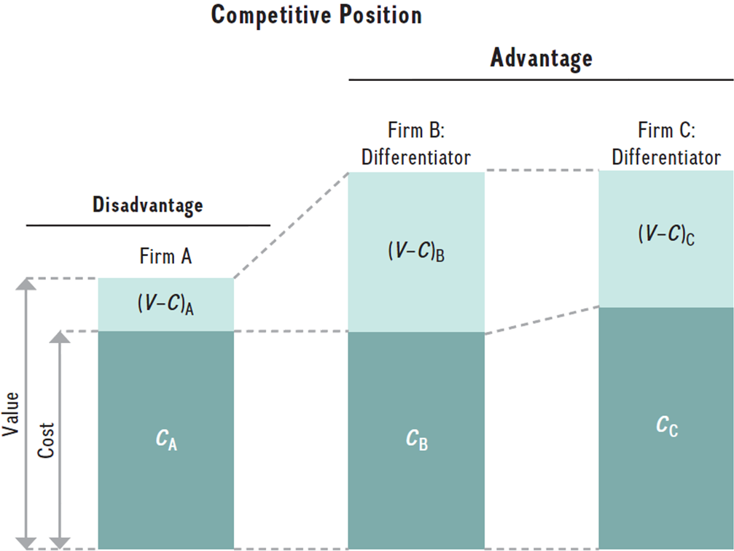
Achieving Competitive Advantage with a Differentiation Strategy
Competitive advantage achieved as long as economic value created (V - C) is greater than competitors
Notes:
Firm A in this image produces a generic commodity. Firm B and Firm C represent two efforts at differentiation. Firm B not only offers greater value than Firm A, but also maintains cost parity, meaning it has the same costs as Firm A. However, even if a firm fails to achieve cost parity (which is often the case because higher value creation tends to go along with higher costs in terms of higher-quality raw materials, research and development, employee training to provide superior customer service, and so on), it can still gain a competitive advantage if its economic value creation exceeds that of its competitors. Firm C represents just such a competitive advantage. For the approach shown either in Firm B or Firm C, economic value creation, (V - C)_{B} or (V – C)_{C}, is greater than that of Firm A (V - C)_{A}. Either Firm B or C, therefore, achieves a competitive advantage because it has a higher value gap over Firm A [(V - C)_{B} > (V - C)_{A}, or (V – C)_{C} > (V – C)_{A}], which allows it to charge a premium price, reflecting its higher value creation. To complete the relative comparison, although both companies pursue a differentiation strategy, Firm B also has a competitive advantage over Firm C because although both offer identical value, Firm B has lower cost, thus (V - C)_{B} > (V - C)_{C.}

Slide 26
CORE CONCEPT: Broad Differentiation Strategy
The essence of a broad differentiation strategy is to offer unique product or service attributes that a wide range of buyers find appealing and worth paying for.

Slide 27
Benefits of Successful Differentiation
Successful execution of a differentiation strategy allows a firm to:
Command a premium price.
Increase its unit sales.
Gain buyer loyalty to its brand.

Slide 28
Approaches to Differentiation
Companies pursuing differentiation:
Unique taste: Red Bull, Doritos
Multiple features: Microsoft Office, Apple iPhone
Wide selection and one-stop shopping: Home Depot, Amazon.com
Superior service: Ritz-Carlton, Nordstrom
Spare parts availability: Caterpillar
Engineering design and performance: Mercedes-Benz, BMW
Luxury and prestige: Rolex, Gucci, Chanel
Product reliability: Whirlpool and Bosch
Quality manufacture: Michelin, Toyota and Honda
Technological leadership: 3M Corporation
Full range of services: Charles Schwab in stock brokerage
Complete line of products: Campbell soups, Frito-Lay snack foods

Slide 29
CORE CONCEPT: Uniqueness Driver
A uniqueness driver is a value chain activity or factor that can have a strong effect on customer value and creating differentiation.
Easy-to-copy differentiating features cannot produce sustainable competitive advantage; differentiation based on hard-to-copy competencies and capabilities tends to be more sustainable.
Differentiation can be based on tangible or intangible features and attributes.

Slide 30
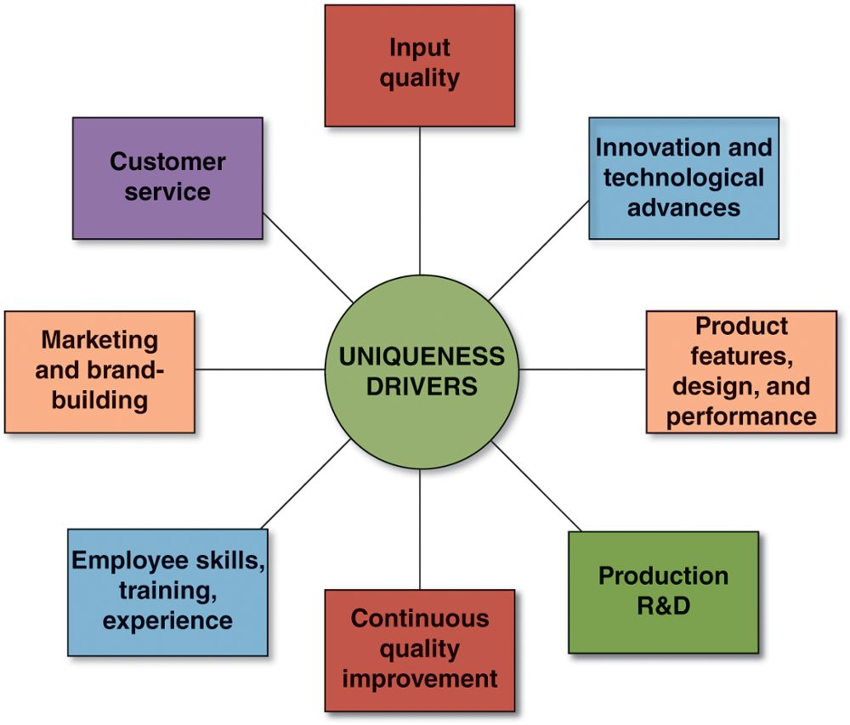
FIGURE 5.3 Important Uniqueness Drivers in a Firm’s Value Chain
Jump to Appendix 3 for long description.

Slide 31
Managing the Value Chain in Ways That Enhance Differentiation
Activities That Enhance Differentiation
Seeking out high-quality inputs
Striving for innovation and technological advances
Creating superior product features, design, and performance
Production-related research and development activities
Pursuing continuous quality improvement
Emphasizing human resource management activities
Emphasizing marketing and brand-building activities
Improving customer service or adding additional services

Slide 32
Revamping the Value Chain System to Increase Differentiation
Approaches to enhancing differentiation through changes in the value chain system
Coordinating with downstream channel allies to enhance customer value
Coordinating with upstream suppliers to better address customer needs

Slide 33
Delivering Superior Value via a Differentiation Strategy
Include product attributes and user features that lower the buyer’s costs
Incorporate tangible features that improve product performance
Incorporate intangible features that enhance buyer satisfaction in noneconomic ways

Slide 34
Perceived Value and the Importance of Signaling Value
A differentiation strategy’s price premium reflects the value actually delivered to the buyer and the value perceived by the buyer.
It is important to signal value when:
The nature of differentiation is subjective.
Buyers are making a first-time purchase.
Repurchase is infrequent.
Buyers are unsophisticated.

Slide 35
When a Differentiation Strategy Works Best
Buyer needs and uses of the product are diverse.
There are many ways to differentiate the product or service that have value to buyers.
Few rival firms are following a similar differentiation approach.
Technological change is fast-paced and competition revolves around rapidly evolving product features.

Slide 36
Pitfalls to Avoid in Pursuing a Differentiation Strategy
Pursuing a differentiation strategy keyed to product or service attributes that are easily and quickly copied
Offering product features or unique attributes in which buyers see little value or are easily copied by rivals
Overspending on efforts to differentiate that erode profitability
Not establishing meaningful gaps in quality or service or performance features over the products of rivals
Over-differentiating so that product quality or service levels exceed buyers’ needs
Trying to charge too high a price premium

Slide 37
Focused (or Market Niche) Strategies
Focused strategies are developed especially for competing in a narrow piece of the total market as defined by geographic uniqueness or special product attributes.
Focused strategies are appealing to smaller and medium-sized firms that may lack the breadth and depth of resources to tackle going after a whole market customer base.

Slide 38
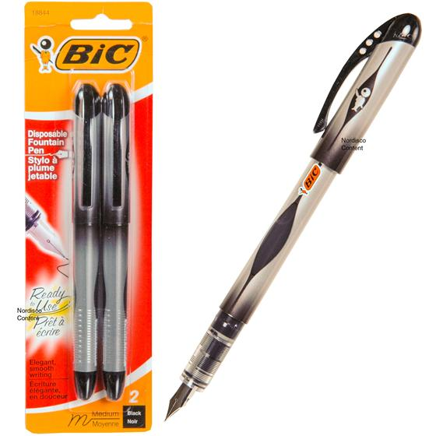
Focused Business Strategies

Slide 39
A Focused Low-Cost Strategy
A strategy that aims at securing a competitive advantage by serving buyers in the target market niche at a lower cost and a lower price than rival competitors.
A strategy that achieves its cost advantage in the same way as for low-cost leadership—by outmanaging rivals in keeping costs low and bypassing or reducing nonessential activities.

Slide 40
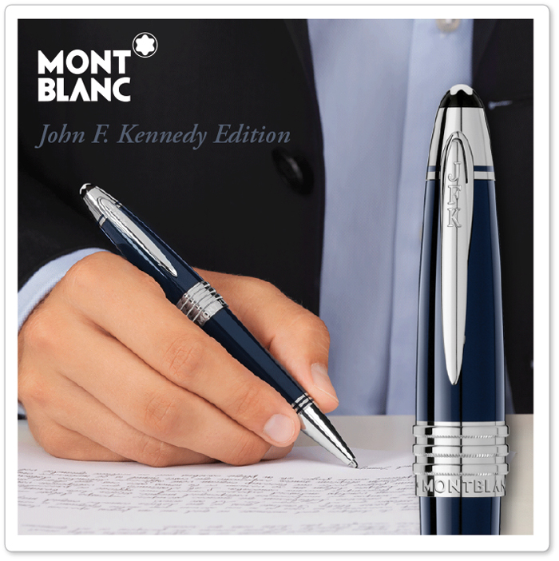
Focused Business Strategies

Slide 41
Focused Differentiation Strategy
Focused differentiation strategy is keyed to offering carefully designed products or services to appeal to the unique preferences and needs of a narrow, well-defined group of buyers (as opposed to a broad differentiation strategy aimed at many buyer groups and market segments).

Slide 42
When a Focused Low-Cost or Focused Differentiation Strategy Is Viable
The target market niche is big enough to be profitable and offers good growth potential.
Market leaders have chosen not to compete in the niche—focusers can avoid battling head-to-head against the biggest and strongest competitors.
It is costly or difficult for multi-segment competitors to meet the specialized needs of niche buyers and at the same time satisfy the expectations of mainstream customers.
The market has many different niches and segments, allowing a focuser to pick a niche suited to its strengths and capabilities.
Few rivals attempt to specialize in the same target segment.

Slide 43
The Risks of a Focused Low-Cost or Focused Differentiation Strategy
Competitors will find effective ways to match a focuser’s capabilities in serving the target niche.
The preferences and needs of niche members to shift over time toward the product attributes desired by the majority of buyers.
The segment may become so attractive it is soon inundated with competitors, intensifying rivalry, and splintering segment profits.

Slide 44
Best-Cost Provider Strategies
A hybrid of low-cost provider and differentiation strategies that:
Involves giving customers more value for money by satisfying buyer expectations on key quality/features/ performance/service attributes while exceeding customer expectations on price
Creates a powerful competitive approach with value-conscious buyers looking for a good-to-very-good product or service at an economical price
Creates a “best-cost” status as the low-cost provider of a product or service with upscale attributes

Slide 45
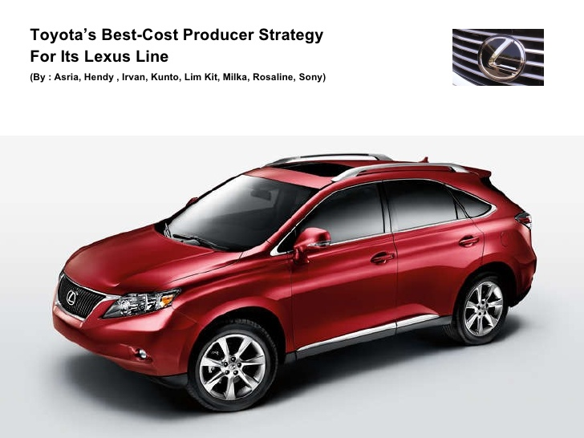
Best-Cost Provider Strategies

Slide 46
CORE CONCEPT: Best-Cost Provider Strategies
Best-cost provider strategies are a hybrid of low-cost provider and differentiation strategies that aim at satisfying buyer expectations on key quality, features, performance, and service attributes while beating customer expectations on price.

Slide 47
Employing Best-Cost Strategies
Profitable best-cost strategies are contingent on the firm having the capability to deliver attractive or upscale attributes at a lower cost than rivals through:
A superior value chain configuration that eliminates or minimizes activities that do not add value.
Unmatched efficiency in managing essential value chain activities.
Core competencies that allow differentiating attributes to be incorporated at a low cost.

Slide 48
When a Best-Cost Provider Strategy Works Best
A best-cost provider strategy works best in markets where:
Product differentiation is the norm.
Large numbers of value-conscious buyers can be induced to purchase economically-priced mid-range products and services, especially during recessionary times.
A provider can offer either a medium-quality product at a below-average price or a high-quality product at an average or slightly higher-than-average price.

Slide 49
The Danger of an Unsound Best-Cost Provider Strategy
Losing at both ends of the market:
Dual vulnerability to both low-cost providers and high-end differentiators in not having
the requisite core competencies and efficiencies in managing value chain activities to offer significantly differentiating product attributes.
features at attractive lower prices without significantly increasing costs.

Slide 50
Core Concept: Competitive Strategy (2 of 2)
A company’s competitive strategy should be well matched to its internal situation and predicated on leveraging its collection of competitively valuable resources and competencies.

Slide 51
Successful Competitive Strategies Are Resource Based (1 of 2)
Low-Cost Providers
Must have the resources and capabilities to keep their costs below those of their competitors.
Must have expertise to cost-effectively manage value chain activities better than rivals.
Differentiators
Must have the resources and capabilities to incorporate unique attributes that a broad range of buyers will find appealing and are will paying for.

Slide 52
Successful Competitive Strategies Are Resource Based (2 of 2)
Narrow Segment Focusers
Must have the capability to do an outstanding job of satisfying the needs and expectations of niche buyers.
Best-Cost Providers
Must have the resources and capabilities to incorporate upscale product or service attributes at a lower cost than rivals.

Slide 53
Appendices
Long descriptions of images

Slide 54
Appendix 1 FIGURE 5.1 The Five Generic Competitive Strategies
A graphics shows how competitive strategies are differentiated from one another by one, whether a company’s market target is broad or limited and two, whether the company is pursuing a competitive advantage linked to lower costs or differentiation. These factors comprise the two axes of the best-cost provider strategy. Aligned with the axes (broader market or limited market; pursuing lower costs or pursuing differentiation) are four text boxes which read: overall low-cost provider (broad market, lower cost); broad differentiation strategy (broad market, differentiating features); focused low-cost strategy (limited market, lower cost); and focused differentiation strategy (limited market, differentiating features).
Return to slide.

Slide 55
Appendix 2 FIGURE 5.2 Important Cost Drivers in a Firm’s Value Chain
A figure lists the important cost drivers in a firm’s value chain: labor productivity and compensation costs, economies of scale, learning and experience, capacity utilization, input costs, production technology and design, communication systems and information technology, bargaining power, and outsourcing or vertical integration.
Return to slide.

Slide 56
Appendix 3 FIGURE 5.3 Important Uniqueness Drivers in a Firm’s Value Chain
A figure lists the eight important uniqueness drivers in a company's value chain. They are: input quality; innovation and technological advances; product features, design, and performance; production R and D; continuous quality improvement; employee skills and training; marketing and brand building; and customer service.
Return to slide.

