Slide 1
CHAPTER 9 Ethics, Corporate Social Responsibility, Environmental Sustainability, and Strategy

Slide 2
LEARNING OBJECTIVES
Understand why the standards of ethical behavior in business are no different from ethical standards in general.
Recognize conditions that give rise to unethical business strategies and behavior.
Identify the costs of business ethics failures.
Understand the concepts of corporate social responsibility and environmental sustainability and how companies balance these duties with economic responsibilities to shareholders.

Slide 3
Linking Strategy, Ethics and Social Responsibility
In crafting and executing a strategy that delivers value to both customers and shareholders, what is a firm’s duty?
Act in an ethical manner?
Demonstrate socially responsible behavior by being a committed corporate citizen?
Adopt business practices that conserve natural resources, protect the interest of future generations, and preserve the well-being of the planet?
Notes:
3

Slide 4
What Do We Mean by Business Ethics?
Business ethics
It is the application of ethical principles and standards to the actions and decisions of business organizations and the conduct of their personnel.
How do ethics and business ethics differ?
Ethical principles in business are not materially different from ethical principles in general.
Business actions
Actions are judged by general ethical standards of society.
Actions are not subject to more permissive standards.

Slide 5
CORE CONCEPT: Business Ethics
Business ethics involves the application of general ethical principles to the actions and decisions of businesses and the conduct of their personnel.

Slide 6
Drivers of Unethical Strategies and Business Behavior
What might lead to unethical strategies and business behavior?
The view that “the business of business is business, not ethics”
Faulty oversight, enabling the unscrupulous pursuit of personal gain and other selfish interests
Heavy pressures on managers to meet or beat performance targets
Company culture that puts profitability and good business performance ahead of ethical behavior

Slide 7
The Business Case for Ethical Strategies
Deliberate pursuit of unethical strategies and tolerance of unethical conduct is a risky and costly practice from both a shareholder perspective and a reputational standpoint.
Adopting ethical strategies and engaging only in ethical conduct are simply good business.
Sarbanes-Oxley Act (2002)
Publicly traded firms must have a code of ethics or else explain in writing to the Securities and Exchange Commission why they do not.

Slide 8
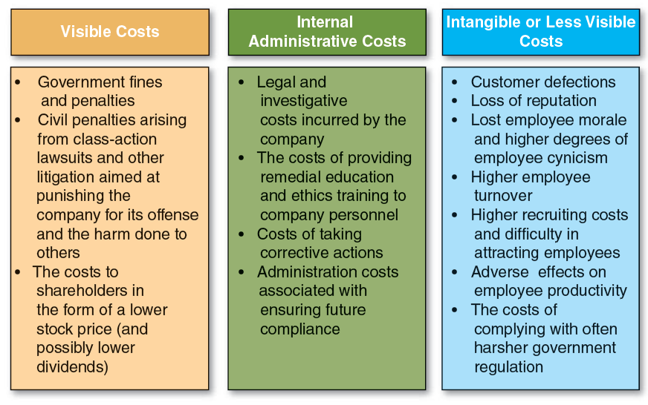
FIGURE 9.1 The Costs Companies Incur When Ethical Wrongdoing Is Discovered and Punished
Jump to Appendix 1 for long description.

Slide 9
Ensuring a Strong Commitment to Business Ethics in Companies with International Operations
There are three schools of thought about the extent to which the ethical standards travel across cultures and whether multinational firms can apply the same set of ethical standards in all of the locations where they operate.
Ethical Universalism
Ethical Relativism
Integrative Social Contracts Theory

Slide 10
The School of Ethical Universalism
According to the school of ethical universalism:
Concepts of what is right and what is wrong are universal and transcend most cultures, societies, and religions.
All societies, companies, and individuals are accountable to a set of universal ethical standards.
Where basic moral standards really do not vary significantly according to local cultural beliefs, traditions, or religious convictions, a multinational firm can develop a code of ethics that it applies more or less evenly across its worldwide operations.

Slide 11
CORE CONCEPT: Ethical Universalism
According to the school of ethical universalism, the same standards of what is ethical and what is unethical resonate with peoples of most societies regardless of local traditions and cultural norms; hence, common ethical standards can be used to judge employee conduct in a variety of country markets and cultural circumstances.

Slide 12
Examples of Universal Ethical Principles or Norms
Honesty
Trustworthiness
Respecting the rights of others
Practicing the Golden Rule
Avoiding unnecessary harm to:
Workers
Users of a firm’s product or service

Slide 13
The School of Ethical Relativism
School of ethical thought
What is to be deemed ethical or unethical behavior must be judged by local social and moral standards.
It is appropriate for local moral standards to take precedence over ethical standards in a firm’s home market.
Risks of ethical relativism
There might be an assumption that local morality is an adequate guide for ethical behavior.
There might be a loss of a moral basis for enforcing firm-wide ethical standards across differing markets of a multinational firm.

Slide 14
CORE CONCEPT: Ethical Relativism
According to the school of ethical relativism, different societal cultures and customs create divergent standards of right and wrong—thus, what is ethical or unethical must be judged in the light of local customs and social mores and can vary from one culture or nation to another.

Slide 15
Integrative Social Contracts Theory
The ethical standards a firm should uphold are governed by:
A limited number of universal ethical principles that are widely recognized as putting legitimate ethical boundaries on actions and behavior in all situations
The circumstances of local cultures, traditions, and values that further prescribe what constitutes ethically permissible behavior and what does not

Slide 16
CORE CONCEPT: Integrative Social Contracts Theory
According to integrative social contracts theory, universal ethical principles based on collective views of multiple cultures combine to form a “social contract” that all employees in all country markets have a duty to observe. Within the boundaries of this social contract, there is room for host country cultures to exert some influence in setting their own moral and ethical standards.
However, "first-order" universal ethical norms always take precedence over "second-order" local ethical norms in circumstances where local ethical norms are more permissive.

Slide 17
Ethics: It Is Not as Easy as It Seems
Integrative social contracts theory
The theory provides that “first order” universal ethical norms always take precedence over “second order” local ethical norms when local norms are more permissive.
Ethical “gray areas”
There are many instances where cross-country differences in ethical norms create situations where it is tough to draw a line in the sand between right and wrong decisions, actions, and business practices.

Slide 18
Strategy, Corporate Social Responsibility and Environmental Sustainability
Engaging in corporate social responsibility involves the firm’s assumption of a series of responsibilities:
Economic responsibility to shareholders
Legal responsibility to comply with the laws of the countries where it operates
Ethical responsibility to abide by society’s norms
Discretionary philanthropic responsibility to meet the unmet needs of society

Slide 19
CORE CONCEPT: Corporate Social Responsibility
Corporate social responsibility (CSR) refers to a company’s duty to operate in an honorable manner, provide good working conditions for employees, encourage workforce diversity, be a good steward of the environment, and actively work to better the quality of life in the local communities where it operates and in society at large.

Slide 20
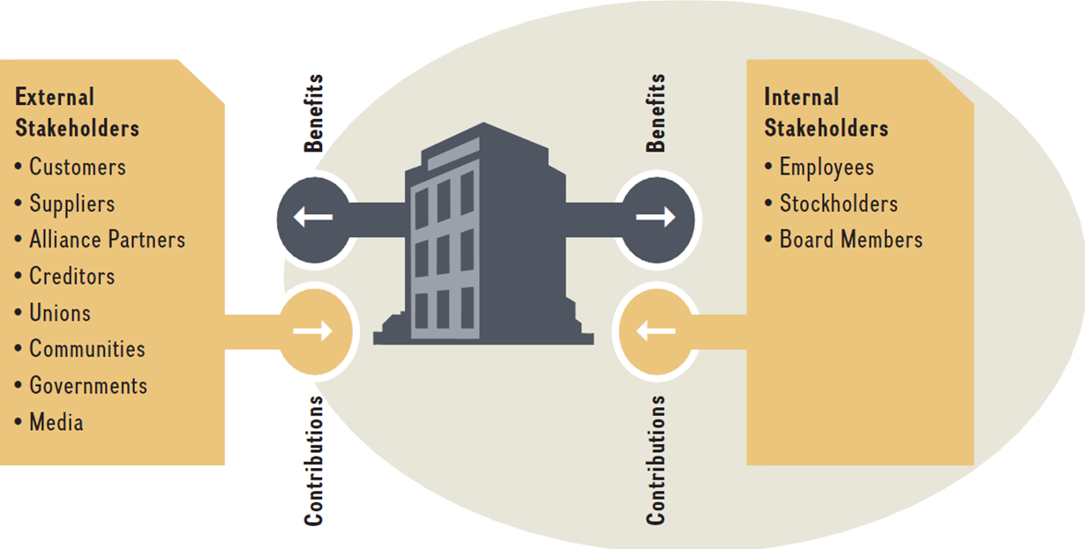
Internal and External Stakeholders in an Exchange Relationship with the Firm

Slide 21
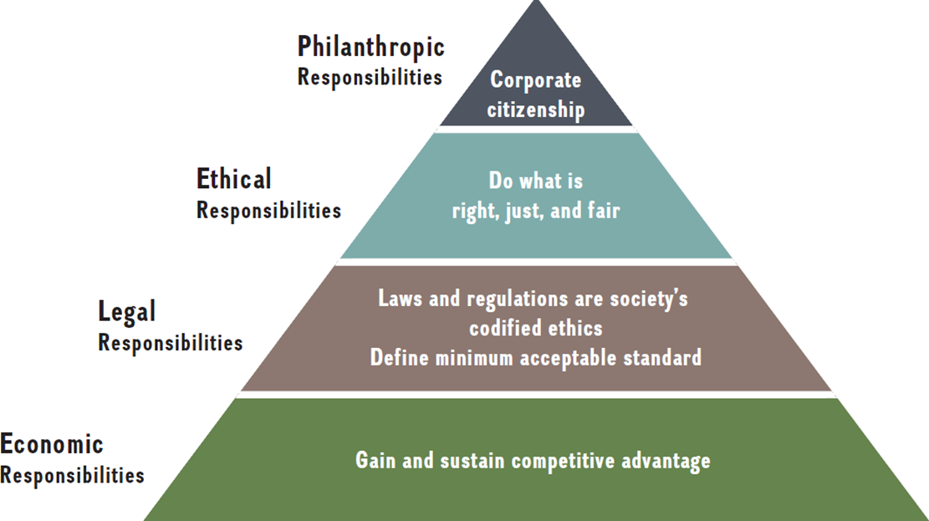
The Pyramid of Corporate Social Responsibility
SOURCE: Adapted from A. B. Carroll (1991), “The pyramid of corporate social responsibility: Toward the moral management of organizational stakeholders,” Business Horizons, July-August: 42.

Slide 22
Common Corporate Social Responsibility (CSR) Initiatives
Initiatives:
Efforts to employ an ethical strategy and observe ethical principles in operating the business
Making charitable contributions, supporting community service endeavors, engaging in broader philanthropic initiatives, and reaching out to make a difference in the lives of the disadvantaged
Actions to protect the environment and, in particular, to minimize or eliminate any adverse impact on the environment stemming from the firm’s own business activities
Actions to create a work environment that enhances the quality of life for employees
Actions to build a workforce that is diverse with respect to gender, race, national origin, and other aspects that different people bring to the workplace

Slide 23
CORE CONCEPT: Corporate Social Responsibility Strategy
A company's corporate social responsibility strategy is defined by the specific combination of socially beneficial activities it opts to support with its contributions of time, money, and other resources.

Slide 24
Corporate Social Responsibility and the Triple Bottom Line
Corporate social responsibility involves recognition of the necessity for triple bottom-line performance in the balancing of respect for people, concern for the planet, the desire of stakeholders for profits.

Slide 25
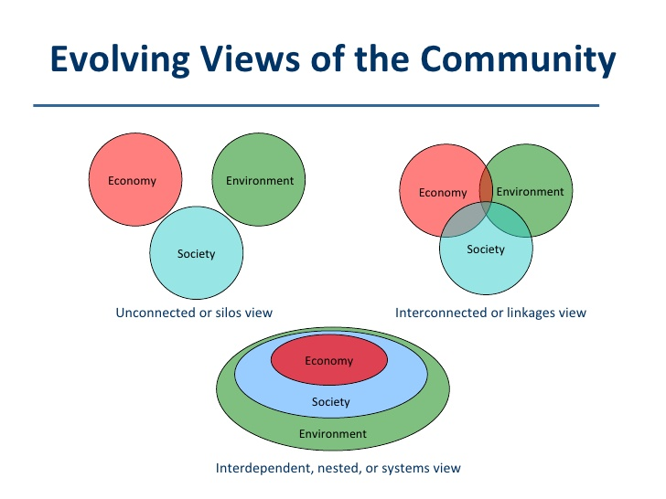
Sustainable Strategy
Exhibit 5.9

Slide 26
CORE CONCEPTS: Environmental Sustainability and Sustainable Business Practices
Environmental sustainability involves deliberate actions to protect the environment, provide for the longevity of natural resources, maintain ecological support systems for future generations, and guard against the ultimate endangerment of the planet.
Sustainable business practices are those that meet the needs of the present without compromising the ability to meet the needs of the future.

Slide 27
What Do We Mean by Sustainability and Sustainable Business Practices?
Environmental sustainability strategies
Entail actions to operate businesses to protect and enhance natural resources and ecological support systems, to guard against outcomes that endanger the planet, and to be sustainable for centuries
Directed at improving a firm’s triple bottom line (TBL): its performance on economic, environment, and social metrics

Slide 28
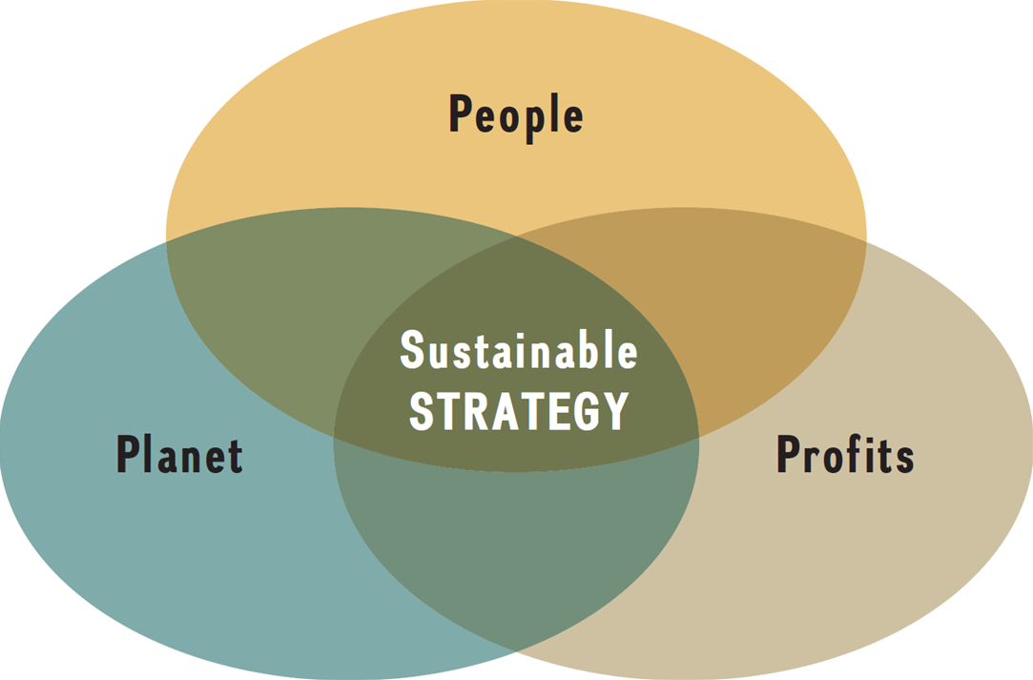
Sustainable Strategy

Slide 29
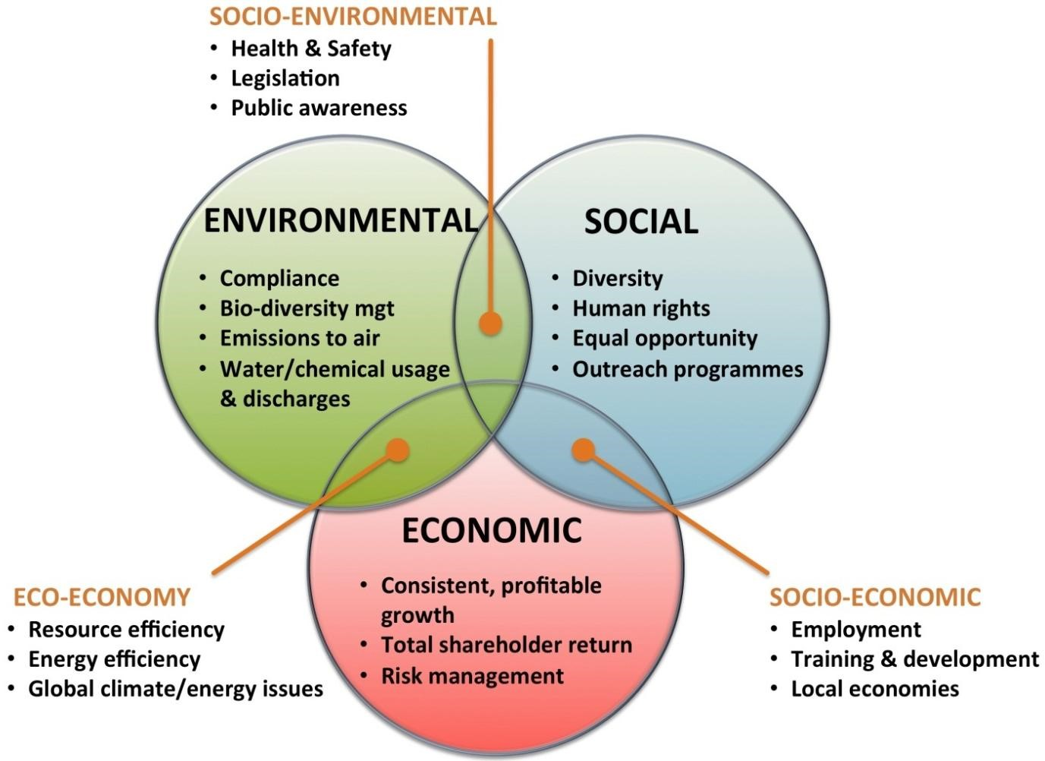
Sustainable Strategy
Exhibit 5.9

Slide 30
Crafting Social Responsibility and Sustainability Strategies
To be socially responsible, there are decisions to make.
What charitable contributions should be made?
What kinds of community service projects should be emphasized?
What environmental actions should be supported?
How should a firm be made a good place to work?
Where and how workforce will diversity fit into the picture?
Which other worthy causes and projects that benefit society will the firm support?

Slide 31
The Business Case for Socially Responsible Behavior
There are reasons why the exercise of corporate social responsibility is good business.
Such actions can lead to increased buyer patronage.
A strong commitment to socially responsible behavior reduces the risk of reputation-damaging incidents.
Socially responsible actions yield internal benefits (e.g., employee recruiting, retention, and training costs) and can improve operational efficiency.
Well-conceived social responsibility strategies work to the advantage of shareholders.

Slide 32
Appendices
Long descriptions of images

Slide 33
Appendix 1 FIGURE 9.1 The Costs Companies Incur When Ethical Wrongdoing Is Discovered and Punished
The image portrays the three areas where the costs of ethical wrongdoing impact organizations: visible costs, internal administrative costs, and intangible or less visible costs.
Visible costs include: government fines and penalties, civil penalties arising from class-action lawsuits and other litigation aimed at punishing the company for its offense and the harm done to others, and the costs to shareholders in the form of a lower stock price (and possibly lower dividends).
Internal administrative costs include: legal and investigative costs incurred by the company, the costs of providing remedial education and ethics training to company personnel, costs of taking corrective actions, and administration costs associated with ensuring future compliance.
Intangible or less visible costs include: customer defections, loss of reputation, lost employee morale and higher degrees of employee cynicism, higher employee turnover, higher recruiting costs and difficulty in attracting employees, adverse effects on employee productivity, and the costs of complying with often harsher government regulation.
Return to slide.

