Slide 1
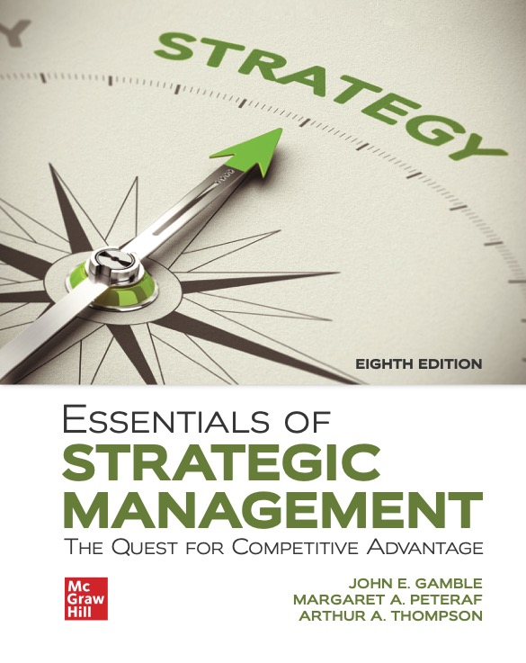
CHAPTER 7
Strategies for Competing in International Markets
Access the text alternative for slide images.
© McGraw Hill LLC. All rights reserved. No reproduction or distribution without the prior written consent of McGraw Hill LLC.
Notes:
The forces of globalization are changing the competitive landscape in many industries, offering companies attractive new opportunities but at the same time introducing new competitive threats. Companies in industries where these forces are greatest are under considerable pressure to develop strategies for competing successfully in international markets.

Slide 2
LEARNING OBJECTIVES
Identify the primary reasons companies choose to compete in international markets.
Understand why and how differing market conditions across countries influence a company’s strategy choices in international markets.
Identify the five general modes of entry into foreign markets.
Identify the three main options for tailoring a company’s international strategy to cross-country differences in market conditions and buyer preferences.
Explain how multinational companies are able to use international operations to improve overall competitiveness.
Recognize the unique characteristics of competing in developing-country markets.
Notes:
This chapter focuses on strategy options for expanding beyond domestic boundaries and competing in the markets of either a few or many countries. We will discuss the factors that shape the choice of strategy in international markets and the specific market circumstances that support the adoption of multidomestic, transnational, and global strategies. This chapter also includes sections on strategy options for entering foreign markets; how international operations may be used to improve overall competitiveness; and the special circumstances of competing in such emerging markets as China, India, Brazil, Russia, and eastern Europe.

Slide 3
Why Companies Expand into International Markets
To gain access to new customers.
To achieve lower costs through economies of scale, experience, and increased purchasing power.
To gain access to low-cost inputs of production.
To further exploit its core competencies.
To gain access to resources and capabilities located in foreign markets.
Also, to retain their position as a key supply chain partner to major customers.
Notes:
A company may opt to expand outside its domestic market for any of the five major reasons.

Slide 4
Factors That Shape Strategy Choices in International Markets
Factors:
Degree to which there are important cross-country differences in demographic, cultural, and market conditions.
Whether opportunities exist to gain a location-based advantage based on wage rates, worker productivity, inflation rates, energy costs, tax rates, and other factors that impact cost structure.
Risks of adverse shifts in currency exchange rates.
Extent to which governmental policies affect the local business climate.
Notes:
Four important factors shape a company’s strategic approach to competing in foreign markets.

Slide 5
Cross-Country Differences in Demographic, Cultural, and Market Conditions
Adjustments to local buyer tastes:
Raise manufacturing and distribution costs.
Reduce scale economies and increase learning curve effects.
Differences in market growth potential:
Reflect wide variances in the demographics, income levels, and cultural attitudes in emerging markets.
Can result from a lack of infrastructure, reliable distribution systems, and existing retail networks.
Indicate local variations in the intensity of competition.
Notes:
The tension between the market pressures to localize a company’s product offerings country by country and the competitive pressures to lower costs is one of the big strategic issues that participants in foreign markets have to resolve.

Slide 6
How Markets Demographics Differ from Country to Country
Differences:
Internal demographic differences.
Consumer tastes and preferences.
Consumer purchasing power.
Consumer buying habits.
Distribution channel emphasis.
Demands for localized products.
Strength of local competitive rivalry.
Notes:
Companies operating in a global marketplace must wrestle with whether and how much to customize their offerings in each different country market to match the tastes and preferences of local buyers or whether to pursue a strategy of offering a mostly standardized product worldwide.

Slide 7
Opportunities for Location-Based Cost Advantages
A firm’s costs and profitability are impacted by the location of its activities due to:
Wage rates.
Worker productivity.
Energy costs.
Environmental regulations.
Tax rates.
Inflation rates.
Access to resources.
Notes:
Increasingly, companies are locating different value chain activities in different parts of the world to exploit location-based advantages that vary from country to country. Differences in wage rates, worker productivity, energy costs, and the like create sizable variations in manufacturing costs from country to country.

Slide 8
Industry Cluster Knowledge Sharing Opportunities
Advantages to operating in a location containing a cluster of related industries:
Closer collaboration with key suppliers that results in greater efficiency and innovativeness.
Opportunities for greater knowledge sharing relationships among firms participating in same value chain cluster.
Notes:
The advantage to firms that develop as part of a related-industry cluster comes from the close collaboration with key suppliers and the greater knowledge sharing throughout the cluster, resulting in greater efficiency and innovativeness.

Slide 9
The Risks of Adverse Exchange Rate Shifts
An exporter gains in competitiveness when the currency of the country in which exported goods are manufactured is weak relative to the currency of the country to which the goods will be exported.
An exporter is at a disadvantage when the currency of the country where exported goods are manufactured grows stronger relative to the country to which the goods will be exported.
Notes:
When companies produce and market their products and services in many different countries, they are subject to the impacts of sometimes favorable and sometimes unfavorable changes in currency exchange rates.

Slide 10
The Positive Impact of Host Country Government Policies on the Business Climate
Host government policies that create a business climate favorable to foreign firms agreeing to construct or expand production and distribution facilities in the host country include:
Reduced taxes.
Low-cost loans.
Site-development assistance.
Notes:
Cross-country variations in government policies and economic conditions affect both the opportunities available to a foreign entrant and the risks of operating within the host country.

Slide 11
The Negative Impact of Host Country Government Policies on the Business Climate
Host government policies that negatively affect foreign-based firms include:
Environmental regulations.
Customs requirements, tariffs, and quotas.
Local content requirements.
Requiring prior approval of capital spending projects.
Limits on repatriation of local funds.
Local ownership or partner requirements.
Subsidies for domestic companies.
Notes:
Political risks stem from instability or weaknesses in national governments and hostility to foreign business. Economic risks stem from the stability of a country’s monetary system, economic and regulatory policies, and the lack of property rights protections.

Slide 12
Export Strategies
Exporting involves using domestic plants as a production base for exporting to foreign markets.
Advantages:
Conservative way to test international waters.
Minimizes both risk and capital investment requirements.
An export strategy is vulnerable when:
Home-country manufacturing costs are higher than in foreign countries where rivals have plants.
Distant market product transportation costs are relatively high.
Adverse shifts can occur in currency exchange rates.
Notes:
Using domestic plants as a production base for exporting goods to foreign markets is an excellent initial strategy for pursuing international sales. It is a conservative way to test the international waters. Unless an exporter can keep its production and shipping costs competitive with rivals’ costs, secure adequate local distribution and marketing support of its products, and effectively hedge against unfavorable changes in currency exchange rates, its success will be limited.

Slide 13
CORE CONCEPTS: Political and Economic Risks
Political risks stem from instability or weakness in national governments and hostility to foreign business.
Economic risks stem from the instability of a country's monetary system, changes in economic and regulatory policies, and the lack of property rights protections.

Slide 14
Thinking Strategically
What effects has the adoption of the euro had on the ability of European Union (EU) countries and firms to respond to changes in intranational economic and trade conditions given that they now share a common currency?
What should a EU firm do to respond to an adverse currency exchange rate shift in a non-EU country?
How will exiting the EU affect the U.K.’s ability to compete in world markets?
Notes:
Instructors may want to discuss the current and collateral effects of tariffs on international trade relationships between and among EU members and other major trading countries (e.g., the United States and China).

Slide 15
Strategy Options for Entering Foreign Markets
Maintain a national (one country) production base and export goods to foreign markets.
License foreign firms to produce and distribute the company’s products abroad.
Employ a franchising strategy.
Establish a subsidiary in a foreign market via acquisition or internal development.
Rely on strategic alliances or joint ventures with foreign partners to enter new country markets.
Notes:
Once a company decides to expand beyond its domestic borders, it must consider the question of how to enter foreign markets. There are five primary modes of entry. The modes vary considerably regarding the level of investment required and the associated risks—but higher levels of investment and risk generally provide the firm with the benefits of greater ownership and control.

Slide 16
Licensing Strategies
Licensing makes sense when a firm:
Has valuable technical know-how or a patented product but has neither the internal capabilities nor resources to enter foreign markets.
Wants to avoid risks of committing resources to country markets that are unfamiliar, politically volatile, economically unstable, or otherwise risky.
Seeks to generate income from potential royalties.
Disadvantage of licensing:
Difficulty in maintaining control over the use of technical know-how provided to foreign firms.
Notes:
Using a licensing strategy as a mode of entry makes sense when a firm with valuable technical know-how, an appealing brand, or a unique patented product has neither the internal organizational capability nor the resources to enter foreign markets.

Slide 17
Franchising Strategies
Franchising strategies are often better suited to the global expansion of service and retailing enterprises.
Advantages:
Franchisee bears many of the costs and risks of establishing foreign locations.
Franchisor must expend only the resources to recruit, train, and support franchisees.
Disadvantages:
Maintaining quality control in franchisee operations.
Allowing franchisees discretion in adapting product offerings to local tastes and expectations.
Notes:
While licensing works well for manufacturers and owners of proprietary technology, franchising is often better suited to the international expansion efforts of service and retailing enterprises.

Slide 18
Foreign Subsidiary Strategies
Foreign subsidiary strategies allow for direct control over all aspects of operating in a foreign market.
Options for developing a subsidiary:
Acquiring either a struggling or successful foreign local firm is the quickest, least risky, and most cost-efficient path to hurdling local-market entry barriers.
Establishing a foreign subsidiary from the ground up via internal development relies heavily on the firm’s prior experience with foreign market operations.
Notes:
Companies that want to participate directly in the performance of all essential value chain activities typically establish a wholly owned subsidiary, either by acquiring a local company or by establishing its own new operating organization from the ground up.

Slide 19
Internal Development and Startup of a Foreign Subsidiary
An internal startup strategy is appealing when:
The parent firm has the experience, competencies, and resources required to develop and operate foreign subsidiaries.
Creating an internal startup is cheaper than making an acquisition in a foreign market.
Adding new production capacity will not adversely impact the supply–demand balance in the local-market.
The startup subsidiary can gain access to local distribution networks (perhaps due to the firm’s recognized brand name).
A startup subsidiary will have the size, cost structure, and resources to compete head-to-head against local rivals.
Notes:
A greenfield venture is a subsidiary business that is established by setting up the entire operation from the ground up. Entering a new foreign country via a greenfield venture makes sense when a company already operates in a number of countries, has experience in establishing new subsidiaries and overseeing their operations, and has a sufficiently large pool of resources and capabilities to rapidly equip a new subsidiary.

Slide 20
Alliance and Joint Venture Strategies (1 of 2)
Mutual benefits of cross-border alliances:
Strengthens a firm’s competitiveness in world markets.
Facilitates host country approval of entry into local-markets.
Captures economies of scale in production and marketing.
Fills gaps in technical expertise and local-market knowledge.
Promotes sharing of distribution facilities, dealer networks, and mutual access to customers.
Assists in coordination of attacks on mutual rivals and the provision of mutual support.
Builds working relationships with local political and host country governmental entities.
Fosters agreements on technical and process standards.
Notes:
Collaborative strategies involving alliances or joint ventures with foreign partners are a popular way for companies to edge their way into the markets of foreign countries. Cross-border alliances enable a growth-minded firm to widen its geographic coverage and strengthen its competitiveness in foreign markets; at the same time, they offer flexibility and allow a firm to retain some degree of autonomy and operating control.

Slide 21
Alliance and Joint Venture Strategies (2 of 2)
Individual partner benefits of alliances:
Preservation of each partner firm’s independence.
Avoidance of the firm’s use of scarce financial resources to fund acquisitions.
Retention of the firm’s flexibility to readily disengage once the purpose of the alliance has been served.
Option to withdraw from the alliance if its benefits prove elusive, unlike the more permanent arrangement required by an acquisition.

Slide 22
Concepts and Connections 7.1 Walgreens Boots Alliance, Inc.: Entering Foreign Markets via Alliance Followed by Merger
Did industry consolidation provoke Walgreens to make its strategic international acquisition?
What strategic advantages does the alliance between Walgreens and Alliance Boots bring to both partners?
What internal challenges could the merger create for Walgreens as it strives to integrate and adjust to the risks of entry into international markets?
Notes:
Alliances may also be used to pave the way for an intended merger; they offer a way to test the value and viability of a cooperative arrangement with a foreign partner before making a more permanent commitment. Concepts and Connections 7.1 shows how Walgreens pursued this strategy with Alliance Boots in order to facilitate its expansion abroad.

Slide 23
The Risks of Strategic Alliances with Foreign Partners
Pitfalls to the success of alliances:
Language and cultural barriers.
Diversity in ethical standards, partner values and objectives, corporate strategies, and operating practices.
Development of trust, coordination, and effective communications between partners.
Interpersonal conflict among partners’ managers.
Overdependence on foreign partners for essential expertise and competitive capabilities.
Notes:
Alliances and joint ventures with foreign partners have their pitfalls, however. One of the lessons about cross-border partnerships is that they are more effective in helping a company establish a beachhead of new opportunity in world markets than they are in enabling a company to achieve and sustain global market leadership.

Slide 24
International Strategy: Three Principal Options
Choosing between localized multicountry strategies or a global strategy:
Deciding upon the degree to vary a firm’s competitive approach country by country to fit the specific market conditions and buyer preferences in each host country when operating in two or more foreign markets.
Options for tailoring a firm's international strategy:
Multidomestic strategy (think local, act local).
Transnational strategy (think global, act local).
Global strategy (think global, act global).
Notes:
An international strategy is a strategy choice to attempt competing in two or more countries simultaneously.

Slide 25
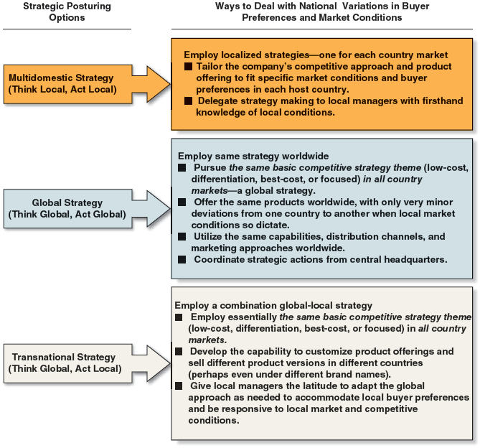
Figure 7.1 A Company’s Three Principal Strategic Options for Competing Internationally
Access the text alternative for slide images.
Notes:
Figure 7.1 shows a company’s three options for resolving this issue: choosing a multidomestic, global, or transnational strategy.
A multidomestic strategy is one in which a company varies its product offering and competitive approach from country to country in an effort to be responsive to differing buyer preferences and market conditions.
A transnational strategy is a think global, act local approach that incorporates elements of both multidomestic and global strategies.
A global strategy is one in which a company employs the same basic competitive approach in all countries where it operates, sells standardized products globally, strives to build global brands, and coordinates its actions worldwide with strong headquarters control. It represents a think global, act global approach.

Slide 26
CORE CONCEPT: International Strategy
A company's international strategy is its strategy for competing in two or more countries simultaneously.

Slide 27
Multidomestic Strategy—A Think Local, Act Local Approach to Strategy Making
Think Local, Act Local:
A firm varies its product offerings and basic competitive strategy from country to country.
Useful when:
Significant country-to-country differences exist in customer preferences, buying habits, distribution channels, or marketing methods.
Host governments enact local content requirements or trade restrictions that preclude a uniform, coordinated worldwide market approach.
Notes:
A multidomestic strategy is one in which a company varies its product offering and competitive approach from country to country in an effort to be responsive to differing buyer preferences and market conditions.

Slide 28
CORE CONCEPT: Multidomestic Strategy
A multidomestic strategy calls for varying a company’s product offering and competitive approach from country to country in an effort to be responsive to significant cross-country differences in customer preferences, buyer purchasing habits, distribution channels, or marketing methods.
Think local, act local strategy-making approaches are also essential when host-government regulations or trade policies preclude a uniform, coordinated worldwide market approach.

Slide 29
Think Local, Act Local Strategies: Two Big Drawbacks
These strategies can hinder the transfer of competencies and resources across country boundaries because the strategies in different host countries can be grounded in varying competencies and capabilities.
They do not promote building a single, unified competitive advantage, especially one based on low-cost leadership.

Slide 30
Global Strategy—A Think Global, Act Global Approach to Strategy Making
Think Global, Act Global Strategy:
Integrates and coordinates the firm’s strategic moves worldwide.
Promotes establishing an identifiably uniform brand image and reputation from country to country.
Focuses the firm’s full resources on securing a sustainable low-cost or differentiation-based competitive advantage over both domestic rivals and global rivals.
Notes:
A global strategy is one in which a company employs the same basic competitive approach in all countries where it operates, sells standardized products globally, strives to build global brands, and coordinates its actions worldwide with strong headquarters control. It represents a think global, act global approach.

Slide 31
CORE CONCEPT: Global Strategies
Global strategies employ the same basic competitive approach in all countries where a company operates and are best suited to industries that are globally standardized in terms of customer preferences, buyer purchasing habits, distribution channels, or marketing methods.
This is the think global, act global strategic theme.

Slide 32
Transnational Strategy—A Think Global, Act Local Approach to Strategy Making
A middle-ground approach that entails:
Utilizing the same basic competitive theme (low-cost, differentiation, or focused) in each country but allows local managers the latitude to:
Incorporate whatever country-specific variations in product attributes are needed to best satisfy local buyers.
Make whatever adjustments in production, distribution, and marketing are needed to respond to local-market conditions and compete successfully against local rivals.
Notes:
A transnational strategy is a think global, act local approach that incorporates elements of both multidomestic and global strategies.

Slide 33
CORE CONCEPT: Transnational Strategy
A transnational strategy is a think global, act local approach to strategy making that involves employing essentially the same strategic theme (low-cost, differentiation, focused, best-cost) in all country markets, while allowing some country-to-country customization to fit local-market conditions.

Slide 34
Concepts and Connections 7.2 Four Seasons Hotels: Local Character, Global Service
Why has Four Seasons Hotels been so successful in expanding its hospitality operations into a broad diversity of countries?
How should local hotel competitors respond to Four Seasons Hotels’ continued expansion into their markets?
Why would a global economic slowdown likely not dampen demand for the Four Seasons luxury hotel offerings? A pandemic?
Notes:
Concepts and Connections 7.2 explains how Four Seasons Hotels has been able to compete successfully on the basis of a transnational strategy.

Slide 35
Using International Operations to Improve Overall Competitiveness
A firm can gain competitive advantage by expanding outside its domestic market in three important ways.
Use location to lower costs or help achieve greater product differentiation.
Transfer competitively valuable resources and capabilities from one country to another or share them across international borders to extend its competitive advantages.
Use cross-border coordination in ways that a domestic-only competitor cannot.
Notes:
There are three important ways in which a firm can gain competitive advantage (or offset domestic disadvantages) by expanding outside its domestic market. First, it can use location to lower costs or achieve greater product differentiation. Second, it can transfer competitively valuable resources and capabilities from one country to another or share them across international borders to extend its competitive advantages. And third, it can benefit from cross-border coordination opportunities that are not open to domestic-only competitors.

Slide 36
Using Location to Build Competitive Advantage
Multinational firms attempting to gain location-based competitive advantage should consider:
Whether to concentrate activities in a few countries or disperse performance of each process to many countries.
Which countries offer the best locational advantage for each activity.
Notes:
Companies that compete internationally can pursue competitive advantage in world markets by locating their value chain activities in whatever nations prove most advantageous.

Slide 37
When to Concentrate Internal Processes in a Few Locations
Circumstances favor concentrating activities and processes in a few countries when:
The costs of manufacturing or other activities are significantly lower in some locations than in others.
Significant scale economies can be achieved by concentrating on particular activities.
There is a steep learning curve associated with performing an activity.
Certain locations offer superior resources, allow better coordination of related activities, or offer other advantages.
Notes:
It is advantageous for a company to concentrate its activities in a limited number of locations for the reason of costs, scale, learning and experience, and availability of resources.

Slide 38
When to Disperse Internal Processes Across Many Locations
Dispersing activities and processes is advantageous when:
Buyer-related activities must take place close to buyers.
High transportation costs, diseconomies of large size, and trade barriers make it too expensive to operate from a central location.
Dispersing activities reduce the risks of fluctuating exchange rates and adverse political developments.
Notes:
In some instances, dispersing activities across locations is more advantageous than concentrating them when costs and business risks can be lowered through localization of activities.

Slide 39
Using Cross-Border Coordination to Build Competitive Advantage
Multinational and global competitors coordinate activities across borders to achieve competitive advantage by:
Sharing product knowledge, operating skills, and supply chain efficiencies across their markets.
Shifting production between plants in different countries to take advantage of changes in exchange rates, energy costs, or in tariffs and quotas.
Shifting production to locations having excess capacity or underutilized personnel.
Notes:
When a company has competitively valuable resources and capabilities, it may be able to leverage them further by expanding internationally. If its resources retain their value in foreign contexts, then entering new foreign markets can extend the company’s resource-based competitive advantage over a broader domain. Sharing and transferring resources and capabilities across country borders may also contribute to the development of broader or deeper competencies and capabilities—helping a company achieve dominating depth in some competitively valuable area.

Slide 40
Strategies for Competing in the Markets of Developing Countries
Developing-economy markets:
China, India, Brazil, Indonesia, Thailand, Poland, Russia, and Mexico—where business risks are considerable, but growth opportunities are huge as their economies develop and living standards climb toward those of the industrialized world.
Tailoring products to fit conditions in emerging markets often involves:
Making more than minor product adaptations.
Becoming more familiar with local cultures and habits.
Rethinking pricing, packaging, and product features.
Notes:
Companies racing for global leadership have to consider competing in developing-economy markets like China, India, Brazil, Indonesia, Thailand, Poland, Mexico, and Russia—countries where the business risks are considerable but where the opportunities for growth are huge, especially as their economies develop and living standards climb toward levels in the industrialized world.

Slide 41
Strategy Options for Competing in Developing-Country Markets
Prepare to compete on the basis of low price.
Modify aspects of the firm’s business model or strategy to accommodate local circumstances.
Try to change the local-market to better match the way the firm does business elsewhere.
Avoid emerging markets where it is impractical or uneconomical to modify the firm’s business model to accommodate local circumstances.
Be patient, work within the system to improve the infrastructure and lay the foundation for generating sizable revenues and profits once conditions are ripe for market takeoff.
Notes:
There are several options for tailoring a company’s strategy to fit the sometimes unusual or challenging circumstances presented in developing-country markets.

Slide 42
End of Main Content
© McGraw Hill LLC. All rights reserved. No reproduction or distribution without the prior written consent of McGraw Hill LLC.

Slide 43
Accessibility Content: Text Alternatives for Images

Slide 44
CHAPTER 7 - Text Alternative
Return to parent-slide containing images.
The authors are John E. Gamble, Margaret A. Peteraf, and Arthur A. Thompson. The photo shows a navigational compass pointing at the text reading, strategy.
Return to parent-slide containing images.

Slide 45
Figure 7.1 A Company’s Three Principal Strategic Options for Competing Internationally - Text Alternative
Return to parent-slide containing images.
The three strategic posturing options for competing internationally are as follows: multidomestic strategy (think local, act local), global strategy (think global, act global), and transnational strategy (think global, act local). For each strategy, several ways are listed to deal with national variations in buyer preferences and market conditions.
Multidomestic strategy (think local, act local): employ localized strategies, one for each country market.
Tailor the company’s competitive approach and product offering to fit specific market conditions and buyer preferences in each host country.
Delegate strategy making to local managers with firsthand knowledge of local conditions.
Global strategy (think global, act global): employ same strategy worldwide.
Pursue the same basic competitive strategy theme (low-cost, differentiation, best-cost, or focused) in all country markets, a global strategy.
Offer the same products worldwide, with only very minor deviations from one country to another when local-market conditions so dictate.
Utilize the same capabilities, distribution channels, and marketing approaches worldwide.
Coordinate strategic actions from central headquarters.
Transnational strategy (think global, act local): employ a combination global–local strategy.
Employ essentially the same basic competitive strategy theme (low-cost, differentiation, best-cost, or focused) in all country markets.
Develop the capability to customize product offerings and sell different product versions in different countries (perhaps even under different brand names).
Give local managers the latitude to adapt the global approach as needed to accommodate local buyer preferences and be responsive to local market and competitive conditions.
Return to parent-slide containing images.

