Slide 1
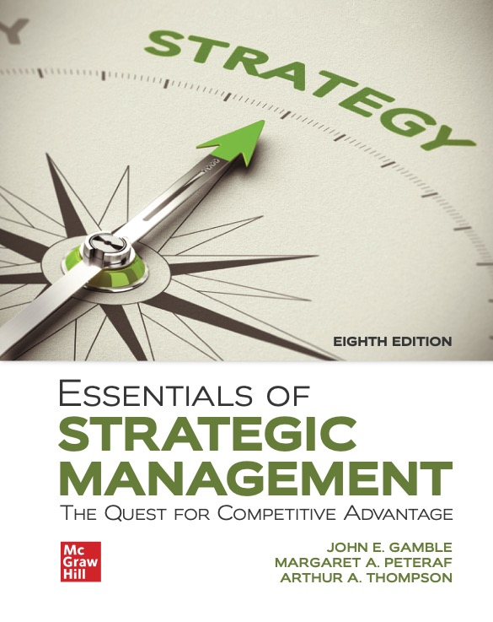
CHAPTER 8
Corporate Strategy: Diversification and the Multi business Company
Access the text alternative for slide images.
© McGraw Hill LLC. All rights reserved. No reproduction or distribution without the prior written consent of McGraw Hill LLC.
Notes:
Chapter 8 moves up one level in the strategy-making hierarchy, from strategy making in a single-business enterprise to strategy making in a diversified multi business enterprise. Because a diversified company is a collection of individual businesses, the strategy-making task is more complicated.

Slide 2
LEARNING OBJECTIVES
Understand when and how business diversification can enhance shareholder value.
Explain how related diversification strategies can produce cross-business strategic fit capable of delivering competitive advantage.
Recognize the merits and risks of corporate strategies keyed to unrelated diversification.
Evaluate a company’s diversification strategy.
Identify a diversified company’s four main corporate strategy options for solidifying its diversification strategy and improving company performance.
Notes:
In the first portion of this chapter, we describe what crafting a diversification strategy entails, when and why diversification makes good strategic sense, the various approaches to diversifying a company’s business lineup, and the pros and cons of related versus unrelated diversification strategies. The second part of the chapter looks at how to evaluate the attractiveness of a diversified company’s business lineup, how to decide whether it has a good diversification strategy, and the strategic options for improving a diversified company’s future performance.

Slide 3
When Business Diversification Becomes a Consideration
Diversification is called for when:
There are diminishing growth prospects in the present business.
An expansion opportunity exists in an industry whose technologies and products complement the present business.
Existing competencies and capabilities can be leveraged by expanding into an industry requires similar resource strengths.
Costs can be reduced by diversifying into closely related businesses.
A powerful brand name can be transferred to the products of other businesses.
Notes:
In every case, however, the decision to diversify must start with a strong economic justification for doing so.

Slide 4
Building Shareholder Value: The Ultimate Justification for Business Diversification
Diversification may result in added shareholder value if it passes three tests.
Industry-Attractiveness Test. The target industry offers equal or better profit and return on potential investment opportunities.
Cost of Entry Test. The cost to enter the target industry does not erode its long-term profit potential.
Better-Off Test. The firm’s businesses will perform better together than as standalone firms, producing a synergistic 1 + 1 = 3 effect on shareholder value.
Notes:
Diversification must do more for a company than simply spread its business risk across various industries. In principle, diversification cannot be considered wise or justifiable unless it results in added long-term economic value for shareholders—value that shareholders cannot capture on their own by purchasing stock in companies in different industries or investing in mutual funds to spread their investments across several industries. A move to diversify into a new business stands little chance of building shareholder value without passing the three Tests of Corporate Advantage.

Slide 5
Approaches to Diversifying the Business Lineup
Options for entering new industries and lines of business:
Diversification by acquisition of an existing business.
Entering a new line of business through internal development.
Using joint ventures to achieve diversification.
Notes:
The means of entering new businesses can take any of three forms: acquisition, internal startup, or joint ventures with other companies.

Slide 6
Strategic Options for Diversified Corporations
Stick with the existing business lineup and pursuing opportunities presented by these businesses.
Broaden the scope of diversification by entering additional industries.
Retrench to a narrower scope of diversification by divesting poorly performing businesses.
Broadly restructure the business lineup with multiple divestitures and/or acquisitions.
Notes:
The demanding and time-consuming nature of these four tasks explains why corporate executives generally refrain from becoming immersed in the details of crafting and executing business-level strategies. Rather, the normal procedure is to delegate lead responsibility for business strategy to the heads of each business, giving them the latitude to develop strategies suited to the particular industry environment in which their business operates and holding them accountable for producing good financial and strategic results.

Slide 7
Crafting a Diversified Firm’s Overall Corporate Strategy
Pick new industries to enter and deciding on the means of entry.
Pursue opportunities to leverage cross-business value chain relationships into competitive advantage.
Establish investment priorities and steering corporate resources into the most attractive business units.
Initiate actions to boost the combined performance of the corporation’s collection of businesses.
Notes:
The decision to diversify presents wide-ranging possibilities. A company can diversify into closely related businesses or into totally unrelated businesses. It can diversify its present revenue and earnings base to a small or major extent. It can move into one or two large new businesses or a greater number of small ones. It can achieve diversification by acquiring an existing company, starting up a new business from scratch, or forming a joint venture with one or more companies to enter new businesses. In every case, however, the decision to diversify must start with a strong economic justification for doing so.

Slide 8
Diversification by Acquisition of an Existing Business
Quick and effective way to hurdle target market entry barriers related to:
Acquiring technological know-how.
Establishing supplier relationships.
Achieving scale economies.
Building brand awareness.
Securing adequate distribution access.
The big dilemma is whether to pay a premium price to buy a successful firm or to buy a struggling firm at a bargain price.
Notes:
Acquisition is a popular means of diversifying into another industry. Not only is it quicker than trying to launch a new operation, but it also offers an effective way to hurdle such entry barriers
An acquisition premium, or control premium, is the amount by which the price offered exceeds the preacquisition market value of the target company.

Slide 9
Entering a New Line of Business Through Internal Development
Is more attractive when:
The parent firm already has the in-house skills and resources needed to compete effectively.
There is ample time to launch a new business.
Startup cost is lower than cost of entry via acquisition.
The startup will not compete against powerful rivals.
Adding capacity will not adversely impact supply–demand balance in industry.
Incumbent firms are likely to be slow or ineffective in responding to an entrant’s efforts to crack the market.
Notes:
Achieving diversification through internal development involves starting a new business subsidiary from scratch. Internal development has become an increasingly important way for companies to diversify.
Corporate venturing, or new venture development, is the process of developing new businesses as an outgrowth of a firm’s established business operations. It is also referred to as corporate entrepreneurship or intrapreneurship since it requires entrepreneurial-like qualities within a larger enterprise.
Generally, internal development of a new business has appeal only when (1) the parent company already has in-house most of the resources and capabilities it needs to piece together a new business and compete effectively; (2) there is ample time to launch the business; (3) the internal cost of entry is lower than the cost of entry via acquisition; (4) adding new production capacity will not adversely impact the supply–demand balance in the industry; and (5) incumbent firms are likely to be slow or ineffective in responding to a new entrant’s efforts to crack the market.

Slide 10
Using Joint Ventures to Achieve Diversification
Situations call for a joint venture when:
Pursuing the expansion opportunity is too complex, uneconomical, or risky to go it alone.
The opportunities in a new industry require a broader range of competencies and know-how than an expansion-minded firm can marshal.
Drawbacks:
Potential for conflicting objectives.
Operational and control disagreements.
Culture clashes.
Notes:
Entering a new business via a joint venture can be useful in at least three types of situations.
First, a joint venture is a good vehicle for pursuing an opportunity that is too complex, uneconomical, or risky for one company to pursue alone.
Second, joint ventures make sense when the opportunities in a new industry require a broader range of competencies and know-how than a company can marshal on its own.
Third, companies sometimes use joint ventures to diversify into a new industry when the diversification move entails having operations in a foreign country.
However, partnering with another company has significant drawbacks due to the potential for conflicting objectives, disagreements over how to best operate the venture, culture clashes, and so on. Joint ventures are generally the least durable of the entry options, usually lasting only until the partners decide to go their own ways.

Slide 11
Choosing the Diversification Path: Related Versus Unrelated Businesses
Related businesses:
Have value chains with competitively valuable cross-business relationships that present opportunities for the businesses to perform better operating under the same corporate umbrella than they could as standalone entities.
Unrelated businesses:
Have value chains and resource requirements that are so dissimilar no competitively valuable cross-business relationships are present.
Notes:
Once a company decides to diversify, it faces the choice of whether to diversify into related businesses, unrelated businesses, or some mix of both.
Related businesses possess competitively valuable cross-business value chain and resource matchups.
Unrelated businesses have dissimilar value chains and resource requirements, with no competitively important cross-business relationships at the value chain level.

Slide 12
CORE CONCEPTS: Related and Unrelated Businesses
Related businesses possess competitively valuable cross-business value chain and resource matchups; unrelated businesses have dissimilar value chains and resources requirements, with no competitively important cross-business value chain relationships.

Slide 13
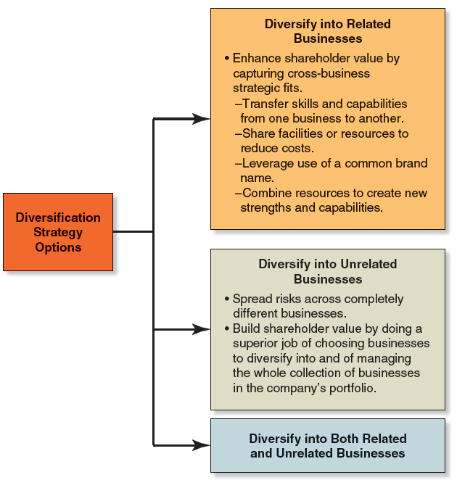
Figure 8.1 Strategic Themes of Multi business Corporation
Access the text alternative for slide images.
Notes:
Figure 8.1 shows the range of alternatives for companies pursuing diversification.

Slide 14
Diversifying into Related Businesses
Strategic Fit:
Exists whenever one or more activities comprising the value chains of different businesses are sufficiently similar to present opportunities for:
Transferring competitively valuable resources, expertise, technological know-how, or other capabilities from one business to another.
Cost sharing between separate businesses where value chain activities can be combined.
Brand sharing between business units that have common customers or that draw upon common core competencies.
Notes:
Strategic fit exists whenever one or more activities constituting the value chains of different businesses are sufficiently similar in present opportunities for cross-business sharing or transferring of the resources and capabilities that enable these activities.

Slide 15
CORE CONCEPT: Strategic Fit
Strategic fit exists when the value chains of different businesses present opportunities for cross-business skills transfer, cost sharing, or brand sharing.
Notes:
Capturing the benefits of strategic fit along the value chains of its related businesses gives a diversified company a clear path to achieving competitive advantage over undiversified competitors and competitors whose own diversification efforts don’t offer equivalent strategic-fit benefits. Such competitive advantage potential provides a company with a dependable basis for earning profits and a return on investment that exceeds what the company’s businesses could earn as standalone enterprises.

Slide 16
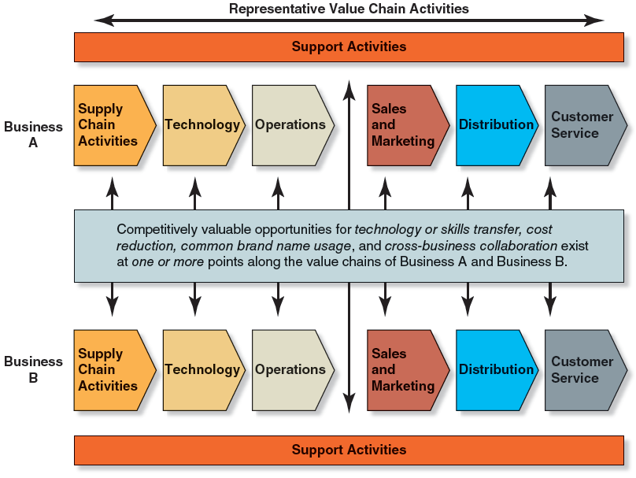
Figure 8.2 Related Diversification Is Built upon Competitively Valuable Strategic Fit in Value Chain Activities
Access the text alternative for slide images.
Notes:
Figure 8.2 illustrates the range of opportunities to share and/or transfer specialized resources and capabilities among the value chain activities of related businesses. It is important to recognize that even though general resources and capabilities may be shared by multiple business units, such resource sharing alone cannot form the backbone of a strategy keyed to related diversification.
The resources and capabilities that are leveraged in related diversification are specialized resources and capabilities that have very specific applications; their use is restricted to a limited range of business contexts in which these applications are competitively relevant. Because they are adapted for particular applications, specialized resources and capabilities must be utilized by particular types of businesses operating in specific kinds of industries to have value; they have limited utility outside this designated range of industry and business applications. This is in contrast to general resources and capabilities (such as general management capabilities, human resource management capabilities, and general accounting services), which can be applied usefully across a wide range of industry and business types.

Slide 17
Strategic Fit and Economies of Scope
Scope-related cost savings stemming from the strategic fit of the value chains of related businesses:
Operating businesses under same corporate umbrella.
Taking shared advantage of the interrelationships anywhere along the value chains of different businesses.
Advantage:
The greater the cross-business economies associated with cost-saving strategic fit, the greater the potential for a related diversification strategy to yield a competitive advantage based on lower costs than rivals.
Notes:
The greater the cross-business economies associated with resource sharing and transfer, the greater the potential for a related diversification strategy to give individual businesses of a multi business enterprise a cost advantage over their rivals.

Slide 18
CORE CONCEPT: Economies of Scope and Economies of Scale
Economies of scope are cost reductions stemming from strategic fit along the value chains of related businesses (thereby, a larger scope of operations), whereas economies of scale accrue from a larger operation.
Notes:
Economies of scope are cost reductions that flow from operating the same essential activities in multiple businesses (a larger scope of operation).
Economies of scale accrue from the lower variable costs of outputs from a larger-size operation.

Slide 19
The Ability of Related Diversification to Deliver Competitive Advantage and Gains in Shareholder Value
Cross-business strategic fit:
Builds shareholder value in ways that shareholders cannot replicate by simply owning a diversified portfolio of stocks.
Captures benefits that are possible only through related diversification.
Does not automatically result in benefits; must be pursued by management in order to capture the greater profitability of cross-business benefits.
Notes:
Diversifying into related businesses where competitively valuable strategic-fit benefits can be captured puts a firm’s businesses in position to perform better financially as part of the firm than they could have performed as independent enterprises, thus providing a clear avenue for boosting shareholder value and satisfying the better-off test.

Slide 20
Concepts and Connections 8.1 The Kraft-Heinz Merger: Managerial Missteps in Capturing Cross-Business Strategic Fit and Building Shareholder Value
Why did Kraft choose to seek a merger with Heinz rather than starting its own food products subsidiary?
What are the anticipated results of the merger?
To what extent is decentralization required when seeking cross-business strategic fit?
What should Kraft-Heinz do to ensure the continued success of its related diversification strategy?
Notes:
Concepts and Connections 8.1 describes the merger of Kraft Foods Group, Inc., with the H. J. Heinz Holding Corporation, in pursuit of the strategic-fit benefits of a related diversification strategy.

Slide 21
Diversifying into Unrelated Businesses
Strategic approach:
Growth through acquisition into any industry where potential exists for enhancing shareholder value through upward-trending corporate revenues and earnings and/or a stock price that rises yearly.
While industry attractiveness and cost-of-entry tests important, better-off test secondary.
Involves diversifying into businesses with:
No strategic fit.
No meaningful value chain relationships.
No unifying strategic theme.
Notes:
Achieving cross-business strategic fit is not a motivation for unrelated diversification. Companies that pursue a strategy of unrelated diversification often exhibit a willingness to diversify into any business in any industry where senior managers see an opportunity to realize consistently good financial results.
With an unrelated diversification strategy, company managers spend much time and effort screening acquisition candidates and evaluating the pros and cons of keeping or divesting existing businesses using the criteria listed in this slide.

Slide 22
Types of Acquisition Candidates in Unrelated Diversification Strategies
Candidates for acquisition:
Firms with bright growth prospects but short on investment capital.
Undervalued firms that can be acquired at a bargain price.
Struggling firms that can be turned around with parent firm’s financial resources and managerial know-how.
Notes:
Unrelated diversification strategies require careful consideration of acquisition candidates as they usually involve putting at risk valuable resources of capital and managerial resources.

Slide 23
Building Shareholder Value Through Unrelated Diversification
Corporate executives must:
Do a superior job of identifying and acquiring new businesses that can produce consistently good earnings and returns on investment.
Do an excellent job of negotiating favorable acquisition prices.
Do such a good job of overseeing and parenting the firm’s businesses that they perform at a higher level than they would otherwise be able to do through their own efforts alone.
Notes:
For a strategy of unrelated diversification to produce companywide financial results above and beyond what the businesses could generate operating as standalone entities, corporate executives must do three things to pass the three tests of corporate advantage:
Diversify into industries where the businesses can produce consistently good earnings and returns on investment (to satisfy the industry-attractiveness test).
Negotiate favorable acquisition prices (to satisfy the cost of entry test).
Do a superior job of corporate parenting via high-level managerial oversight and resource sharing, financial resource allocation and portfolio management, and/or the restructuring of underperforming businesses (to satisfy the better-off test).

Slide 24
The Pitfalls of Unrelated Diversification (1 of 2)
Demanding managerial requirements:
Staying abreast of what is happening in each industry and each subsidiary.
Picking business unit heads having the requisite combination of managerial skills and know-how to drive gains in performance.
Telling the difference between those strategic proposals of business unit managers that are prudent and those that are risky or unlikely to succeed.
Knowing what to do if a business unit stumbles and its results suddenly head downhill.

Slide 25
The Pitfalls of Unrelated Diversification (2 of 2)
Limited competitive advantage potential:
Unrelated strategy offers limited competitive advantage beyond what each individual business can generate on its own.
Without strategic fit, consolidated performance of an unrelated group of businesses is unlikely to be better than the sum of what the individual business units could achieve independently.
Notes:
Unrelated diversification strategies have two important negatives that undercut the pluses: very demanding managerial requirements and limited competitive advantage potential.

Slide 26
Misguided Reasons for Pursuing Unrelated Diversification
Misguided reasons for diversifying:
Risk reduction.
Growth.
Earnings stabilization.
Managerial motives.
Notes:
Companies sometimes pursue unrelated diversification for reasons that are entirely misguided. Because unrelated diversification strategies at their best have only a limited potential for creating long-term economic value for shareholders, it is essential that managers not compound this problem by taking a misguided approach toward unrelated diversification, in pursuit of objectives that are more likely to destroy shareholder value than create it.

Slide 27
Diversifying into Both Related and Unrelated Businesses
Dominant-business enterprises:
One major core business accounting for 50 to 80 percent of total revenues and a collection of small related or unrelated businesses accounts for the remainder.
Narrowly diversified firms:
Diversification into a few (two to five) related or unrelated businesses.
Broadly diversified firms:
Diversification includes a wide collection of either related or unrelated businesses or a mixture of both.
Multi business enterprises:
Diversification into several unrelated groups of related businesses.
Notes:
Combination related–unrelated diversification strategies have particular appeal for companies with a mix of valuable competitive assets, covering the spectrum from general to specialized resources and capabilities.
There’s ample room for companies to customize their diversification strategies to incorporate elements of both related and unrelated diversification, as may suit their own competitive asset profile and strategic vision. Combination related–unrelated diversification strategies have particular appeal for companies with a mix of valuable competitive assets, covering the spectrum from general to specialized resources and capabilities.

Slide 28
Evaluating the Strategy of a Diversified Company
Step 1: Assess the attractiveness of the industries the company has diversified into.
Step 2: Assess the competitive strength of the company’s business units.
Step 3: Evaluate the extent of cross-business strategic fit along the value chains of the company’s various business units.
Step 4: Check whether the company’s resources fit the requirements of its present business lineup.
Step 5: Rank the performance of the businesses from best to worst and determine a priority for allocating resources.
Step 6: Craft new strategic moves to improve overall corporate performance.
Notes:
Strategic analysis of diversified companies builds on the concepts and methods used for single-business companies. The procedure for evaluating the pluses and minuses of a diversified company’s strategy and deciding what actions to take to improve the company’s performance involves six steps.

Slide 29
Step 1: Evaluating Industry Attractiveness
Industry-attractiveness measures:
Market size and projected growth rate.
Intensity of competition.
Emerging opportunities and threats.
Presence of cross-industry strategic fit.
Resource requirements.
Seasonal and cyclical factors.
Social, political, regulatory, and environmental factors.
Industry profitability.
Industry uncertainty and business risk.
Notes:
A principal consideration in evaluating the caliber of a diversified company’s strategy is the attractiveness of the key measures of industries in which it has business operations.
The more attractive the industries (both individually and as a group) that a diversified company is in, the better its prospects for good long-term performance.
The more one industry’s value chain and resource requirements match up well with the value chain activities of other industries in which the company has operations, the more attractive the industry is to a firm pursuing related diversification. However, cross-industry strategic fit is not something that a company committed to a strategy of unrelated diversification considers when it is evaluating industry attractiveness.

Slide 30
Table 8.1 Calculating Weighted Industry-Attractiveness Scores
Industry-Attractiveness Measure | Importance/ Weight | Industry A Rating/Score | Industry B Rating/Score | Industry C Rating/Score | Industry D Rating/Score
Market size and projected growth rate | 0.10 | 8/0.80 | 5/0.50 | 2/0.20 | 3/0.30
Intensity of competition | 0.25 | 8/2.00 | 7/1.75 | 3/0.75 | 2/0.50
Emerging opportunities and threats | 0.10 | 2/0.20 | 9/0.90 | 4/0.40 | 5/0.50
Cross-industry strategic fit | 0.20 | 8/1.60 | 4/0.80 | 8/1.60 | 2/0.40
Resource requirements | 0.10 | 9/0.90 | 7/0.70 | 5/0.50 | 5/0.50
Seasonal and cyclical influences | 0.05 | 9/0.45 | 8/0.40 | 10/0.50 | 5/0.25
Societal, political, regulatory, and environmental factors | 0.05 | 10/0.50 | 7/0.35 | 7/0.35 | 3/0.15
Industry profitability | 0.10 | 5/0.50 | 10/1.00 | 3/0.30 | 3/0.30
Industry uncertainty and business risk | Underlined 0.05 | Underlined 5/0.25 | Underlined 7/0.35 | Underlined 10/0.50 | Underlined 1/0.05
Sum of the assigned weights | 1.00
Overall weighted industry-attractiveness scores. Rating scale: 1 = very unattractive to the company, 10 = very attractive to the company |  | 7.20 | 6.75 | 5.10 | 2.95
A table divided into 6 columns lists the ratings for 4 industries with industry-attractiveness measures. Columns 3 through 6 for the industries have no values in the second last data row for sum of the assigned weights. Column 2 labeled importance or weight has no value in the last data cell.
Notes:
The sum of the weighted scores for all the attractiveness measures provides an overall industry-attractiveness score. The importance weights must add up to 1.
This procedure is illustrated in Table 8.1. Keep in mind here that the more intensely competitive an industry is, the lower the attractiveness rating for that industry.

Slide 31
Step 2: Evaluating Business Unit Competitive Strength
Competitive strength factors:
Relative market share.
Costs relative to competitors’ costs.
Products or services that satisfy buyer expectations.
Ability to benefit from its strategic fit with sibling businesses.
Number and caliber of strategic alliances and collaborative partnerships.
Brand image and reputation.
Competitively valuable capabilities.
Profitability relative to competitors.
Notes:
Relative market share is the ratio of a business unit’s market share to the market share of its largest industry rival as measured in unit volumes, not dollars. Using relative market share to measure competitive strength is analytically superior to using straight-percentage market share.
A simple and reliable analytic tool for gauging industry attractiveness involves calculating quantitative industry-attractiveness scores based on these measures.

Slide 32
Table 8.2 Calculating Weighted Competitive Strength Scores for a Diversified Company’s Business Units
Competitive Strength Measure | Importance Weight | Business A in Industry A Rating/Score | Business B in Industry B Rating/Score | Business C in Industry C Rating/Score | Business D in Industry D Rating/Score
Relative market share | 0.15 | 10/1.50 | 1/0.15 | 6/0.90 | 2/0.30
Costs relative to competitors’ costs | 0.20 | 7/1.40 | 2/0.40 | 5/1.00 | 3/0.60
Ability to match or beat rivals on key product attributes | 0.05 | 9/0.45 | 4/0.20 | 8/0.40 | 4/0.20
Ability to benefit from strategic fit with sister businesses | 0.20 | 8/1.60 | 4/0.80 | 4/0.80 | 2/0.60
Bargaining leverage with suppliers/buyers; caliber of alliances | 0.05 | 9/0.45 | 3/0.15 | 6/0.30 | 2/0.10
Brand image and reputation | 0.10 | 9/0.90 | 2/0.20 | 7/0.70 | 5/0.50
Competitively valuable capabilities | 0.15 | 7/1.05 | 2/0.30 | 5/0.75 | 3/0.45
Profitability relative to competitors | 0.10 | 5/0.50 | 1/0.10 | 4/0.40 | 4/0.40
Sum of assigned weights | 1.00
Overall weighted competitive strength scores Rating scale: 1 = very weak; 10 = very strong |  | 7.85 | 2.30 | 5.25 | 3.15
A table divided into 6 columns lists the ratings for 4 business units with competitive strength measures. Columns 3 through 6 for the business units have no values in the second last data row for sum of assigned weights. Column 2 labeled importance weight has no value in the last data cell.
Notes:
After settling on a set of competitive strength measures that are well matched to the circumstances of the various business units, the company needs to assign weights indicating each measure’s importance. As in the assignment of weights to industry-attractiveness measures, the importance weights must add up to 1. Each business unit is then rated on each of the chosen strength measures, using a rating scale of 1 to 10 (where a high rating signifies competitive strength, and a low rating signifies competitive weakness).
In the event that the available information is too limited to confidently assign a rating value to a business unit on a particular strength measure, it is usually best to use a score of 5—this avoids biasing the overall score either up or down. Weighted strength ratings are calculated by multiplying the business unit’s rating on each strength measure by the assigned weight. For example, a strength score of six times a weight of 0.15 gives a weighted strength rating of 0.90.
The sum of the weighted ratings across all the strength measures provides a quantitative measure of a business unit’s overall competitive strength. Table 8.2 provides sample calculations of competitive strength ratings for three businesses.

Slide 33
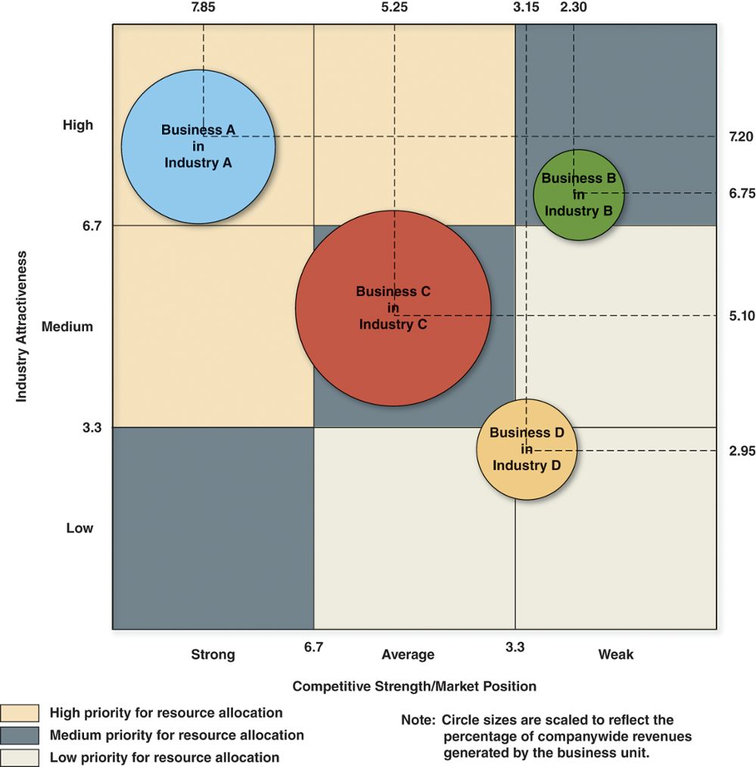
Figure 8.3 A Nine-Cell Industry Attractiveness–Competitive Strength Matrix
Access the text alternative for slide images.
Notes:
A nine-cell grid divides the vertical axis into three regions (high attractiveness, medium attractiveness, and low attractiveness) and the horizontal axis into three regions (strong competitive strength, average competitive strength, and weak competitive strength). As shown in Figure 8.3, scores of 6.7 or greater on a rating scale of 1 to 10 denote high industry attractiveness, scores of 3.3 to 6.7 denote medium attractiveness, and scores below 3.3 signal low attractiveness. Likewise, high competitive strength is defined as scores greater than 6.7, average strength as scores of 3.3 to 6.7, and low strength as scores below 3.3.
Each business unit is plotted on the nine-cell matrix according to its overall attractiveness score and strength score, and then it is shown as a “bubble.” The size of each bubble is scaled to the percentage of revenues the business generates relative to total corporate revenues. The bubbles in Figure 8.3 were located on the grid using the three industry-attractiveness scores from Table 8.1 and the strength scores for the three business units in Table 8.2.

Slide 34
Strategy Implications of the Attractiveness/Strength Matrix
Businesses in the upper-left corner:
Receive top investment priority.
Strategic prescription: grow and build.
Businesses in the three diagonal cells:
Given medium investment priority.
Brighter or dimmer prospects than others.
Businesses in the lower-right corner:
Candidates for divestiture or to be harvested to take cash out of the business.
Notes:
The industry-attractiveness and business-strength scores can be used to portray the strategic positions of each business in a diversified company. Industry attractiveness is plotted on the vertical axis and competitive strength on the horizontal axis. A nine-cell grid emerges from dividing the vertical axis into three regions (high attractiveness, medium attractiveness, and low attractiveness) and the horizontal axis into three regions (strong competitive strength, average competitive strength, and weak competitive strength).

Slide 35
Step 3: Determining the Competitive Value of Strategic Fit in Multi business Companies
Value chain matchups provide competitive advantage when there are opportunities to:
Combine performance of certain activities, thereby reducing costs and capturing economies of scope.
Transfer skills, technology, or intellectual capital from one business to another.
Share a respected brand name across multiple product and/or service categories.
Notes:
The greater the value of cross-business strategic fit in enhancing a firm’s performance in the marketplace or on the bottom line, the more competitively powerful is its strategy of related diversification. Without significant cross-business strategic fit and dedicated company efforts to capture the benefits, one has to be skeptical about the potential for a diversified company’s businesses to perform better together than apart.

Slide 36
Step 4: Evaluating Resource Fit
A diversified firm’s lineup of businesses exhibit good resource fit when:
Each of its businesses, individually, strengthen the firm’s overall mix of resources and capabilities.
The firm has sufficient resources that add customer value to support its entire group of businesses without spreading itself too thin.
Notes:
The businesses in a diversified company’s lineup need to exhibit good resource fit. In firms with a related diversification strategy, good resource fit exists when the firm’s businesses have well-matched specialized resource requirements at points along their value chains that are critical for the businesses’ market success. Matching resource requirements are important in related diversification because they facilitate resource sharing and low-cost resource transfer.

Slide 37
CORE CONCEPT: Resource Fit
A diversified company exhibits resource fit when its businesses add to a company's overall mix of resources and capabilities and when the parent company has sufficient resources to support its entire group of businesses without spreading itself too thin.

Slide 38
CORE CONCEPT: Internal Capital Market
A strong internal capital market allows a diversified company to add value by shifting capital from business units generating free cash flow to those needing additional capital to expand and realize their growth potential.

Slide 39
Determining Financial Resource Fit
Use a portfolio approach to determine the firm’s internal capital market requirements.
Which businesses are cash hogs in need of additional funds to maintain growth and expansion?
Which businesses are cash cows with cash flow surpluses available to fund growth and reinvestment?
Assess the portfolio’s overall condition.
Which businesses are (or not) capable of contributing to achieving companywide performance targets?
Does the firm have the financial strength to fund all of its businesses and maintain a healthy credit rating?
Notes:
A portfolio approach to ensuring financial fit among a firm’s businesses is based on the fact that different businesses have different cash flow and investment characteristics.
A cash cow business generates cash flows over and above its internal requirements, thus providing a corporate parent with funds for investing in cash hog businesses, financing new acquisitions, or paying dividends.
A cash hog business generates cash flows that are too small to fully fund its operations and growth and requires cash infusions to provide additional working capital and finance new capital investment.

Slide 40
CORE CONCEPTS: Cash Hog and Cash Cow
A cash hog generates operating cash flows that are too small to fully fund its operations and growth; a cash hog must receive cash infusions from outside sources to cover its working capital and investment requirements.
A cash cow generates operating cash flows over and above its internal requirements, thereby providing financial resources that may be used to invest in cash hogs, finance new acquisitions, fund share buyback programs, or pay dividends.

Slide 41
Assessing Cash Hogs
Reasons for not divesting a cash hog business:
It has highly valuable strategic fit with other business units.
Capital infusions needed from the corporate parent are modest relative to the funds available.
There’s a decent chance of growing the cash hog into a solid bottom-line contributor.

Slide 42
Examining a Diversified Company’s Nonfinancial Resource Fit
A diversified firm must ensure that it can meet the nonfinancial resource needs of its portfolio of businesses.
Does the firm have or can it develop the specific resources and capabilities needed to be successful in each of its businesses?
Are the firm’s resources being stretched too thinly by the requirements of one or more of its original businesses or a recent acquisition?
Notes:
Matching resource requirements are important in related diversification because they facilitate resource sharing and low-cost resource transfer.

Slide 43
Step 5: Ranking Business Units and Setting a Priority for Resource Allocation
Factors to consider in judging business unit performance:
Sales growth.
Profit growth.
Earnings contribution.
Return on investment.
Cash flow generation.
Notes:
Once a diversified company’s strategy has been evaluated from the perspective of industry attractiveness, competitive strength, strategic fit, and resource fit, the next step is to use this information to rank the performance prospects of the businesses from best to worst. Such ranking helps top-level executives assign each business a priority for resource support and capital investment.

Slide 44
Figure 8.4 The Chief Strategic and Financial Options for Allocating a Diversified Company’s Financial Resources
Strategic Options for Allocating Company Financial Resources:
Invest in ways to strengthen or grow existing business.
Make acquisitions to establish positions in new industries or to complement existing businesses.
Fund long-range R&D ventures aimed at opening market opportunities in new or existing businesses.
Financial Options for Allocating Company Financial Resources:
Pay off existing long-term or short-term debt.
Increase dividend payments to shareholders.
Repurchase shares of the company’s common stock.
Build cash reserves; invest in short-term securities.
Notes:
As a rule, business subsidiaries with the brightest profit and growth prospects, attractive positions in the nine-cell matrix, and solid strategic and resource fit should receive top priority for allocation of corporate resources. However, in ranking the prospects of the different businesses from best to worst, it is usually wise to also take into account each business’s past performance in regard to sales growth, profit growth, contribution to company earnings, return on capital invested in the business, and cash flow from operations. While past performance is not always a reliable predictor of future performance, it does signal whether a business is already performing well or has problems to overcome.

Slide 45
Step 6: Crafting New Strategic Moves to Improve the Overall Corporate Performance
Sticking closely with existing business lineup and pursue opportunities it presents.
Broadening the firm’s business scope by making acquisitions in new industries.
Divesting some businesses and retrench to a narrower base of business operations.
Restructuring the firm’s business lineup to put a new face on its business makeup.
Notes:
The conclusions flowing from the five preceding analytic steps set the agenda for crafting strategic moves to improve a diversified company’s overall performance. The strategic options boil down to four broad categories of actions.

Slide 46
Sticking Closely with the Existing Business Lineup
Choosing not to expand beyond the current lineup of businesses makes sense when the firm’s present businesses:
Offer attractive growth opportunities, good earnings, and cash flows.
Are in a good position for the future and have good strategic and resource fits.
Have resources that management can steer into areas of the greatest potential and profitability.

Slide 47
Broadening the Diversification Base
Multi business firms may consider adding to the diversification base when:
There are sluggish revenues and profit growth.
They are vulnerable to seasonality or recessionary influences.
There is potential for transfer resources and capabilities to related businesses.
Unfavorable driving forces are facing its core businesses.
Acquisition of related businesses will strengthen the market positions of one or more of its businesses.
Notes:
Companywide restructuring (corporate restructuring) involves making major changes in a diversified company by divesting some businesses or acquiring others, so as to put a whole new face on the company’s business lineup.

Slide 48
Divesting Businesses and Retrenching to a Narrower Diversification Base
Retrenchment to focus resources on building strength in fewer businesses requires divesting or eliminating the following:
Once-attractive businesses in deteriorating markets.
Businesses that will have a poor strategic or resource fit in the firm’s future portfolio.
Cash hog businesses with poor long-term investment returns potential.
Weakly positioned businesses with little prospect for earning a decent return on investment.
Notes:
A spin-off is an independent company created when a corporate parent divests a business either by selling shares to the public via an initial public offering or by distributing shares in the new company to shareholders of the corporate parent.

Slide 49
CORE CONCEPTS: Corporate Restructuring and Spin-offs
Corporate restructuring involves radically altering the business lineup by divesting businesses that lack strategic fit or are poor performers and acquiring new businesses that offer better promise for enhancing shareholder value.
A spin-off is an independent company created when a corporate parent divests a business either by selling shares to the public via an initial public offering or by distributing shares in the new company to shareholders of the corporate parent.

Slide 50
Broadly Restructuring the Business Lineup Through a Mix of Divestitures and New Acquisitions
Radical surgery on the business lineup is necessary when:
There is a serious mismatch between the firm’s resources and capabilities and the type of diversification that it has pursued.
Too many businesses are in slow-growth, declining, low-margin, or otherwise unattractive industries.
There are too many competitively weak businesses.
New technologies threaten the survival of important businesses.
There are ongoing declines in the market shares of one or more major business units that are falling prey to more market-savvy competitors.
An excessive debt burden with interest costs eats deeply into profitability.
Ill-chosen acquisitions have not lived up to expectations.
Notes:
Diversified companies need to divest low-performing businesses or businesses that do not fit in order to concentrate on expanding existing businesses and entering new ones where opportunities are more promising.

Slide 51
End of Main Content
© McGraw Hill LLC. All rights reserved. No reproduction or distribution without the prior written consent of McGraw Hill LLC.

Slide 52
Accessibility Content: Text Alternatives for Images

Slide 53
CHAPTER 8 - Text Alternative
Return to parent-slide containing images.
The authors are John E. Gamble, Margaret A. Peteraf, and Arthur A. Thompson. The photo shows a navigational compass pointing at the text reading, strategy.
Return to parent-slide containing images.

Slide 54
Figure 8.1 Strategic Themes of Multi business Corporation - Text Alternative
Return to parent-slide containing images.
A figure illustrating three diversification strategy options available to a multi business corporation: one, diversify into related businesses; two, diversify into unrelated businesses; and three, diversify into both related and unrelated businesses.
1. Diversify into related businesses. Enhance shareholder value by capturing cross-business strategic fits.
Transfer skills and capabilities from one business to another.
Share facilities or resources to reduce costs.
Leverage use of a common brand name.
Combine resources to create new strengths and capabilities.
2. Diversify into unrelated businesses.
Spread risks across completely different businesses.
Build shareholder value by doing a superior job of choosing businesses to diversity into and of managing the whole collection of businesses in the company’s portfolio.
3. Diversify into both related and unrelated businesses.
Return to parent-slide containing images.

Slide 55
Figure 8.2 Related Diversification Is Built upon Competitively Valuable Strategic Fit in Value Chain Activities - Text Alternative
Return to parent-slide containing images.
A figure demonstrates the representative value chain activities for two businesses. Both follow the same types of support activities: supply chain activities, technology, operations, sales and marketing, distribution, and customer service.
Competitively valuable opportunities for technology or skills transfer, cost reduction, common brand name usage, and cross-business collaboration exist at one or more points along the value chains of Business A and Business B.
Return to parent-slide containing images.

Slide 56
Figure 8.3 A Nine-Cell Industry Attractiveness–Competitive Strength Matrix - Text Alternative
Return to parent-slide containing images.
The image contains a grid that portrays the strategic positions of each business in a diversified company. Industry attractiveness of each firm is plotted on the vertical axis and competitive strength of that firm on the horizontal axis. A nine-cell grid emerges from dividing the vertical axis into three regions (high, medium, and low attractiveness) and the horizontal axis into three regions (strong, average, and weak competitive strength).
A circle labeled Business A in Industry A is positioned in the upper left of the nine-cell grid (high industry attractiveness and strong competitive strength and/or market position). This business is in the high priority for resource allocation area.
A circle labeled Business B in Industry B is shown in the upper right of the nine-cell grid (high industry attractiveness and weak competitive strength and/or market position). It is in the medium priority for resource allocation area.
A circle labeled Business C in Industry C is shown in the center of the nine-cell grid (medium industry attractiveness and average competitive strength and/or market position). It is in the medium priority for resource allocation area.
A circle labeled Business D in Industry D is shown in the lower right of the nine-cell grid (borders medium and low industry attractiveness and average to weak competitive strength and/or market position). This business in the low priority for resource allocation area.
Note: Each circle’s size is scaled to reflect the percentage of companywide revenues generated by the business unit. Business C is the largest, and Business B is the smallest. Businesses A and D fit in between these two sizes.
Return to parent-slide containing images.

