Slide 1
Unsupervised Learning

Slide 2
The Data
Body Fat Prediction Dataset Used from Kaggle
Features of the data include body measurements (e.g. height, weight, abdomen circumference) of 252 adult males.
Body fat percentage (BFP) is the target variable of the analysis. In this dataset, BFP is calculated from hydrodynamically measured body density by using the Siri Equation.
Follow this link for a comprehensive summary of the data set, its attributes, and the Siri Equation:
https://www.kaggle.com/datasets/fedesoriano/body-fat-prediction-dataset

Slide 3
The Data – Features copied from Kaggle for the convenience of the reader
Density determined from underwater weighing
Percent body fat from Siri's (1956) equation
Age (years)
Weight (lbs)
Height (inches)
Neck circumference (cm)
Chest circumference (cm)
Abdomen 2 circumference (cm)
Hip circumference (cm)
Thigh circumference (cm)
Knee circumference (cm)
Ankle circumference (cm)
Biceps (extended) circumference (cm)
Forearm circumference (cm)
Wrist circumference (cm)

Slide 4
Preprocessing Efforts
5 BFP data points were not in agreement with the Siri Equation. All 5 observations were removed.
2 observations with outlying Ankle measurements were removed.
A Body Mass Index (BMI) feature was added.
One observation had a severely outlying BMI (BMI>165!!). This point was removed.
Further inspection shows a height of 2.45’. This data is written off as a recording error.
To see if the unsupervised algorithms could identify this split without guidance, the BMI feature was removed before training the unsupervised models.
The feature was added back in at the end of the analysis for comparison purposes.

Slide 5
Objective of this Analysis
This dataset was used for the Supervised Learning Project. There a variety of linear regression models were trained to predict BFP from measurements easily taken at home. In that activity, all data corresponding to obese individuals was removed to normalize the data.
The objective of this analysis is to use Unsupervised learning to cluster the data into subcategories for linear regression. The hope is to see model performance increase after the data has been stratified by the unsupervised learning models.

Slide 6
Objective of this Analysis (cont’d)
Kmeans, AgglomerativeClustering, and DBSCAN models will be trained for this exercise. The majority cluster from each algorithm will be kept and used to train a linear regression with LASSO model.
Each model will be fine tuned for the optimal hyperparameters.
Coefficients of Determination between the test data and the model predictions will be the only metric used to evaluate performance

Slide 7
Objective of this Analysis (cont’d)
For this exercise, Kmeans, and AgglomerativeClustering (AG) will be limited to two clusters. The intention is to see if unsupervised algorithms can recreate a healthy weight/obesity split like the one employed in the supervised learning activity.
It is feared that forcing Kmeans, and AG models to assign all data into these categories will be counter productive to the goal of regression.

Slide 8
The Models: Workflow
Three unsupervised models were trained on the entire dataset. The skewed columns were normalized with a logarithmic transformation.
The subsequent regressions were all performed on data that was standardly scaled following the train/test split. It is noted that the BMI feature was reintroduced for regression.

Slide 9
The Models: Kmeans
When forced to assign data into two clusters, Kmeans had two hard splits: Observations above a BMI of 27.21 were placed in group one, and observations below a BMI 22 were placed in group zero.
BMIs between 22-27.2 generally were placed in group 0.
97 zeros out of 132 total observations.
BMIs between 25-27.2 were overwhelmingly placed in group zero.
31 zeros out of 58 total observations.
BMIs between 22-25 were overwhelmingly placed in group zero.
71 zeros out of 82 total observations.

Slide 10
The Models: Kmeans (cont’d)
With the expected blurry boundaries, it seems Kmeans was able to find a BMI cutoff close to the one modern medicine advises as being overweight.
Despite the interesting 2-mean split identified by the kmeans algorithm, the performance of the linear regression model decreased.
All model performances will be discussed at the end of the presentation.
There were 139 observations in the majority split, and 105 observations in the minority split.

Slide 11
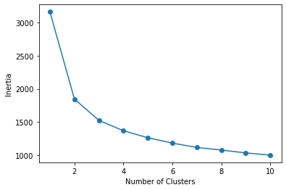
The Models: Kmeans (cont’d)
The inertia vs. number of clusters suggests the model could be further optimized. More on this in future directions…

Slide 12
The Models: DBSCAN
The dynamic method (DM) was used to calibrate epsilon (ep) for the DBSCAN model.
Recall that ep is the maximum distance between two samples for the samples to be considered neighbors of one another.

Slide 13
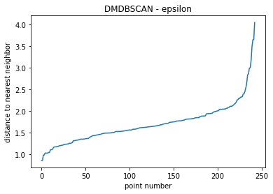
The Models: DBSCAN (cont’d)
The DM involves looking at the distance of each points closest neighbor and plotting these values in ascending order:
Ep is selected at the location where it’s value begins to increase drastically. This is the point at which nearest neighbors are outlying data points. In this case, ep ≈ 2.25.
Note all data was standard scaled for this process

Slide 14
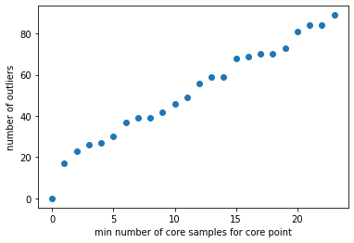
The Models: DBSCAN (cont’d)
Next, the min_samples hyper parameter was calibrated by looping through possible values and identifying the number of outliers.
3 was selected for min_samples as the slope from x = 0-3 was the most pronounced. Other increments do not seem to identify structure in the data.

Slide 15
The Models: DBSCAN (cont’d)
With the discussed hyperparameters, 23 outlying data points were identified by the DBSCAN algorithm.
Unlike with the kmeans algorithm, there was not a strong correlation with BMI as the BMIs of the outlying dataset range from [19.8,39.1]
There were 220 observations in the majority split, and 22 outliers.
Surprisingly, the performance of the linear regression did increase relative to standard OLS.
Discussion to come.

Slide 16
The Models: Hierarchical Clustering
An agglomerative clustering model with ward linkage was trained.
This model, like DBSCAN, did not identify correlations with BMI.
There were 177 observations in the majority split, and 66 observations in the minority split.
However, this gave rise to the best performance in linear regression.

Slide 17
Regression Results
Kmeans decreased the performance of regression. Likely because it was constrained to
 | R2
OLS | 0.661000
DBSCAN | 0.682673
kmeans | 0.597994
HA | 0.721767
LASSO | 0.665282
R2
OLS 0.661000
DBSCAN 0.682673
kmeans 0.359610
HA 0.721767

Slide 18
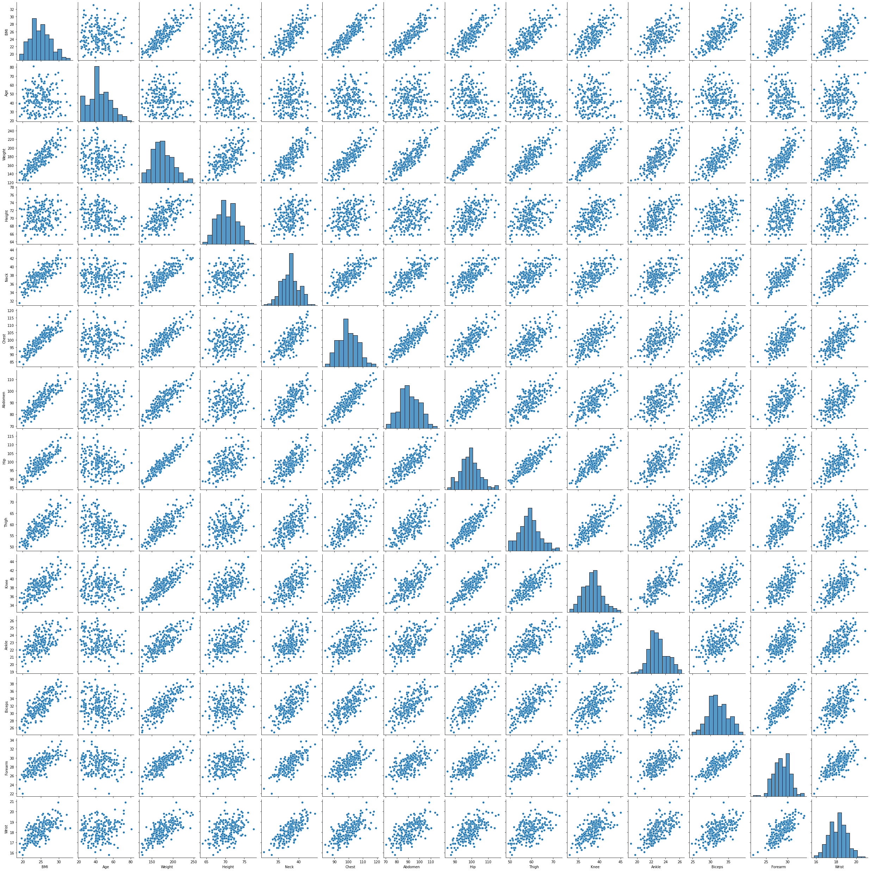

Slide 19
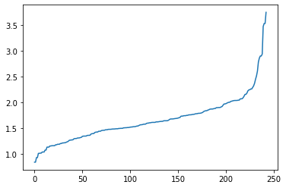
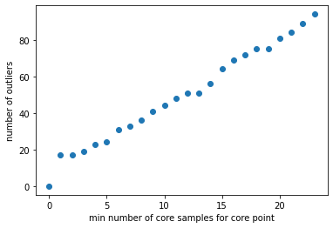
Normalized data

