Slide 1
Classification Project
M. Matrona

Slide 2
Data Summary

Slide 3
Overview
The dataset contains 918 observations. Of these observations, 508 have been previously diagnosed with heart disease [HeartDisease = 1].
This dataset is balanced.
Link to data:
https://www.kaggle.com/datasets/fedesoriano/heart-failure-prediction

Slide 4
Feature Descriptions – As Published on Kaggle
Age: age of the patient [years]
Sex: sex of the patient [M: Male, F: Female]
ChestPainType: chest pain type [TA: Typical Angina, ATA: Atypical Angina, NAP: Non-Anginal Pain, ASY: Asymptomatic]
RestingBP: resting blood pressure [mm Hg]
Cholesterol: serum cholesterol [mm/dl]
FastingBS: fasting blood sugar [1: if FastingBS > 120 mg/dl, 0: otherwise]
RestingECG: resting electrocardiogram results [Normal: Normal, ST: having ST-T wave abnormality (T wave inversions and/or ST elevation or depression of > 0.05 mV), LVH: showing probable or definite left ventricular hypertrophy by Estes' criteria]
MaxHR: maximum heart rate achieved [Numeric value between 60 and 202]
ExerciseAngina: exercise-induced angina [Y: Yes, N: No]
Oldpeak: oldpeak = ST [Numeric value measured in depression]
ST_Slope: the slope of the peak exercise ST segment [Up: upsloping, Flat: flat, Down: downsloping]
HeartDisease: output class [1: heart disease, 0: Normal]

Slide 5
Feature Descriptions - Clarifications
Chest Pain Type
Typical Angina [TA]
Substernal pain
brought on by exertion or emotional stress
Relieved by stopping activity or administering nitroglycerides.
Atypical Angina [ATA]
When 2 of the 3 typical angina symptoms are present
Non-Anginal Pain
Pain that occurs near the heart without being related to heart disease.

Slide 6
Feature Descriptions - Clarifications
Resting Electrocardiogram [RestingECG]
The categories are results of an ECG. Each is indicative of a different damage state of the heart. i.e. Left ventrical hardening, myocardial eschemia, coronary artery occlusion.
The ST keyword has different abnormalities lumped into this feature. This will not be an issue for modelling since the models need not be fully interpretable for this academic exercise.
Exercise-Induced Angina [ExerciseAngina]
Oldpeak and ST_Slope features describe the ECG taken during exercise.

Slide 7
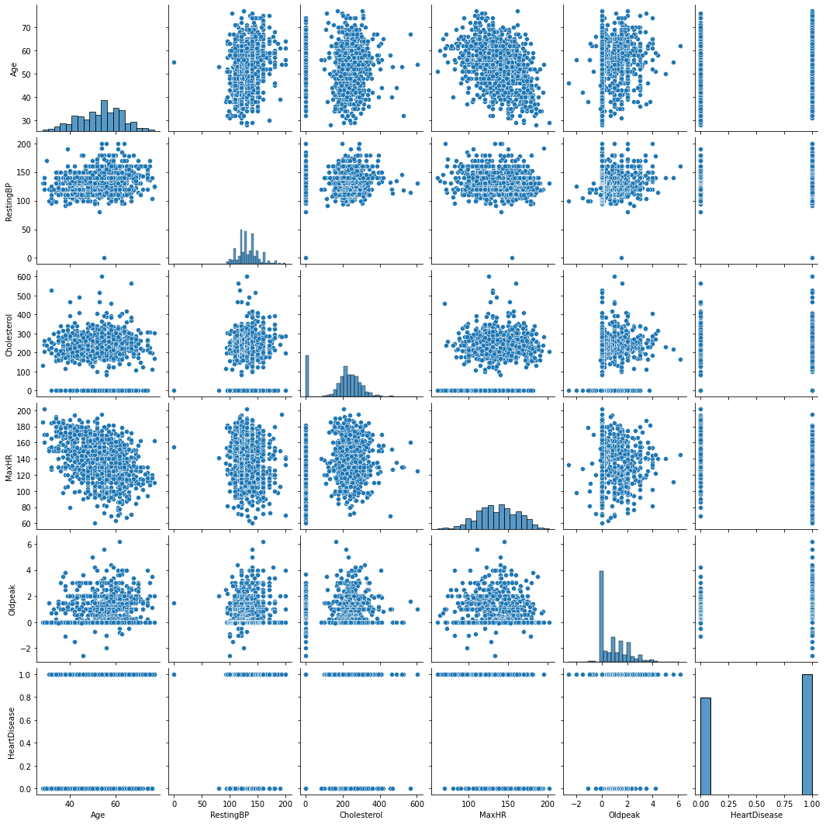
Feature Description – Correlations
Note that all nominal and ordinal data aside from the target variable have been removed from the pair plot.
We see from these plots that many observations do not have a cholesterol measurement.

Slide 8
Feature Engineering – Cholesterol Data
Further exploration of the cholesterol feature shows that 172 observations have a 0 cholesterol measurement.
Of these 172 observations, 152 of them are for diseased patients.
The doctor was likely able to make a diagnosis without ordering a cholesterol test.
Going forward, this feature will remain as is. The user of the models should be aware that a missing cholesterol measurement may be biased towards heart disease.

Slide 9
Feature Engineering – Polynomial Features
Polynomial Features were selectively added to both the SVC and Logistic Regression models.
The logistic regression model was marginally improved by their introduction, while the SVC model suffered dramatically.
Details are not shown in this presentation, but the curious member of the audience can find their results in the attached notebook.

Slide 10
Object of Analysis
The objective of this analysis is to provide a model(s) to assist Doctors in diagnosing heart disease based on the features present.
This will be attained by training 4 classification models and providing the model with the best performance to the “production team.”
Each model will have a varying degree of interpretability. However, the final model selected will be the one which minimizes false negatives; without regard to interpretability.

Slide 11
The Classifiers

Slide 12
Model Training Details
All models were trained using 5-fold cross validation of the training data.
A holdout set was taken so that models could be tested on data that was not used in any training capacity.

Slide 13
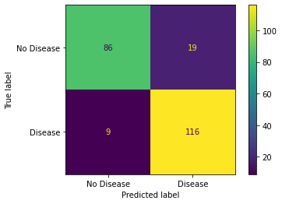
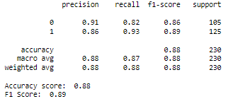
Logistic Regression
A basic logistic regression was used as a model for comparison.
The “C” hyperparameter was optimized by Grid Searching.
C = 5, scoring method = Recall

Slide 14
SVM : Support Vector Machine - Details
Radial Basis function used
Looped through the “C” and “gamma” hyperparameters to find the best fit.
Manually selected the scoring metric to get a feel for how each metric influenced the model results.
The metrics used were Recall, Accuracy, and F1

Slide 15
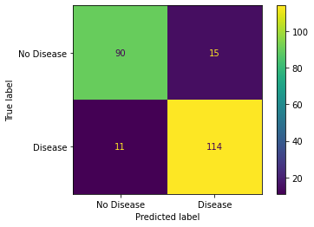
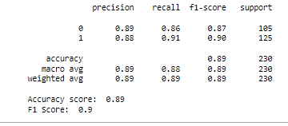
SVM – Best Model
The confusion matrix for the best performing model is given here.
Recall was the scoring method that was best able to minimize false negatives.
The optimized hyperparameters are:
{'C': 8, 'gamma': 0.001, 'kernel': 'rbf'}

Slide 16
Decision Tree
Two decision trees were fit to the training.
A tree with the maximum amount of overfitting (nodes/feature importances)
A pruned tree which checked the recall metric at a variety of node counts and features importances.
The top performing pruned tree had 15 nodes and 3 feature importances.

Slide 17
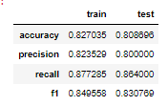
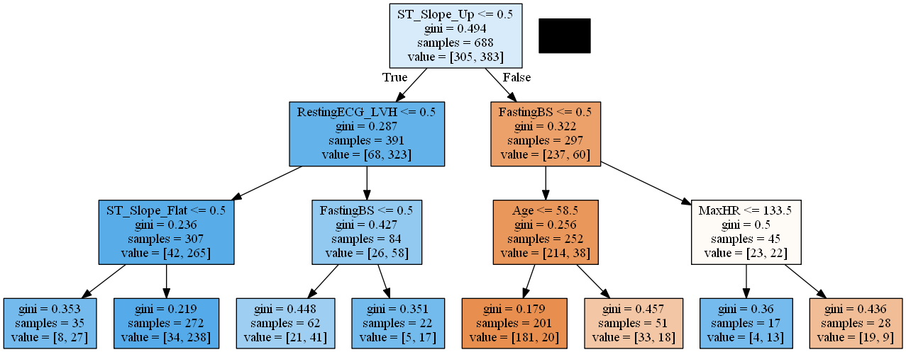
Decision Tree – Best Pruned Model

Slide 18
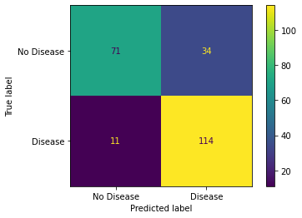
Decision Tree – Confusion Matrix
The optimized tree performed dramatically worse than the logistic regression models and the SVC.

Slide 19
Model Recommendation
The base logistic regression model (without the introduction) of polynomial features is recommended for “production.”
This model minimized the number of false negatives while maintaining reasonable accuracy.

Slide 20
Next Steps
Additional classification models could be used.
Ensemble methods, boosting, stacking, neural nets, etc
If working with the same data, a different number of folds can be tried for cross validation.
Different scoring metrics can be studied and applied to the models.

